Slide 1
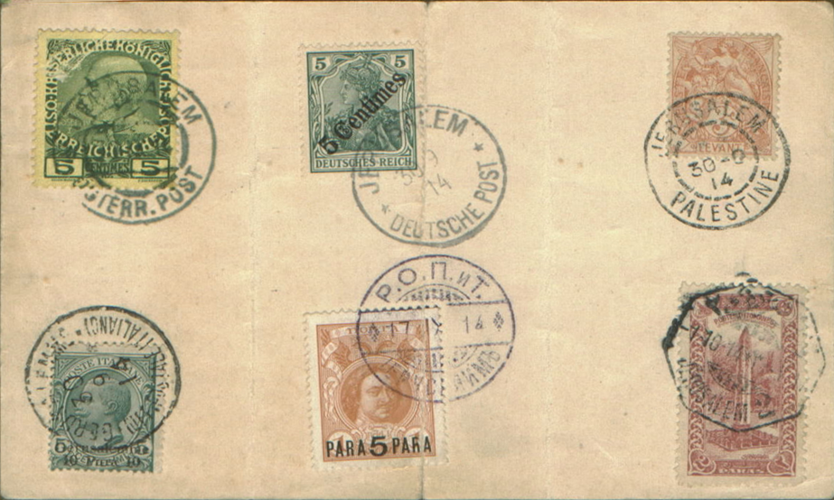
The Forerunner Posts in the Holyland by Jack Rosenstein

Slide 2
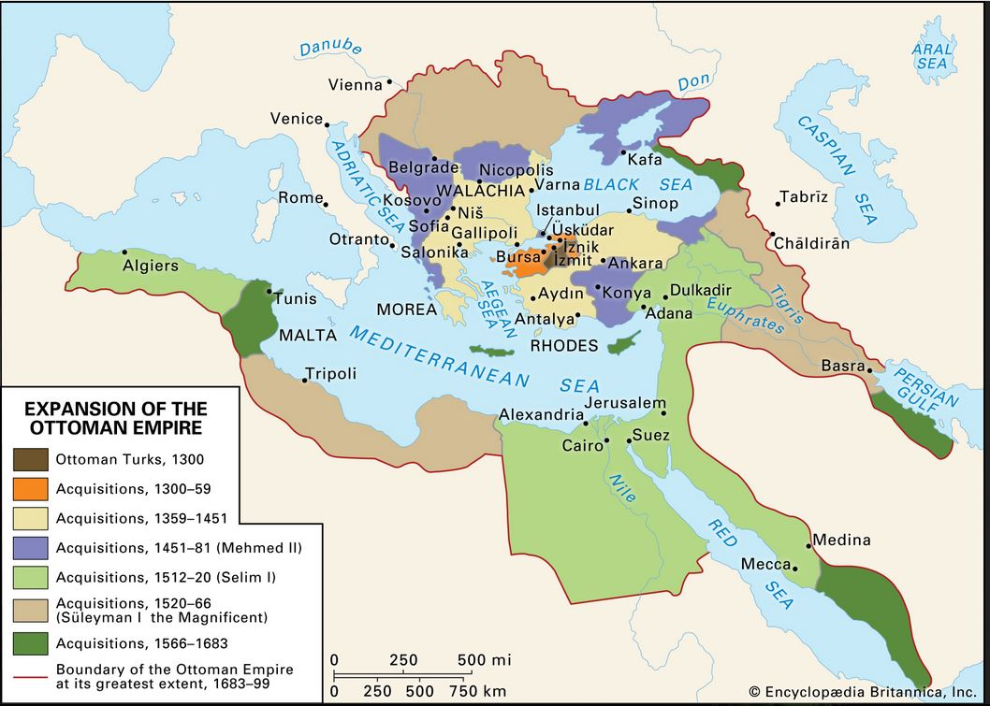
Map 1

Slide 3
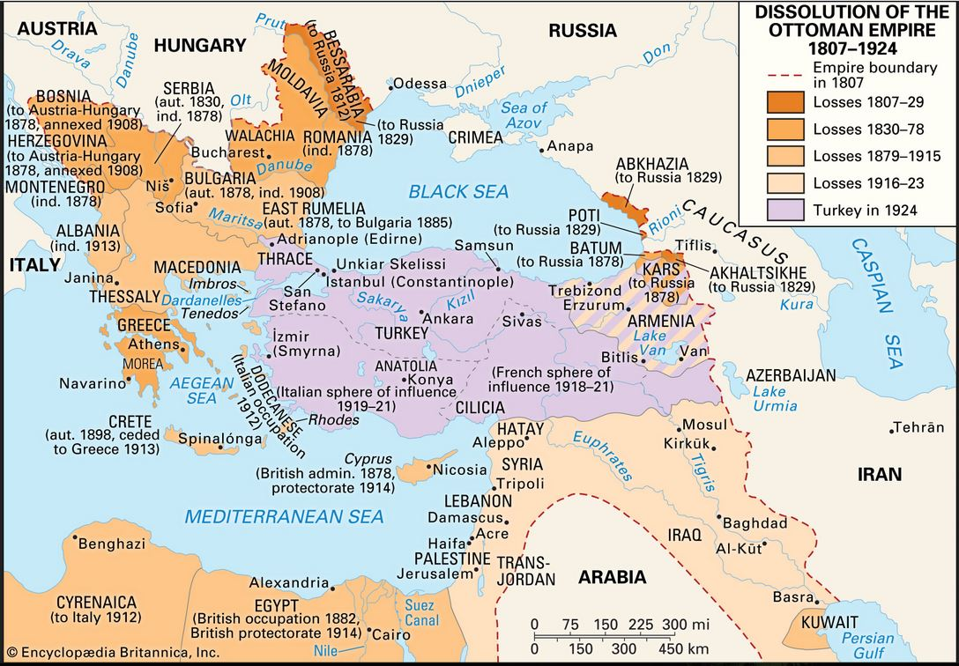
Map 2

Slide 4
Acre
Haifa
Beersheeba
Hebron
Beni Saab
Jaffa
Bethlehem
Jericho
Bon Samaritan
Jerusalem

Slide 5
Nablus
Acre
Jaffa
Jerusalem

Slide 6
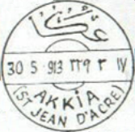
Acre

Slide 7
Beersheba

Slide 8
Beni Saab

Slide 9
Bethlehem

Slide 10

Bethlehem

Slide 11
Bethlehem

Slide 12
Bon Samaritan

Slide 13
Haifa

Slide 14
Haifa

Slide 15
Haifa

Slide 16
Haifa

Slide 17
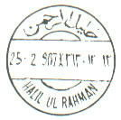
Hebron

Slide 18
Jaffa

Slide 19
Jaffa

Slide 20
Jaffa

Slide 21
Jericho

Slide 22
Jericho

Slide 23
Jerusalem

Slide 24
Jerusalem

Slide 25
Jerusalem

Slide 26
Jerusalem

Slide 27
Jerusalem

Slide 28
Jerusalem

