Slide 1

Friends I Have Met in the
Philatelic Dollar Box by Richard Spinelli
Past President, Rochester Philatelic Association
October 27, 2022
with assistance from Donald C. Spinelli
B.A., SUNY at Buffalo, 1964
M.A., SUNY at Buffalo, 1966
Ph.D., THE Ohio State University, 1971
Retired as professor and associate dean from Wayne State University in September, 2009
Friend For Life

Slide 2
Donald C. Spinelli is a published expert in 18th century French literature and Pierre-Augustin Caron de Beaumarchais, in particular.
At various times in his life, Beaumarchais was a watchmaker, inventor, playwright, musician (Marriage of Figaro), diplomat, spy, publisher, horticulturist, arms dealer, satirist, financier, and revolutionary. He was born January 24, 1732, and died May 18, 1799, in Paris, France.
After a few slides Don will discuss some “Dollar Box Friends” who have written foreign language letters.

Slide 3
A “Friend” Defined
To be my “Friend from the Philatelic Dollar Box” I will have found and bought the authentic postal item, usually from a dealer’s unsorted lot or box of inexpensive items, which has historical significance and interest after researching it. This presentation is based on one I gave to the RPA in 2016.
Up first, Richard Spinelli’s “Friends…”

Slide 4
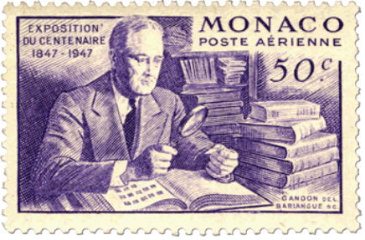
Postal Cover from the Collection of
President Franklin Roosevelt
postmarked Galion, Ohio, April 21, 1875
Auctioned by H. H. Harmer, April, 1946
FDR started collecting stamps in 1890 at the age of 8
Life long philatelist
Became world’s most famous stamp collector and elevated stamp collecting
Took his stamp collection to prep school, Harvard, the White House, and WWII conferences such as Casablanca and Yalta
He credited stamp collecting with helping his recovery from Polio: “I owe my life to my hobbies, especially stamp collecting.”
As president, he helped design or held influence over every stamp issued by the United States (1933 – 1945)

Slide 5
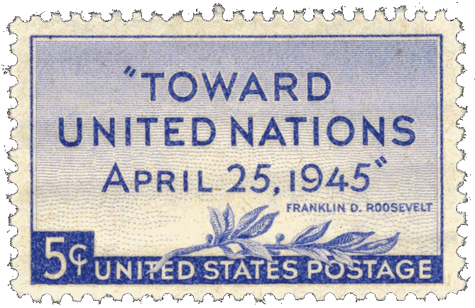
On the morning of April 12, 1945, FDR approved the design for the new “Toward the United Nations” commemorative stamp, then spent an hour with his stamps.
Shortly thereafter, while posing for a portrait, he collapsed and died from a massive cerebral hemorrhage.

Slide 6
In 1946, following FDR’s death, his family sold his philatelic estate through Harmer Auction. The four FDR stamp sales brought high prices and controversy. Most philatelists wanted to own a piece of the nation’s most famous stamp collection, but some argued that the U.S. government actually owned the fabulous holdings of U.S. essays and proofs.
Winning bidders in Harmer’s FDR auctions could have their purchases marked with a rubber stamp to verify that they came from the president’s collection.
Stamp dealers bought many large lots of common stamps and mounted them on cards for sale as inexpensive souvenirs. Today, collectors still eagerly seek these ex-FDR philatelic items for their own collections.

Slide 7
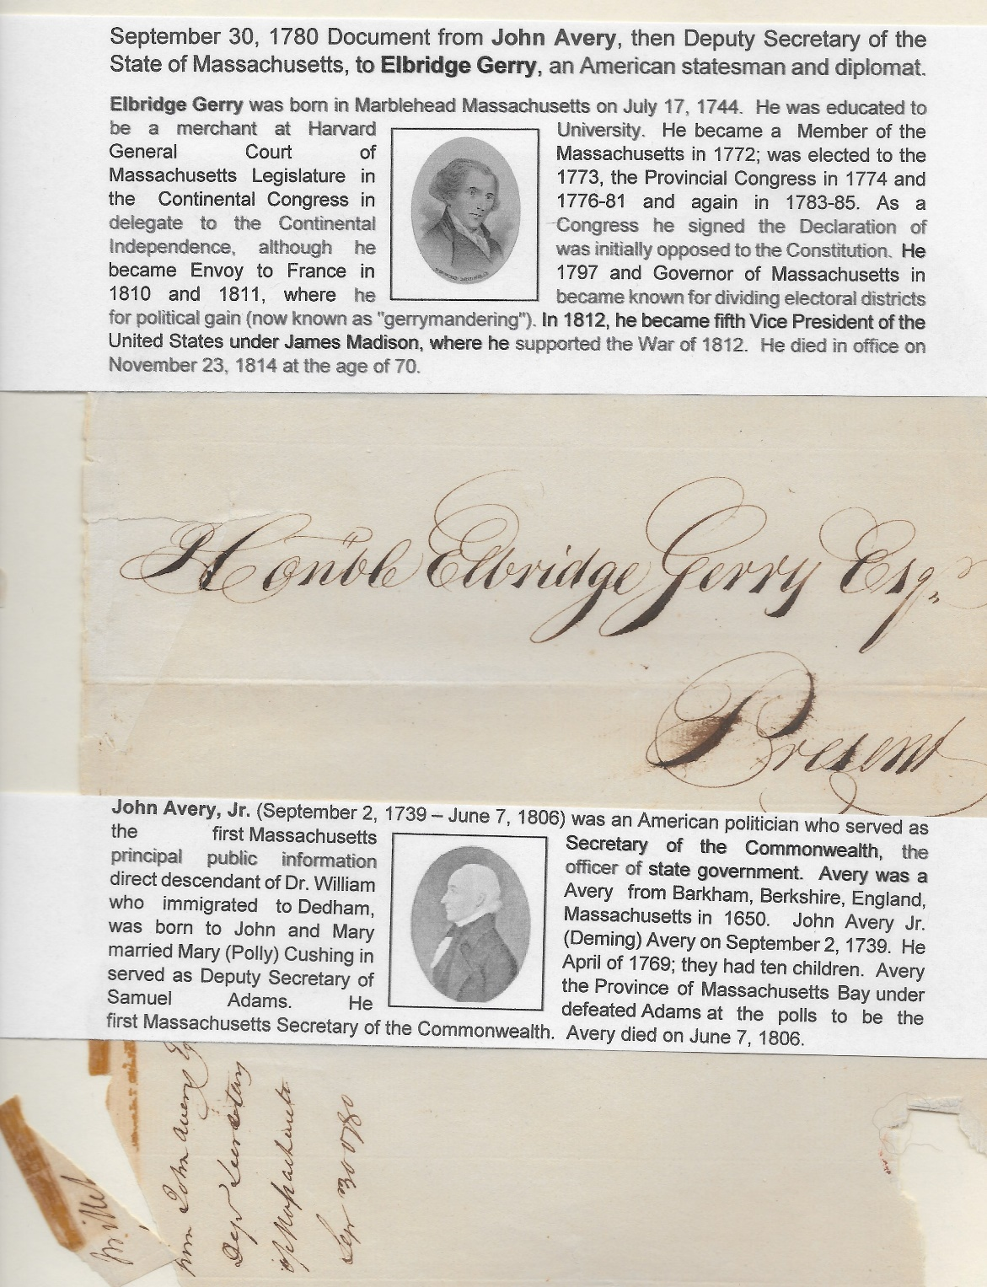
September 30, 1780
Document from John Avery, Deputy Secretary of the State of Massachusetts, to Elbridge Gerry, an American Statesman and diplomat.
(contents on the next page)

Slide 10
Written by
Donald Spinelli
Pierre-Augustin Caron de Beaumarchais
Described by the magazine American Heritage as the "Most Underrated French Hero of the French Revolution,” Caron de Beaumarchais, the French watchmaker who rose to fame and fortune as a dramatist, polemicist, and Enlightenment free thinker, became the most famous arms dealer of the American Revolutionary War.
It can be said that if it weren’t for this man, we would still be speaking the King’s English and saying, among other things, “shedule” for schedule and “lorrie” for truck.
Painting by Nattier

Slide 11
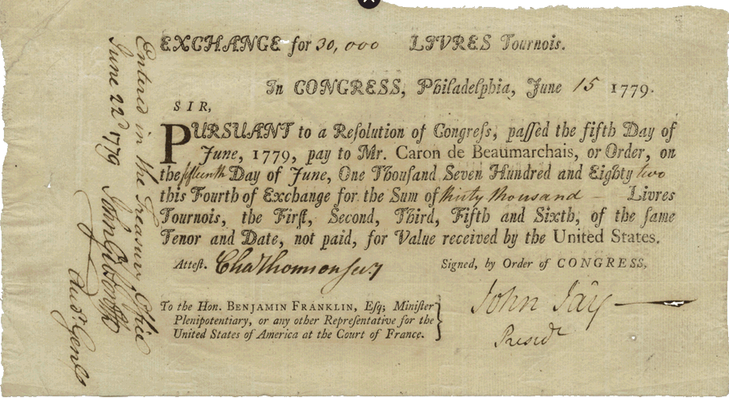
Pierre-Augustin Caron de Beaumarchais
Upon meeting President John Kennedy, a latter-day descendant of Pierre-Augustin Caron de Beaumarchais presented him with this IOU signed by John Jay on Order of Congress agreeing to pay Mr. Caron de Beaumarchais for goods received by the United States. As a student of American history, Kennedy knew, of course, what the bill was for and asked if he might keep it as a souvenir. “Of course,” was the reply, “there are many more where that came from.”

Slide 12
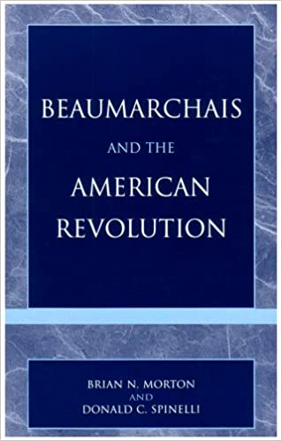
Pierre-Augustin Caron de Beaumarchais
How is it that more than 200 years after Beaumarchais’s death the family still has unpaid bills of exchange from the American government? Colleague Brian Morton and I spent over 20 years and 350 pages to explain it, but here is the short version.
In 1775 Beaumarchais was on a mission in London by order of King Louis XVI of France. While in London he met Mayor John Wilkes, who introduced him to Arthur Lee of the famous Lee family, that was eventually to supply Robert E. Lee the Confederate general. Beaumarchais was sympathetic to the American cause and agreed with Lee to help them obtain materials for the war. In exchange, the two agreed that Beaumarchais would receive tobacco and indigo for his goods and services. It was this agreement that was to cause Beaumarchais immense problems throughout the rest of his life, for Lee would deny it.

Slide 13
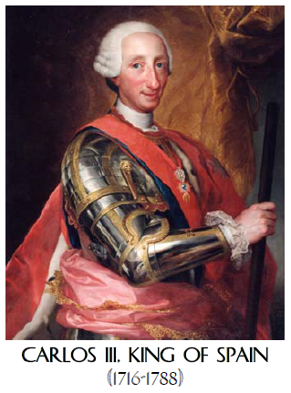
Pierre-Augustin Caron de Beaumarchais
Beaumarchais returned to France and convinced the king that France should help the Americans in defeating the English claims on the colonies. He founded “Roderigue Hortalez and Company” to begin accumulating arms and materiel to ship to America. The King gave Beaumarchais 1 million livres (pounds) as a start-up and Beaumarchais convinced the Spanish king to offer the same, with the money to be repaid in the future. Both France and Spain were anxious to lessen British influence in the world and cause them to lose some of their colonies. Neither country was prepared to declare war against England and, therefore, were perfectly happy to let the company do all of the dirty work without the governments themselves being directly involved.
Over the next few years Beaumarchais’ company purchased and shipped cannons, mortars, firearms and ammunition, gunpowder, uniforms, and other equipment as minor as needles and pins to supply more than 25,000 men. By September of 1777, he had sent over five million livres’ worth of supplies to America. In return, he received NOTHING. One million livres in 1776 adjusted for inflation was worth approximately four million dollars in 2002, probably much more today. This was an enormous sum of money here for an independent businessman.
Louis XVI of France

Slide 14
Pierre-Augustin Caron de Beaumarchais
Beaumarchais sent one of his aides to America to verify that the goods were arriving and that they were being distributed. Theveneau de Francy, the aide, was also to go to Congress to make Beaumarchais’ claim for reimbursement. Arthur Lee, in the meantime, feeling that he was being cut out of any profits to be made from the sales, fought Beaumarchais in Congress. He maintained that all the supplies were offered by the French and Spanish governments at no cost and, therefore, no reimbursement was to be made to Beaumarchais. He was a conniver and a scoundrel, they said, like his hero Figaro in The Barber of Seville and The Marriage of Figaro.
Beaumarchais fought until his death to recoup his money and wrote numerous petitions to Congress. He hired lawyers, and his daughter came over to defend her rights years after his death. Again, to shorten; after numerous debates in Congress and committee resolutions, the Beaumarchais family was forced to accept what was offered to them or renounce their request.

Slide 15
Pierre-Augustin Caron de Beaumarchais
Beaumarchais’ signature on the petition to US Congress
In a completely separate fight with the French government, the Americans offered to pay a fine of 25 million francs for their transgressions, and stipulated that any Revolutionary War debts were to be taken and paid from that amount. By the time the other debts had been paid, the Beaumarchais heirs received 800,000 francs in 1837 almost 40 years after Beaumarchais’ death. This was one-fourth of the actual bill! Thus, Congress succeeded in avoiding any final resolution of the Beaumarchais claim on its own merits during half a century of haggling.

Slide 16
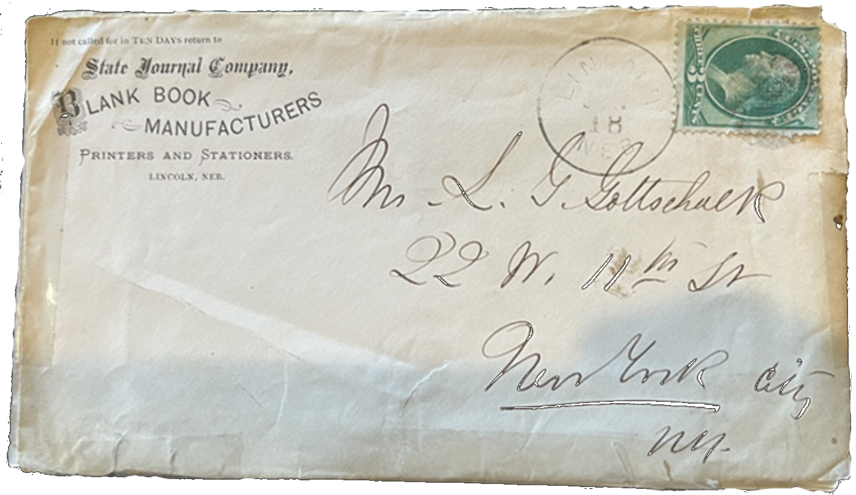
Written by
Donald Spinelli
Louis Gaston and Louise Gottschalk
We move on to the story of this envelope and two letters inside written in French by Louis Gaston Gottschalk, a well known singer/entertainer to his wife Louisette (Louise) Boucher.
The advertising corner card on this 1870’s envelope states:
State Journal Company.
Blank Book Manufacturers.
Printers and Stationers.
Lincoln, Neb.
It was addressed and mailed to their Manhattan home at the time:
Mrs. L. G. Gottschalk
22 W. 11th St.
New York City, NY.

Slide 17
Louis Gaston and Louise Gottschalk
First letter translated, written on Nebraska State Journal letterhead…
Lincoln, Nebraska 18 June 1973
My dear Louisette,
My dear baby, this will be for you alone these few lines. It’s stronger than me, I have to write to say how much I miss you. Do you see my dearest angel, the more I go the more I feel the need to have you with me, at times, I am about to speak to you, as if you were next to me. Unfortunately, you are with me in thought only. You are everything to me, my dearest, you and baby that’s all I have in the world. It’s so nice here and the temperature is so pleasant that I would love to have you both near; to have my dearest Louisette with me, to have you in my arms to tell you how much I love you and to be able to kiss you to prove it. Oh, my dear Louisette, I have lost my reason you are going to say. No my adored angel, but I love you so much you see, and you know yourself how difficult it is to be separated, you would prefer having me with you my dear since you look for me at night by your side and I assure you I want to be with you, too, my adorable Louisette, to feel you by my side, to be in the arms of my wife, with you always my beloved Louisette, that’s all I desire now, you see my dear, if I was unjust/unfair with you I have been punished and now would like to have never caused you the least problem, my dearest baby. I love you, you know that and yet it is stronger than me, I have to tell you that to repeat it, it’s a need because when I write to you, I get closer to you, my dearest angel, my adorable wife, who is everything to me. Oh, my dearest Louise, I know that you love me like I love you but say it in your next letter, since you are no longer afraid to tell me now, tell me everything you are thinking my angel. It’s so good to communicate one’s thoughts when we love the way we do. You see my dear Lou, when I return, it will be a continuation of our honeymoon, unless however you do not want to separate yourself from Mrs. Caivollé, in that case, I would go sleep upstairs. Please oblige me with a reply to this statement, as if you were with me, your adored lips would reply for you, do you remember when I hugged you for the first time, and the first time I stole a kiss from your burning lips my adorable Louisette, oh, mine burn just thinking of it; the other night I dreamed of you, my dear, we were together. I pictured us in a room of the hotel in a small bed but we were comfortable. You were holding me in your arms, my adorable Louisette, you were reacting to my caresses as I would want you to do now. Unfortunately, I suddenly woke up and looked for you at my side in vain, it was only a dream. My dearest Lou, you whom I love, you who are my life, all that I have in the world, take the kiss that I place on this letter for you, there is only one kiss, but in this only kiss is summed up all of my being, all of my life, which is yours, my dear wife. Your Gaston, yours alone.

Slide 18
Louis Gaston and Louise Gottschalk
Second letter translated, written on plain paper…
Lincoln, Nebraska 18 June 1973 (same date as the first one)
My dear Louisette,
I received in the evening your last letter of Friday, June 3, Gilder who had remained behind brought it to me. We are singing tonight in Lincoln, the capital of Nebraska, tomorrow, Friday [crossed out] Thursday in Plattsmouth and Friday in Omaha, where we will leave on Saturday directly on route for Salt Lake City, where we will be on Monday. Consequently, don’t be worried if you are without my news, because on Saturday, Sunday and Monday I’ll be on a train. This will prevent me from giving you any news. I received the music sent to Omaha. I am very happy that ?????? found it because the old skeptic yelled at the time of my marriage, What a fool to get ???? a singer. I told him quite calmly that I had a made a very good ???? to which he replied that he hoped so for my sake. I see that I got away lightly, because I suppose that my ????? have me at his concert. Goodbye my dearest Lou, the ????? closes at 10 in the morning so that if I continue I will be late. Kiss our ??????? for me and dear baby ??????? ???? to M C. & Mr. D?? Thousands and thousands of kisses for you my dear Lou, don’t hold my short letters against me [don’t be angry with] but, going all around as we do at this time [being as busy as we are], I don’t have time to write ?????????
Your husband who loves you. My dear Lou, and who would like to hold you in his arms my good ????? I love you do you see my dear angel, it seems to me that the farther I get from you the more I love you, how nice it will be to be together and not be separated. Give me your mouth my dear angel that I kiss on your letters [lips], my Louisette do you see mine burn just thinking of you,
Your husband who loves you. Gaston
---------------------------------------------------------------------------------------------------------------------------------------------------------------------
And now… additional research explains each part of the rest of the story!

Slide 19
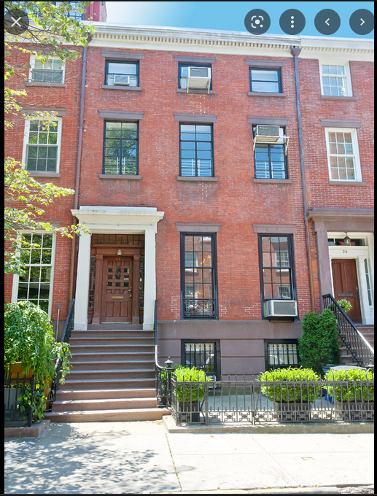
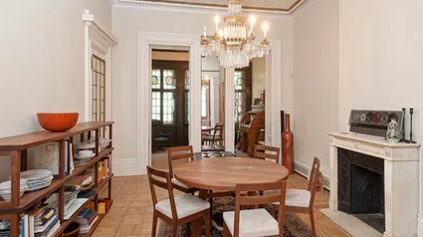
Louis Gaston and Louise Gottschalk
Their home…
Per a Sotheby's Realty property listing, "This beautiful Greek Revival townhouse, one of five houses, known as ‘Bride’s Row’, was built by Henry Brevoort, Jr. for his five daughters in 1844-1845. Now, Fifth Avenue and 11th Street, the heart of the Gold Coast, is the most desirable block in Greenwich Village.” It sold in 2013 for $10,500,000. source

Slide 20
Louis Gaston and Louise Gottschalk
Letter 1’s letterhead…
C.H. Gere and H.D. Hathaway, mentioned in the top corners, are editors and proprietors of the Nebraska State Journal. I found that Charles H. Gere was a history buff and very knowledgeable of local Nebraska history. Besides being a journalist, he was a state senator, and must have been quite well-liked as he was re-elected several times to various other political offices. H.D. Hathaway (he was always referred to that way in what information I found), published a paper in Plattsmouth, Neb. (more about that shortly). Along with Gere, according to one source, Hathaway made the State Journal in Lincoln one of the best newspapers west of Chicago. Finally, a tidbit about the building that housed the paper: The paper was published above Rudolph’s Grocery House; the Journal was published from 1867-1951.
the enclosed letter

Slide 21
Louis Gaston and Louise Gottschalk
Written in French…
As for the letters themselves, you can see, the original letters were written in French. Why? Well, Louis Gaston Gottschalk (a.k.a. Gaston) was born in New Orleans. His father was English and emigrated to the city and his mother, Aimée Marie Bruslé, although born there, was the daughter of a refugee from the slave revolt in Saint Domingue, today Haiti. The mother, then, would be considered a French Créole. So, Gaston might have picked up his French within the family or from his nurse, who also escaped from the island.
His older brother, Louis Moreau Gottschalk, was a child prodigy and sent to Paris at an early age to study piano. Gaston, his mother, and sisters joined Louis Moreau in France several years later. Gaston lived in France for 14 years. The brother became a famous pianist and composer playing all over the world. He wrote in English to his sisters in Paris that his little brother was “French all over, frenchified down to his spine and unfortunately ignorant and niais [stupid or inexperienced] as only the French can be.”

Slide 22
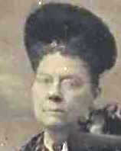
Louis Gaston and Louise Gottschalk
Louise’s French connection…
What about Louise, Louisette here, Gaston’s wife, to whom the letters are addressed? Why was she a francophone? When Louis Moreau moved to New York City, Gaston followed. They lived in the house we saw. It was the home of a Frenchman and music professor, Alfred Boucher, who entertained musicians, composers and impresarios in a salon in that house on West 11th Street. It was in that house that Gaston discovered his taste for music and decided he would like to follow in his brother’s footsteps and start a career in that field. Little by little, under the guidance of Professor Boucher, Gaston took voice and singing lessons and for the first time, in 1870, sang on a public stage. The critics applauded his baritone voice and his career in lyrical interpretations blossomed.
It was also around that time that he fell under the charm of Boucher’s daughter, Louise, whom he married in April 1872. And there you have it: two speakers of the language of love. To the best of my knowledge, we have no letters in either French or English from Louise, but we know she wrote because Gaston mentions it in the very first sentence of his letter: “I received last night your last letter of the 13th. . . “
Louise Boucher Gottschalk
source

Slide 23
Louis Gaston and Louise Gottschalk
Lincoln, Nebraska…
Why was Gaston writing from Lincoln, Nebraska? Besides the content of the letters, we have an answer to that, too. It is presumably at one of the social functions held at the professor’s house that Gaston met the opera singer Madame Anna Bishop (1810-1884), who was praised as one of the most widely traveled vocalists of the 19th century. She asked the young Gaston to join her music company for her farewell tour which started in New York in May 1873. This is how, by June, the young baritone found himself in the Midwest for the performance of various concerts.
From what we read in the local papers of the period, these concerts were well-received in each city where they were held. The troupe probably left NYC in late May or early June and were still traveling in October. This is known because we have a program of performance in British Columbia in August and letters from California in October. Los Angeles, San Diego, San Francisco, and other places in California are mentioned in two letters found on the internet. They are now in the Homestead Museum in the City of Industry, a part of Los Angeles. Our two letters discussed here will be sent to that museum shortly.
Anna Bishop

Slide 24
Louis Gaston and Louise Gottschalk
Other members of Ms. Anna Bishop’s group include Frank Gilder, an eminent pianist, who is mentioned by Gaston, and Alfred Wilkie, an English tenor. Just a quick humorous anecdote about the latter: He had the pleasure of reading his own obituary. A few weeks before, he was reported to be on his deathbed. Half a dozen physicians declared he would not see the sunrise the following morning. Some newspaper men wrote that he had passed. He was discharged from the hospital a week later. Barring the loss of about twenty pounds of flesh, he was a long way from dying.
Ms. Bishop, despite her eminent colleagues, was the real star of the show. She was famous for having a beautiful voice and having sung, literally, all over the world. Before going on to a rather exciting story about her, I should mention that on the tour we are discussing, on 14 July 1873, during the trip discussed here, at the personal invitation of Brigham Young, she gave the first concert at the Mormon Tabernacle in Salt Lake City.
The interesting story about her involves a shipwreck of the ship she was on in the middle of the Pacific Ocean in 1866. She lost all her jewelry, scores and costumes, and spent three weeks surviving on seabirds and fish on a coral atoll. She and her fellow survivors recovered two small rowboats from the shipwreck and sailed 1400 miles towards the Mariana Islands. They left behind, buried, all of the expensive items they were able to salvage. After her stay in Guam, she continued her tour and sang at Manila, Hong Kong, Singapore and various locales in India, and returned to England via Australia. Rumors of the buried items have attracted treasure hunters to this day. Ms. Bishop died in New York in March 1884 at age 74.

Slide 25
Louis Gaston and Louise Gottschalk
Let’s return to our letters. What is in these letters to make them somewhat interesting? First, I would say is the love he shows for his wife. Both letters are full of phrases like “my darling angel,” “You’re everything to me,” “my darling Louisette,” “My adored angel,” “I love you,” etc., etc. However, love is not without its problems in paradise, the Garden of Eden, or in Lincoln, Nebraska and New York City. Unfortunately, we don’t know what they are, but we do know they exist.
Notice in Letter 1 this hiccup. Gaston writes:
“My dear, if I was unjust/unfair with you I have been punished and now would like to have never caused you the least problem, my dearest baby… Oh, my dearest Louise, I know that you love me like I love you but say it in your next letter, since you are no longer afraid to tell me now, tell me everything you are thinking my angel.”
But that’s not all, he continues in a few lines:
“You see my dear Lou, when I return, it will be a continuation of our honeymoon, unless however you do not want to separate yourself from Mrs. Caivollé, in that case, I would go sleep upstairs. Please oblige me with a reply to this statement, as if you were with me, your adored lips would reply for you…”
Really? As we know, the poor guy has been away for months and upon his return he would like it to be like their honeymoon—unless, she can’t separate herself from her friend, the soprano, Claudine Cairoli. Maybe she sings her to sleep at night. In that case, he will “go sleep upstairs.”

Slide 26
Louis Gaston and Louise Gottschalk
I think we can finish up by noting that Gaston’s career sent him to Europe by way of a contract with Covent Garden in England. He also sang in France and Russia, though his marriage to Louise did not survive these repeated absences; they divorced in 1896.
In 1889, he established The Gottschalk Lyric School in Chicago and at the age of fifty married a twenty-two-year-old young woman of German descent, Gertrude Meyer. In his later years, Gaston lived in Portland, Oregon, but returned to the Windy City where he died at age 66 in 1912. He is buried in Brooklyn, NY.
Find an interesting online article dealing with the October 1873 correspondences between the couple from Pico House, Los Angeles, here: https://homesteadmuseum.blog/2022/03/02/striking-a-chord-while-reading-between-the-lines-a-pair-of-letters-from-vocalist-louis-gaston-gottschalk-written-from-the-pico-house-los-angeles-october-1873/

Slide 27
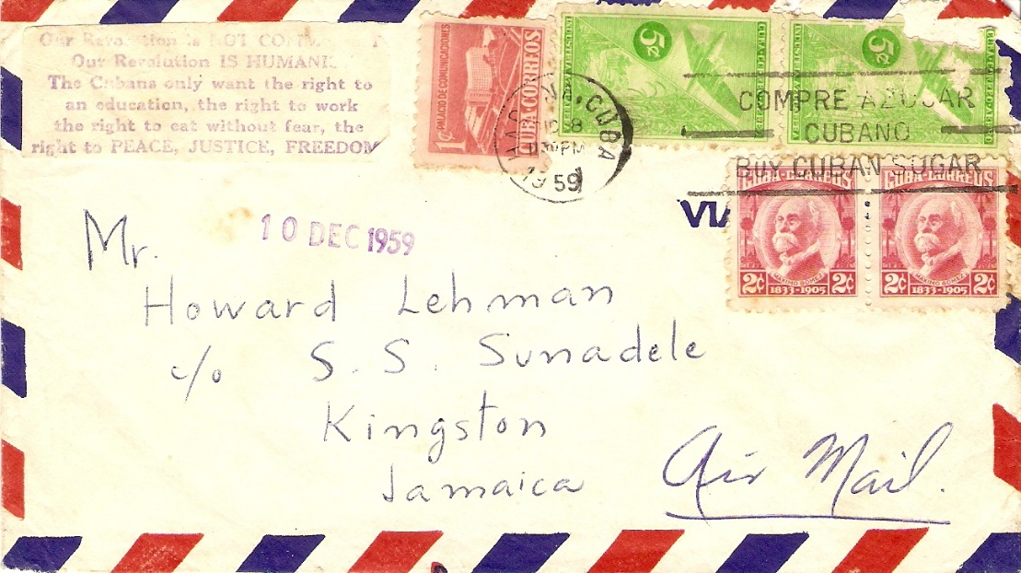
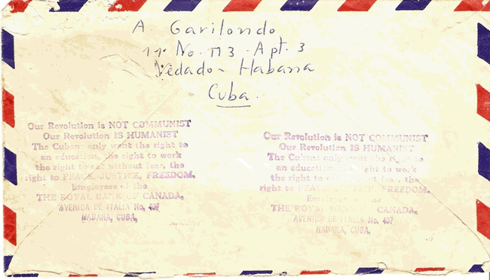
Back to Richard Spinelli Findings…
1959 Cuban Airmail Letter with Fidel Castro Propaganda Message
Before assuming the presidency of the Island of Cuba, Fidel Castro stressed that the pillars of the future administration-“the right to peace, justice and freedom”-do not communicate with Communist ideas. In 1959, the year Castro took power from the fallen Bastista regime, he introduced a stamp which said: “Our Revolution is not Communist. Our revolution is Humanistic. Cubans only want the right to education, the right to work, the right to eat without fear, the right to peace, justice and freedom”. The Royal Bank of Canada, the only bank in Cuba not nationalized by Castro since he needed financial contact with the West, released this cover with Castro’s message imprinted twice on the back and once on the front. It is believed Castro’s message disappeared forever on airmail covers after its 1959 usage.

Slide 28
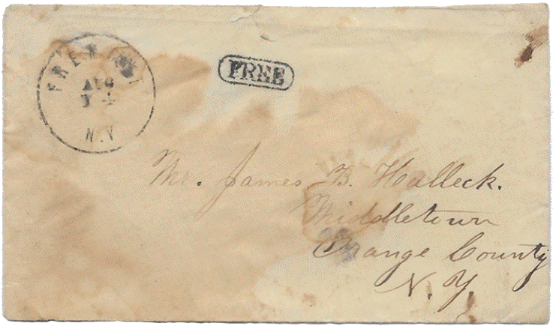

Slide 29
1849 Stampless Cover to William Hickey
Office of the Secretary of the US Senate
William Hickey 1798 – 1866
Assistant Secretary of the United States Senate. 42 Years in Service of the Senate. Author of works on the Senate. Edited an official printed version of the Constitution used by the Government and certified by then Secretary of State James Buchanan (corrected several words and 65 punctuation errors). Ordered survey map of land tracts in Washington DC. Was involved in the creation of the official Vice Presidential Seal of the day. Only one impression - on–cover (1850 - Millard Fillmore), is known today
DEC 17,1849 Philadelphia to Washington 5 cents
(under 300 miles rate)

Slide 30

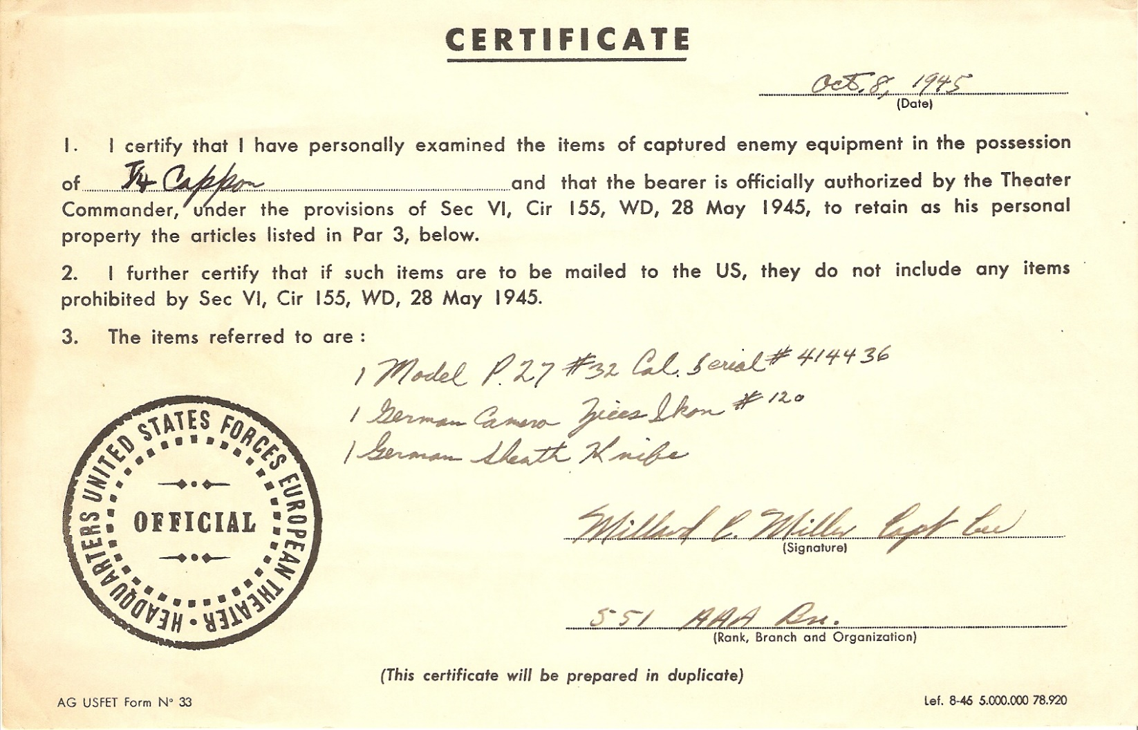
World War II Spoils of War: Soldiers were allowed to return to the US with captured items, as long as they were properly registered. This 1945 certificate allowed a soldier to return with a German p27 pistol, a Zeiss camera and a souvenir dagger. Daggers were not used in combat by German military, but were mainly decorative.

Slide 31
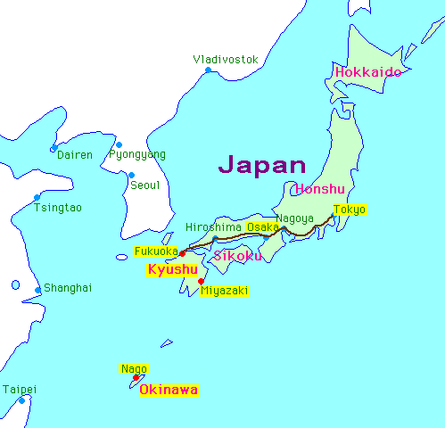
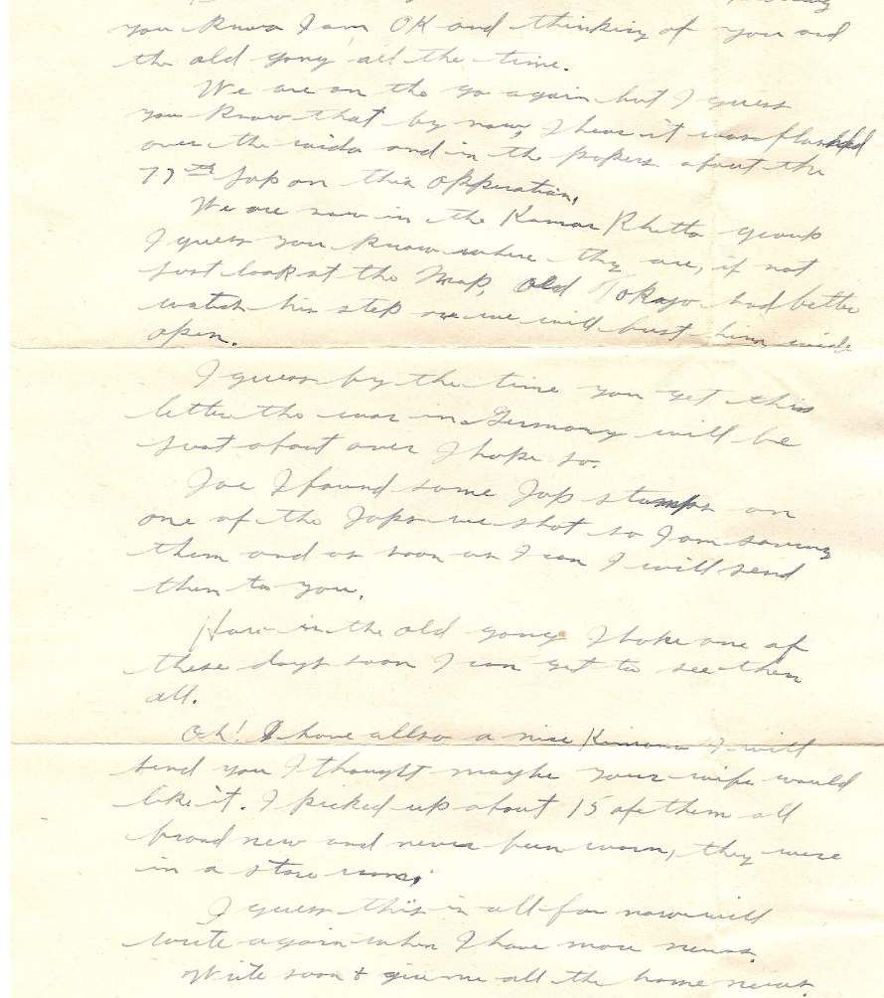
World War II US Soldier Letter From Japan
April 6, 1945
“… Joe, I found some Jap stamps on one of the Japs we shot. So, I am saving them and as soon as I can, I will send them to you.
… Oh, I also have a nice Kimono I will send you. I thought maybe your wife would like it. I picked up about 15 of them. All brand new and never been worn. They were in a store room.”
This US soldier was probably on the island of Okinawa on April 6, 1945 when he captured the spoils of war and wrote this letter to a friend back home. Okinawa is 340 miles off the coast of Japan and was being prepared as an air base for the planned US invasion of Japan.

Slide 32
Maria Teresa Spinelli (1789-1850) was an Italian woman who journeyed from a separated woman to a head of school. She became foundress of the Congregation of Augustinian Sisters, Servants of Jesus and Mary.
Maria Teresa Spinelli, who as a young lady, realized that in Frosinone, Italy, there was no education for girls and she was the first to start this venture by gathering two prostitutes from the street. She later felt a great desire to dedicate herself totally to God in this mission and so became a Sister with some of her friends who were teaching with her at that time.
In October, 2016, Pope Francis advanced the cause of sainthood. He remarked that Maria Teresa Spinelli lived a life of heroic virtues and declared her “venerable.” (postcard)

Slide 33
The area of Georgia was inhabited by Native Americans before English settlers arrived in the 1730’s led by James Oglethorpe,
a member of British Parliament.
Oglethorpe proposed that the area be colonized with the “worthy poor” of England to provide an alternative to overcrowded Debtor’s Prisons. He initially did not support slavery but capitulated since there was not a way to get enough labor.
Hand Written
December 7, 1777 Revolutionary War era “Warrant of Appraisement” document (disposition of a deceased’s assets) signed by ten founders of the State of Georgia,
United States of America

Slide 34
Signers of this Document
Jonathan Bryan: American born, friend of Oglethorpe, supporter of independence, financier of Continental troops, captured and held prisoner for two years by British
James McKay: Planter, captained George Militia, pillaged and sunk British boats, killed 10-25 King’s Rangers who refused to support the Patriots
George Gray: An original receiver of British Plantation Land grants, whose last will demanded that his “Negroes and chattels be sold to pay debts”
Hugh Morrison: Scottish immigrant granted Georgia lands between 1757 and 1769
Roderick McIntosh: British Army Officer who turned sides against the British, part of Continental garrison which attacked Savannah, received wound to face

Slide 35
Signers of this Document
Peter Nephew: Immigrated to Georgia by 1756, received an early 100 acre British Land Grant, ultimately received 1250 acres in 27 years in Georgia
Donald Bain McIntosh: Land Grant recipient, rice grower and neighbor and probably relative of Roderick McIntosh
John Hampton: First mentioned in Georgia in 1747 as selling cattle to a neighbor.
Thomas Whitefield: Probable son of George Whitefield, noted British Preacher, co-founder of Methodism and early leader of evangelical movement in Georgia and America. Anti-slavery in 1740, but by 1770 convinced Georgia needed slaves. Co-founder with his father of the first and oldest child-caring institution in the Country
John Sandiford: Georgia conservator of the peace, his father left him “one half of tract mentioned above, Negro girl named Beck, eleven cows and calves”

Slide 36
By the late 1770’s, two facts are believed:
(1) James McKay and the other “Worthy Poor” were slave holders, but their sentiments were anti slavery. (2) The political emotions of these men were with the Patriots.
In 1775, residents of St. Andrews Parish, including these men, met in convention and adopted six resolutions:
Approval for” the decent, but firm and manly conduct of the loyal and brave people of Boston and Massachusetts Bay to preserve their liberty”.
Approved three resolutions against specific British colonial practices
…Confirmed “our disapprobation and abhorrence of the unnatural practice of slavery in America…”
Named delegates to an upcoming provincial congress in Georgia and requested that Georgia appoint delegates to the upcoming Continental Congress

Slide 37
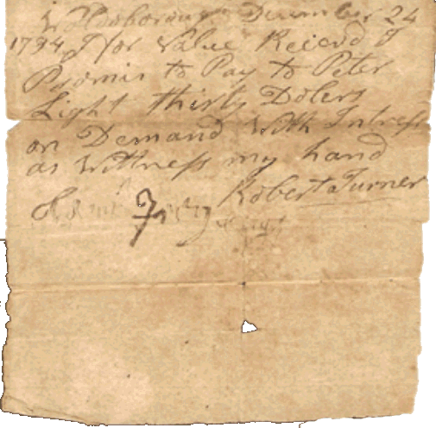
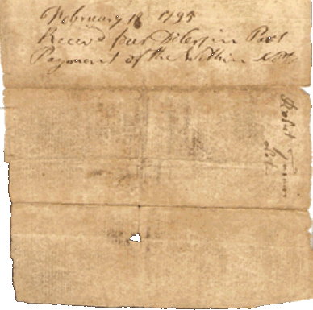
1794 Promissory Note from Robert Turner to
Peter Light with Connection to War of 1812
Obverse Content
Woldoboro, Maine
For value received, I promise to pay Peter Light thirty dollars on demand with interest as witnessed my hand.
(Signed) Robert Turner
Reverse Content
February 18, 1795
Rec’d four dollars in part payment of this note.
Peter Light
During the war of 1812, Peter Light, a fisherman, was captured by a British privateer and carried to Halifax, NS. The crew, having gone ashore for a holiday, left Light and the cook on-board the vessel. Light and the cook cut the cable, stole the ship and steered for the New England coast. As they sailed up the Waldoboro River, they fired several guns which alarmed the people in the vicinity.

Slide 38
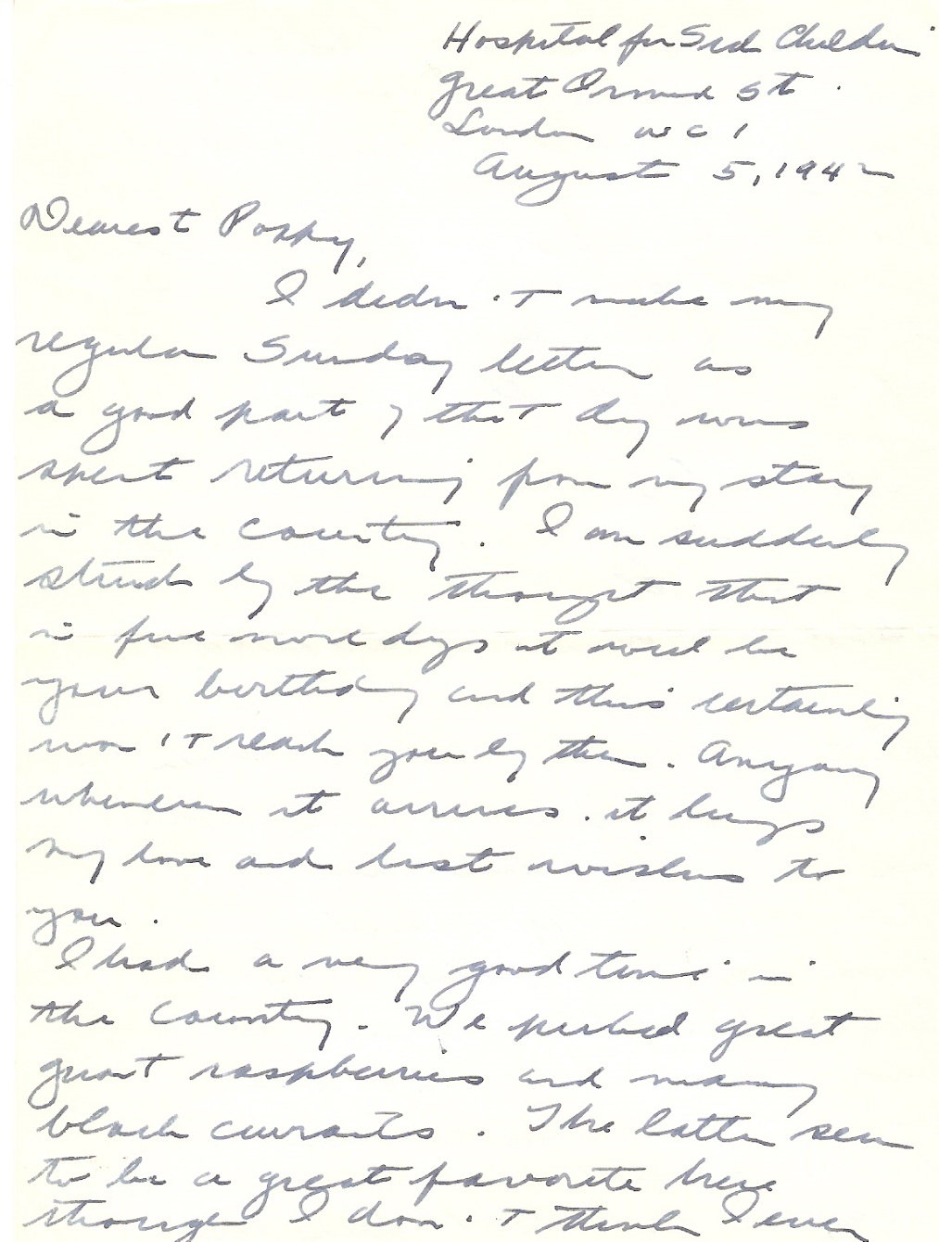
1942 Censored Letter From One of First Seven
American Women Doctors in WWII, Eleanor K. Peck
Women doctors in the United states sought to use their medical skills in support of the American war effort during WWII. Commissions in the Army and Navy, however, did not become available to them until 1943. In the summer of 1941, the American Red Cross sought women doctors for the British Emergency Medical Services. Seven medical doctors responded to this call, including Eleanor K. Peck.
Dr. Peck served as a pediatrician in London in 1941 and 1942. In 1943, she transferred from the Red Cross to the US Army.
In her letters, Dr. Peck describes her trip overseas, air raids, the hospital, rationing, commissioning of female doctors and her reaction to the bombing of Pearl Harbor.
Fifteen of Dr. Peck’s letters home to her aunt and uncle are contained in the Library of the University of North Carolina. Three of Dr. Peck’s letters are contained in my personal collection.

Slide 39
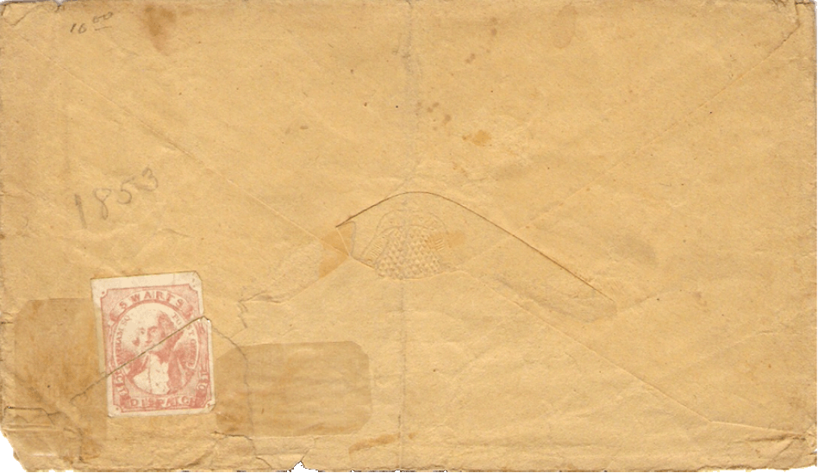
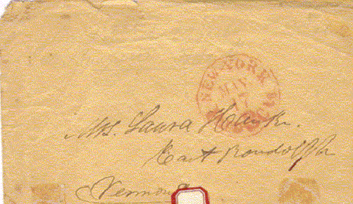
1853 Stampless Cover from New York City Addressed to Mrs. Laura Hawke
East Randolph, Vermont
Swarts’ City Dispatch Post (New York City) local stamp on the reverse
Aaron Swarts was employed by the Post Office Department at Chatham Square (NYC) in 1845 and 1846. On January 5, 1847 the Chatham Square branch was discontinued leaving area residents and businesses without a convenient nearby post office. Swarts saw an opportunity and on January 15th announced the opening of his local branch, advertising it as the Branch Post Office, although there was no official connection to the government Post Office. The Company lasted until 1863.
Robert Siegel recently auctioned three similar Swarts covers at an average price of $400 each.

Slide 40
Letter to Caleb Stark (1759 – 1838), Revolutionary War Veteran and
Eldest Son of Revolutionary War Hero General John Stark
During the Revolutionary War, Caleb served with his father in the 1st New Hampshire Regiment at the Battles of Bunker Hill, Trenton and Princeton. General John Stark is credited with “Live free or die: Death is not the worst of evils”, the phrase which ultimately became New Hampshire’s state motto. John was personally thanked for his War efforts by George Washington and was the last surviving General of the War.
After his father resigned his commission Caleb remained in the Continental Army, serving the rest of the war and rising to the rank of major. He was the youngest survivor of the Battle of Bunker Hill. In 1811, Caleb Stark started the first cotton mill in Suncook, New Hampshire. He also practiced law and became a historian, and a member of the New Hampshire State Senate.
1829
Richmond, Virginia to Pembroke,
New Hampshire
25 cents
(over 400
mile rate)

Slide 41
Stampless Cover to Miss Harriet Stark, Dumbarton, New Hampshire
Harriet was the daughter of Caleb Stark and granddaughter of General John Stark. She lived to be 85 years old and “left a big estate”.

Slide 42
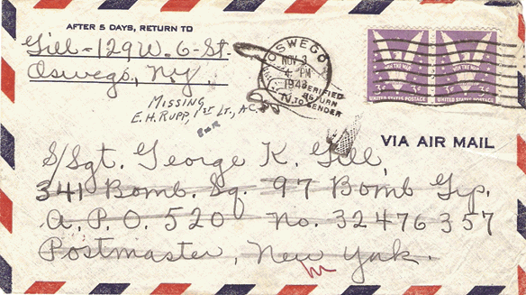
1943 World War II “Return to Sender” Cover Without Letter
From the John M. Gill Family , 129W. Sixth Street Oswego, New York
To S/Sgt. George K. Gill 341st Bomb Squadron, 97th Bomb Group APO 520, no. 32476357, Postmaster, New York
This envelope with letter left Oswego, New York on November 3, 1943 and was returned to sender on December 21, 1943 with a notation by 1st Lieutenant E. H. Rupp that S/Sgt. Gill was Missing In Action.
S/Sgt. George K. Gill was born about 1920 and enlisted in the US Army on September 16, 1942. He was assigned to the 341st Bombardment Squadron, 97th Bombardment Group, XII Air Force as a tail gunner in a B-17 Heavy Bomber.
On November 8, 1943, 81 B-17’s bombed the Turin, Italy ball bearing works, marshalling yard, motor and aircraft engine works. S/Sgt. Gill was shot down in his B-17 and declared lost on November 8, five days after the posting of his family’s letter. His remains were never found. The letter was returned to the family.

Slide 43
1901 Cover Addressed to Paul Friedrich Wolfskehl, Industrialist and Mathematician
Wolfskehl bequeathed 100,000 Marks (1,000,000 pounds today) to the first person to prove Fermat’s last theorem.
Fermat's Last Theorem states that no three positive integers a, b, and c satisfy the equation a^{n} + b^{n} = c^{n} for any integer value of n greater than two.
The cases n = 1 and n = 2 were known to have infinitely many solutions, including:
a² + b² = c²
a = 3, b = 4, c = 5
3² + 4² = 5²
9 + 16 = 25
This theorem was first conjectured by Pierre de Fermat in 1637 in the margin of a copy of Arithmetica where he claimed he had a proof that was too large to fit in the margin. The first successful proof was released in 1994 by Andrew Wile, and formally published in 1995, after 358 years of effort by mathematicians.
Why the prize? Theory one is that Wolfskehl was spurned by a young lady and decided to commit suicide, but was distracted by an error in a paper on Fermat’s famous problem. This rekindled his will to live, and in thanks, he established his prize. Theory two is that he missed his suicide time because he was in a library studying Fermat’s theorem.

Slide 44
Other Friends I Have Met Through Stampless Covers…
James Smith Bush (1800 – 1867) – Great-Great Grandfather of President George W. Bush and a Rochester resident
Virgil Douglas Parris (1807 – 1874) - US Congressional Representative from Maine
Jonathon Tarbell (1830 – 1888) - US Civil War Brigadier General.
Amy Kirby Post (1818 – 1914) – 19th Century US Women’s rights suffragette and her abolitionist friends Frederick Douglas, William L. Chapman, Issac Post (her husband), J. C. Hathaway, J. C. Jackson plus six run-away underground railway slaves; this is my most prized stampless cover; Amy’s papers reside at University of Rochester
Charles P. Leverich (1803 – 1876) – New Orleans cotton broker and business partner of Confederate President Jefferson Davis
Gouverneur Morris Jr. (1813 – 1883) - Son of a US founding father and a New York railroad tycoon
Judge Augustus Seymour Porter – The first white settler of what is now Niagara Falls, New York; promoter of the power of the Niagara River and a pioneer of Great Lakes transportation

Slide 45
Other Friends I Have Met Through Stampless Covers…
Royal Chapin Taft (1823 – 1912) – Member of the political Taft family (shared a great-great-great-great grandfather with President William Howard Taft), Governor of Rhode Island, banker and railroad executive. His extensive art collection resides at RI School of Design
Lewis Bradley (1815 – 1900) – Noted American landscape painter, lithographer and drawing master
John Savin (1820 - ?) – White slave holder great grandfather of American writer and poetess Maya Angelou
Edgar Ketchum (1811 – 1882) – Appointer by President Abraham Lincoln as Collector of Internal Revenue. Wife’s grandfather delivered the welcoming speech to George Washington upon his entry to New York for his inauguration address
John H. Swift – Last member of the New York State Assembly who served in the Civil War (1900 – 1901)
David Rittenhouse Porter – Governor of Pennsylvania, 1838 – 1845
Silas Wright (1795 – 1847) – New York Senator, Brigadier General New York State Militia, 20th US Congress (1827 – 1829), New York State Comptroller, US Senator from New York (1833 – 1844)

Slide 46
Other Friends I Have Met Through Stampless Covers…
Azariah Cutting Flagg (1790 – 1873) – New York Secretary of State, State Comptroller and NYC Comptroller. Political crony of President Martin Van Buren
Royal Chapin Taft (1823 – 1912) – Member of the political Taft family (shared a great-great-great-great grandfather with President William Howard Taft), Governor of Rhode Island, banker and railroad executive. His extensive art collection resides at RI School of Design
Lewis Bradley (1815 – 1900) – Noted American landscape painter, lithographer and drawing master
John Savin (1820 - ?) – White slave holder, great grandfather of American writer and poetess Maya Angelou
Edgar Ketchum (1811 – 1882) – Appointer by President Abraham Lincoln as Collector of Internal Revenue. Wife’s grandfather delivered the welcoming speech to George Washington upon his entry to New York for his inauguration address
John H. Swift – Last member of the New York State Assembly who served in the Civil War (1900 – 1901)
David Rittenhouse Porter – Governor of Pennsylvania, 1838 – 1845

Slide 47
Other Friends I Have Met Through Stampless Covers…
Silas Wright (1795 – 1847) – New York Senator, Brigadier General New York State Militia, 20th US Congress (1827 – 1829), New York State Comptroller, US Senator from New York (1833 – 1844)
Azariah Cutting Flagg (1790 – 1873) – New York Secretary of State, State Comptroller and NYC Comptroller. Political crony of President Martin Van Buren
Job Mann – Pennsylvania State Treasurer and three term US congressman from PA
Albert Sands Southworth (1811 – 1894) – Operator of Southworth and Hawes Daguerrotype studio and student of Samuel F. B. Morse.
Myron H. Clark (1806 – 1892) – Governor of New York (1855 – 1857), State Senator and Ontario County Sheriff
George E. Paine – New Orleans cotton broker for Southern growers, including Confederate States President Jefferson Davis. Arranged for transport and sale of black slaves and Chinese coolies as labor for cotton trade

Slide 48
Other Friends I Have Met Through Stampless Covers…
David Elder – Builder of the only Wire Suspension Bride (1866) still standing in America (Carrabassett River, Maine)
Lorenzo Lorraine Langstroth – Invented the modern Beehive in 1851 (US Patent 9,300) enabling greater production of honey

Slide 49
The End

