Slide 1
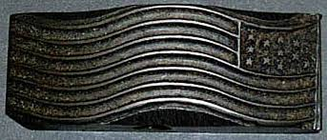
Flag Cancels
By Charles Adrion

Slide 2
Unites States Flag Cancels
American Postal Machine Company
1894-1941
And others…

Slide 3
United States Flag Cancels
US Machine cancels – 1847-1870, 1870-1894
1894 an important year
Overwhelming increase in mail flow
Technology changes – industrial age
Many innovators, inventors, and companies
Hand and machine power
Political procurement

Slide 4
United States Flag Cancels
American Postal Machine Company
Boston based – 445 varieties in Boston alone
State of the art in 1894 – however…
Completely phased out by 1941
National distribution – 3198 towns, 6968 vars
Detailed USPD records

Slide 5
United States Flag Cancels
Collecting flag cancels
Slow start – 1920’s postal history
1930’s depression style collecting – write ins
Frederick Langford
The Bible – FCE 4 editions
New finds and not founds
Ratings and valuations

Slide 6
United States Flag Cancels
Typical FCE state entry – Delaware

Slide 7
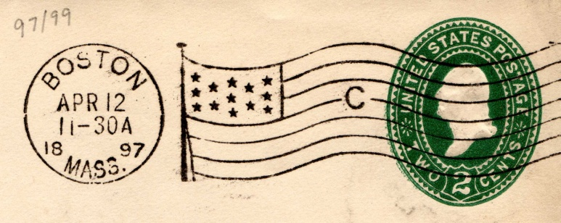
United States Flag Cancels
Cancel = dial + canceller (killer)
Interchangeable dials

Slide 8
United States Flag Cancels
A flag cancel must have STARS or STAFF or BOTH
This is NOT considered a flag cancel

Slide 9
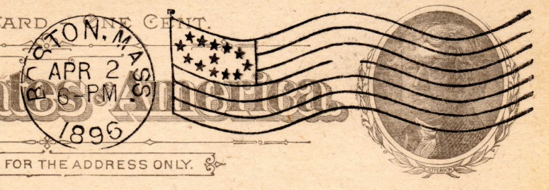
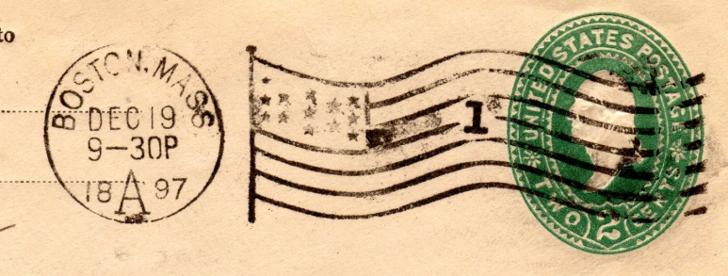
United States Flag Cancels
Canceller = field, in box + stripes
Staff, halyard

Slide 10
United States Flag cancels
The minimal APCM flag cancel
1894 first year EKU is October 31
No halyard, no staff, incomplete stripes

Slide 11
United States Flag Cancels
Diespace: machine id’s and zones

Slide 12
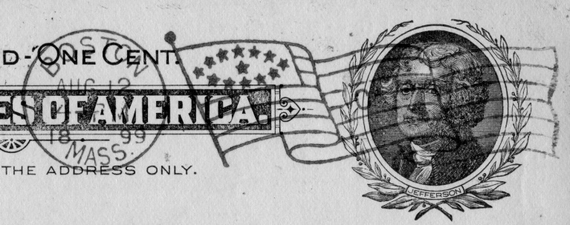
United States Flag Cancels
Involute
Ovate

Slide 13
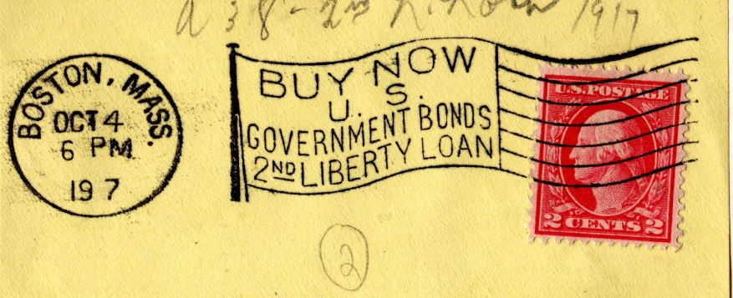
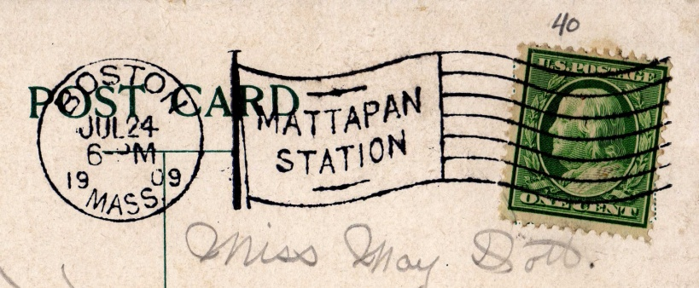
United States Flag Cancels
Slogans
Stations

Slide 14
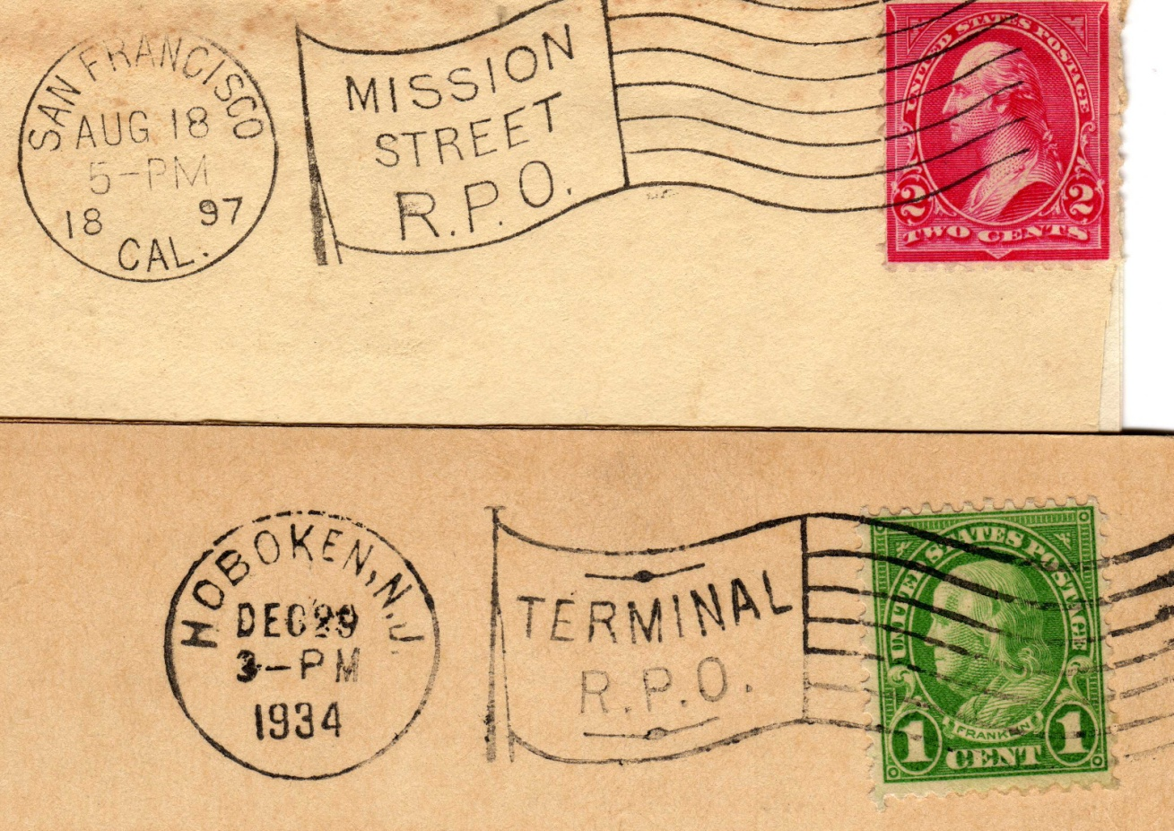
United States Flag Cancels
Railway terminals and RMS

Slide 15
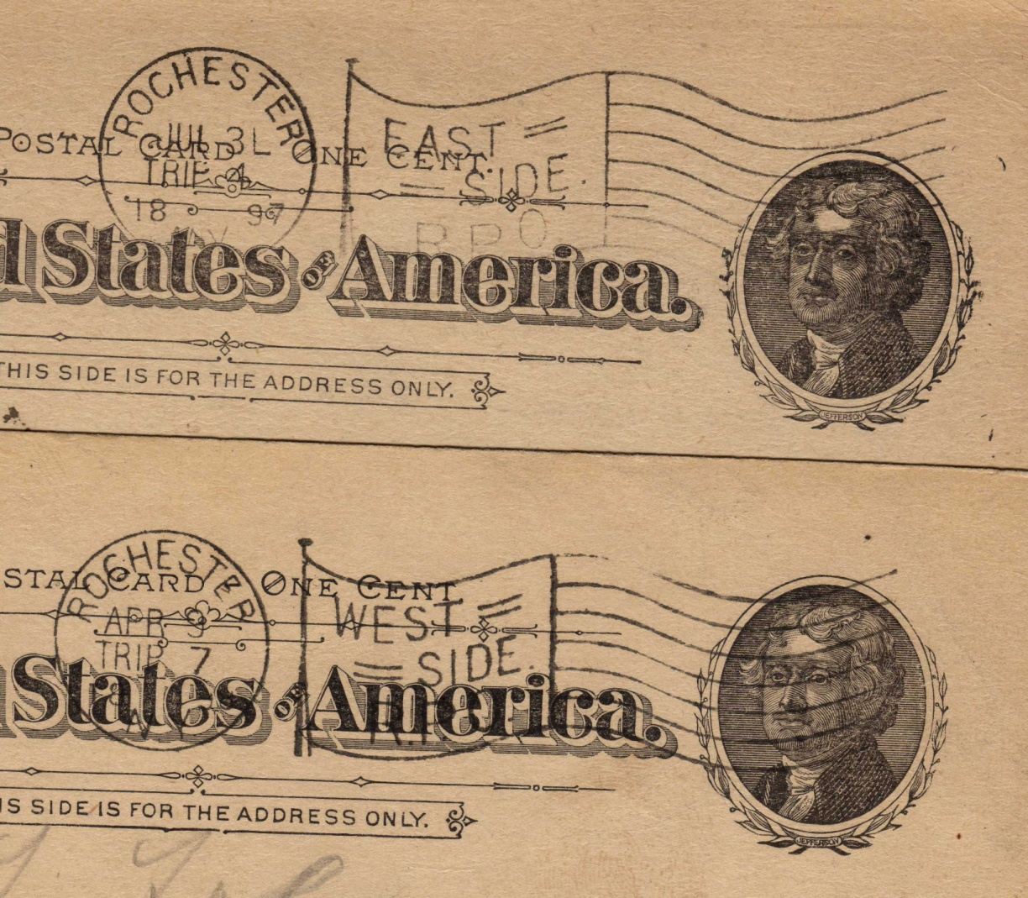
United States Flag Cancels
Rochester NY Streetcars!

Slide 16
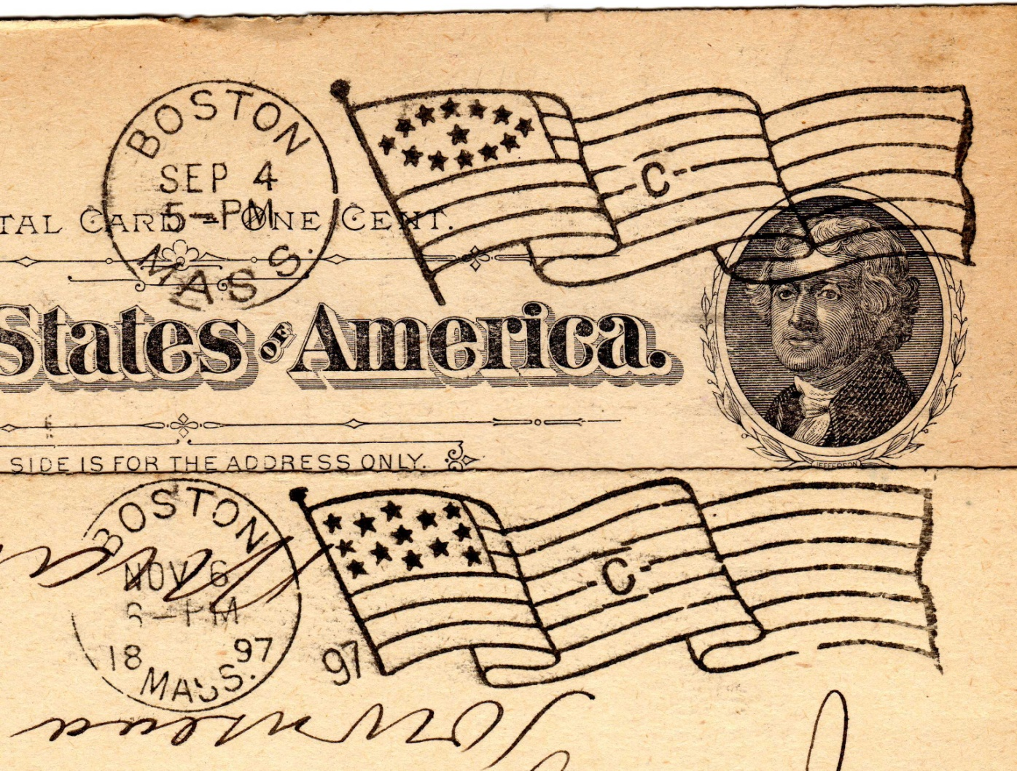
United States Flag cancels
Error flags – no year and redundant year

Slide 17
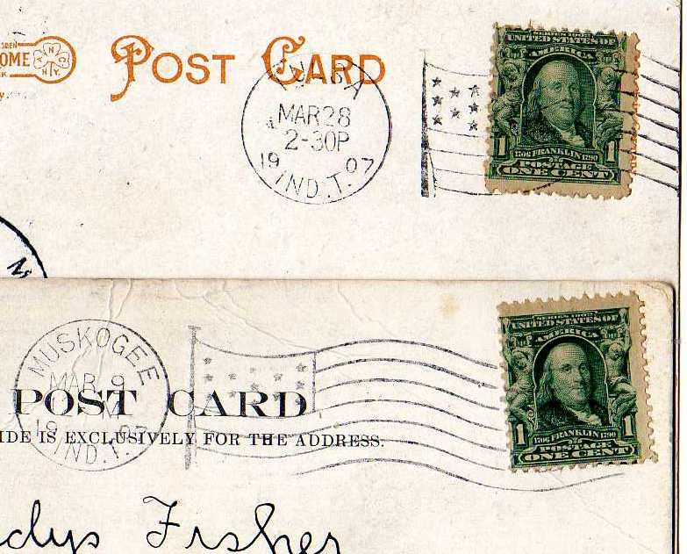
United States Flag Cancels
Indian Territory (pre-1908 Oklahoma)

Slide 18
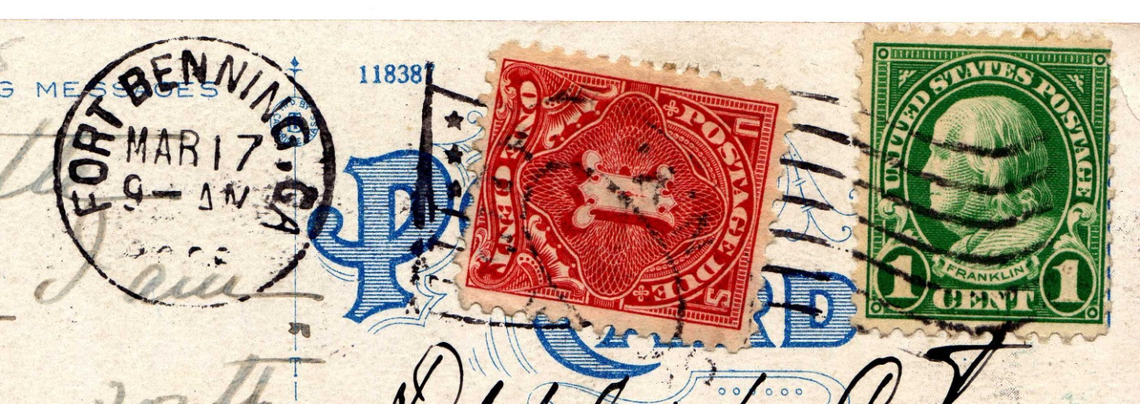
United States Flag Cancels
Military – AEF and US bases

Slide 19
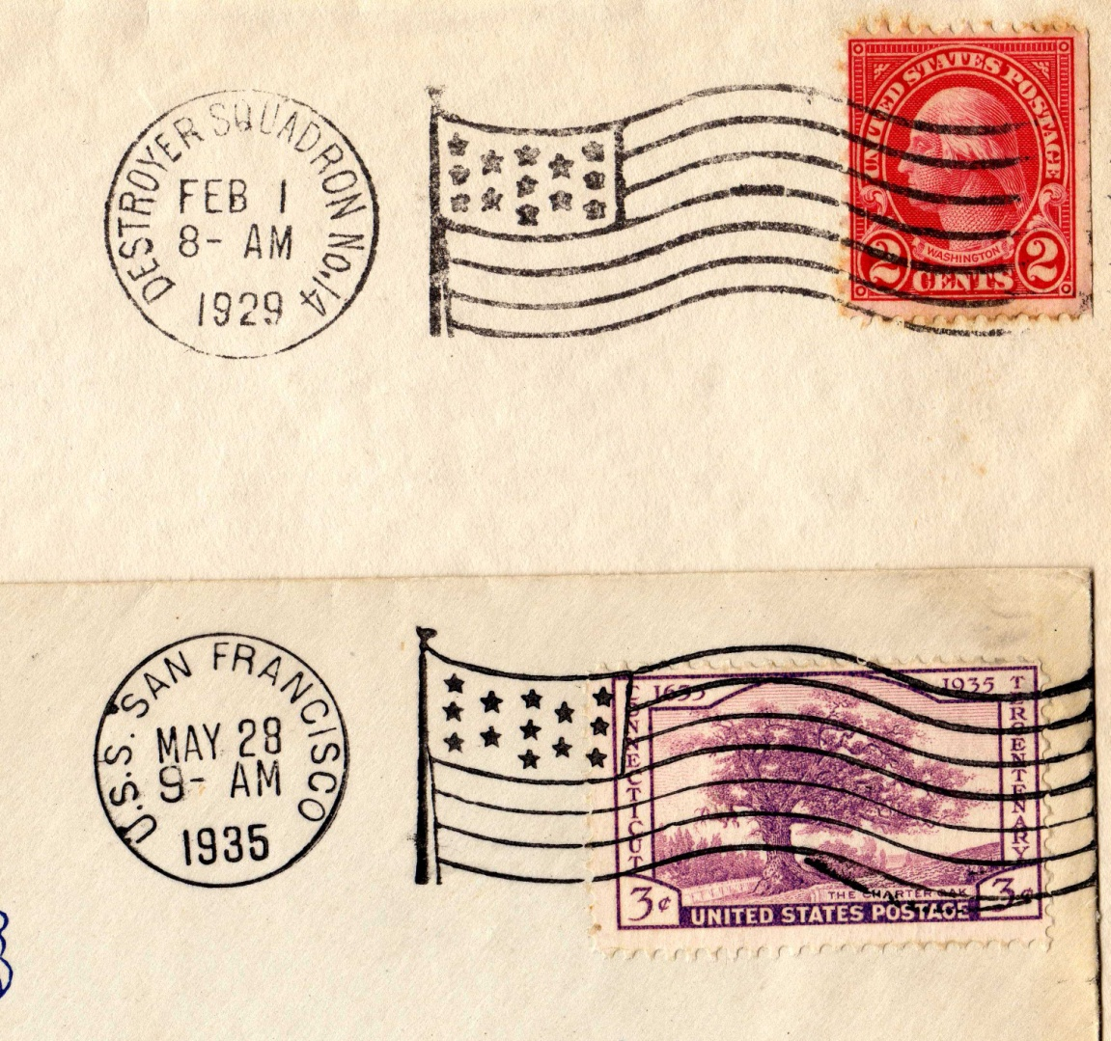
United States Flag Cancels
Ships

Slide 20
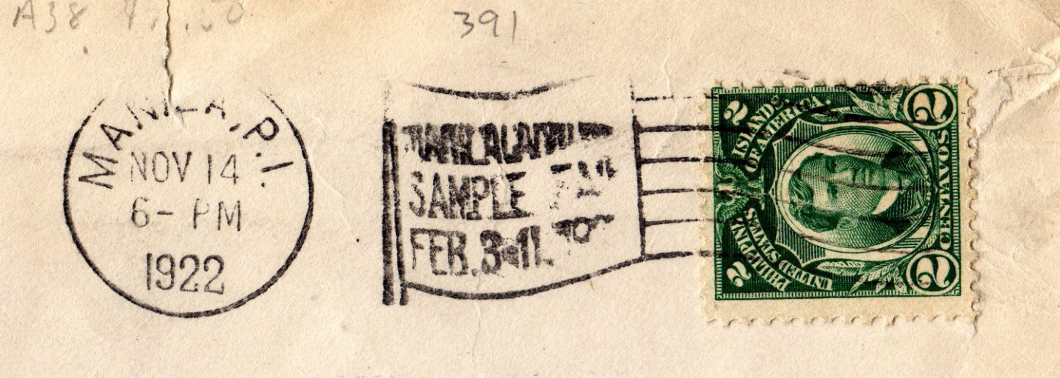
United States Flag Cancels
Possessions

Slide 21
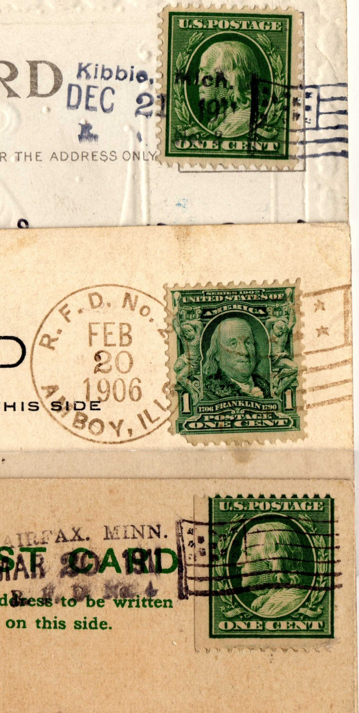
United States Flag Cancels
Classic handstamps
– not APMC
RFD

Slide 22
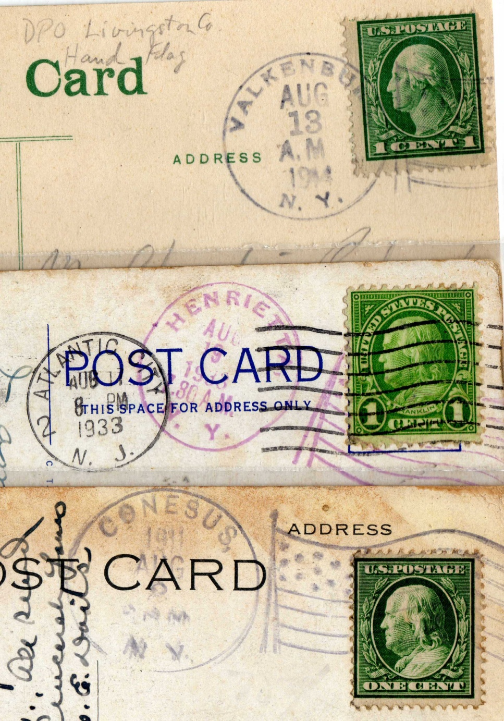
United States Flag Cancels
Classic
Handstamps
From NY

Slide 23
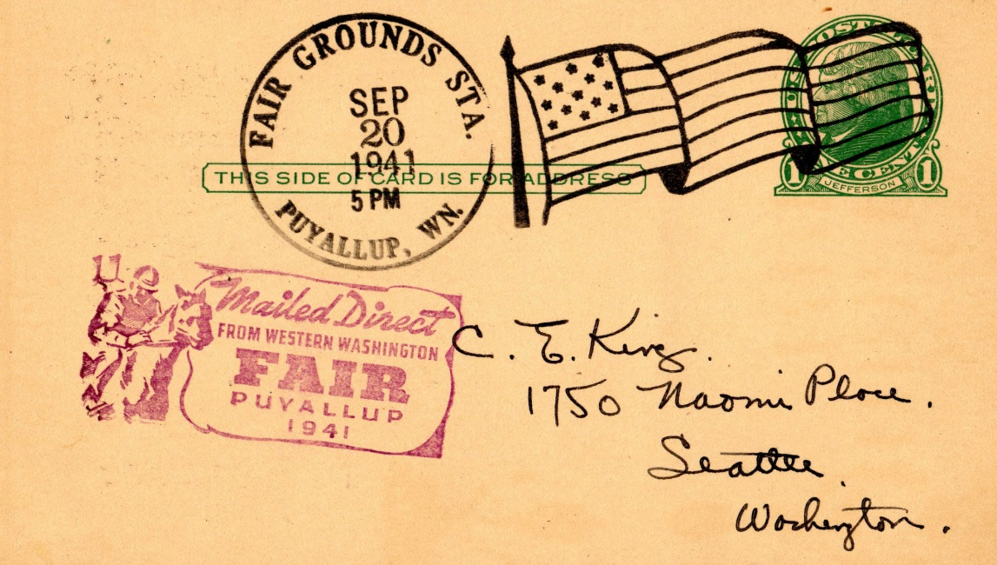
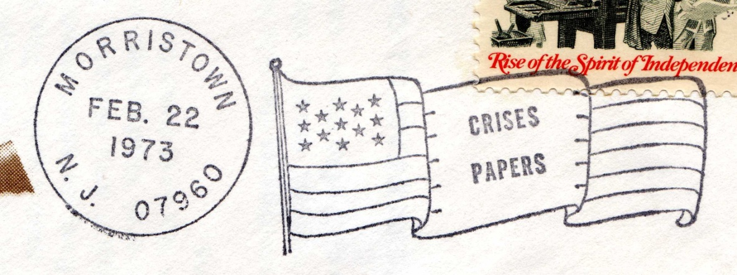
United States Flag Cancels
Modern – not APMC

Slide 24
United States Flag Cancels
I collect them !!!!!!!!
Charlie Adrion

