Slide 1
A & B Countries
Those Far Away Places
with Strange Sounding Names
by Paul Brach

Slide 2
Abu Dhabi 43 (1968)

Slide 3
Abu Dhabi
Sheikdom on the Persian Gulf under British Protection.
Abu Dhabi is one of six Persian Gulf sheikdoms to join the
United Arab Emirates, which proclaimed its independence
Dec. 2, 1971

Slide 4
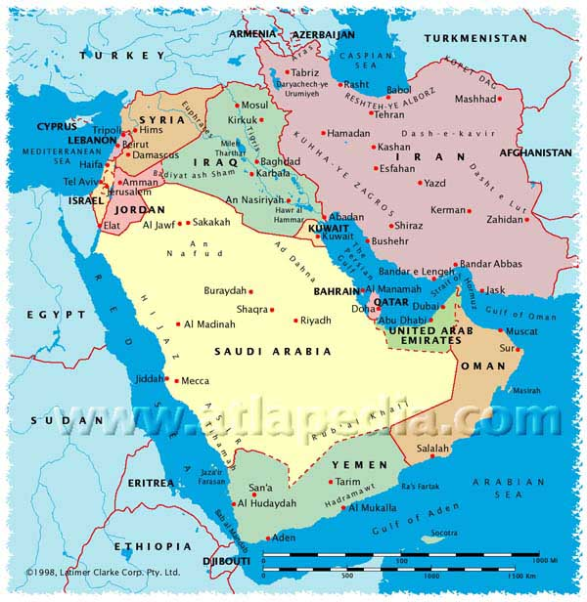

Slide 5
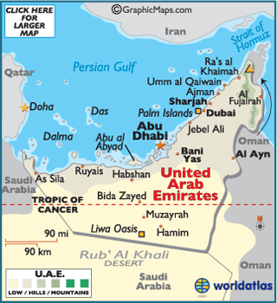

Slide 6
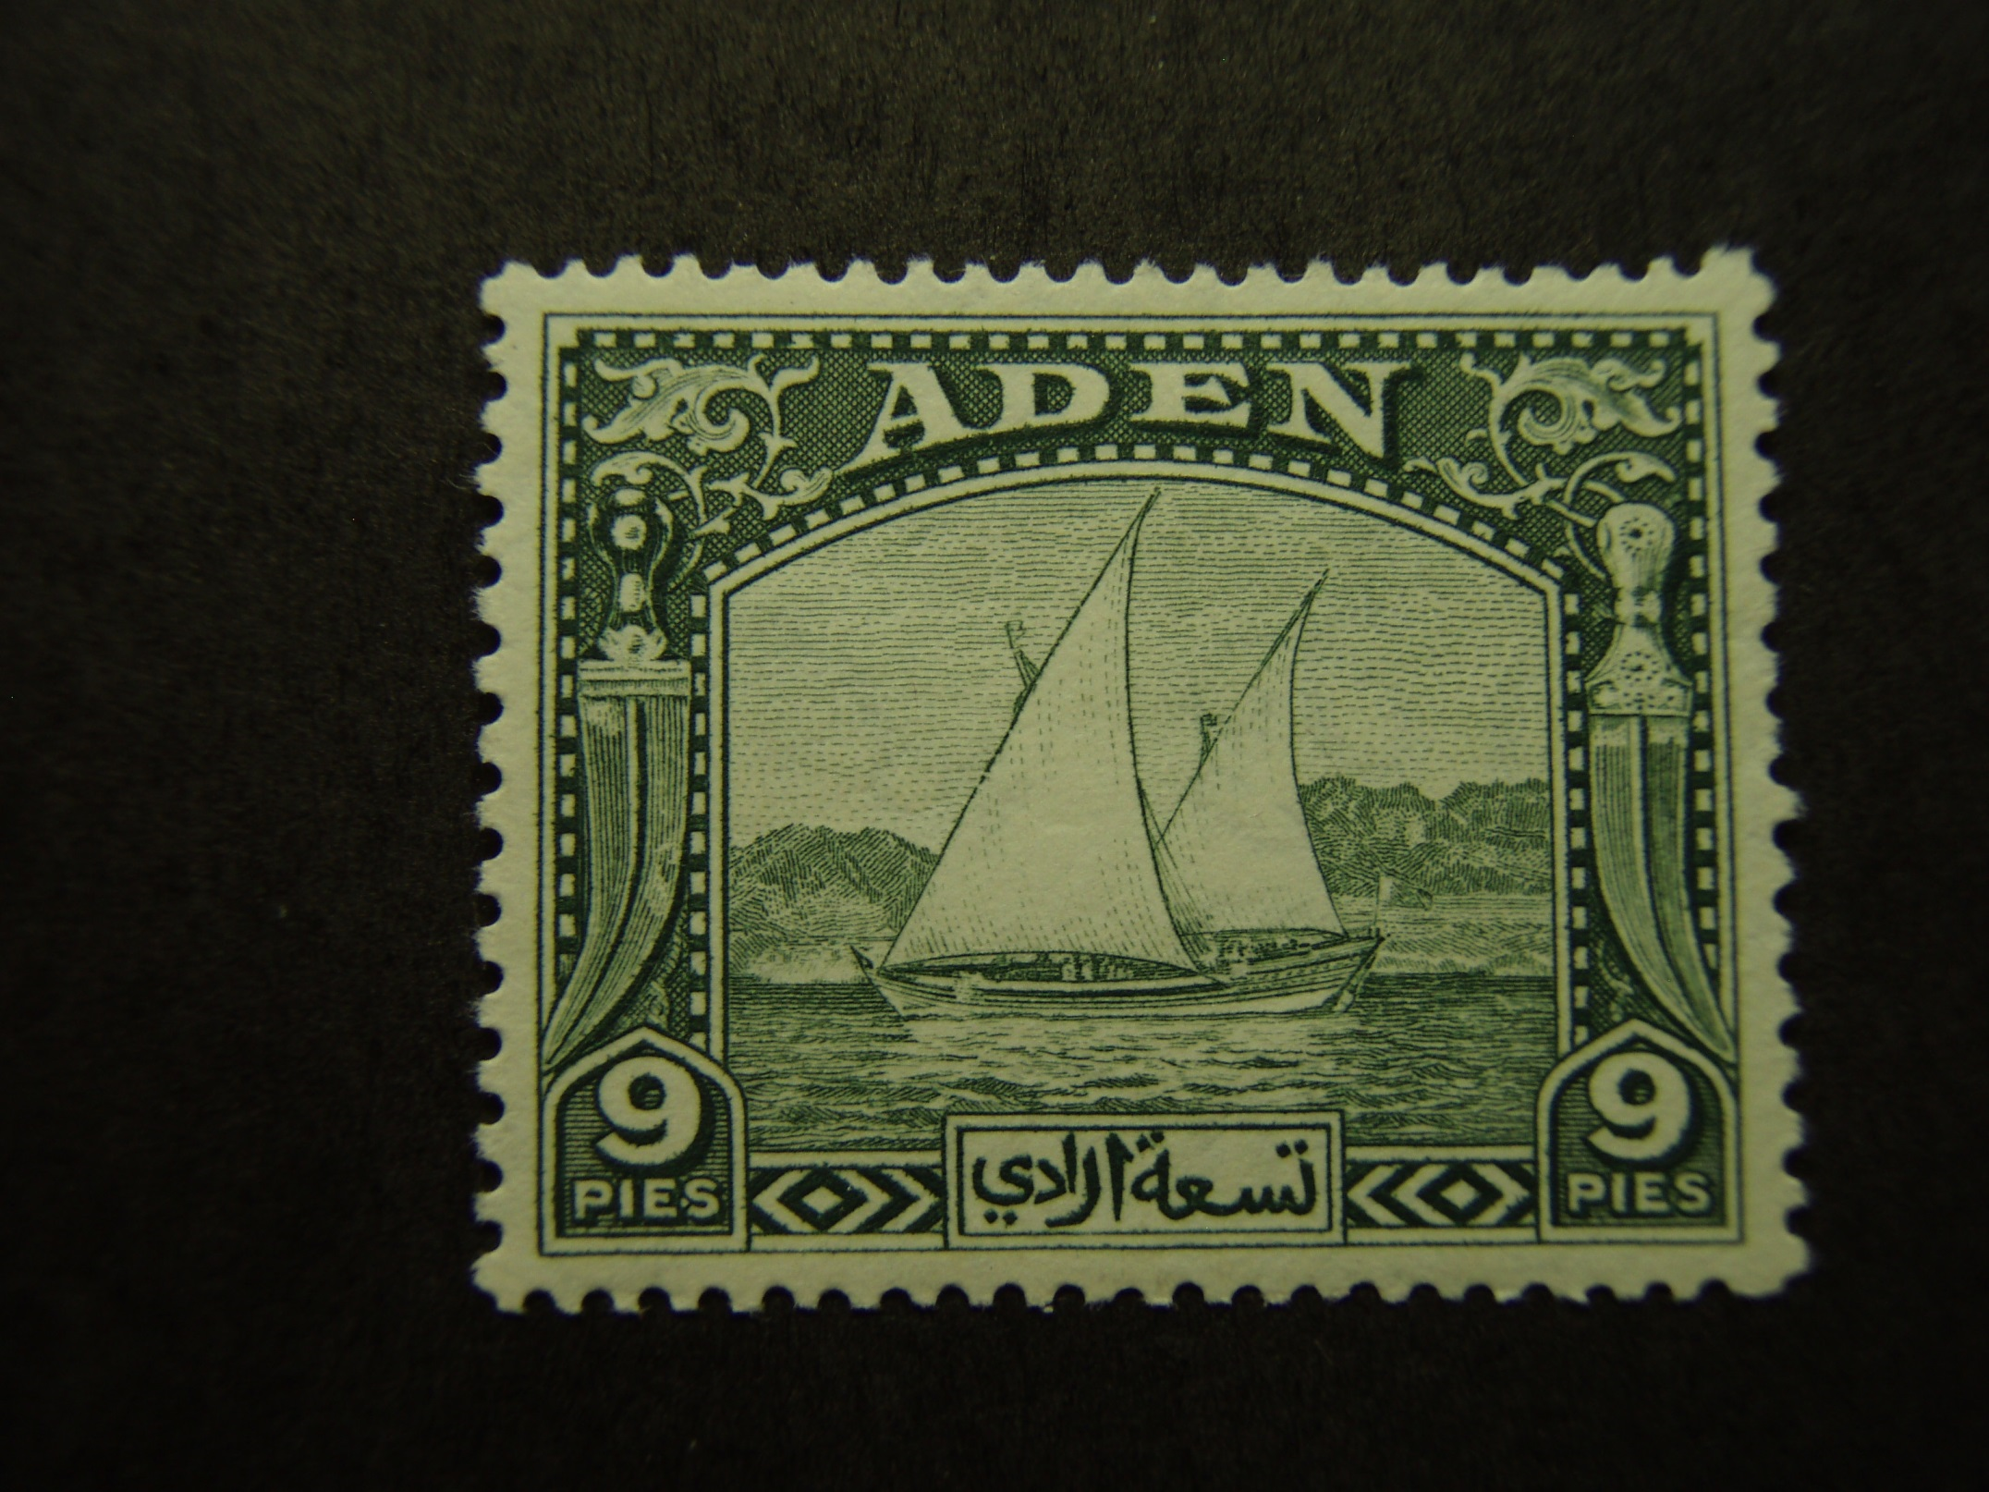
Aden 2
(1937)

Slide 7
Aden
A British colony and protectorate in southern Arabia.
Aden used India stamps before 1937.
In January, 1963, the colony of Aden and the sheikdoms
and emirates of the Western Aden Protectorate formed
The Federation of South Arabia. Stamps of Aden were
replaced Apr. 1, 1965, by those of the Federation of South
Arabia (People’s Democratic Republic of Yemen).

Slide 9
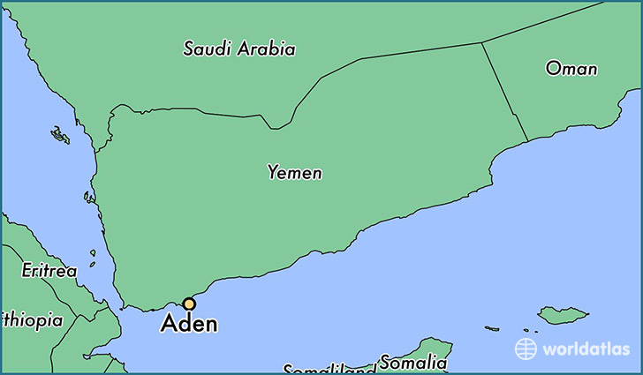

Slide 10
Aegean Islands 24
(1932)

Slide 11
Aegean Islands
A group of islands in the Aegean Sea off the coast of Turkey.
They were occupied by Italy during the Tripoli War and were
ceded to Italy by Turkey in 1924 by the Treaty of Lausanne.
Stamps of Italy overprinted with the name of the island were
In use at the post offices maintained in the various islands.
Rhodes, on the island of the same name, was the capital of
the entire group.

Slide 12
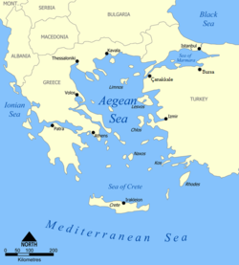

Slide 13
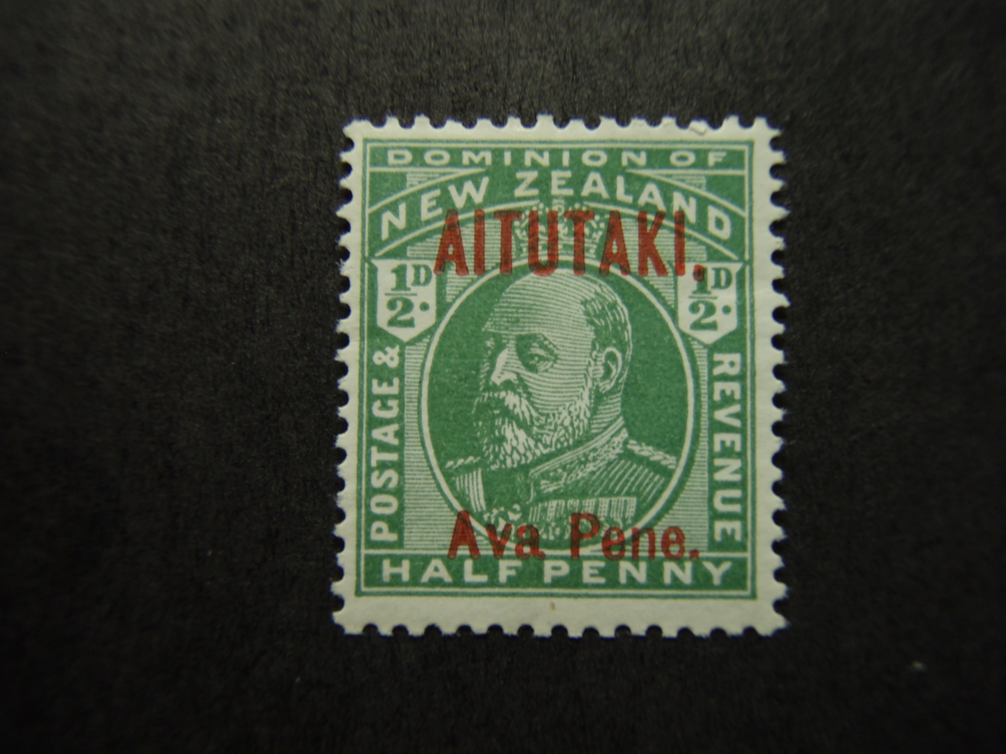
Aitutaki 1
(1903)

Slide 14
Aitutaki
A dependency of New Zealand, Aitutaki is one of the larger
Cook Islands, in the South Pacific Ocean northeast of New
Zealand.
Stamps of Cook Islands were used in 1892-1903 and 1932-72.
Aitutaki acquired its own postal service in August 1972, though
Remaining part of the Cook Islands.

Slide 15
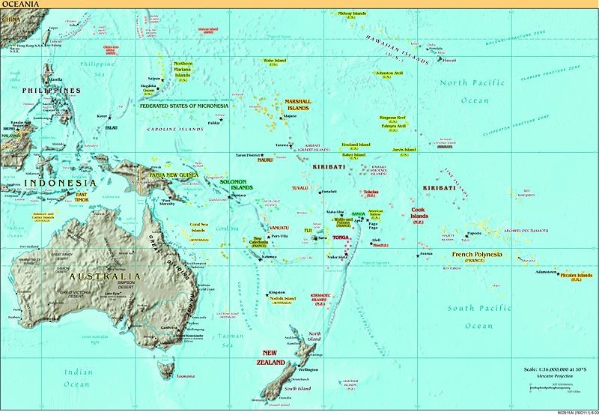

Slide 16
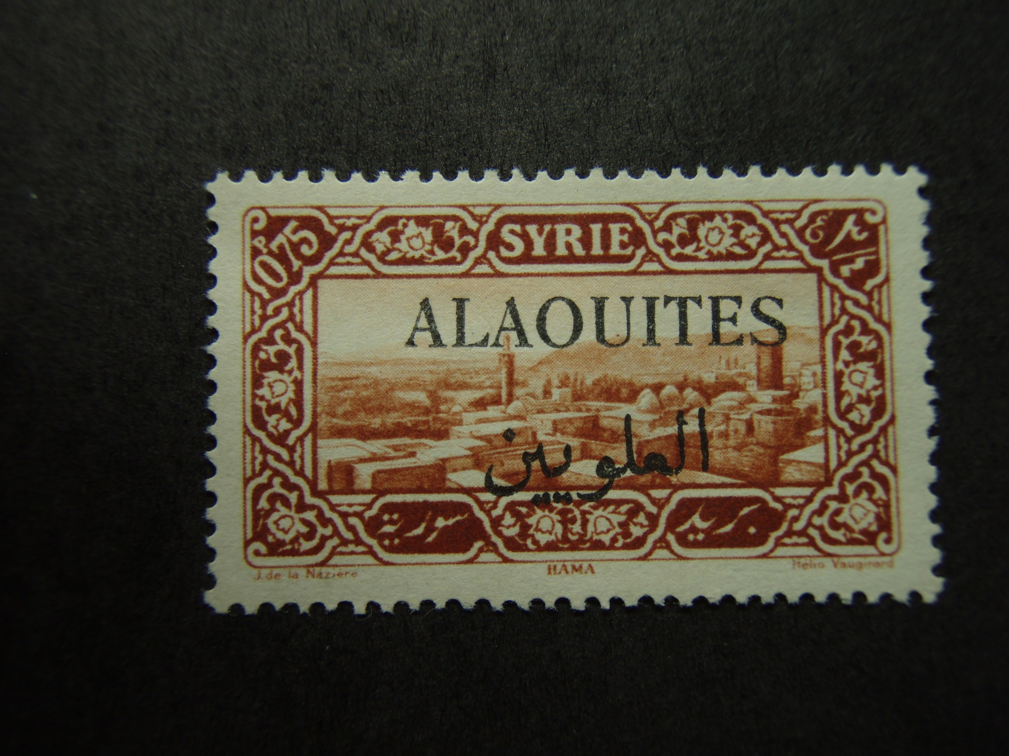
Alaouites 28 (1925)

Slide 17
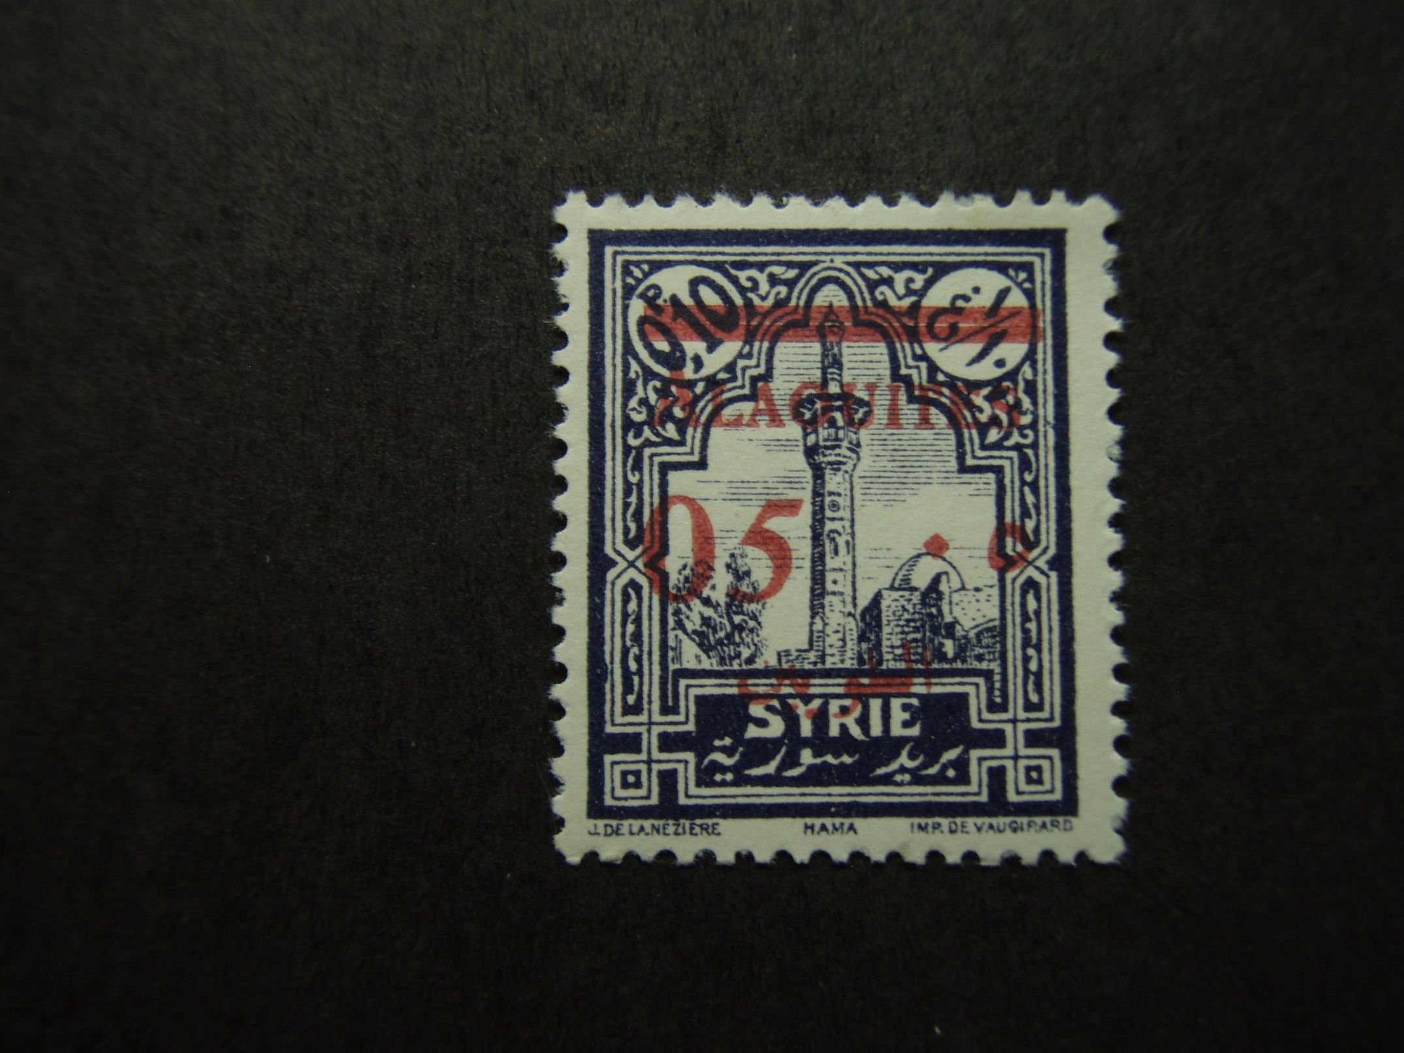
Alaouites 46 (1928)

Slide 18
Alaouites
A division of Syria under French Mandate, in Western Asia.
This territory became an independent state in 1924, although
still administered under the French Mandate. In 1930, it was
renamed Latakia and Syrian stamps overprinted “Lattaquie”
superseded the stamps of Alaouites.

Slide 19
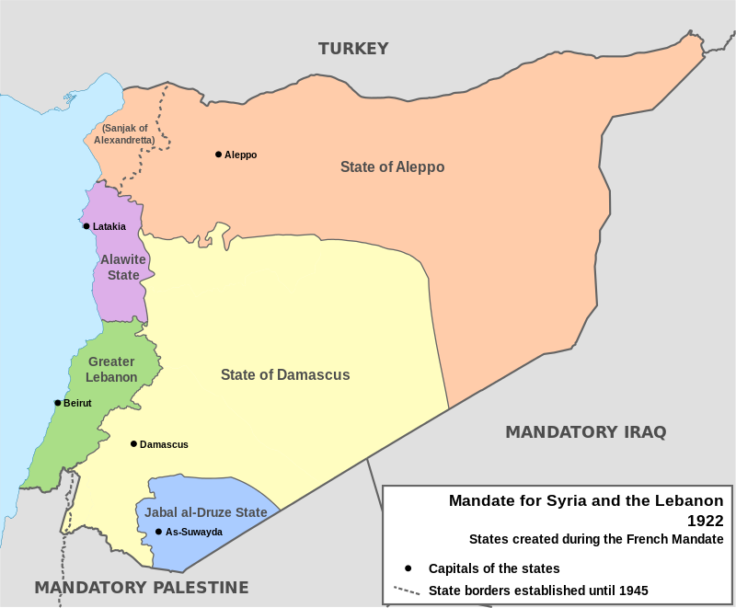

Slide 20
Alberta AP1
(1936)

Slide 21
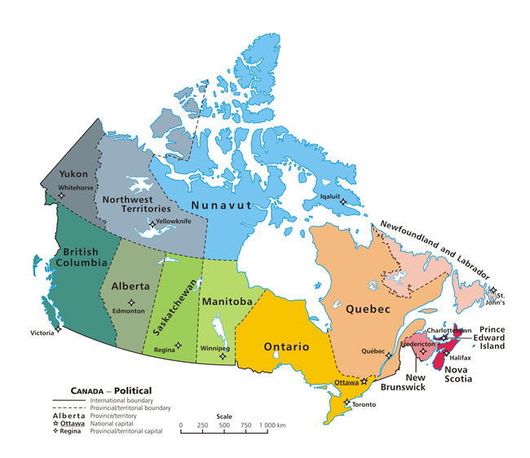

Slide 22
Alberta Prosperity Stamp
Although not technically money, each prosperity certificate was intended to circulate with a value of one dollar. The intent of the program was to keep the certificates circulating and discourage hoarding. To achieve this, a holder had to affix to the back of a certificate a 1-cent stamp before the end of every week, for the certificate to maintain its validity.
As the Program intended, possessors of the certificates tried to avoid having to purchase and affix the stamps, by spending the certificates before the week’s validity expired. The certificates then fell into the hands of merchants, who would then purchase and affix stamps to maintain the notes’ validity.

Slide 23
Alexandretta 14
(1938)

Slide 24
Alexandretta
A political territory under French Mandate in northern
Syria, bordering on Turkey.
Included in the Syrian territory mandated to France
under the Versailles Treaty, the name was changed to
Hatay in 1938. The following year, France returned the
Territory to Turkey in exchange for certain concessions.

Slide 26
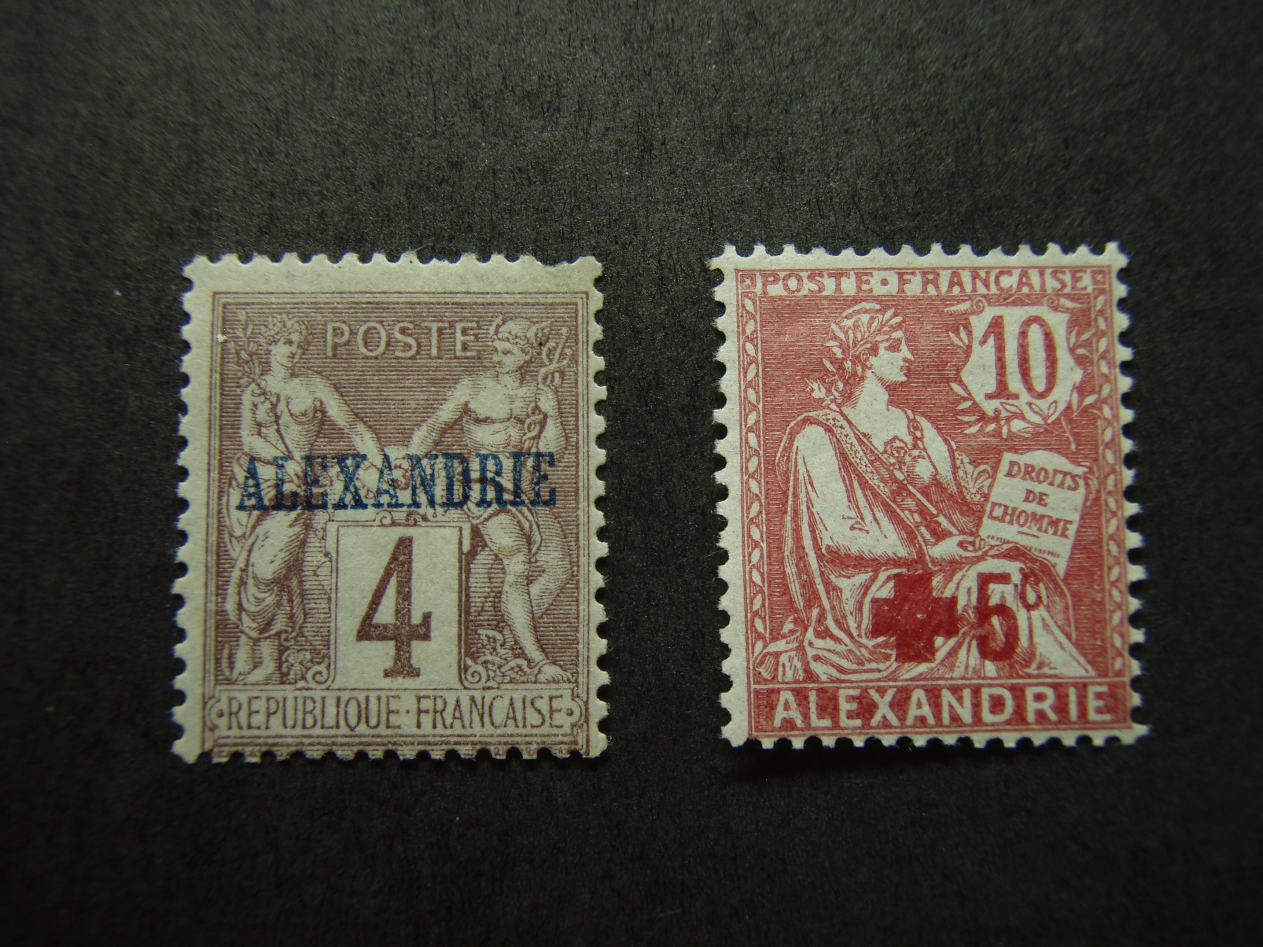
Alexandria
4
(1899)
18
(1902)

Slide 27
Alexandria
French post offices were formerly maintained in
Alexandria and Port Said, as French Offices in Egypt.

Slide 28
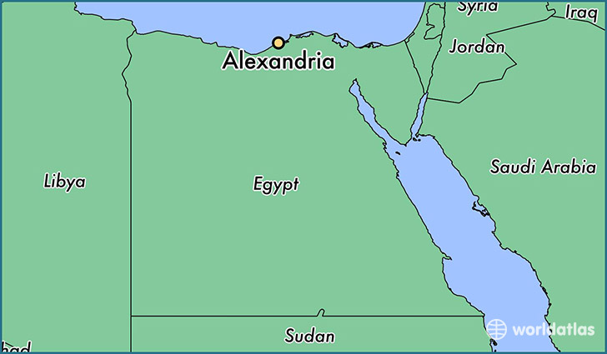

Slide 29
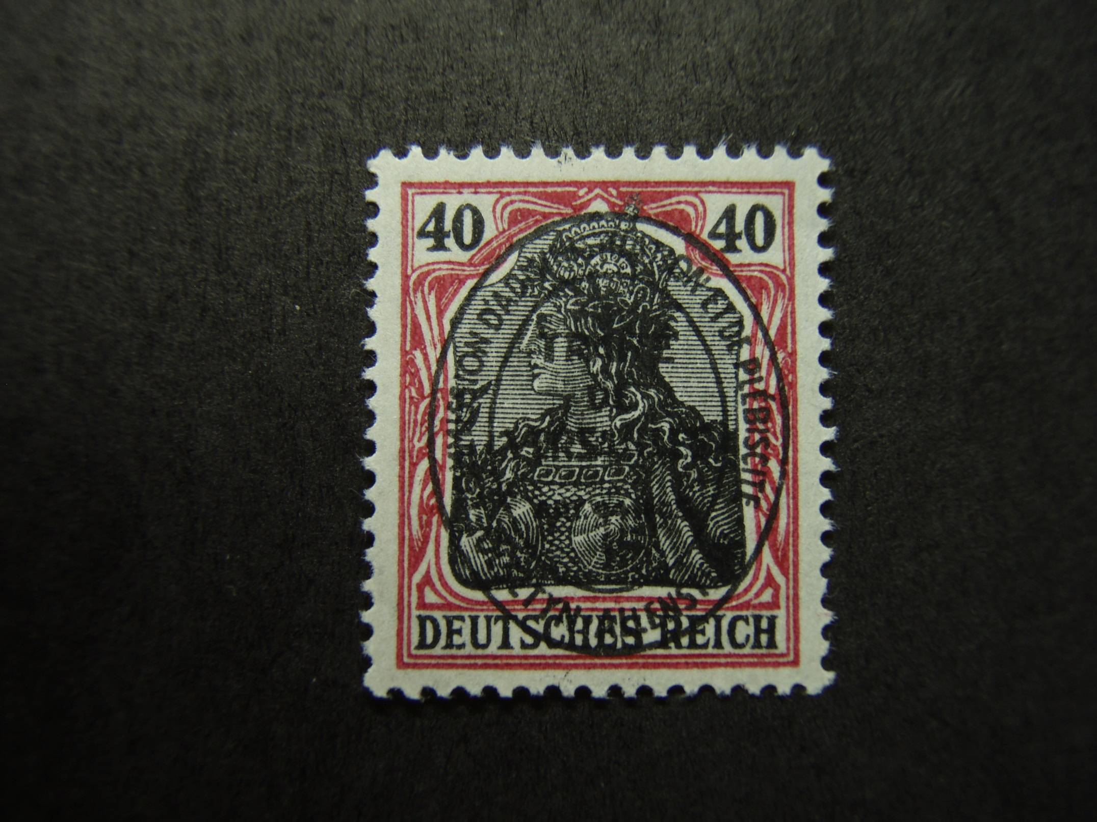
Allenstein 21
(1920)

Slide 30
Allenstein
A district of East Prussia, Allenstein held a plebiscite in 1920 under the Versailles Treaty, voting to join Germany rather than Poland. Later that year, Allenstein became part of the German Republic.

Slide 31
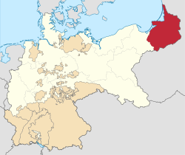

Slide 32
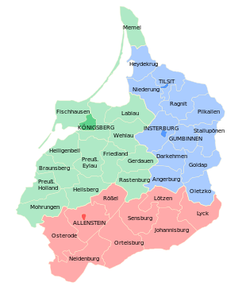

Slide 33
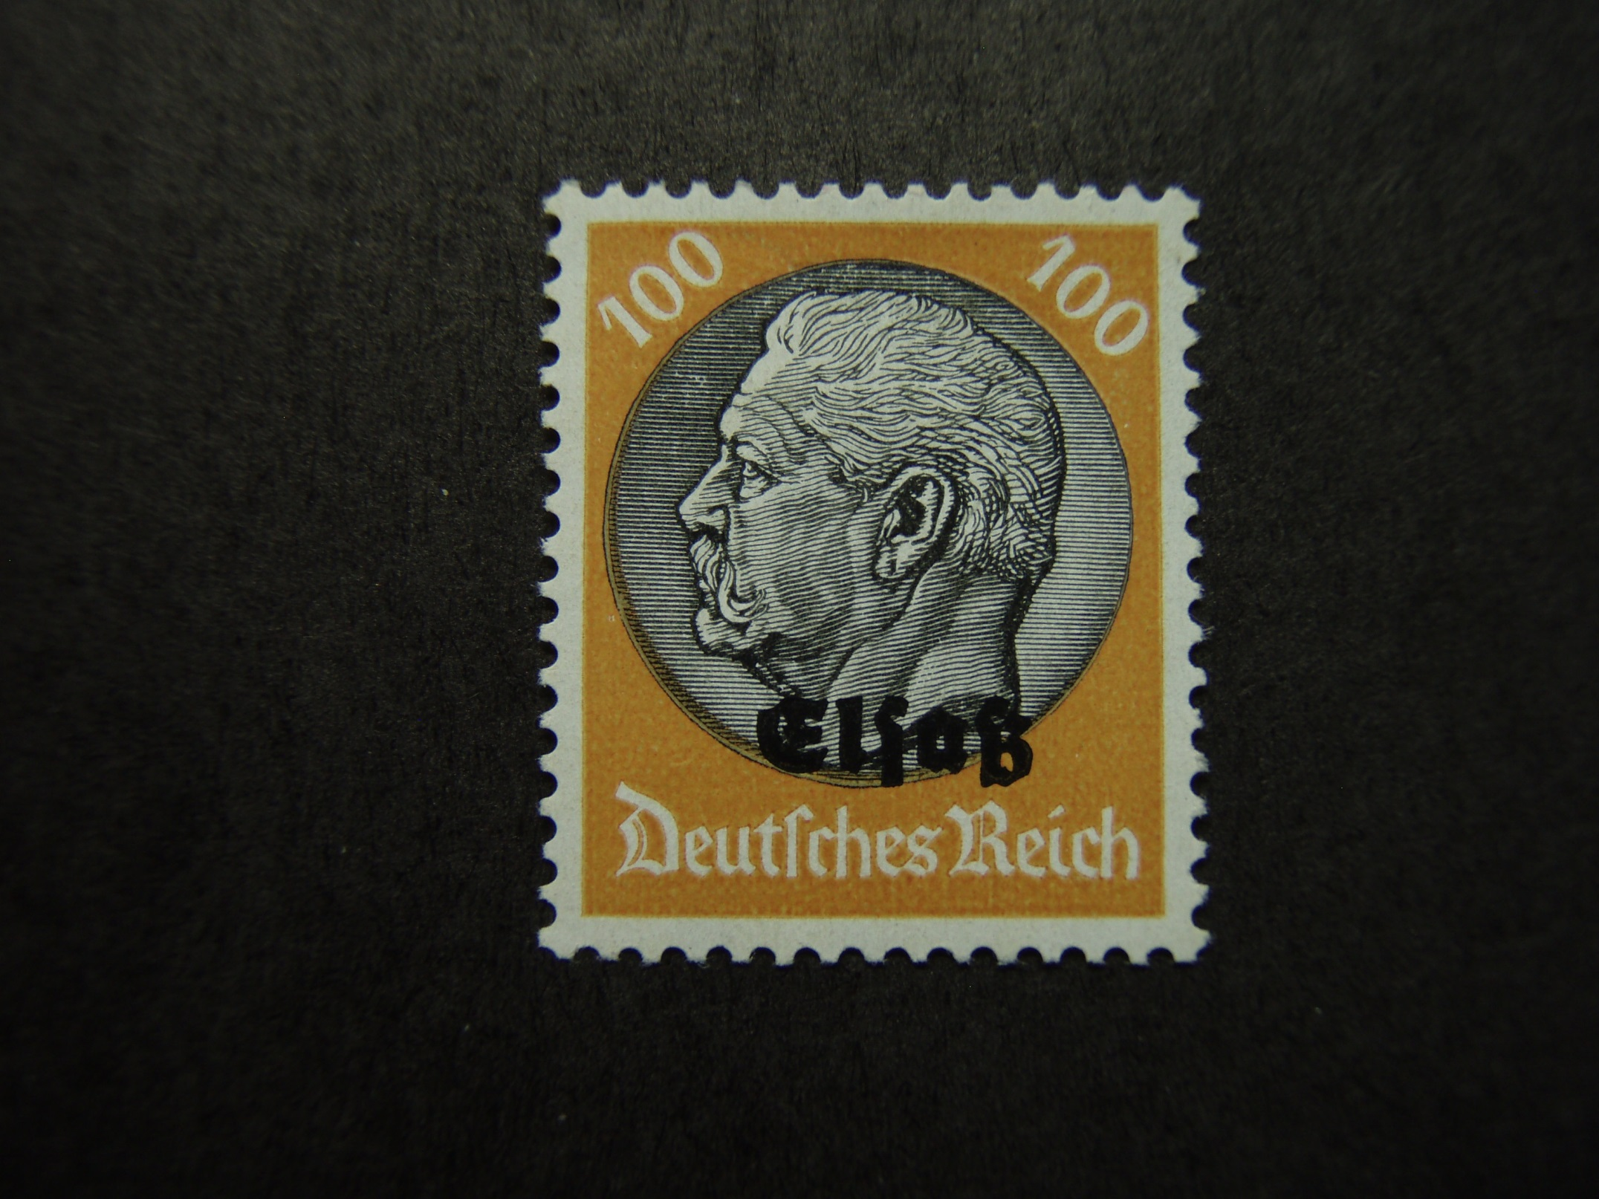
Alsace N42 (1940)

Slide 34
Alsace
Located on France’s eastern border and on the west bank of the upper Rhine adjacent from Germany and Switzerland.

Slide 35
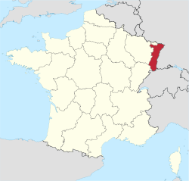

Slide 36
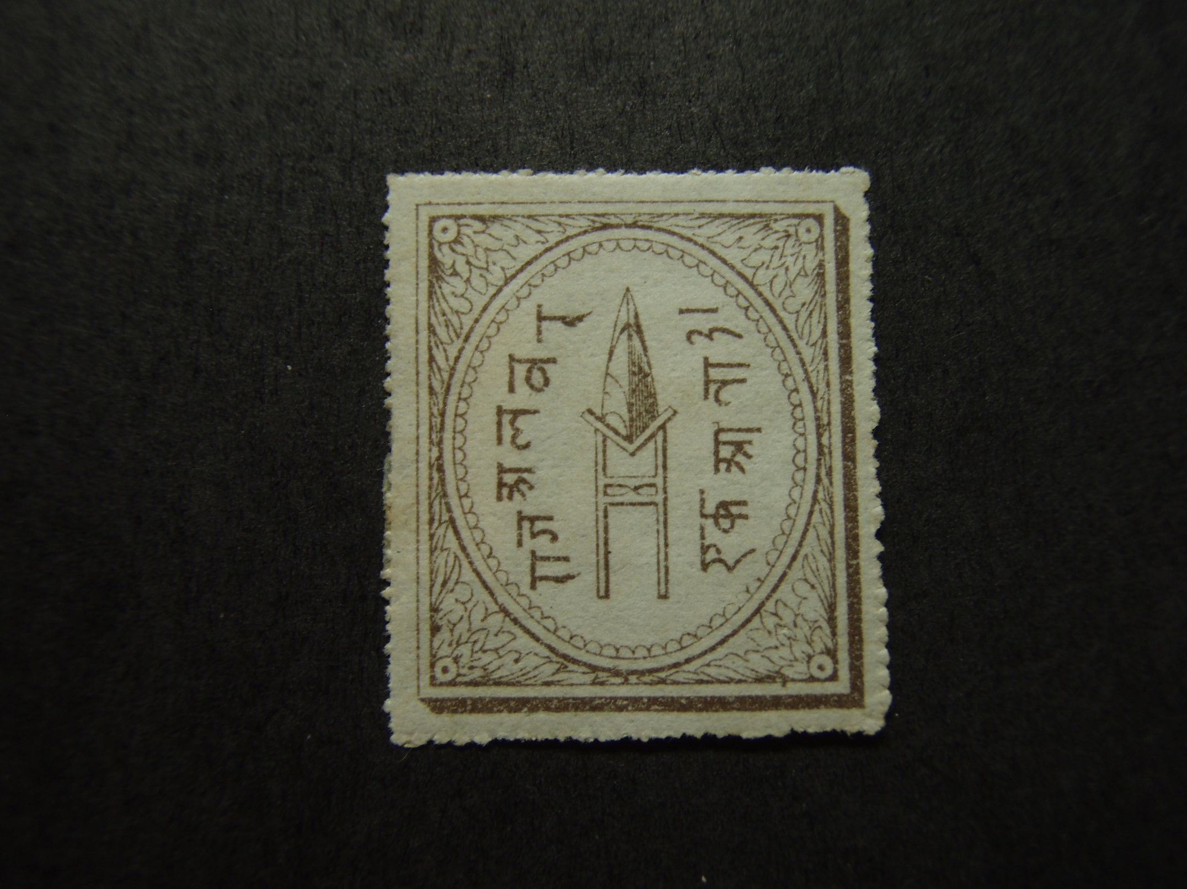
Alwar 2 (1877)

Slide 37
Alwar
A feudatory State of India, lying southwest of
Delhi in the Jaipur Residency.

Slide 38
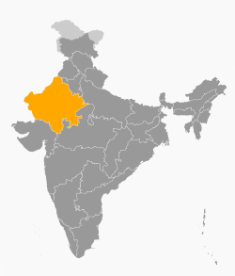

Slide 39
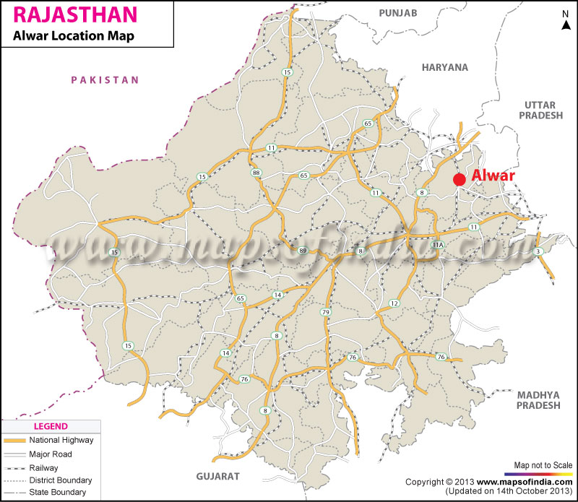

Slide 40
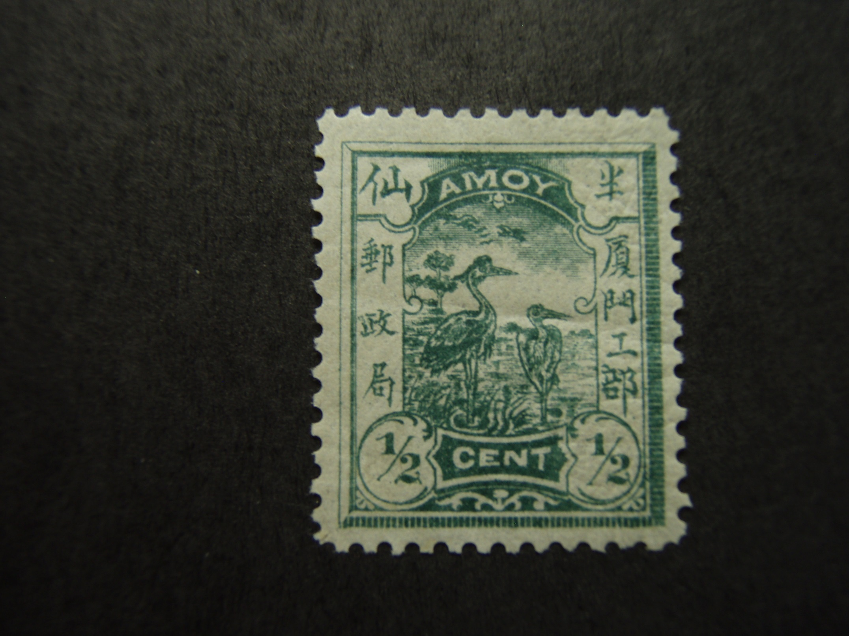
Amoy LA-1 (1895)

Slide 41
Amoy
Southeast coast of China, Fujian Province. Former home of egrets. Known as Xiamen and The Egret Island.
The island is joined to the P.R. China by two causeways.
A United Kingdom treaty port from 1842-1912.
The British established the first treaty ports in China at the
Conclusion of the First Opium War by the Treaty of Nanking in
1842.
(Treaty Ports = name given to port cities that were opened to
Foreign trade with the Western Powers)

Slide 42
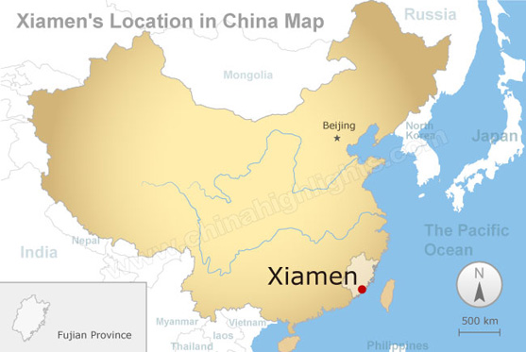

Slide 43
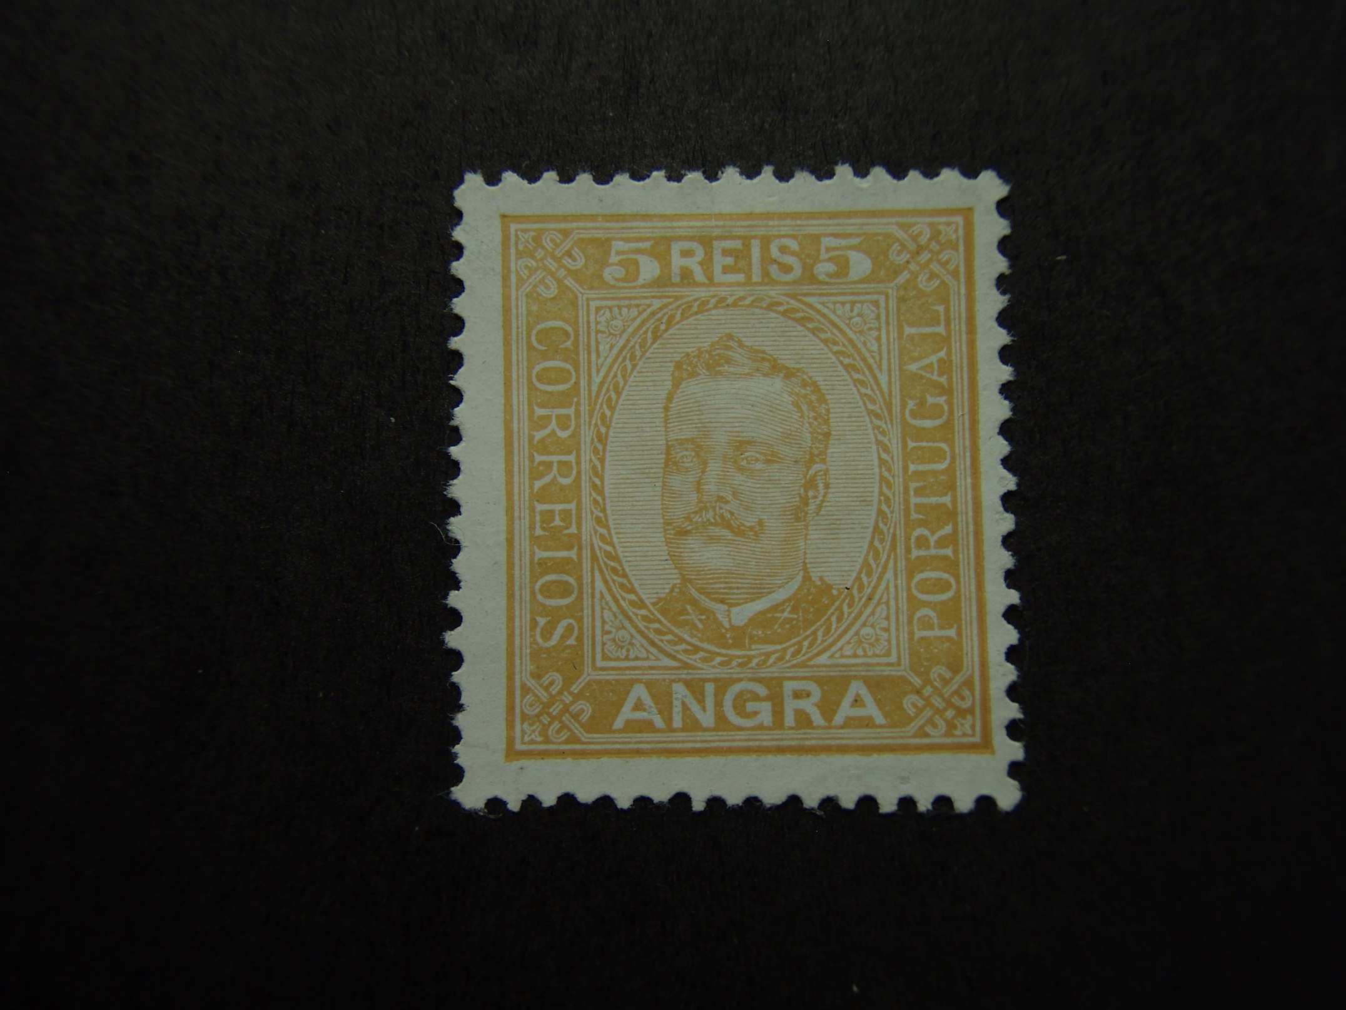
Angra 1 (1892)

Slide 44
Angra
A district of Portugal and an administrative
district of the Azores, consisting of the
islands of Terceira, Sao Jorge and Graciosa.

Slide 45
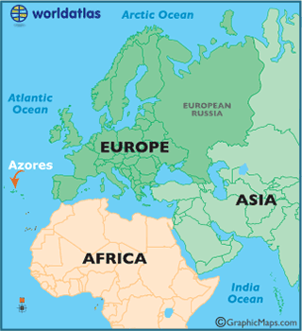

Slide 46
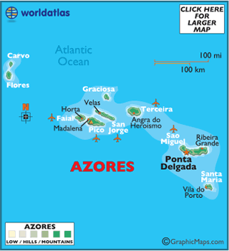

Slide 47
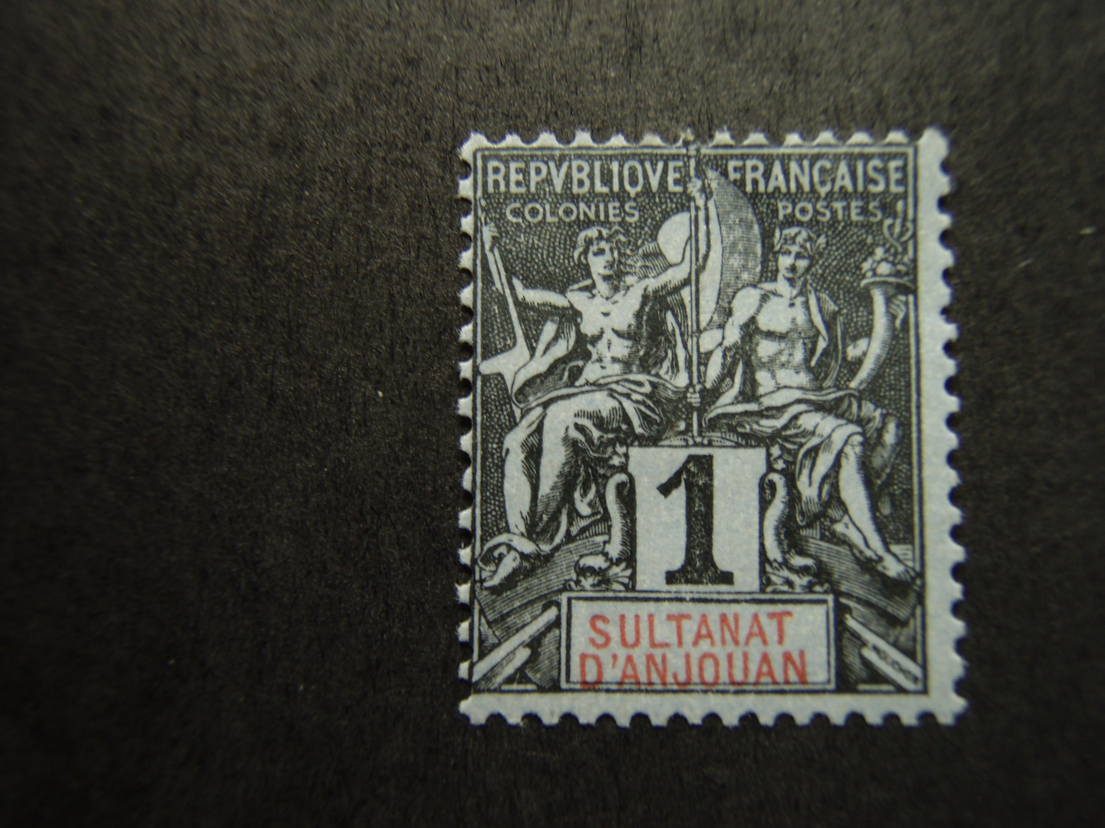
Anjouan 1 (1892)

Slide 48
Anjouan
A French colony
One of the Comoro Islands in the Mozambique Channel between Madagascar and Mozambique

Slide 49
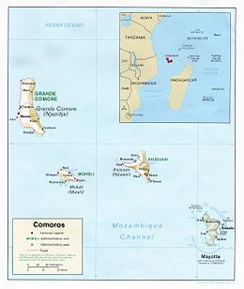

Slide 50
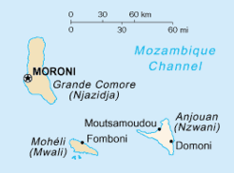

Slide 51
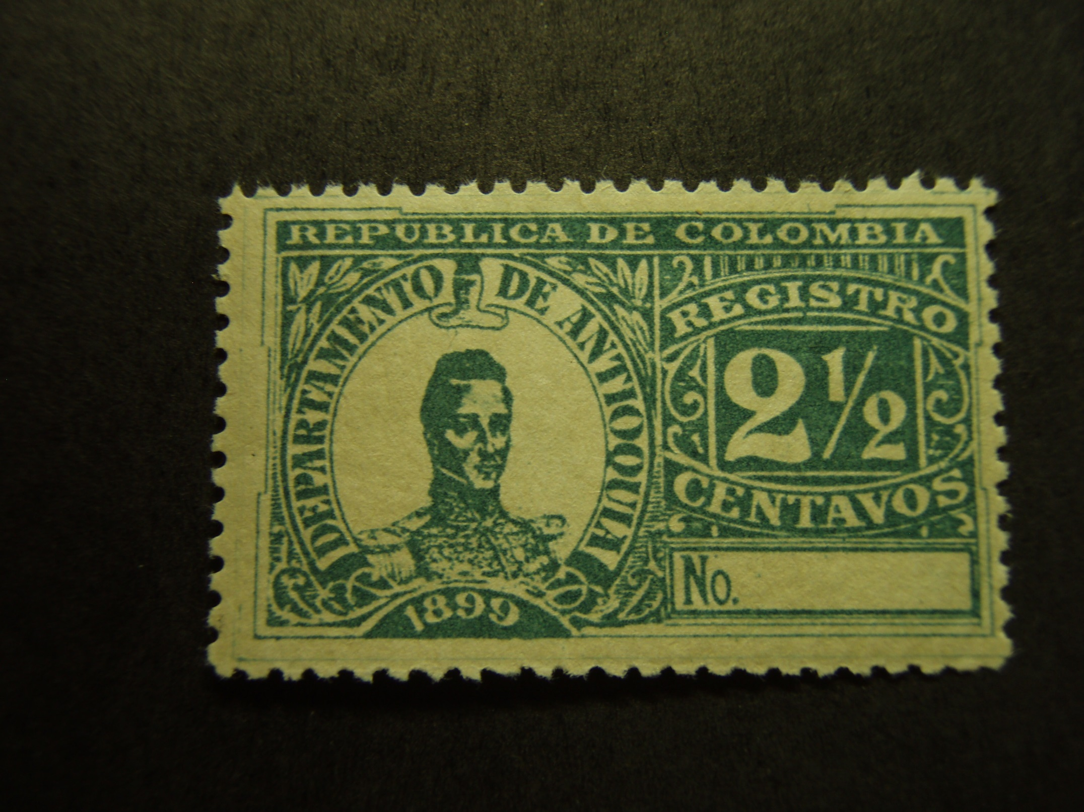
Antioquia F3 (1899)

Slide 52
Antioquia
Originally a State, now a Department of the Republic of Colombia.
Until the revolution of 1885, the separate states making up the
United States of Columbia were sovereign governments in their
own right. On 4 August 1886, the National Council of Bogota
adopted a new constitution which abolished the sovereign rights
of states, which then became departments with governors
appointed by the President of the Republic. The nine original
states represented at the Bogota Convention retained some of
their previous rights, as management of their own finances, and
all issued postage stamps until as late as 1904.

Slide 53
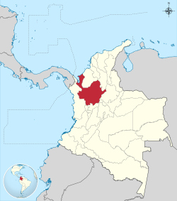

Slide 54
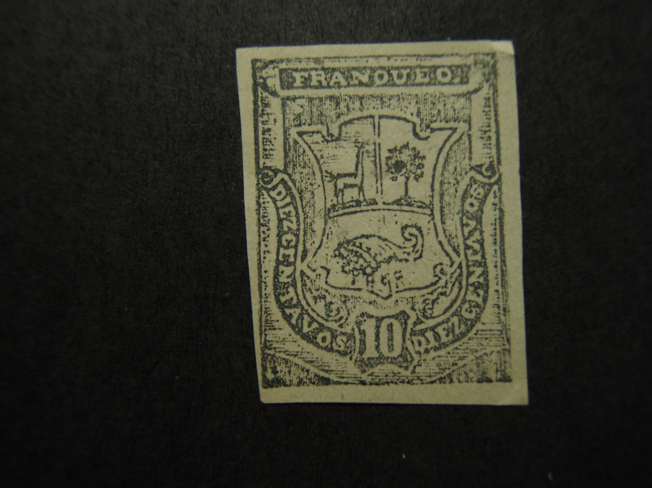
Arequipa 3N23a (1884)

Slide 55
Arequipa
During the Chilean-Peruvian War which took place in 1879 to
1882, the Chilean forces occupied the two largest cities in Peru,
Lima & Callao. As these cities were the source of supply of
postage stamps, Peruvians in other sections of the country were
left without stamps and were forced to the expedient of making
provisional issues from whatever material was at hand. Many of
these were former canceling devices made over for this purpose.

Slide 56
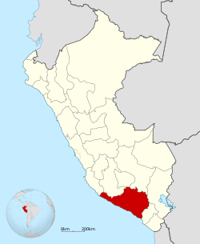

Slide 57
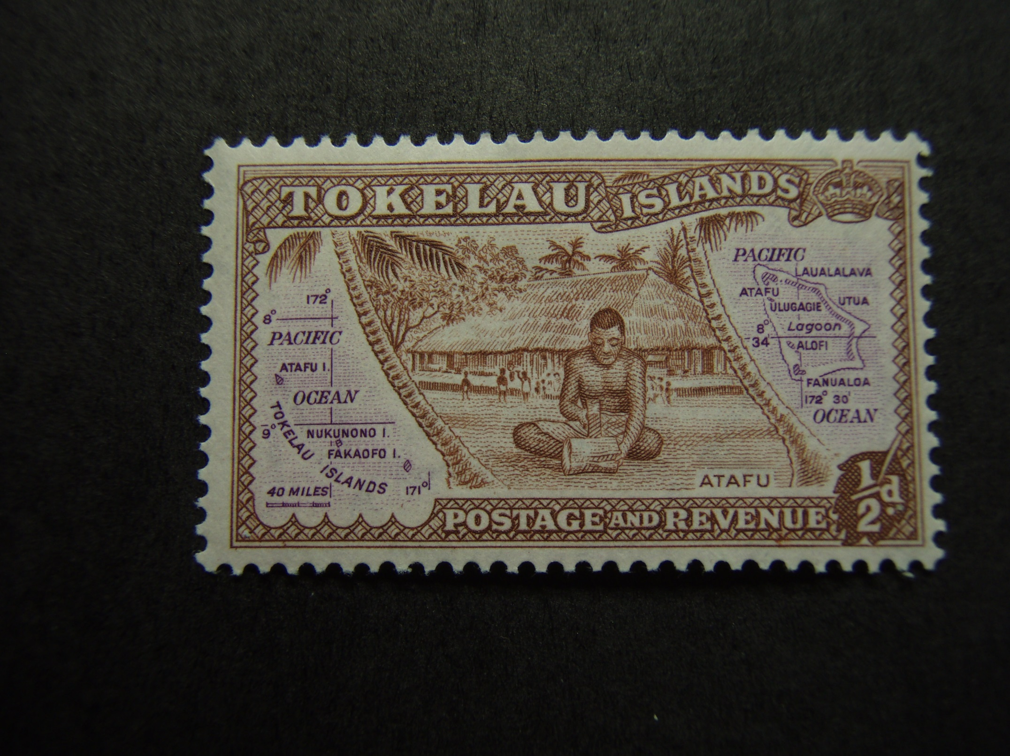
Atafu Island
Tokelau 1 (1948)

Slide 59
Bahawalpur 2 (1948-Apr.)

Slide 60
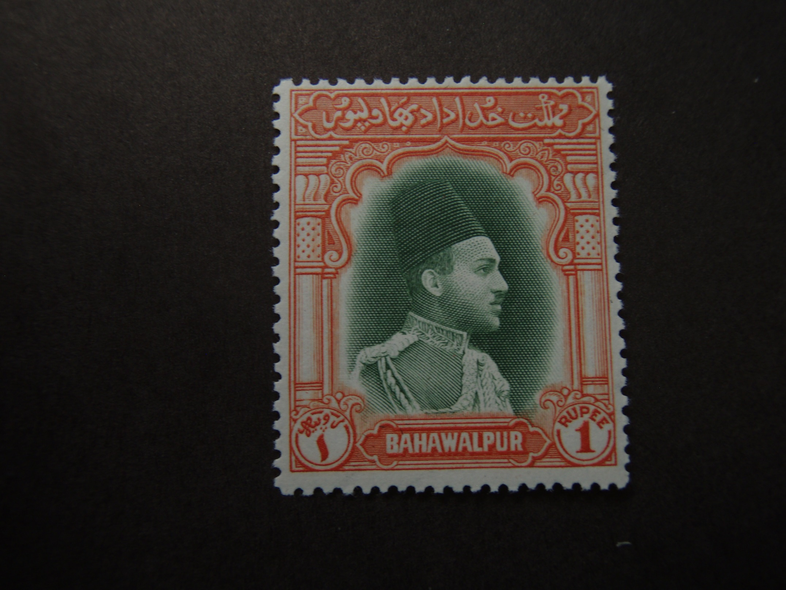
Bahawalpur 18 (1948-Oct.)

Slide 61
Bahawalpur
Frontal & Side portraits of ruler Nawab Sadiq Muhammad Khan V Abbasi.
Bahawalpur was a State of India until 1947.
These stamps had franking power solely within Bahawalpur.

Slide 62
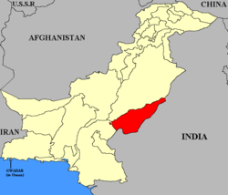

Slide 63
Bamra 7 (1890)

Slide 64
Bamra
A Feudatory State in the Eastern States.
Orissa States Agency, Bengal

Slide 65
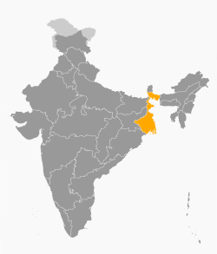

Slide 66
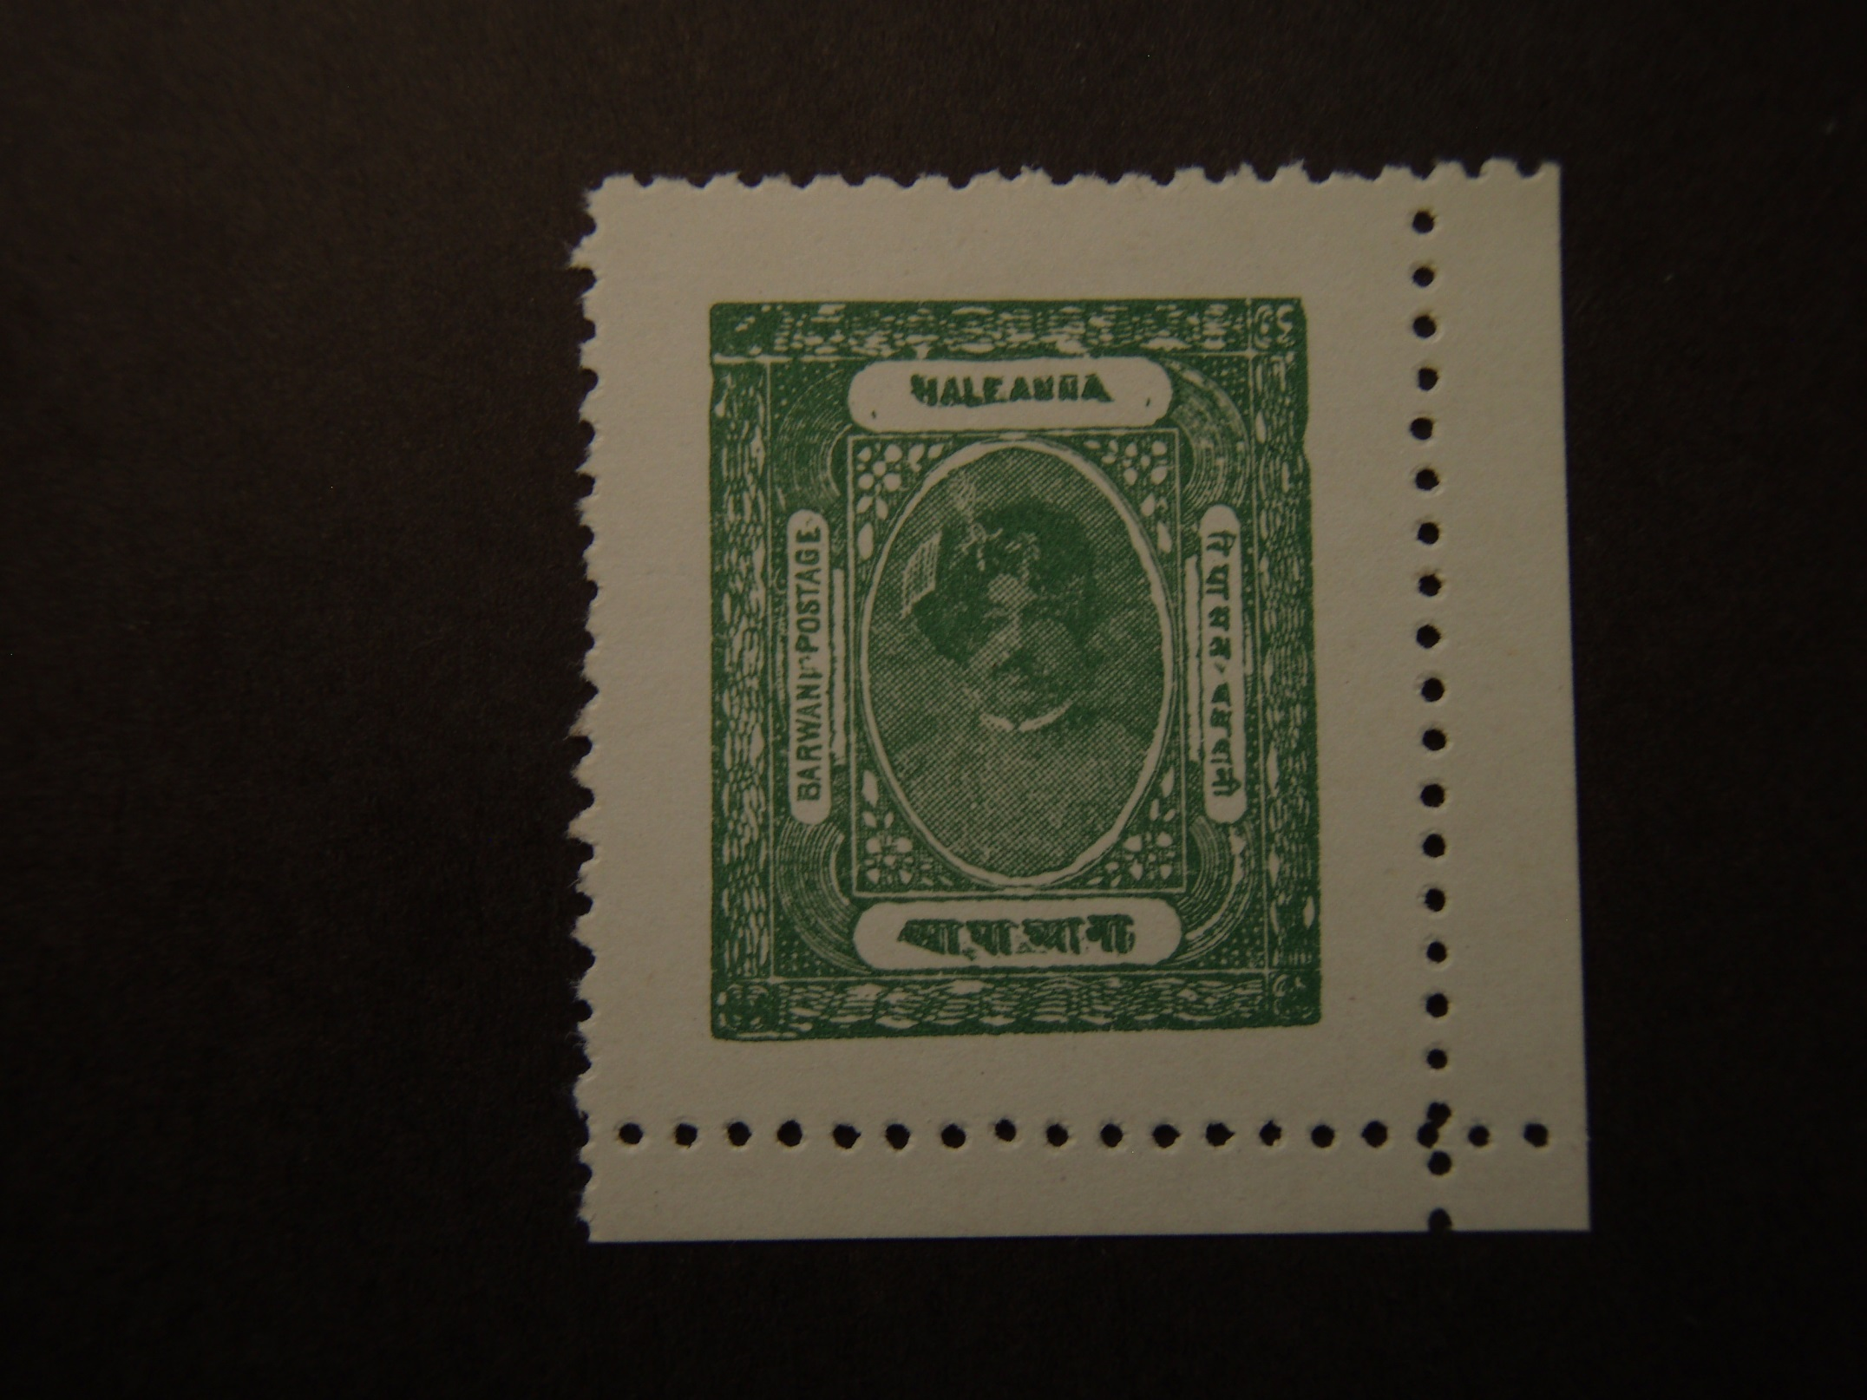
Barwani 23 (1929)

Slide 67
Barwani
A Feudatory State of Central India, in the Malwa Agency.

Slide 68
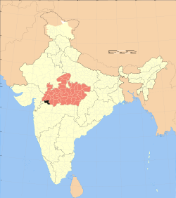

Slide 69
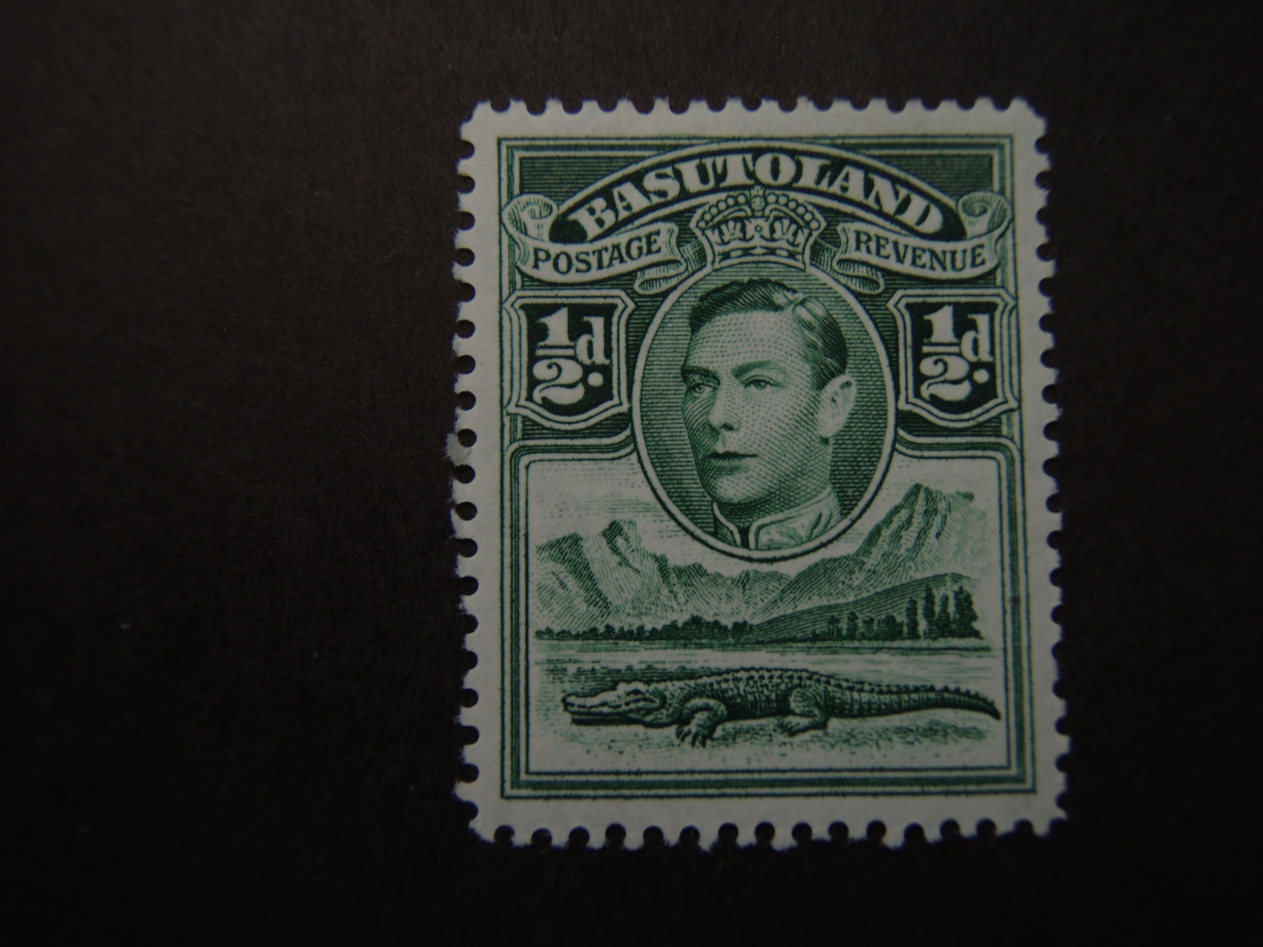
Basutoland 18 (1938)

Slide 70
Basutoland
A British Crown Colony enclave in the state of South Africa.
The Colony, a former independent native state, was annexed
to the Cape Colony in 1871. In 1883 control was transferred
to the British Crown. Stamps of the Cape of Good Hope were
used from 1871 to 1910 and those of the Union of South
Africa from 1910 to 1933.
Basutoland became the independent state of Lesotho on
Oct. 4, 1966.

Slide 71
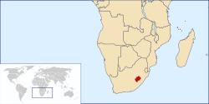

Slide 72
Batum 6 (1919)

Slide 73
Batum
A seaport on the Black Sea.
Batum is the capital of Adzhar, a territory which, in 1921, became an autonomous republic of the Georgian Soviet Socialist Republic.
Stamps of Batum were issued under the administration of British forces which occupied Batum and environs between December 1918, and July 1920, following the Treaty of Versailles.

Slide 74
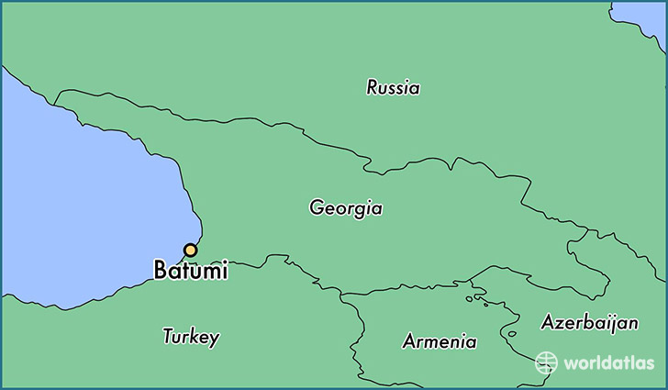

Slide 75
Benadir 11 (1906)

Slide 76
Benadir
(Italian Somaliland)
(Somali Democratic Republic)
Located in Eastern Africa, bordering on the Indian Ocean and
the Gulf of Aden. The former Italian colony which included the
territory west of the Juba River became known as Oltre Giuba
(Trans-Juba), was absorbed into Italian East Africa in 1936.
Somalia stamps continued in use in Italian East Africa for several
years. It was under British military administration from 1941-49.
Italian trusteeship took effect in 1950 with United Nations help.
On 1 July 1960, the former Italian colony merged with British
Somaliland Protectorate to form the independent Republic of
Somalia.

Slide 77
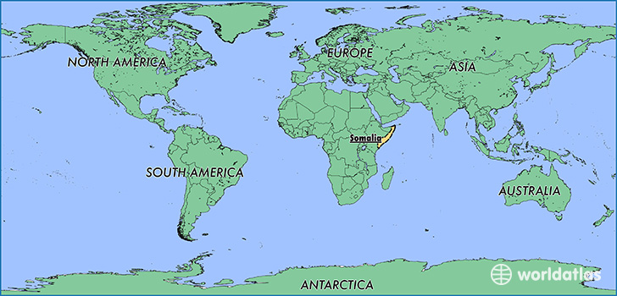

Slide 78
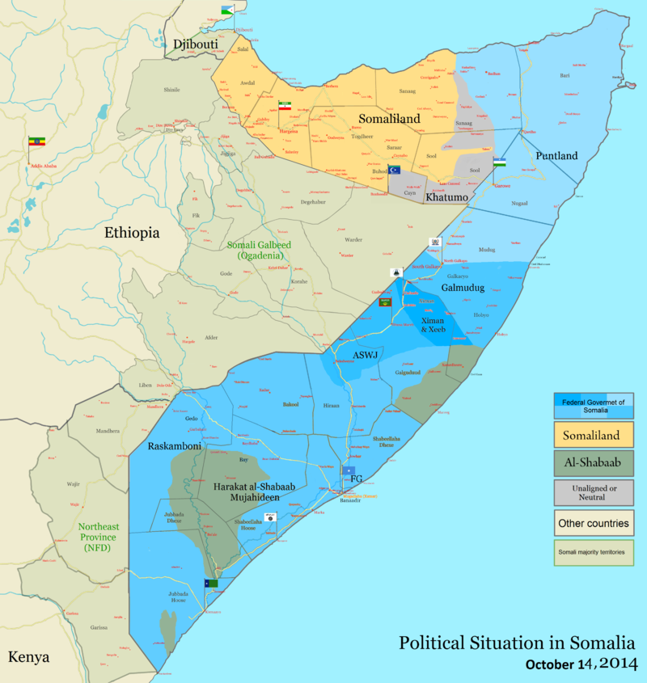

Slide 79
Bergedorf 3 (1861)

Slide 80
Bergedorf
A town in northern Germany.
Originally, Bergedorf belonged jointly to the Free City of Hamburg and the Free City of Lubeck.
In 1867, it was purchased by Hamburg.

Slide 81
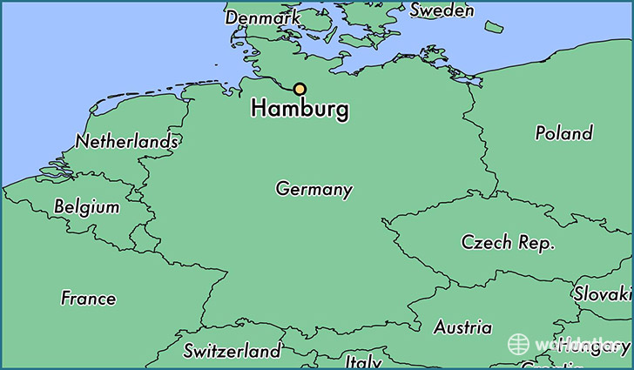

Slide 82
Bhopal O46 (1944)

Slide 83
Bhopal
A Feudatory State of Central India.

Slide 84
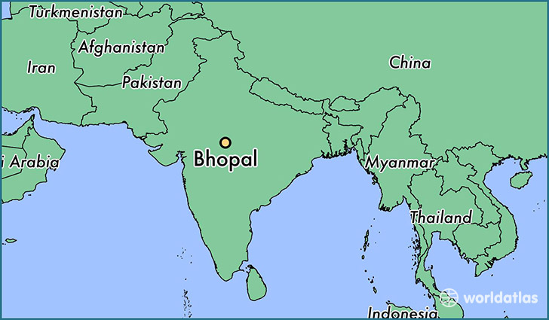

Slide 85
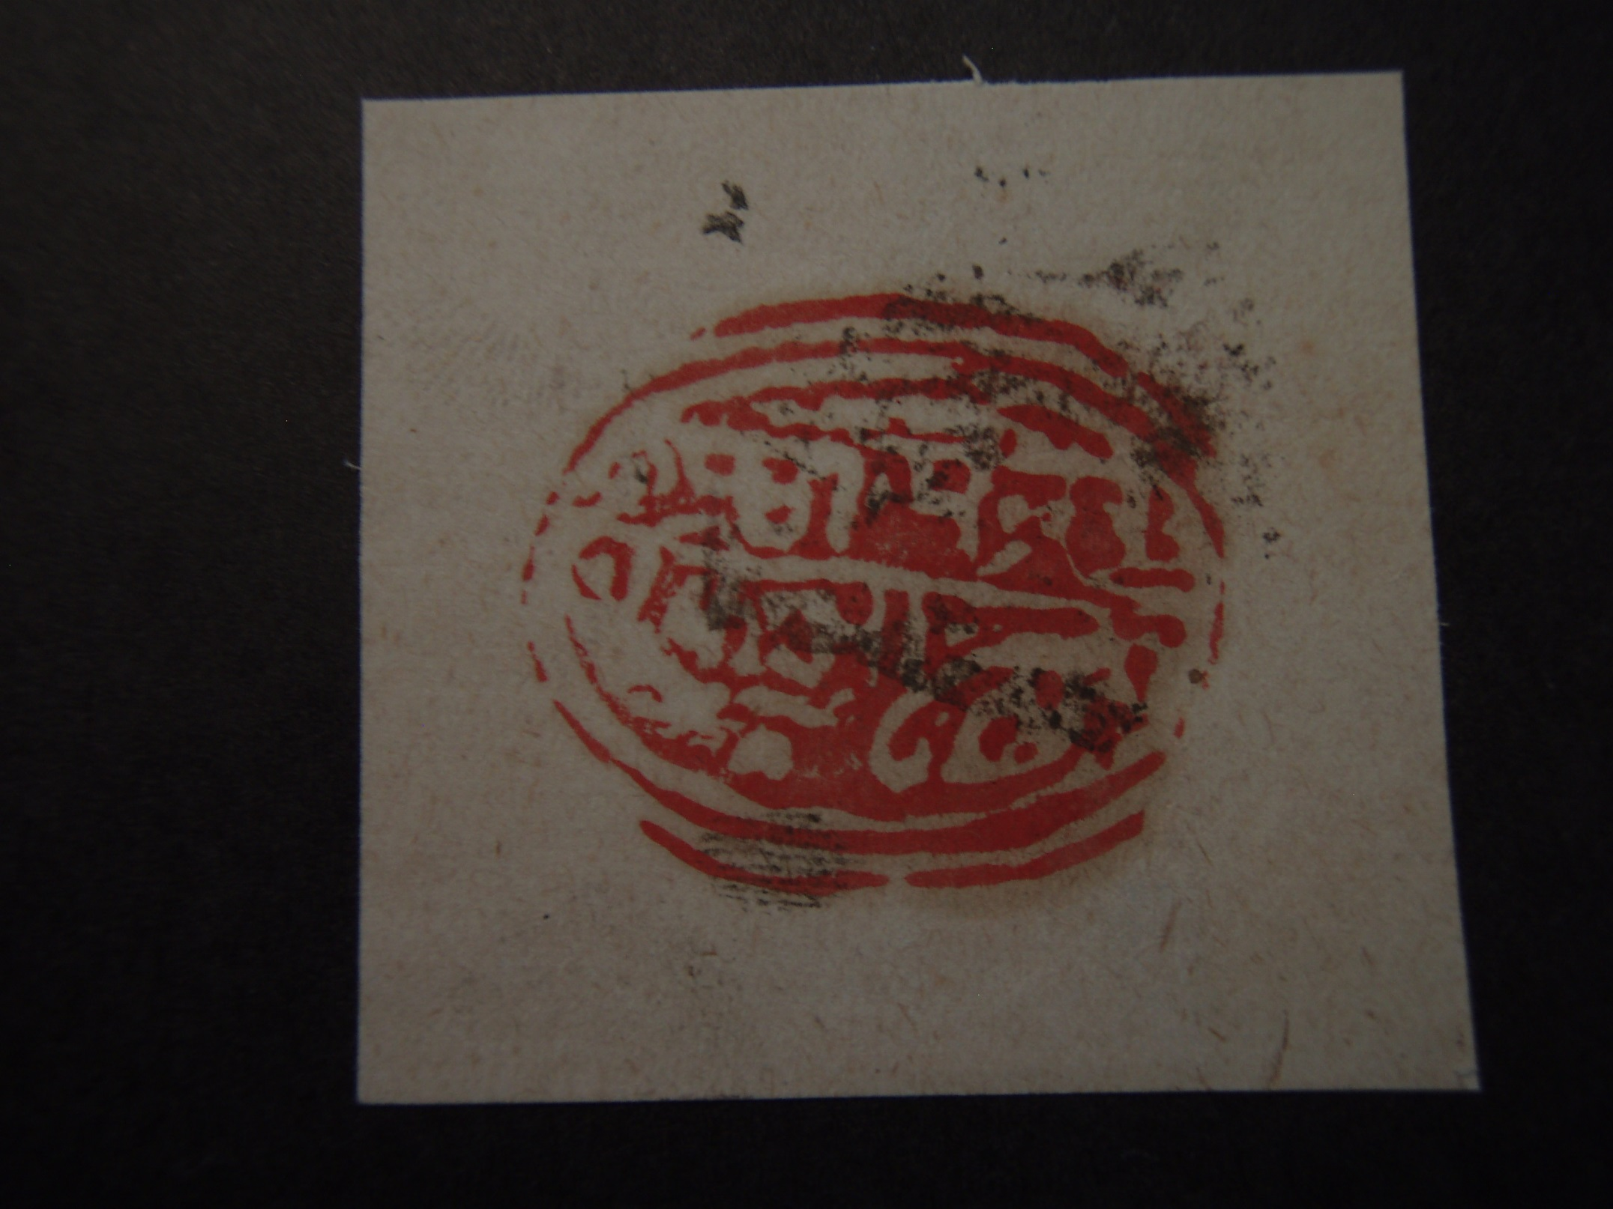
Bhor 1 (1879)

Slide 86
Bhor
A Feudatory State in the Deccan States Agency. Located in the Southern Division of Bombay (current name = Mumbai) on the northwestern coast of India.

Slide 87
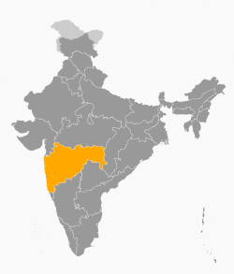

Slide 88
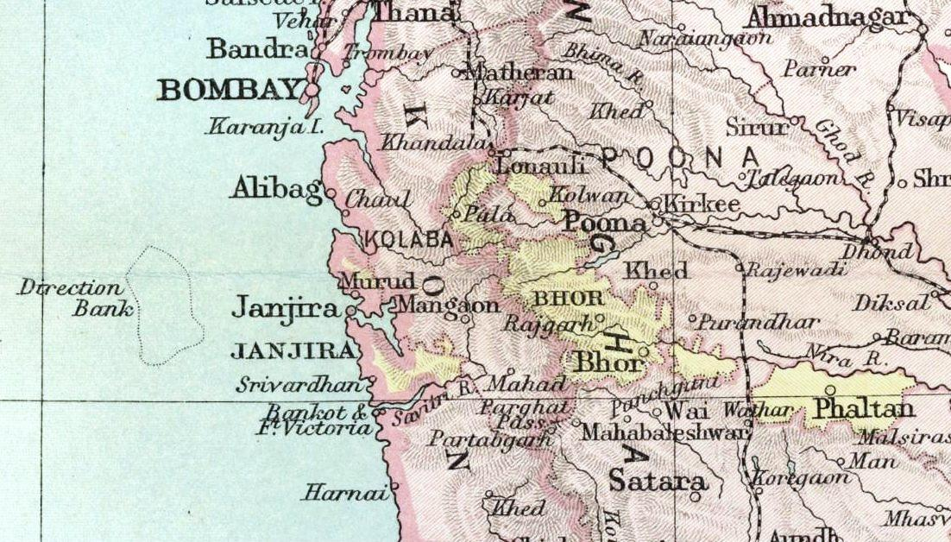

Slide 89
Bogota LX1 (1889)

Slide 90
Bogota
The image is a local stamp for interior postage
within the city of Bogota, Colombia.

Slide 91
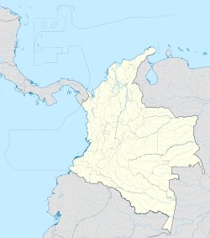

Slide 92
Bolivar
2 (1866)
3 (1863)

Slide 93
Bolivar
Originally a State, now a Department of the Republic of Colombia.

Slide 95
Bosnia and Herzegovina 11 (1900)

Slide 96
Bosnia
and
Herzegovina
Provinces of Turkey under Austro-Hungarian occupation,
1879-1908. Provinces of Austria-Hungary, 1908-1918.
Following World War I, Bosnia and Herzegovina united
with the kingdoms of Montenegro and Serbia, plus
Croatia, Dalmatia and Slovenia, to form the Kingdom of
Yugoslavia.

Slide 99
Boyaca Forbin 1 (1902)

Slide 100
Boyaca
Originally a state, now a Department of the Republic of Colombia.

Slide 102
Buenos Aires 10 (1859)

Slide 103
Buenos Aires
At intervals, Buenos Aires maintained an independent
government as the central point of the Argentine
struggle for independence.
After 1862, Buenos Aires became a province of the
Argentine Republic.

Slide 105
The End
(of A & B countries)

