Slide 1

Fancy Cancels
and
Other Things
I Collect

Slide 2
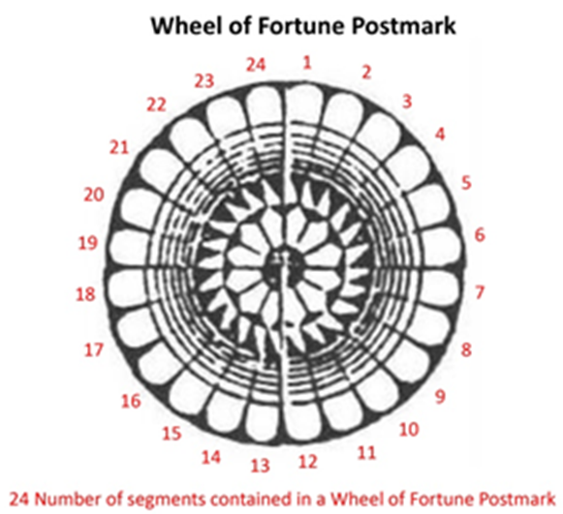
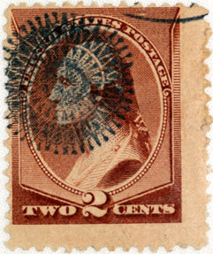
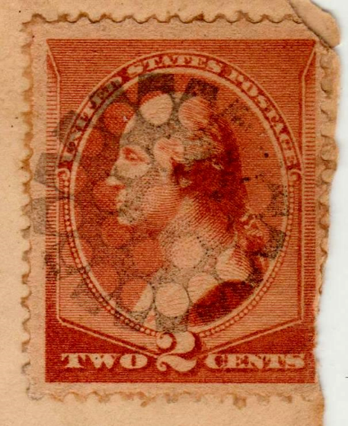


Wheel of Fortune Book
Mistaken Postmarks

Slide 3
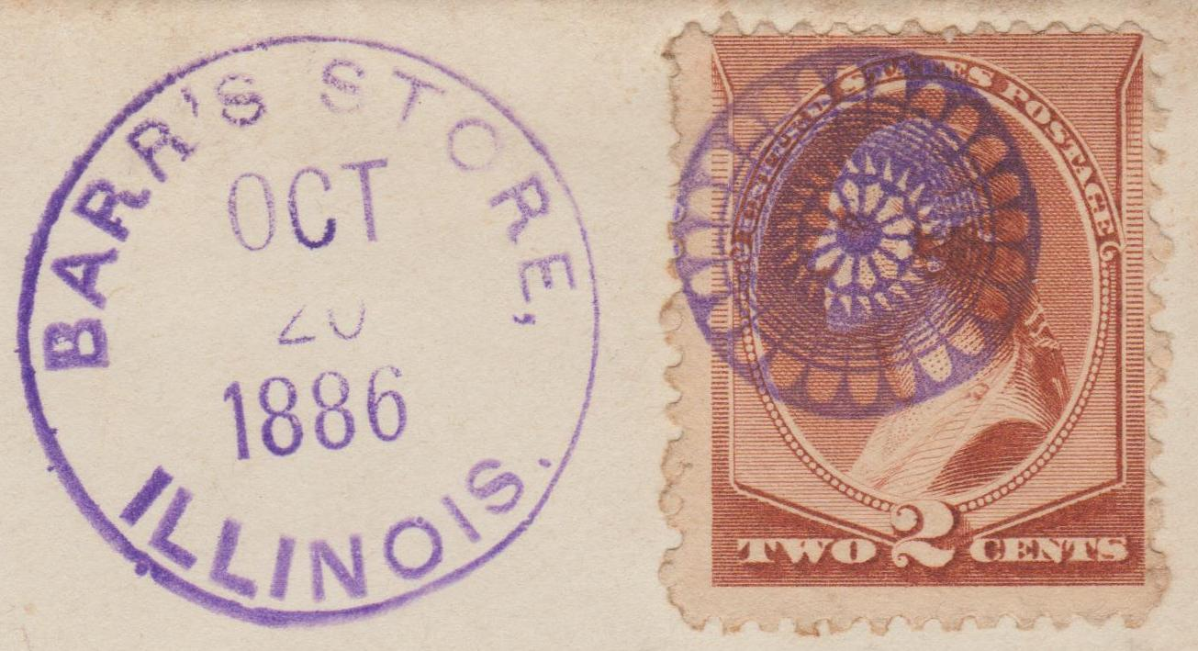
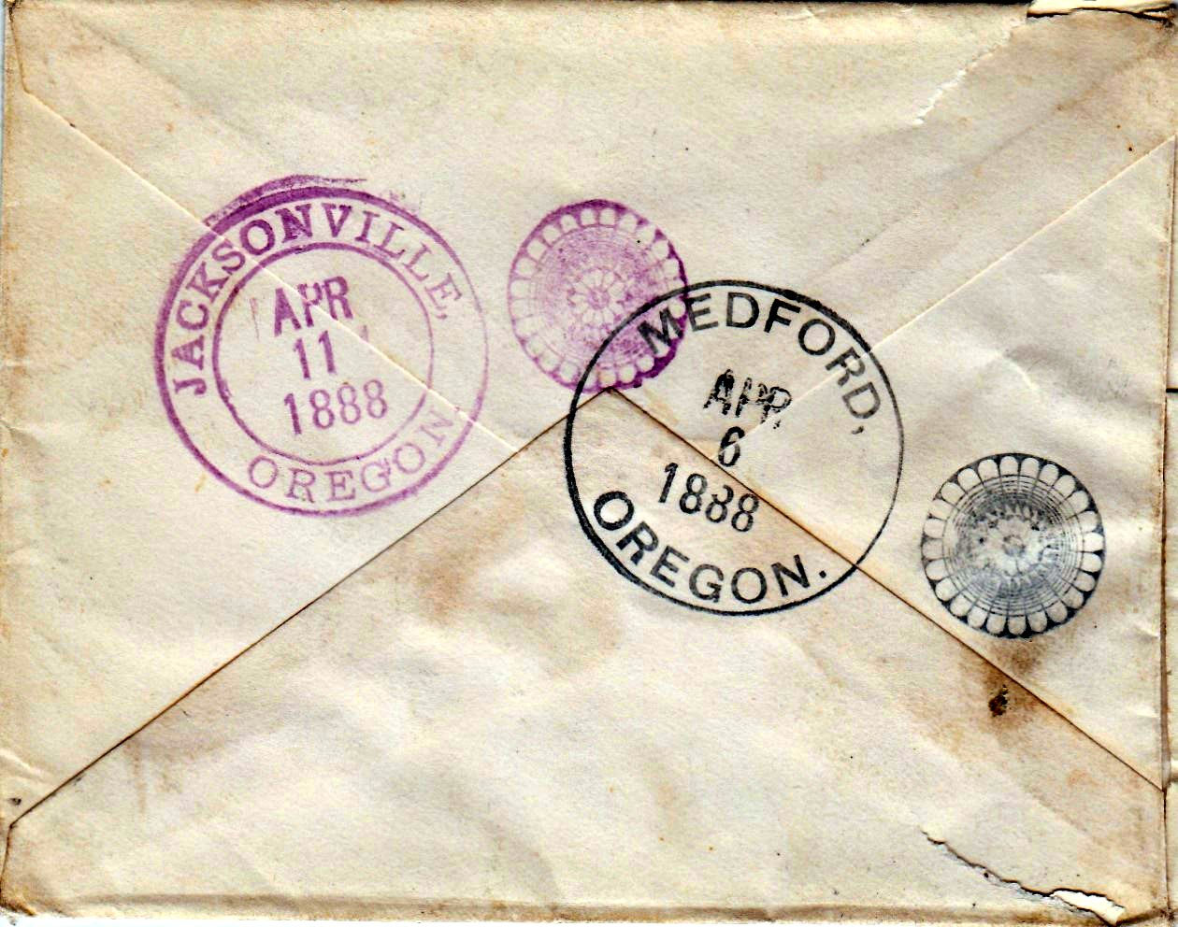
Best struck
Wheel of
Fortune postmark
Only Multi
WOF Postmark
cover

Slide 4
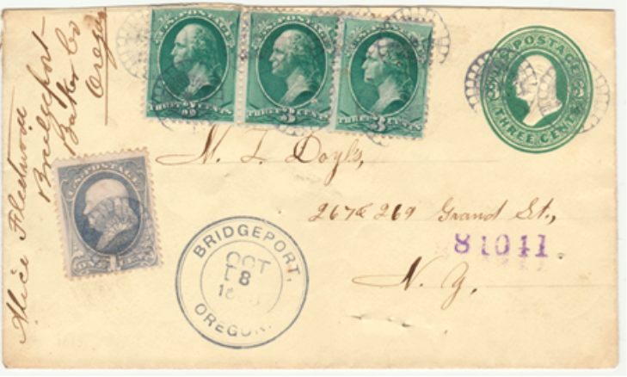
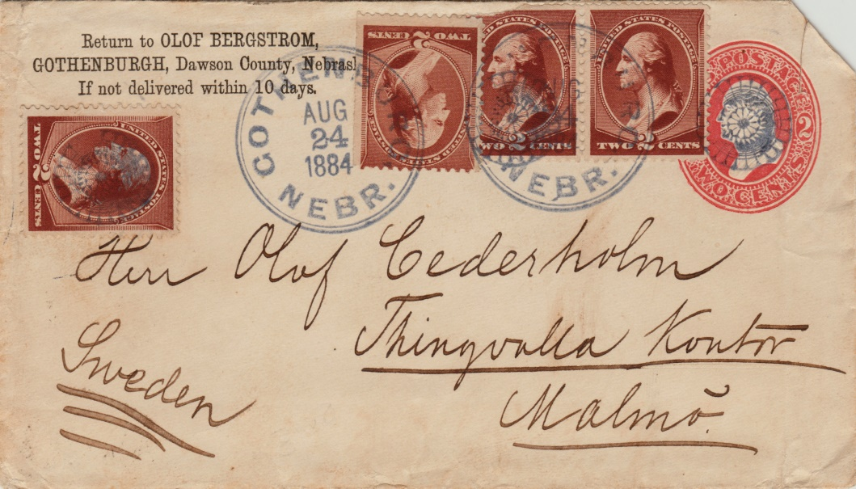
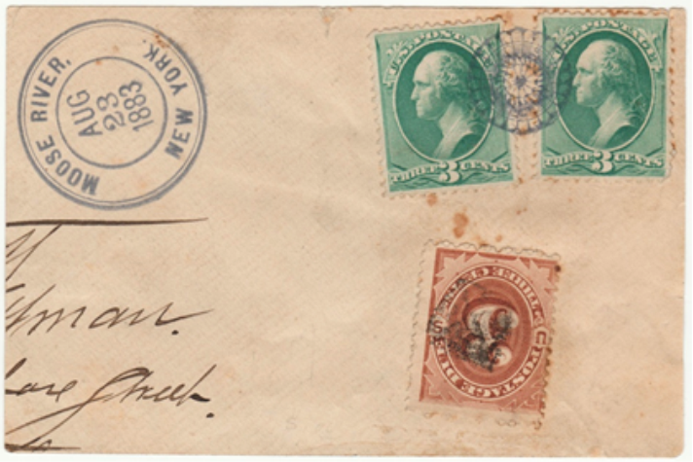
10
Wheel of Fortune
Postmarks
Olof Bergstrom
Founded 1882
Gothenburgh, NE
3 cent
Postage Due WOF
Moose River, NY
Aug 23, 1883

Slide 5
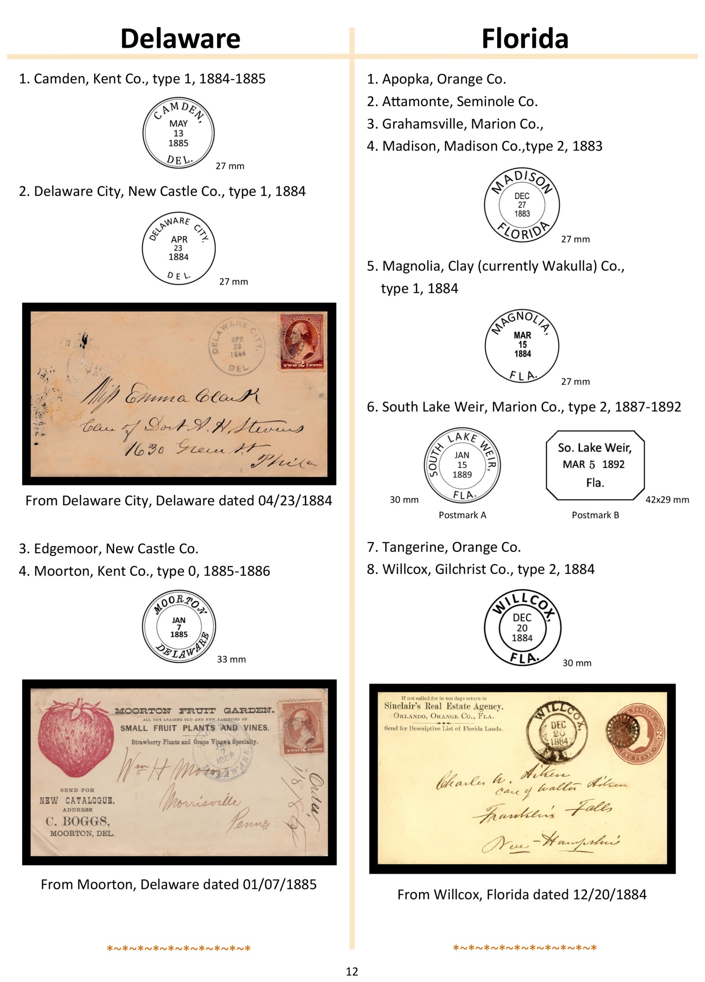

Slide 6









Created Postmarks

Slide 7










Slide 8
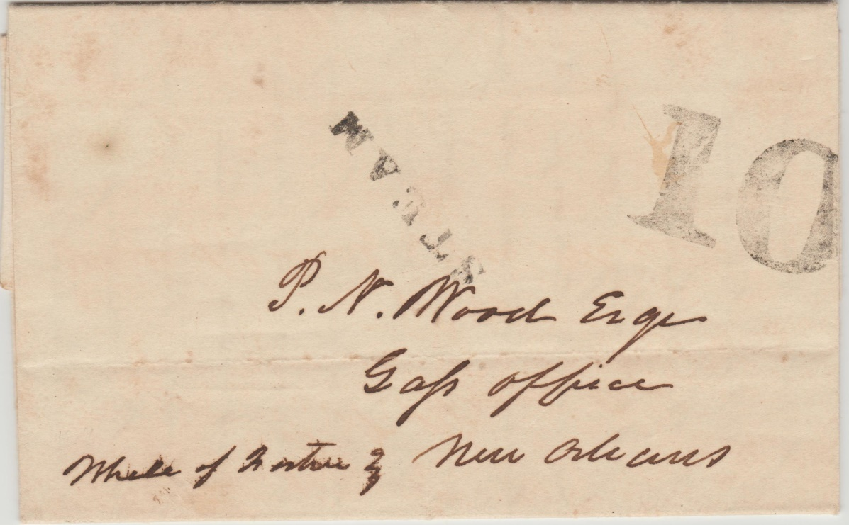
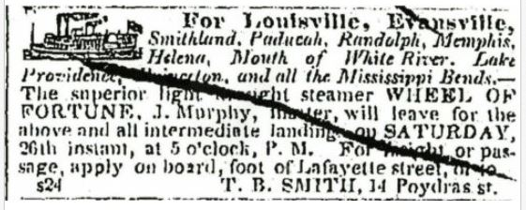
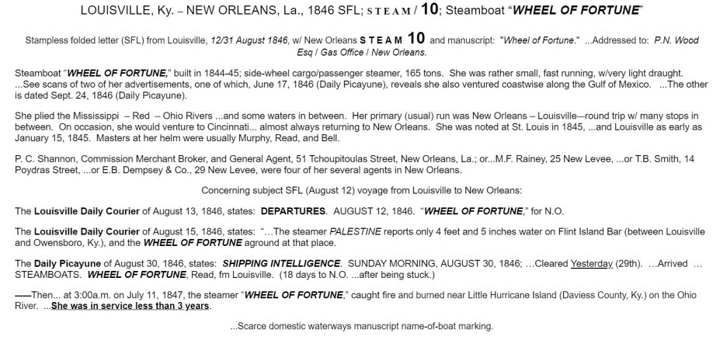
Wheel of Fortune
Steam Boat 1845-47
Side Wheel steamer Dated August 12, 1846
Newspaper ad
Sept. 24, 1846
July 11, 1847
Burned
on Ohio river

Slide 9












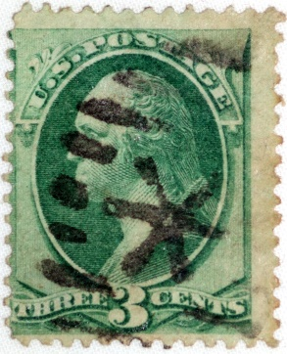



Star Ellipse 41 types 117 towns
15 from New York

Slide 10


Local Ellipse Star
Brighton, NY Oct 20, 1887
Clifton Springs, NY Mar 14, 1884

Slide 11
Pan American
Ithaca, MI Jul 25, 1901
Ashland, OR Mar 13, 1910

Slide 12
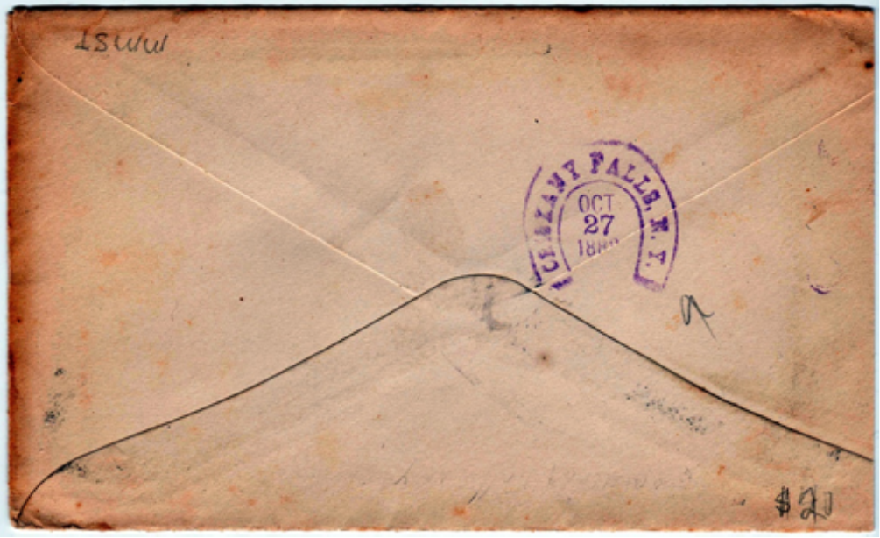

New York, NY May 15, 1938
National Air Mail Week C23
Orinsky Falls, NY Oct 27, 1888

Slide 13
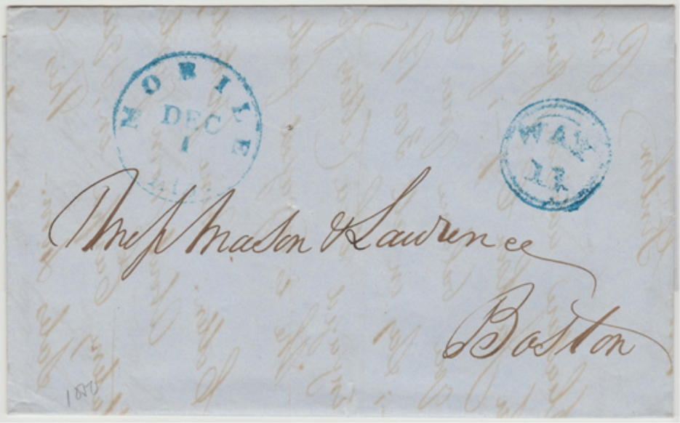
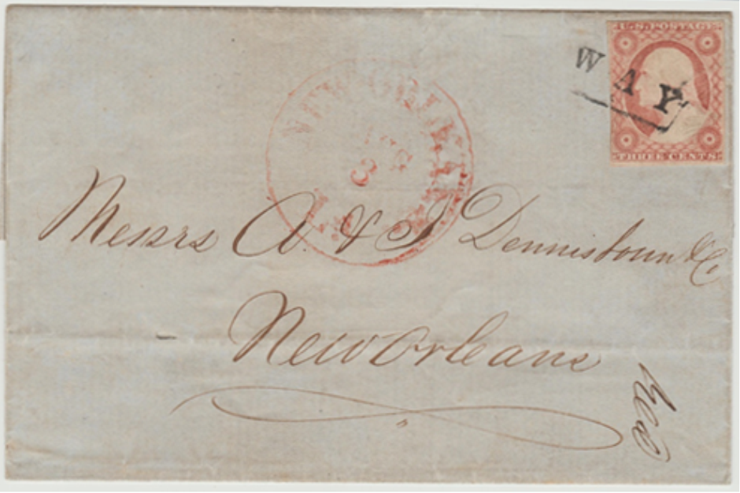
Way Covers
Mobile, AL Dec. 1, 1850
New Orleans, LA Aug. 3, 1852

Slide 14
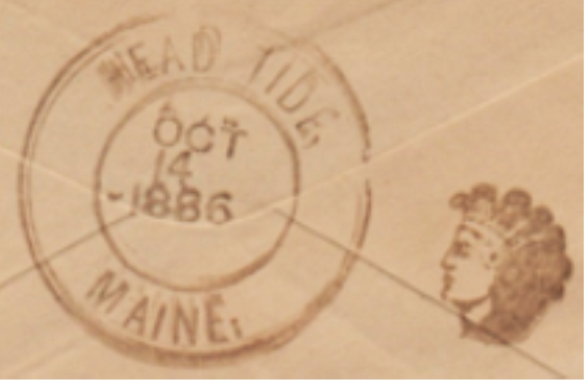
Rome, NY
Jul 9, 1846
Chicago, IL
Jun 23, --
Head Tide, ME
Oct 14, 1886

Slide 15
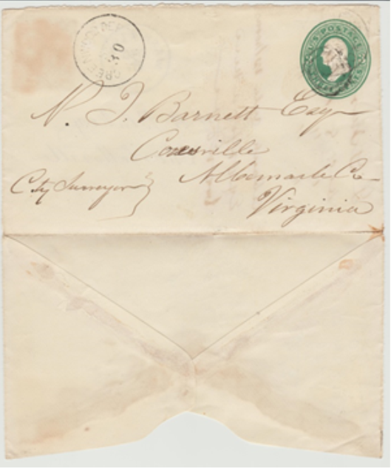
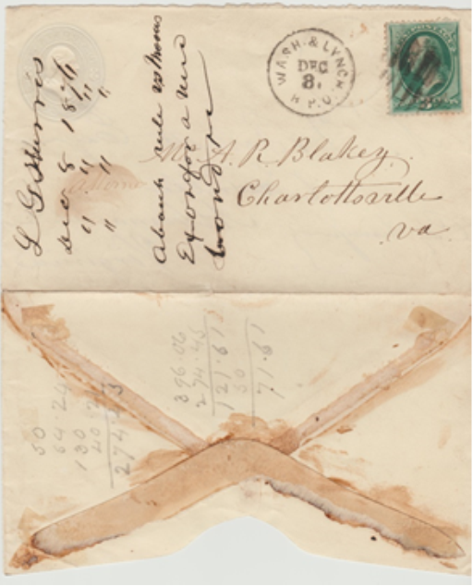
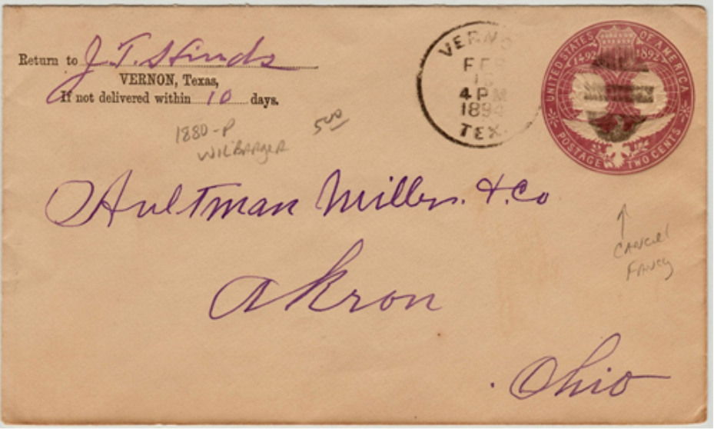
Turned Cover
Sept. 30, 1876
Dec. 8, 1876
Vernon, TX Feb 13, 1894

Slide 16
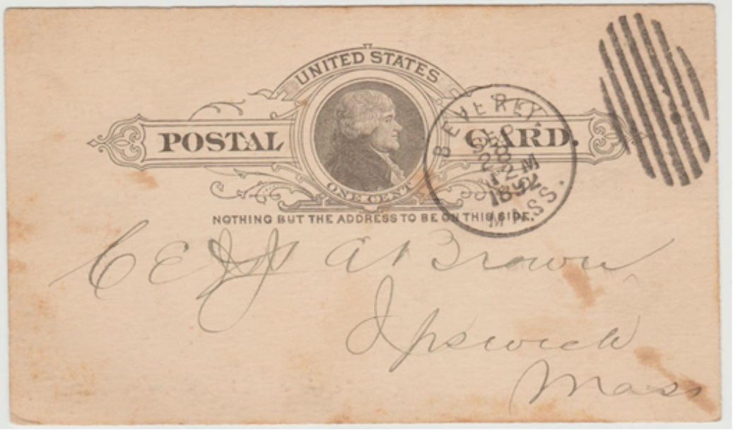
Council Bluffs, IA
Aug 26, 1888
Beverly, MA
Sep 28, 1892
Sudbrook
Park, MD
Mar 31, 1897

Slide 17
Sioux Falls,
Dakota
Sep 19, 1882
Washington, DC
Jan 21, 1881
South
Vineland, NJ
Nov 16, 1886

Slide 18
Baltimore MD
Mar 3, 1884
Coeymans, NY
Nov 19, 1891
Genoa, NY
Nov 18, 1885

Slide 19
Patent
Cancellation
Providence, RI
Feb 28, --
Westerly, RI
Dec 3, 1898
Ogontz
School, PA
May 22, 1889

Slide 20
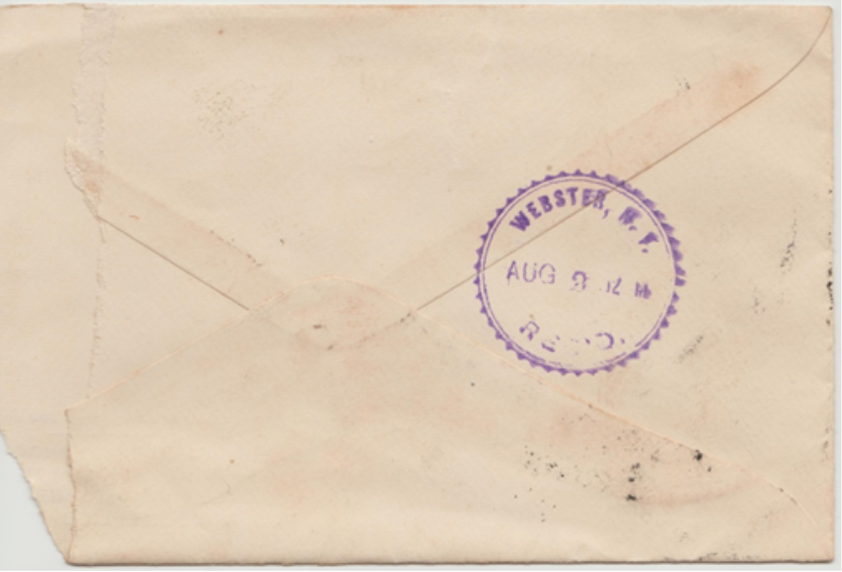
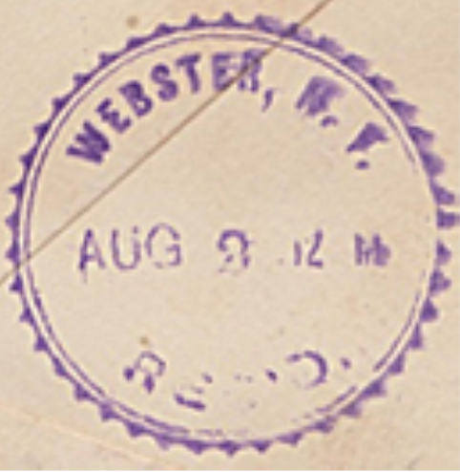
East Side RPO Rochester, NY Feb 3, 1898
Received Postmark
Webster, NY Aug 3, 1895

Slide 21
Perry, NY Jul 30, --
Mendon Centre, NY Mar 28, 1891

Slide 22
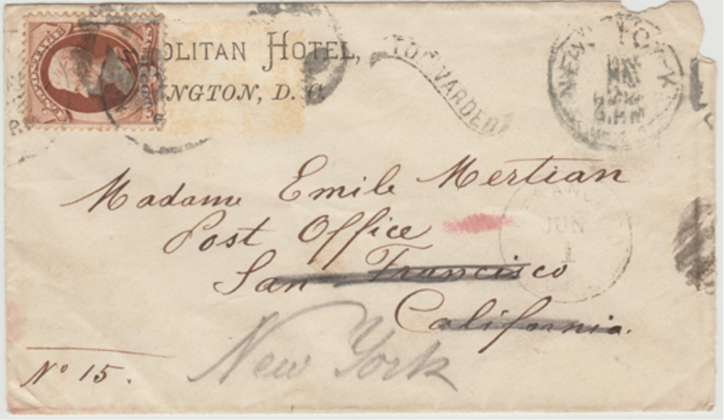
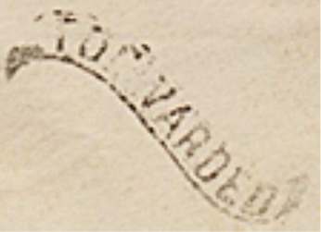
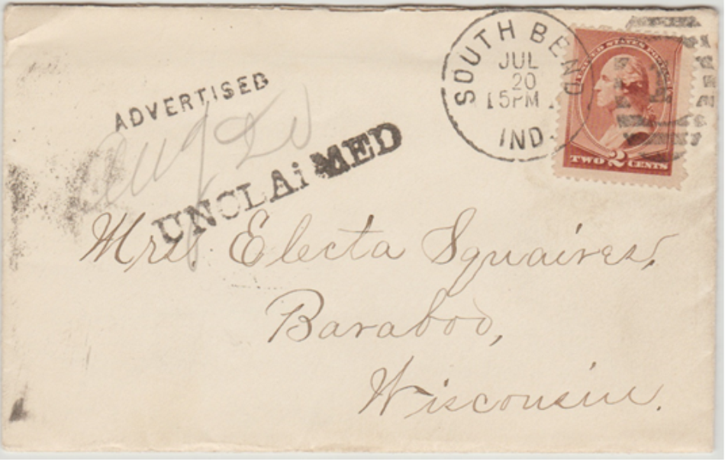
Forwarded
San Francisco, CA Jun 1, --
Advertised Unclaimed
South Bend, IN Jul 20, --

Slide 23
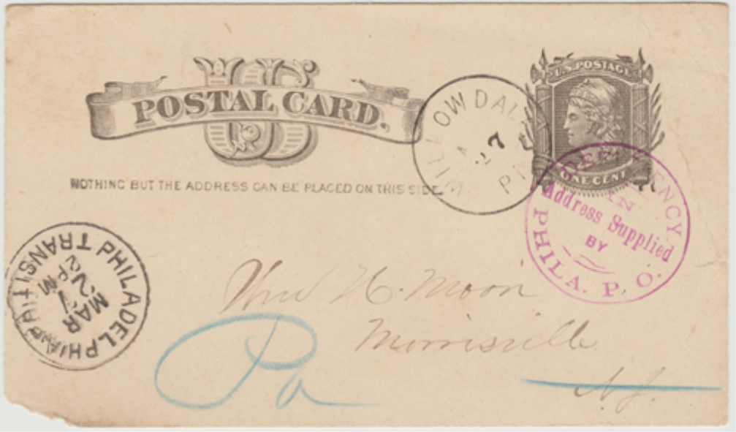
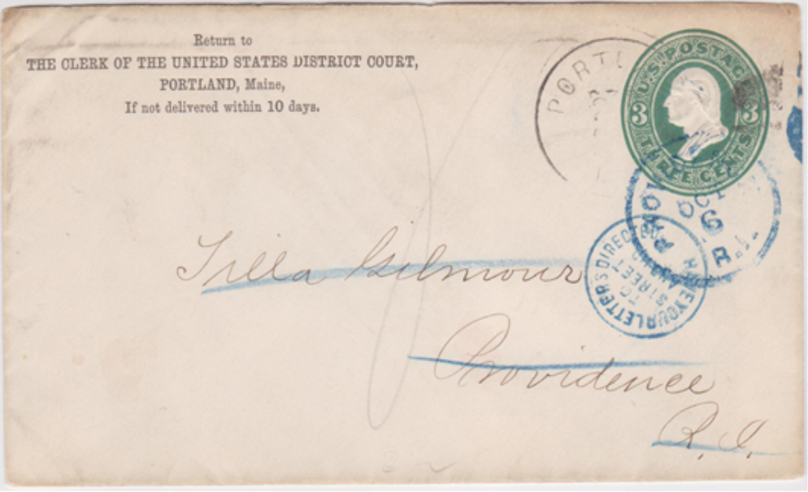

DEFICIENCY in Address Supplied by PHILA. P. O.
Philadelphia, PA Mar 27, 1885
HAVE YOUR LETTER DIRECTED TO STREET ADDRESS
Portland ME Oct 6, --

Slide 24
Savings bond stamp used illegally
Jan 16, 1943
Documentary stamp with illegal use caught
July 12, 1901

Slide 25
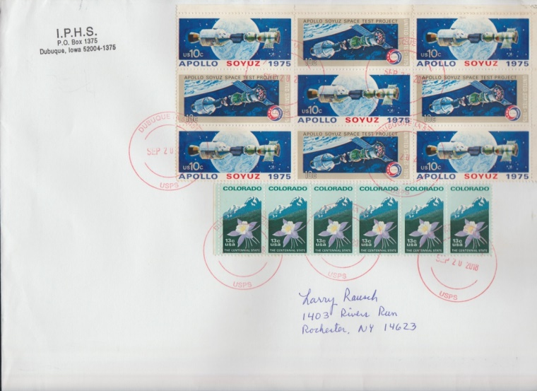

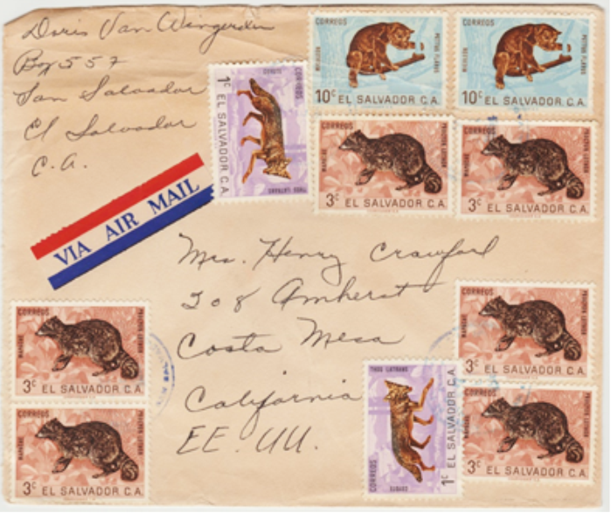
Multiple stamp
covers
Sept 20, 2018
Cote D’Ivoire
March 3, 1969
El Salvador
September 7, 1964

Slide 26
Thank You
For
Watching!

