Slide 1
An Exhibit Primer
A Presentation for the
Rochester Philatelic Association
January, 2014
By Tom Fortunato

Slide 2
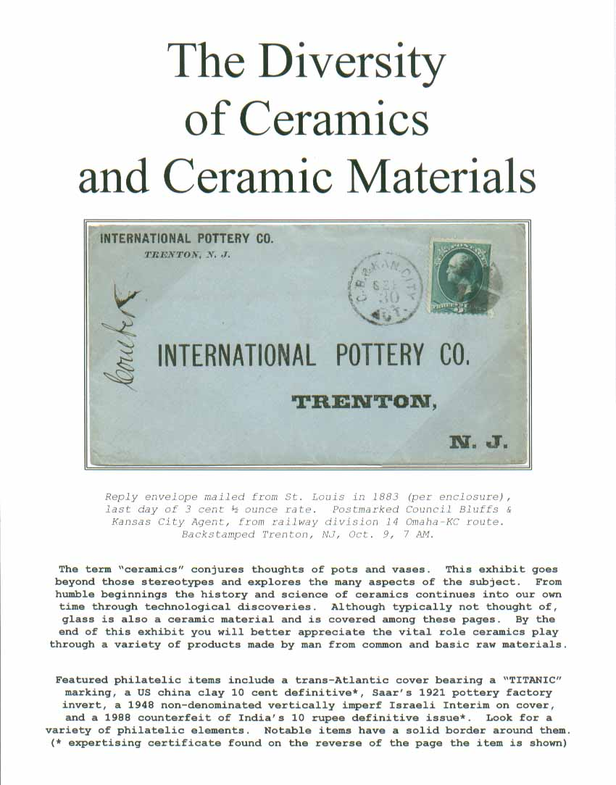
To first timers, exhibiting may seem like a nearly impossible task. But if you break it down into simple steps it’s a fairly easy process.

Slide 3
Once you’ve decided to take the plunge, you have a few decisions to make.
What will kind of material will you be displaying?
How much material do you have?
How many pages do you plan to put together?

Slide 4
Start simple with a One Page exhibit…
Get an 8 ½ by 11 inch piece of paper, preferably white, placing it vertically (rather than horizontally).
Select your philatelic material, whether it be stamps, a cover, or combination of both.
Arrange the items in a pleasing, symmetrical way. Try to place larger items towards the bottom whenever possible.
Leave room for your brief and concise text that can be hand printed or computer generated.

Slide 5
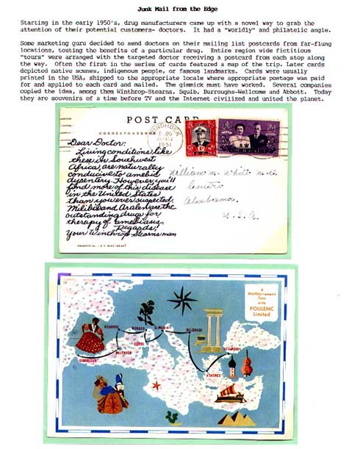
Here are a few examples…

Slide 6
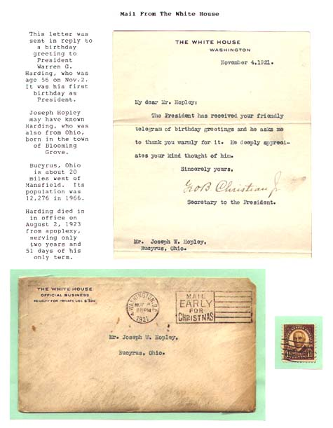

Slide 7
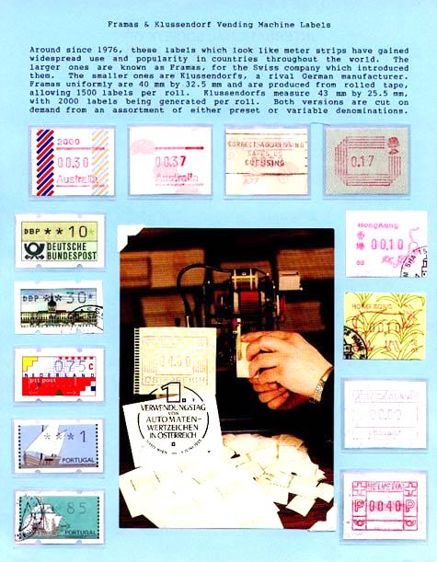

Slide 8
Once you’ve graduated with your first one page exhibit, it’s time to think about putting together one frame or multi-frame exhibits.
These are the types of exhibits displayed competitively at regional, national and international exhibitions.
That’s what sets an exhibition apart from a stamp show. Exhibitions have exhibits!

Slide 9
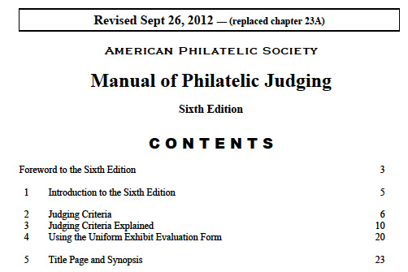
The guidelines for exhibiting at the national level are governed by the American Philatelic Society and explained in the 6th edition of the “Manual of Philatelic Judging,” last updated on September 26, 2012.

Slide 10
Although written for judges, this information is valuable for all exhibitors. There are no formal “rules” that need to be followed, but the recommendations in the manual are considered guidelines and expectations.
Every exhibit is categorized by Class and Division that help explain the material they present. These can be confusing at first and continue to change here in the U.S. and internationally as the hobby evolves.
Let’s take a look at them.

Slide 11
General Class: Postal Division
Traditional – design, production and varieties of a single stamp or set
Postal History – routes, postal rates, postal markings
Aerophilately – air mail routes, rates
Astrophilately – philatelic items dealing with space
Postal Stationery – envelopes, postal cards, wrappers and related paper products bearing a printed paid indicia
First Day Covers – covers that concentrate on the stamp and/or markings found on FDCs
General Class: Revenue Division
Traditional Revenue – tax stamps like Traditional above
Fiscal – uses of tax stamps on documents

Slide 12
General Class: Illustrated Mail Division
Cacheted First Day Covers – study of the designs on FDC envelopes
Advertising, Patriotic and Event Covers – envelopes produced for special purposes
Maximaphily- postcards bearing stamps and cancels relating to a subject or theme
General Class: Display Division – philatelic exhibit that includes a lesser degree of non-philatelic items

Slide 13
General Class: Cinderella Division – stamp-like labels without any postal franking value
General Class: Thematic Division – an exhibit telling a story with a variety of philatelic elements displayed
Picture Postcard Class – presentation exclusively dealing with the image side of a post card
One Frame Class – an exhibit of any type within 16 pages
Youth Class – exhibits of any type presented by young adults under the age of 21

Slide 14
At one time each Division and Class had its own score sheet designed to “level the playing field” among them. This was a nightmare for exhibitors and judges alike. The judging team of 5 had sole discretion to move an exhibit from one Division and/or Class to another if they felt it would score higher in another classification.
The current “Uniform Exhibit Evaluation Form” is the standard score sheet used for judging U.S. national exhibitions. The percentages given are an approximate value for an ideal exhibit. It has four sections:

Slide 15
1. Title and Treatment
Title/Title Page: Subject title, scope, limitations, fit (included in Treatment)
Treatment: Development, clarity, balance, relevance, subject completeness (20%)
Importance: Subject importance, philatelic importance and completeness (10%)

Slide 16
2. Knowledge, Study and Research
Philatelic/General Knowledge: Selection and application, brevity, correctness (25%)
Personal Study and Research: Analysis and evaluation, original and secondary research (10%)

Slide 17
3. Rarity and Condition
Rarity: Challenge, difficulty of acquisition (20%)
Condition: Physical condition and appearance in light of quality obtainable (10%)
--------------------------------------------------------------------------------------------
4. Presentation
Presentation: General layout, attractiveness (5%)

Slide 18
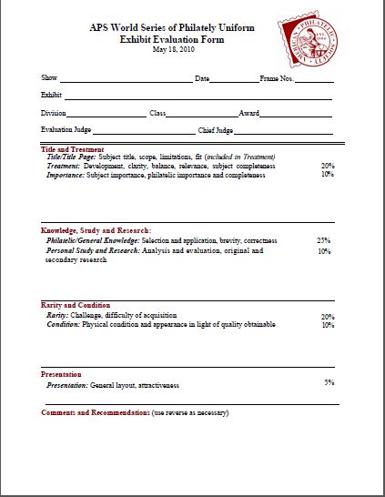
In Summary…
1. Title and Treatment
(30%)
2. Knowledge, Study and Research (35%)
3. Rarity and Condition
(30%)
4. Presentation (5%)
The bottom section is for comments.

Slide 19
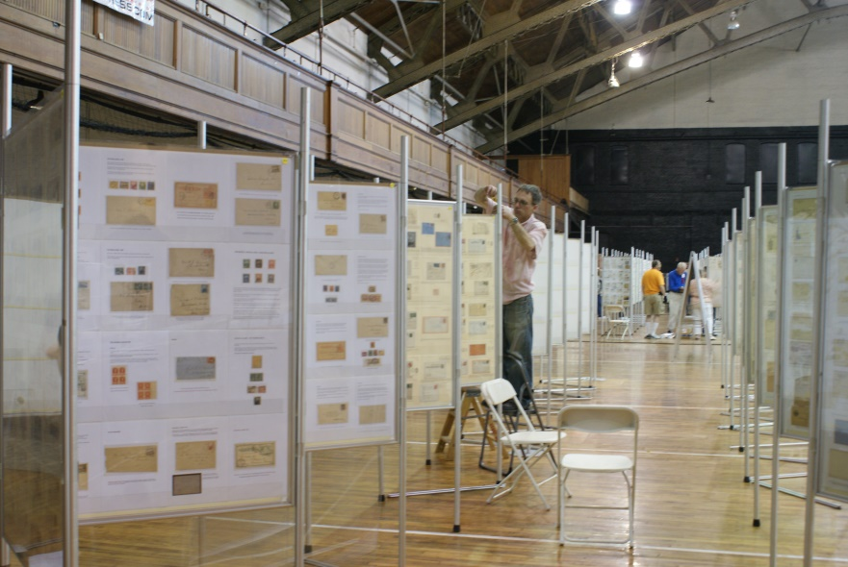
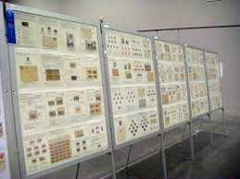
The Structure of an Exhibit
Single or multi-frame exhibits are prepared and presented in multiples of 16 8.5x11 inch pages, in a 4x4 matrix that fit into either type of exhibit frame, the international style or American A frame.

Slide 20
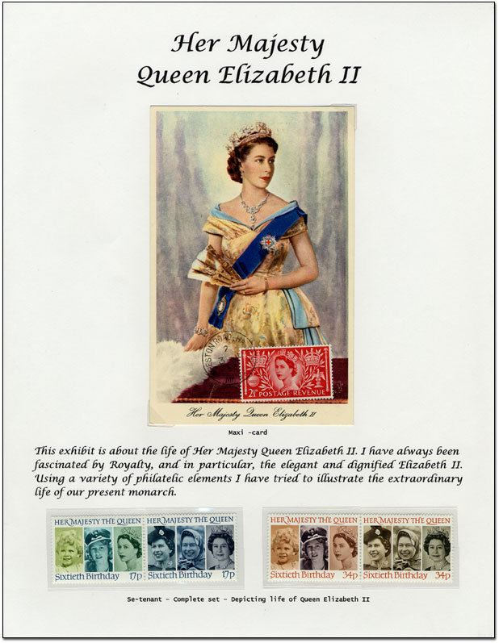
The Title Page
All exhibits have a title page. This defines the scope of the presentation and acts as an introduction to what will be shown. With the exception of the Display Class, it is the only place were non-philatelic material is allowed. You will want to put an eye-catching item on the title page to draw everyone’s attention you your presentation.

Slide 21
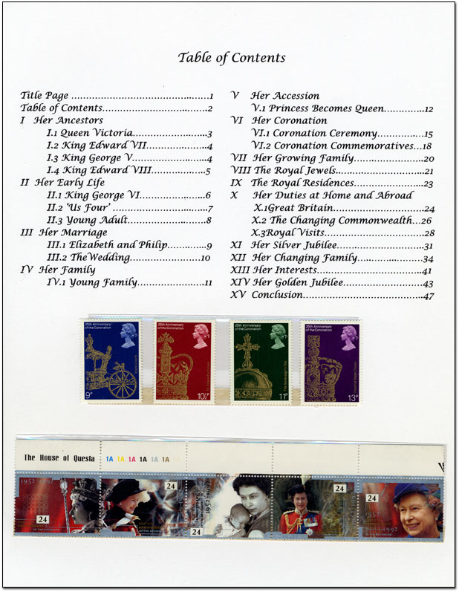
Plan Page
Thematic and Display Division exhibits require that a Plan Page follow the introduction. This is an outline that looks like chapters in a book. A typical numbering scheme is shown here. Other exhibit types may also have an outline of some sort.

Slide 22
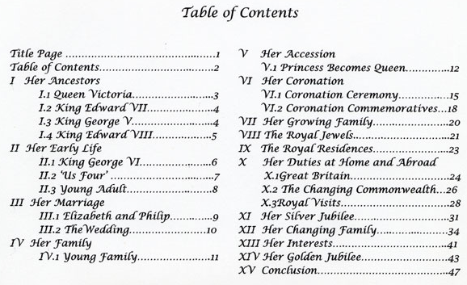

Slide 23
In preparing for their assignments, judges are sent a copy of each exhibit’s title page and either Plan Page or Synopsis a few months before the show explaining the goals of the exhibit. A Synopsis can be several pages long extolling the virtues of the exhibit, including material highlights, original research, awards won, etc.
The Plan or Synopsis is scrutinized to determine if the scope of what the exhibitor is showing can indeed be done in the number of frames presented. The balance of number of pages of each section is reviewed to make sure no one section dominates another.

Slide 24
A well-balanced jury is a must for any exhibition. No one judge can be a specialist or expert in all areas of philately. So the person in charge of selecting the team of judges should look for those with backgrounds in a wide range of Divisions and Classes.
Bottom line…
Exhibiting is nothing more than show and tell. The exhibitor is the expert in his or her area and must convey that knowledge through their presentation, which should have a beginning, middle and end.

Slide 25
Exhibit Tips and Tricks
An exhibit does not need to be typed or made on a computer! Handwritten pages are perfectly acceptable as long as they are neat and readable.
If you print pages, use a standard 10 or 12 point font. Use italics to separate story and philatelic text.
Keep text as brief but complete as possible.
Use white or light colored paper, preferably 85 pound weight or greater. 110 pound card stock is especially good to support covers that don’t flop down when mounting in exhibit frames.

Slide 26
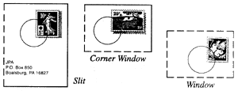
Use clear mounts and not black ones.
Use windowing techniques to hide non-important aspects of a philatelic item.
Highlight your better items in some way to make them stand out. Mounting with a background subtle color is a standard way of doing this.

Slide 27
Now start your exhibiting adventure!

