Slide 1
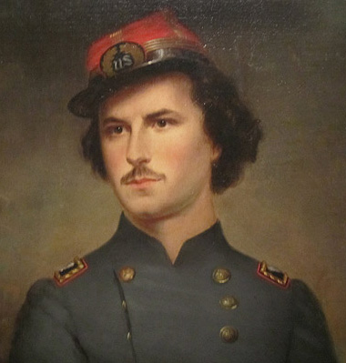
Colonel Ephraim Ellsworth Patriotic envelopes
A presentation by
John Stoltz for the Rochester Philatelic Association, 2014

Slide 3
Colonel Ephraim Ellsworth (April 11, 1837 - May 24,1861) was a law clerk and soldier, best known as the first conspicuous casualty of the American Civil War.
Wikipedia
A rather more “mature” image of Ellsworth than commonly seen.
E. E. Ellsworth, Col. of the New York Fire Zouaves
Lith. & Published by J. H. Bufford, 313 Wash. St, Boston.

Slide 4
This collection was first written up in the December 1933 edition of “The American Philatelist,” publication of the American Philatelic Society.
It is unclear if the writer, Oliver H. Wolcott, RD #2, Copley, Ohio was the possible originator of this exhibit. However this story is as interesting today as it was then.
Union Army officers and soldiers, circa 1863

Slide 5
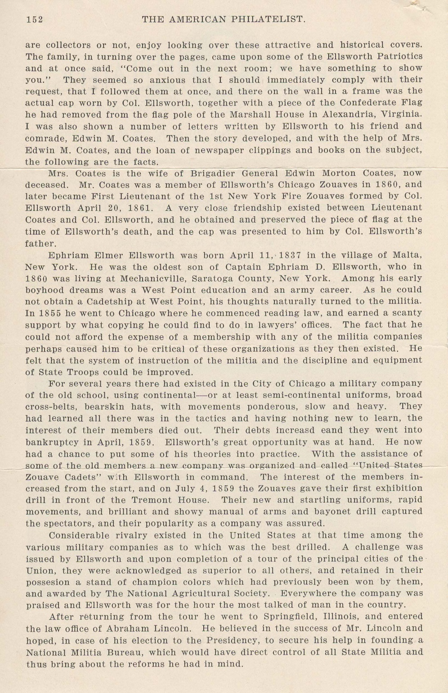

Slide 6
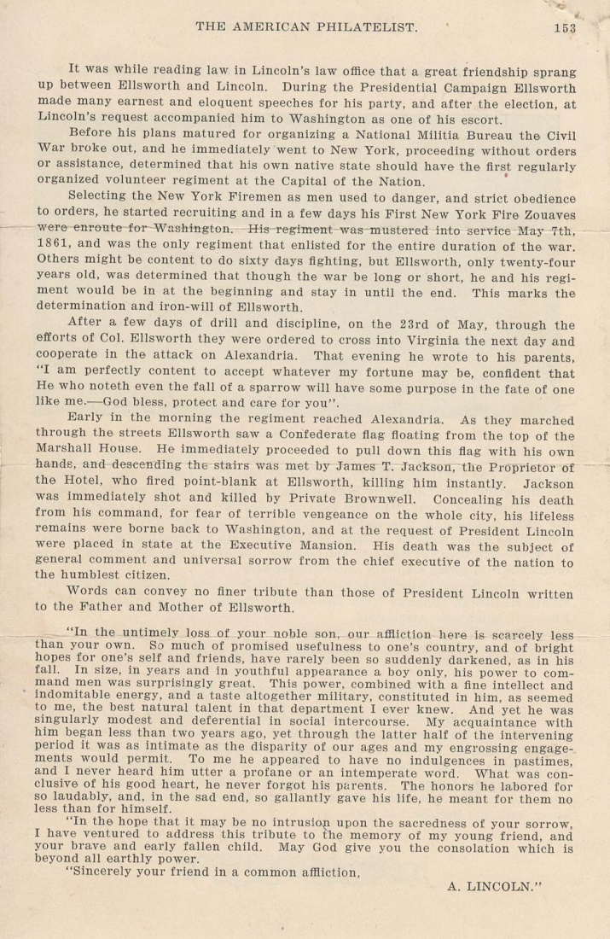
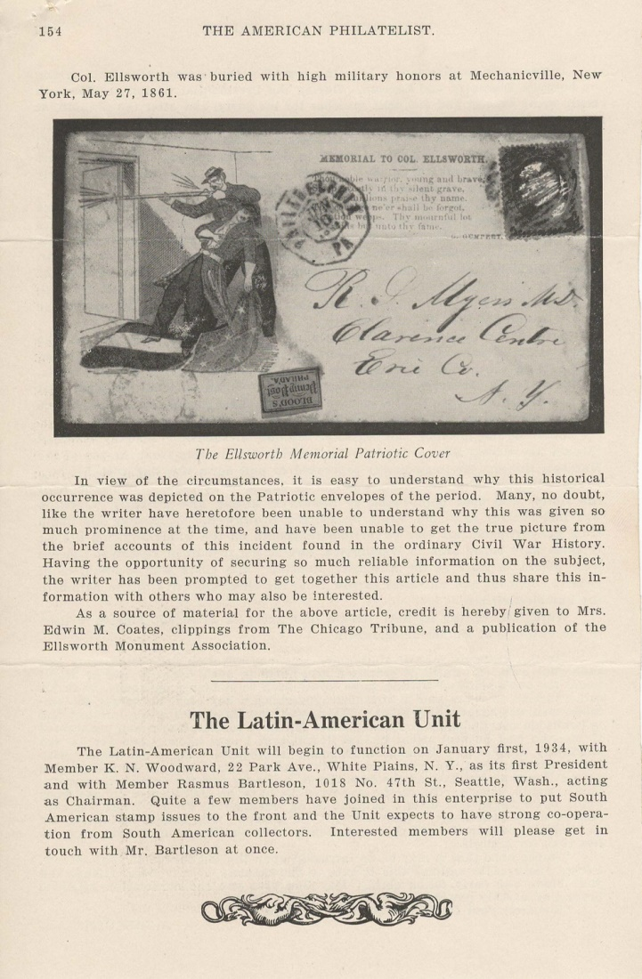

Slide 7
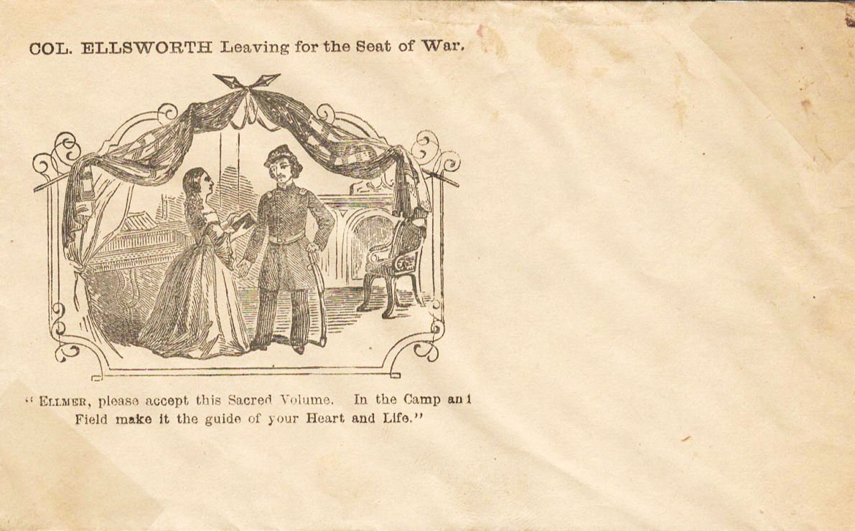
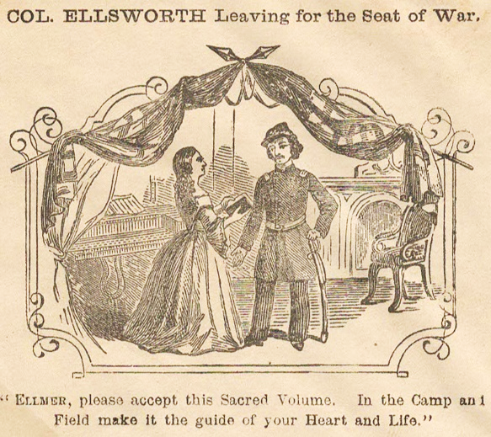
The Colonel accepts a Bible from his wife before he leaves for duty.

Slide 8
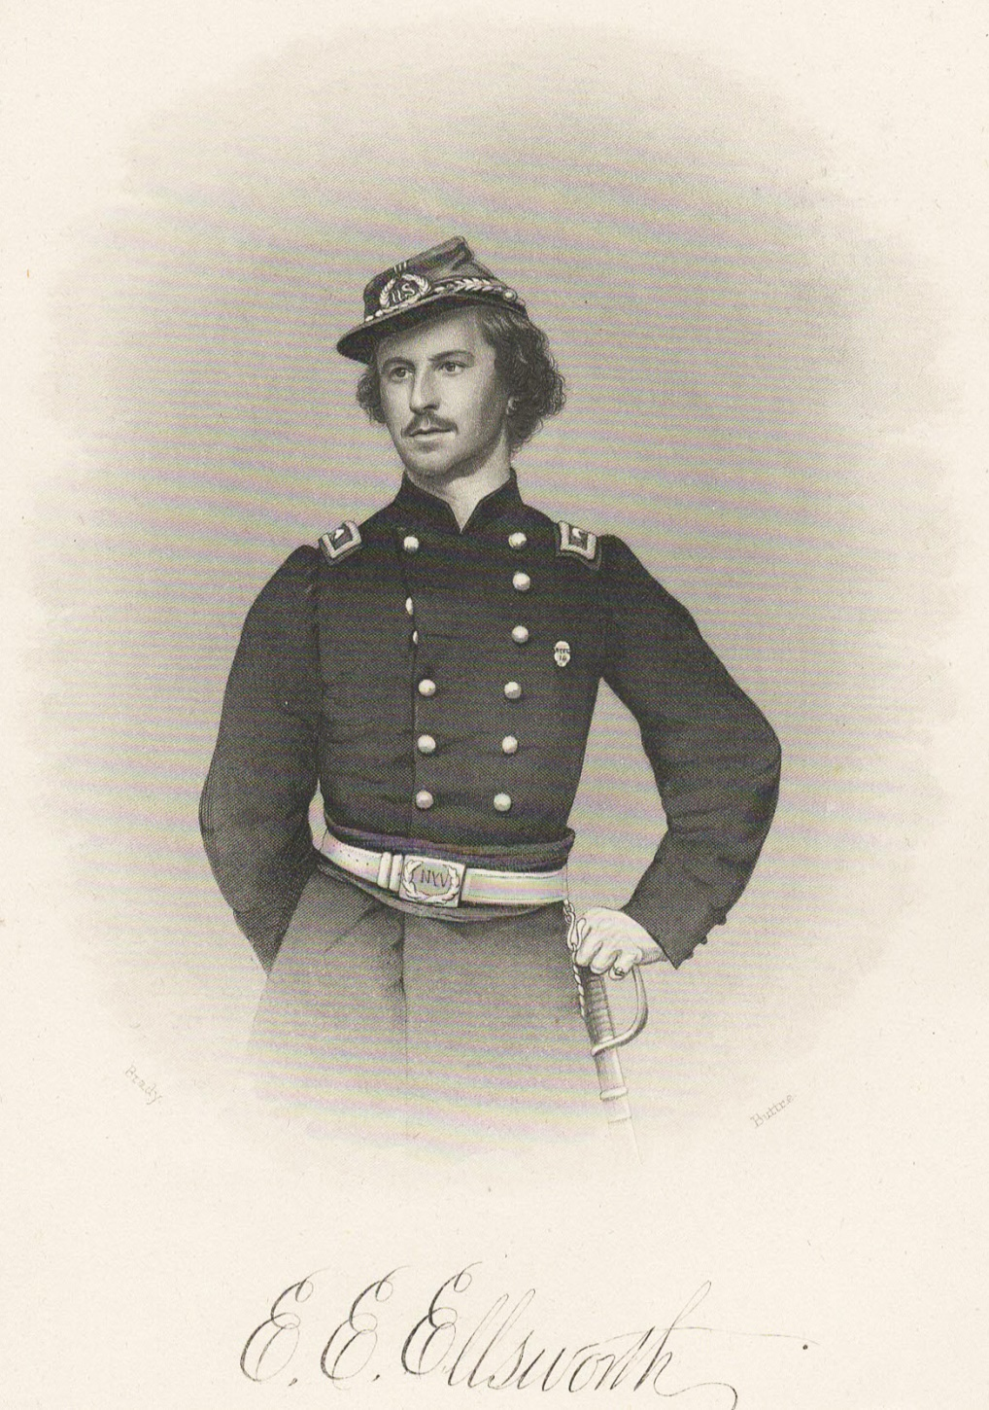
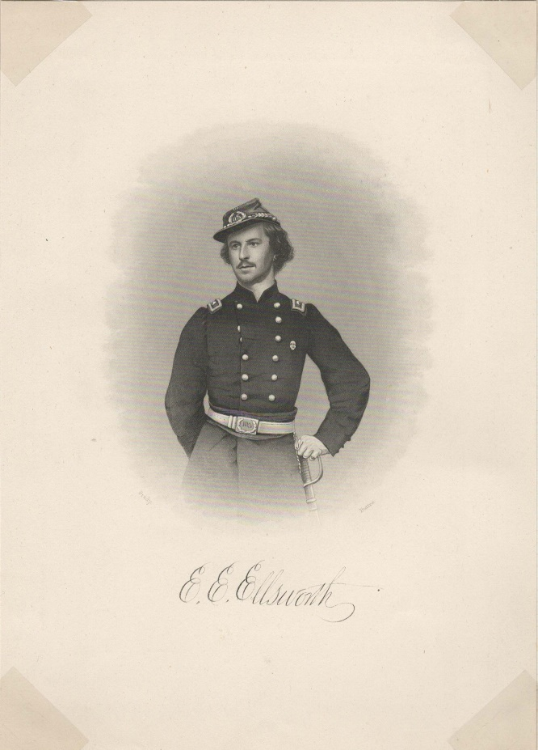

Slide 9
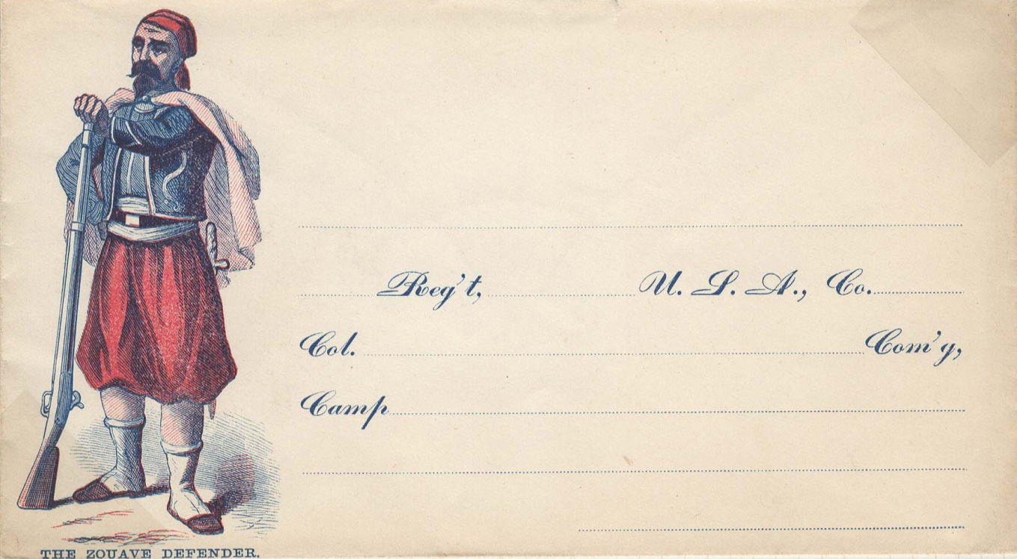
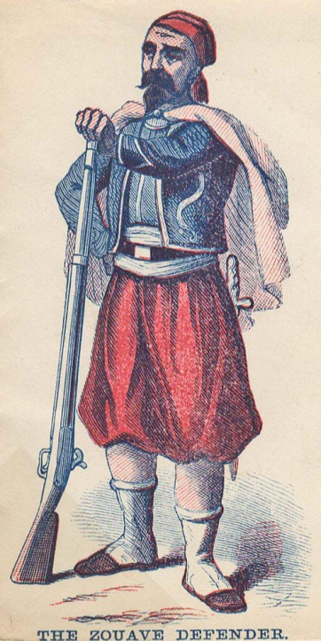

Slide 10
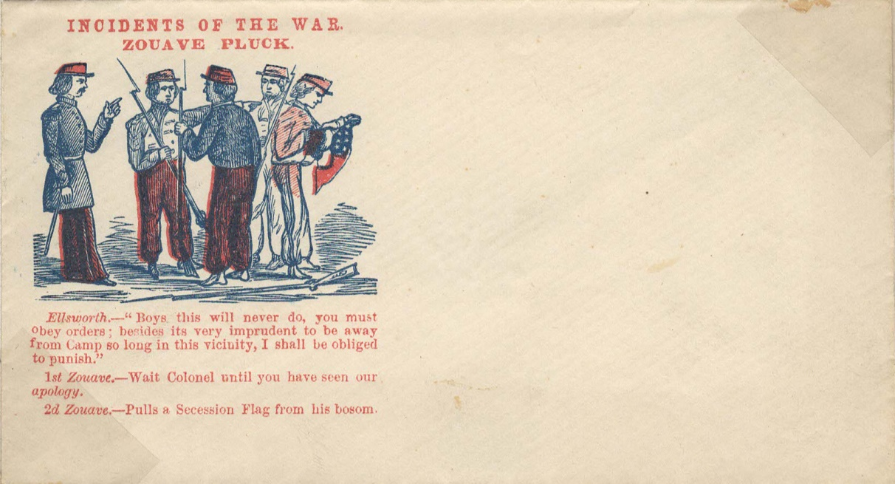
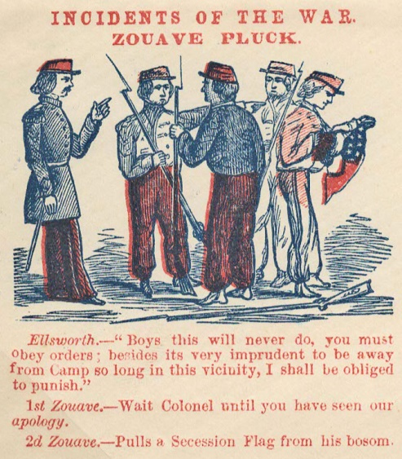

Slide 11
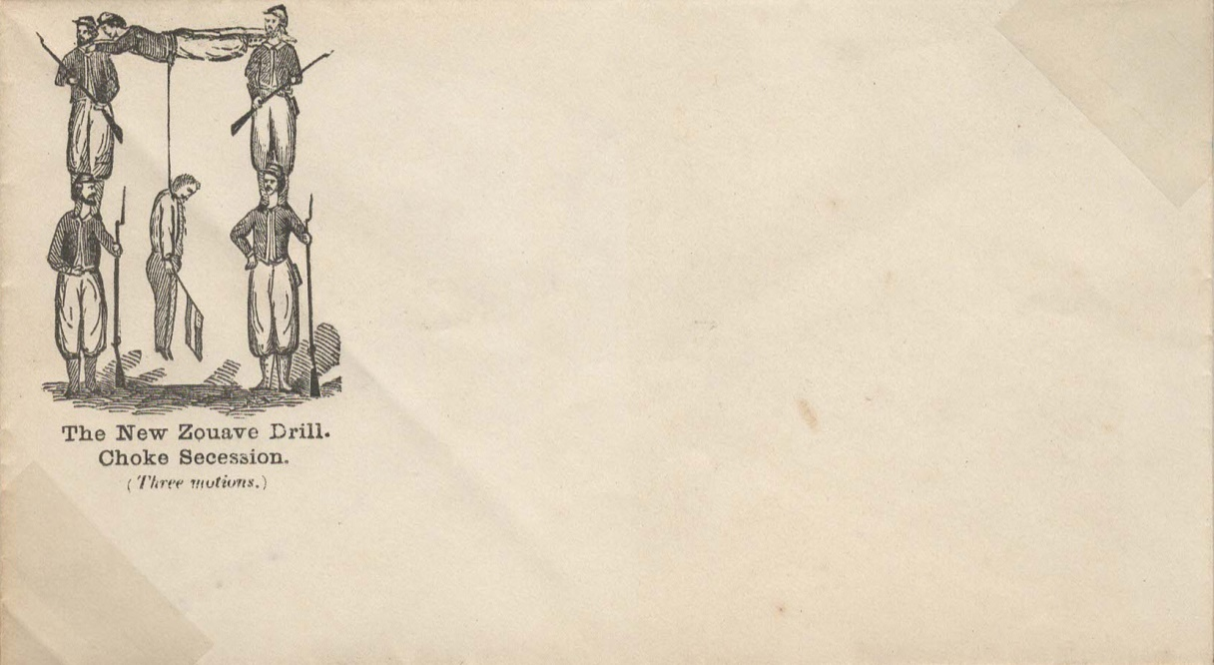
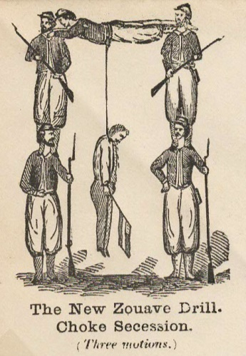

Slide 12
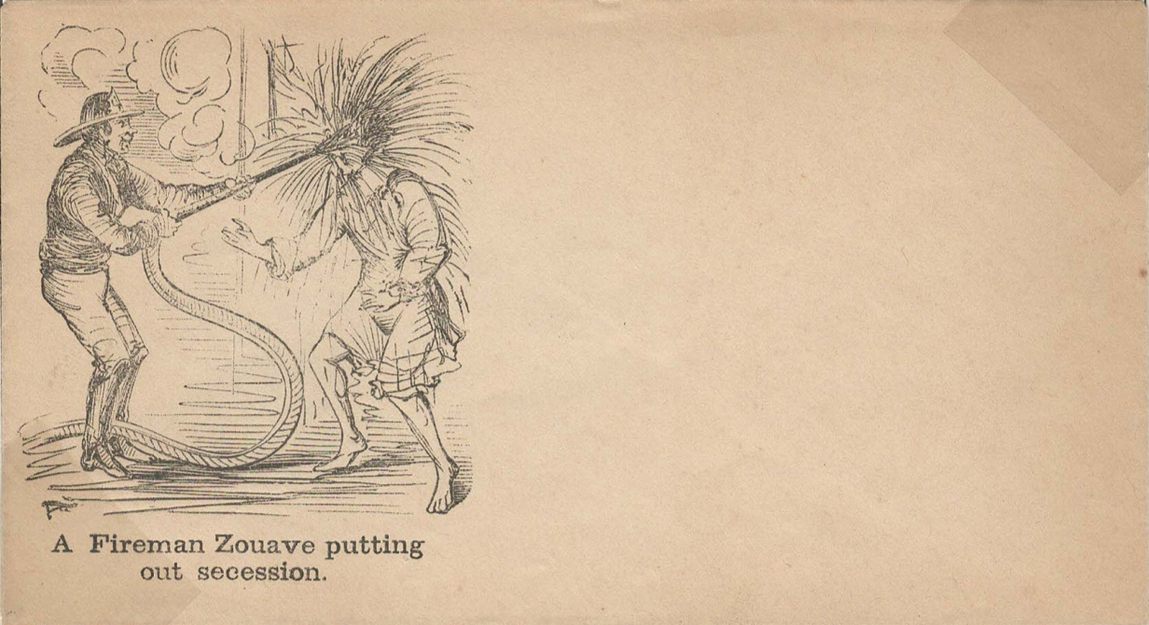
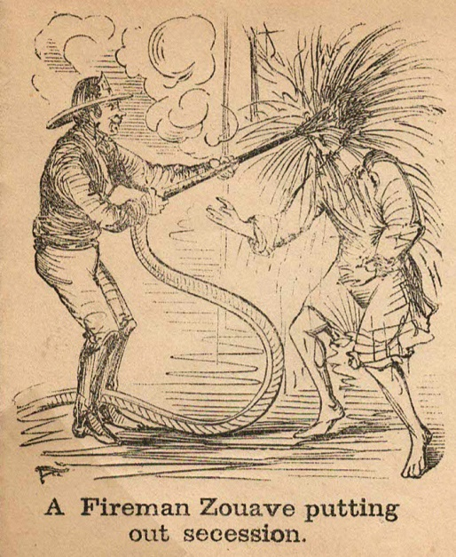

Slide 13
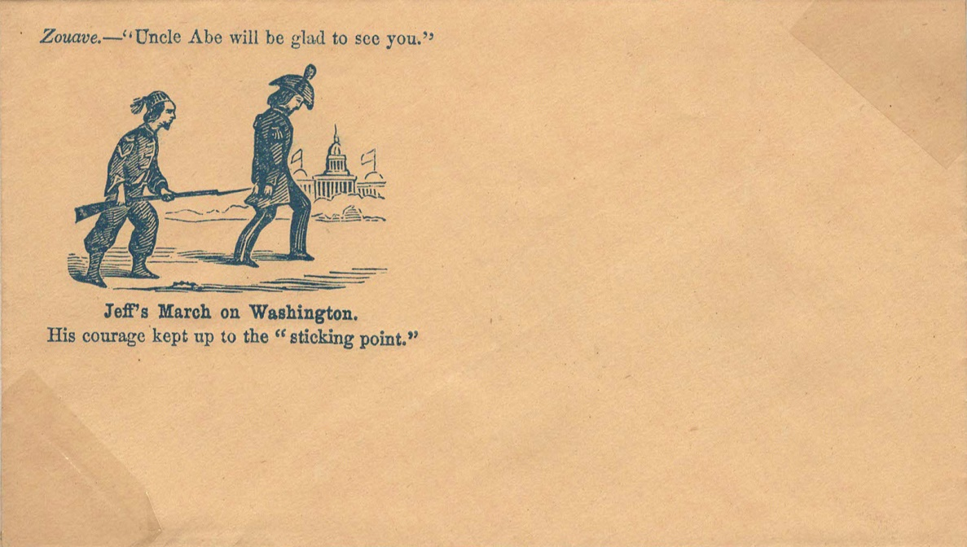
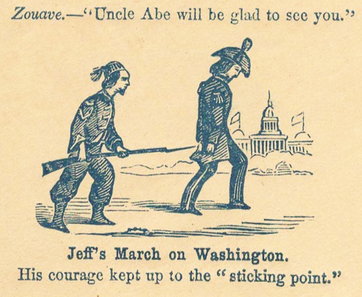

Slide 14
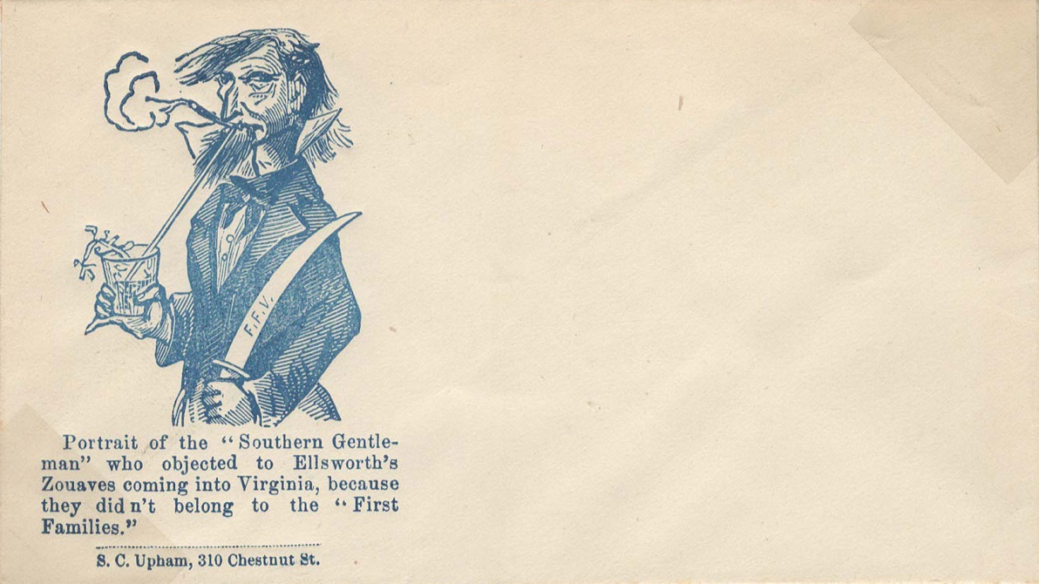
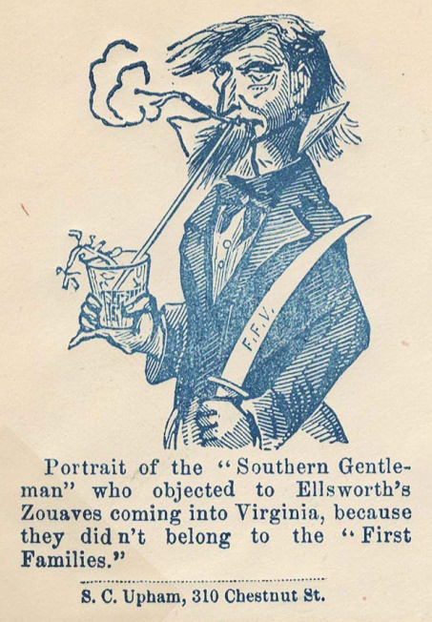

Slide 15
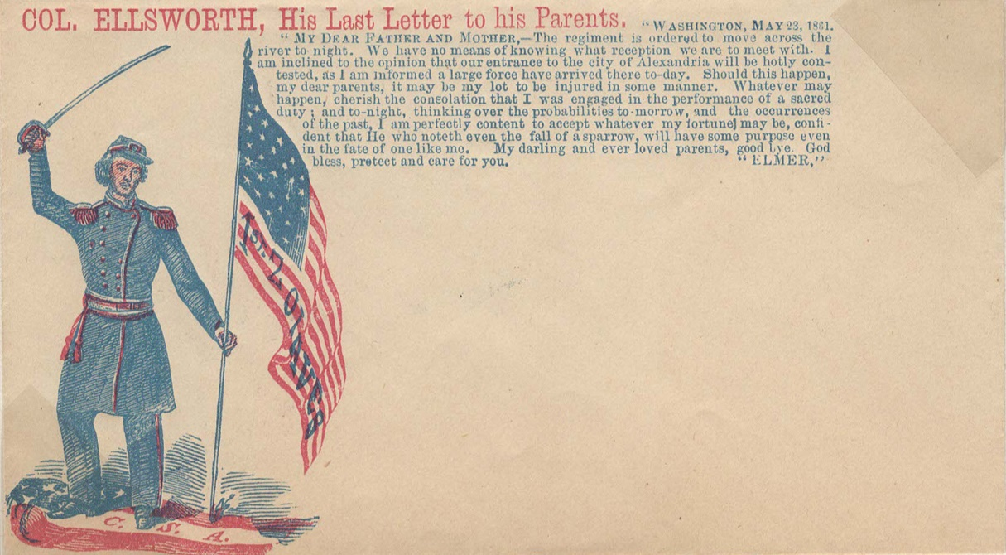
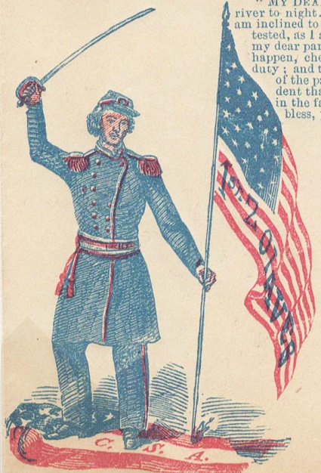

Slide 16
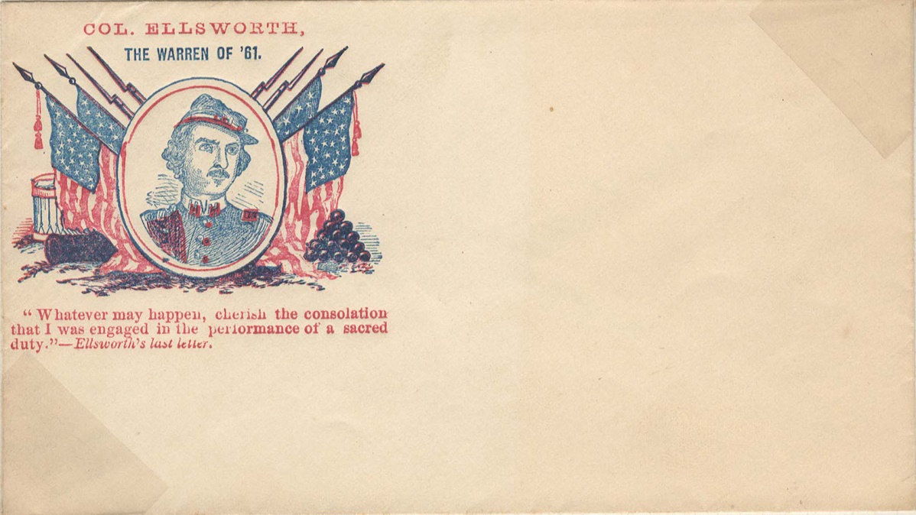
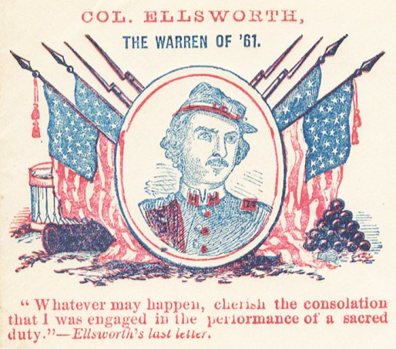

Slide 17
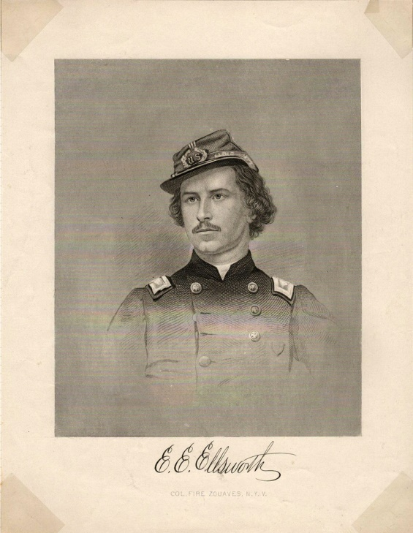
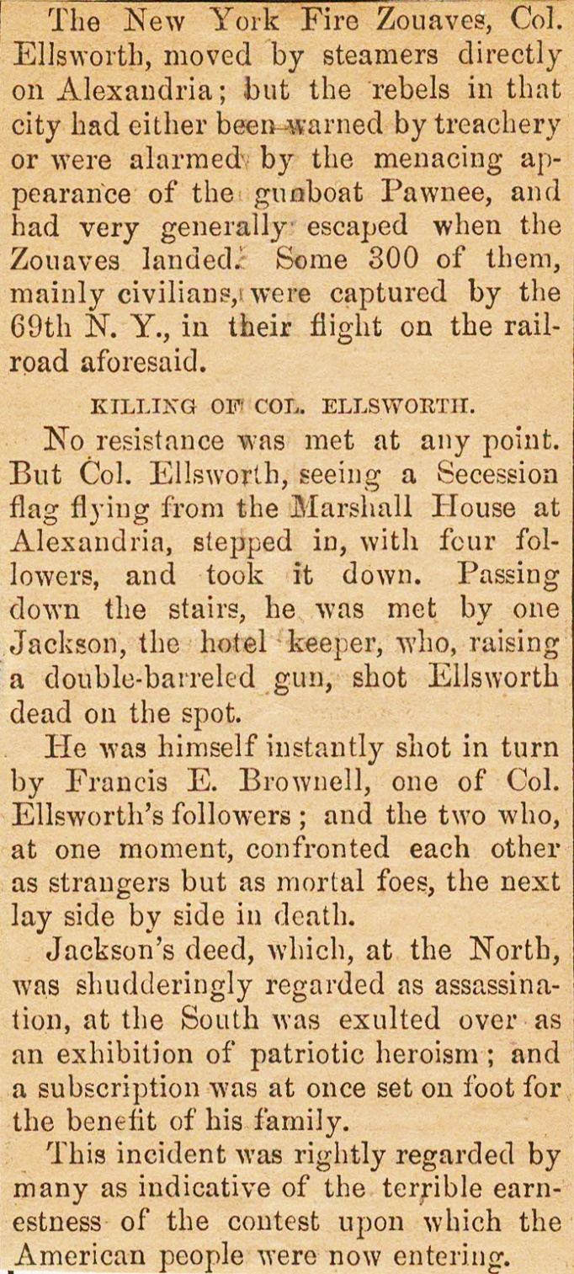
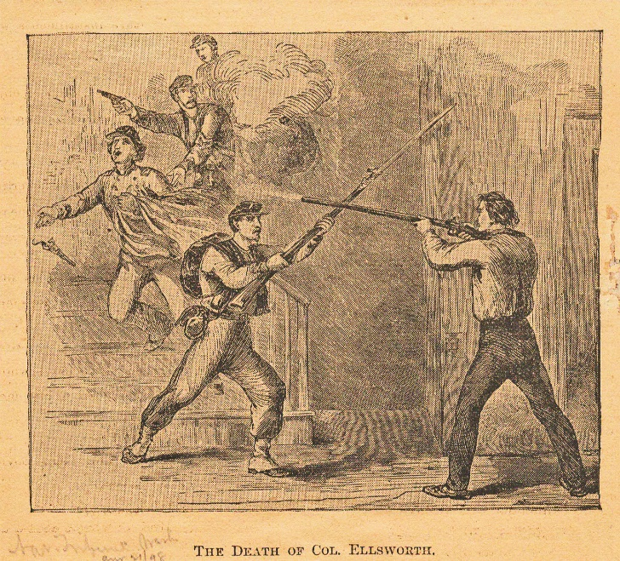

Slide 18
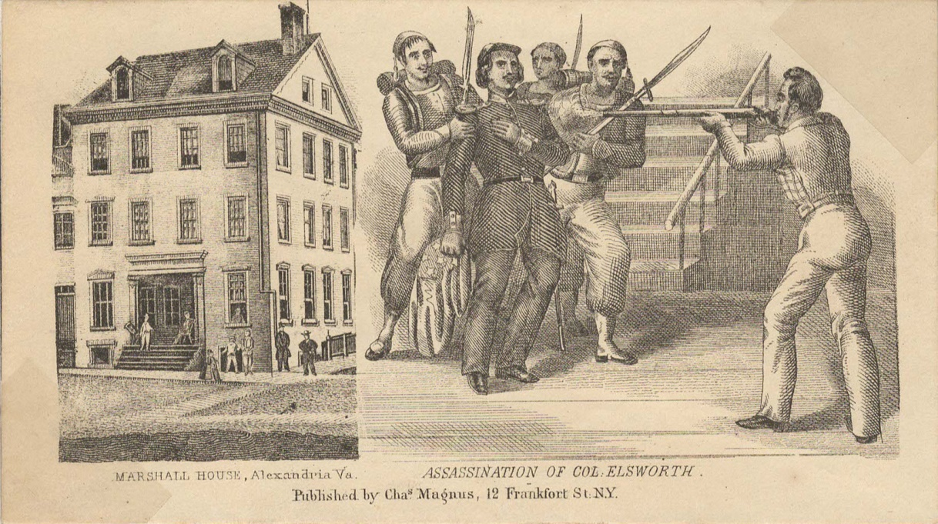
MARSHALL HOUSE, Alexandria, Va. ASSASSINATON OF COL. ELSWORTH
Published by Chas. Magnus, 12 Frankfort St. N.Y.
(full image reverse, note misspelling of Ellsworth)

Slide 19
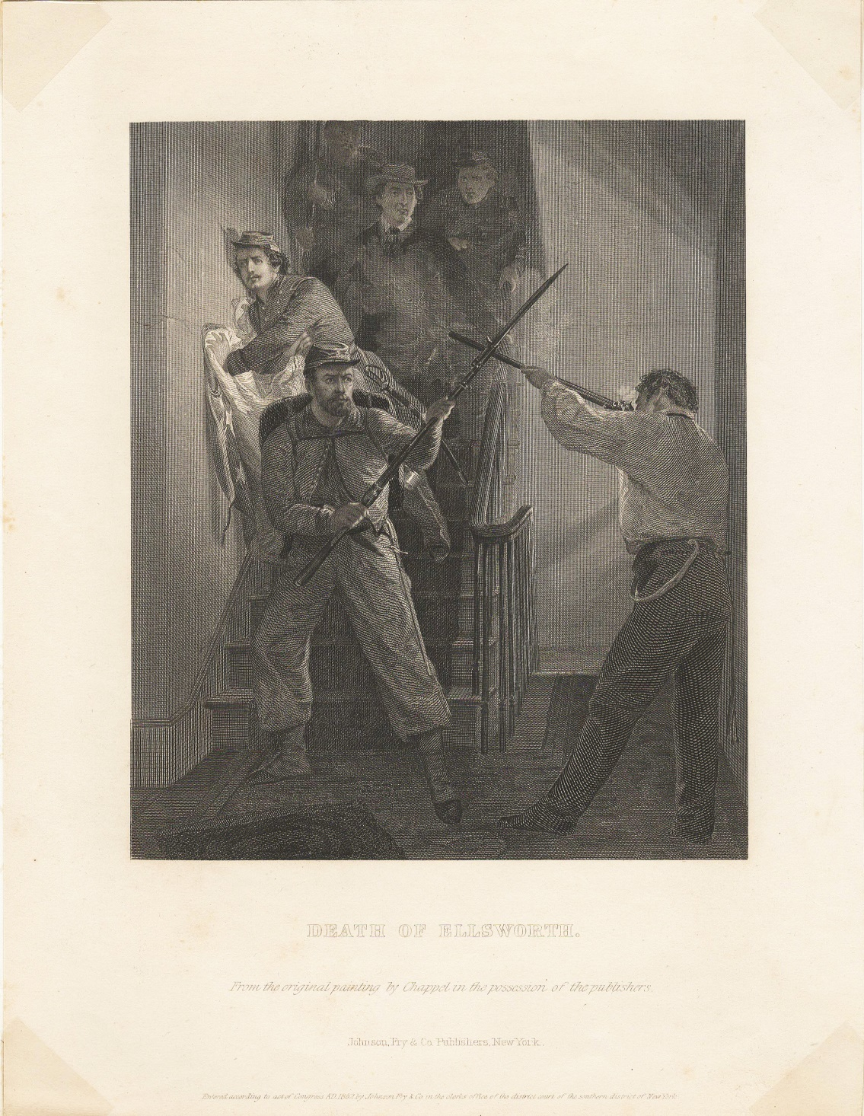
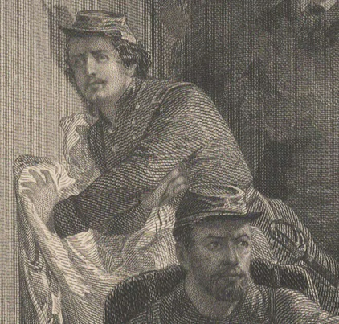
DEATH OF ELLSWORTH.
From the original painting by Chappel in the possession of the publishers.
Johnson, Fry & Co. Publishers, New York

Slide 20
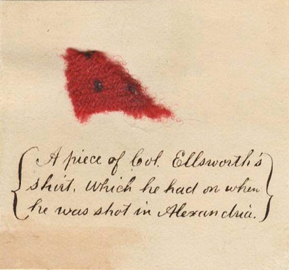
As seen on this and following page, items from the scene became prized possessions.
“A piece of Col. Ellsworth’s
shirt, which he had on when
he was shot in Alexandria.”
Text from the following page…
“A piece of the succession flag which was torn down from the Marshall House at Fairfax (Alexandria) Va. By Col. Elma Ellsworth on the 24th May 1861. Johnson the proprietor, shot the Colonel dead, but he was nobly avenged by Frances E. Brownell a private of his regiment, who shot Johnson through the head and then pinned him to the stairs with his bayonet. Brownell was afterward was rewarded with the Commission of a Second Lieutenant.”

Slide 21
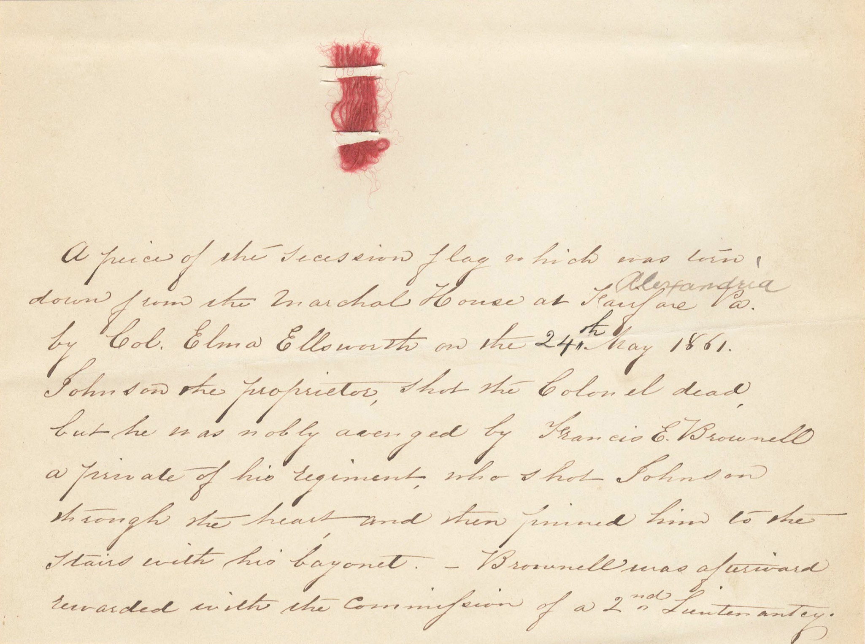

Slide 22
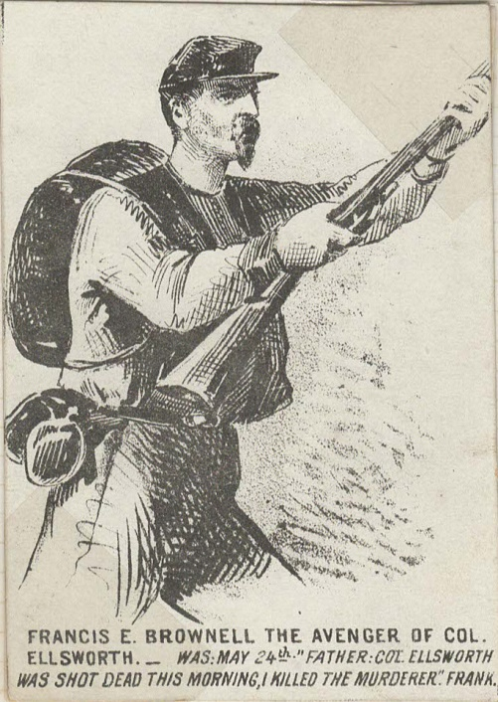
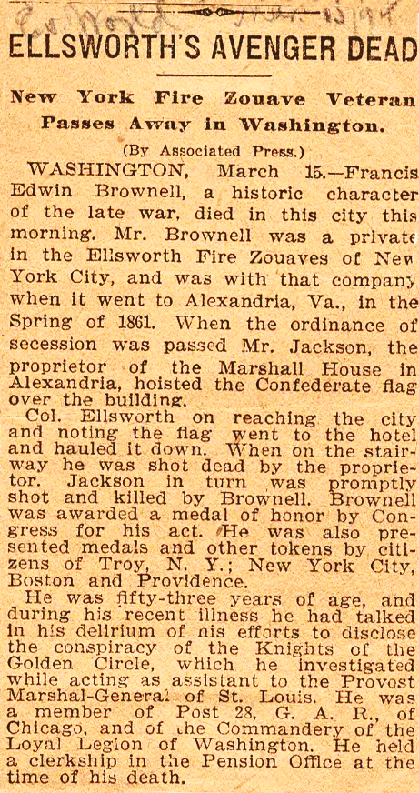

Slide 23
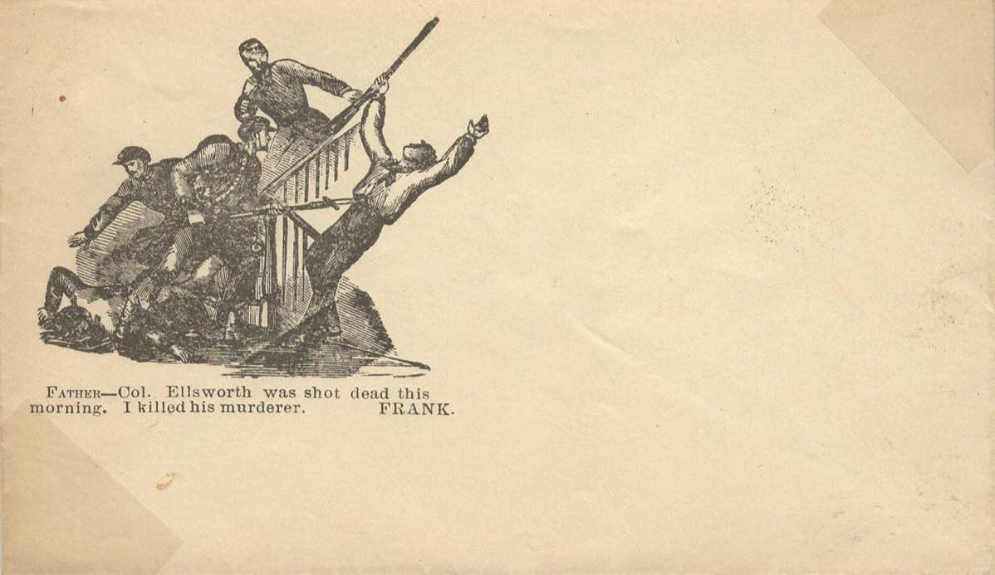
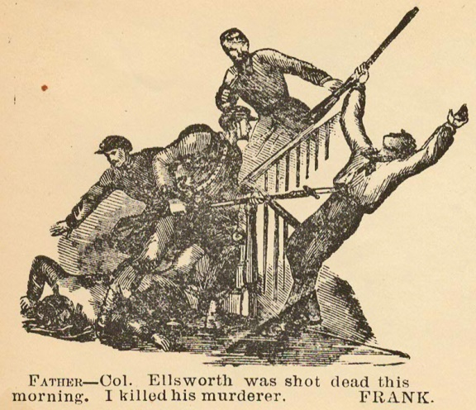

Slide 24
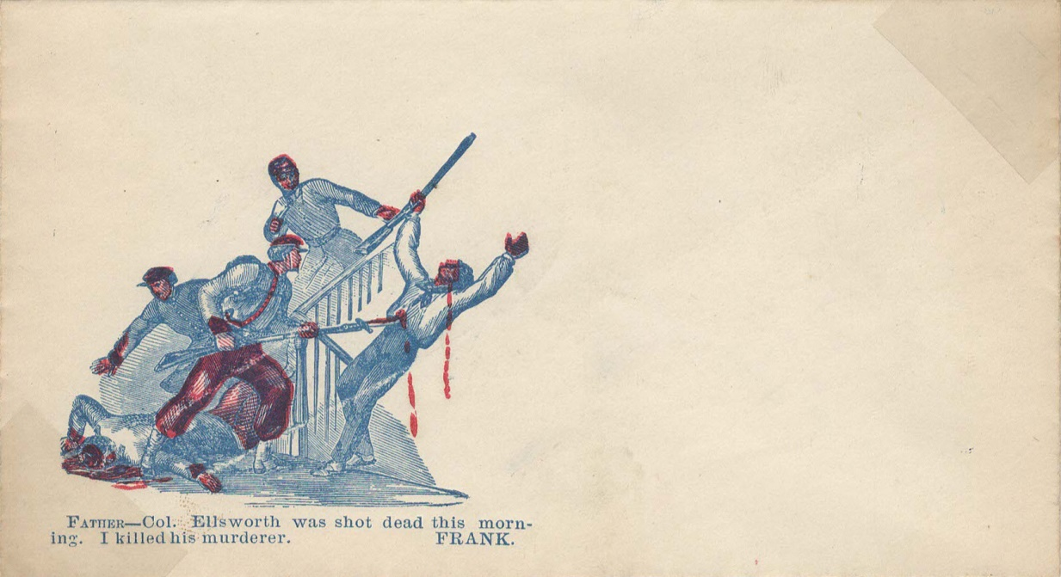
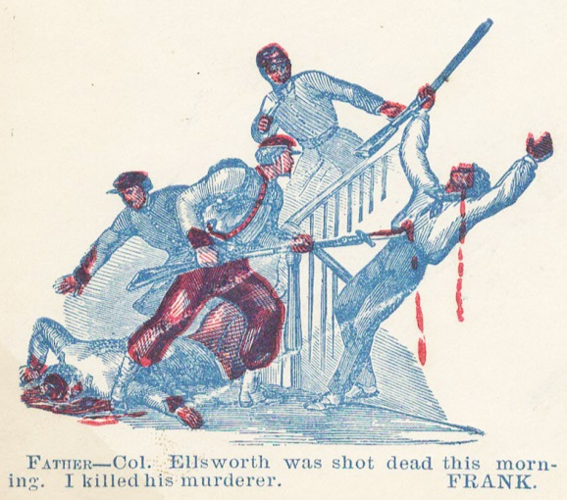

Slide 25
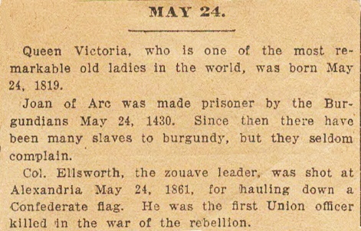
Newspaper clipping (unknown source) noting the events of May 24 over various years. Ellsworth’s death was obviously historically noteworthy at the time.
Pass used by the New York firemen “Zouaves” regiment.

Slide 26
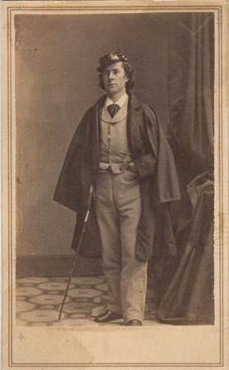
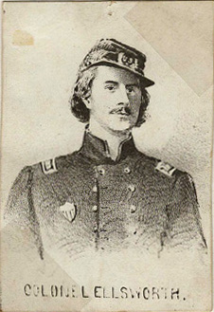
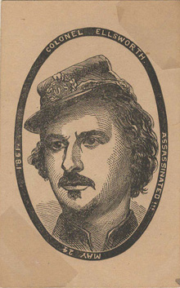
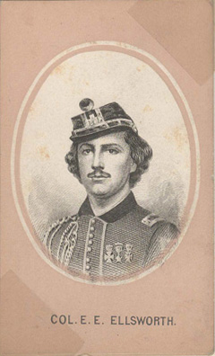
Assorted cards depicting Ellsworth.

Slide 27
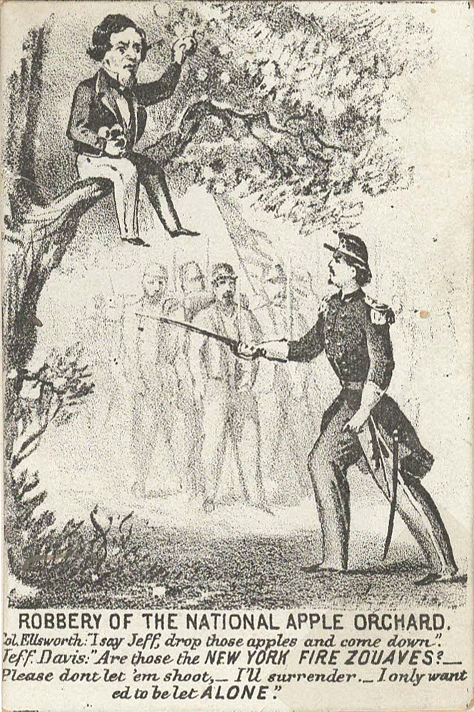
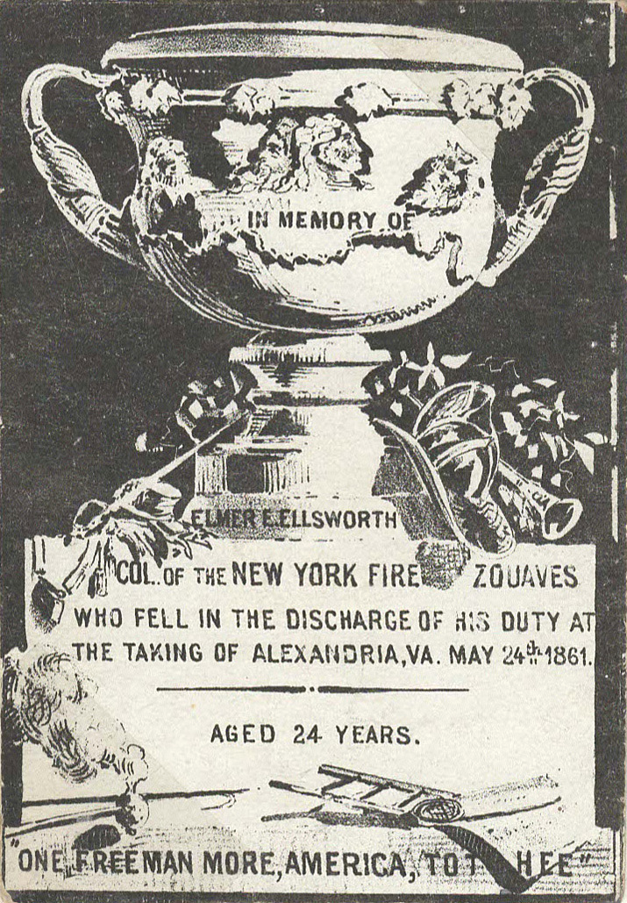
Additional cards.

Slide 28
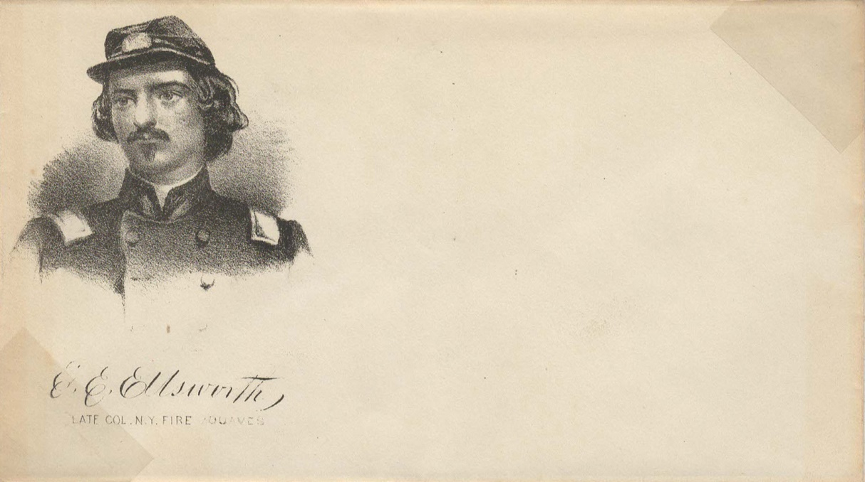
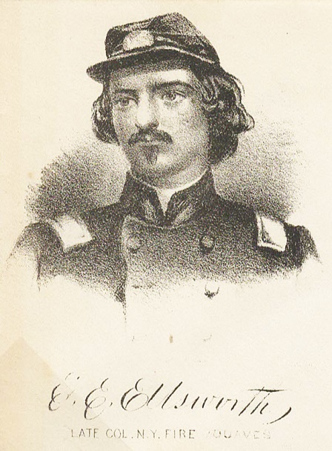

Slide 29
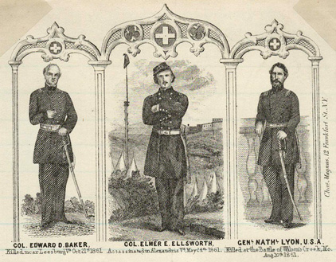
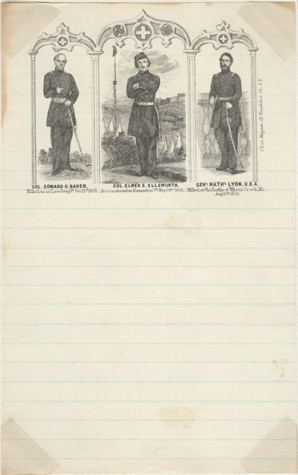
Letter sheet printer: Chas. Magnus, 12 Frankfort St., N.Y.
Col. Edward D. Baker- Killed near Leesburg, Va., October 21st, 1861.
Col. Elmer E. Ellsworth- Assassinated in Alexandria, Va., May 24th, 1861.
Genl. Nathl. Lyon, U.S.A.- Killed at the Battle of Wilson’s Creek, Mo., Aug. 10th, 1861.

Slide 30
In
memory of
Col. E. E.
Ellsworth,
of the
New York
Fire
Zouaves.
Our country mourns the loss of one so noble & so brave.
Who fell by the hand
of an assassin at Alex-
andria, Va., May 14, 1861.
No war alarm, nor martial air
shall reach the noble sleep-
er here.
C. Y. Haynes,
30 S. 4th St., Phila.

Slide 31
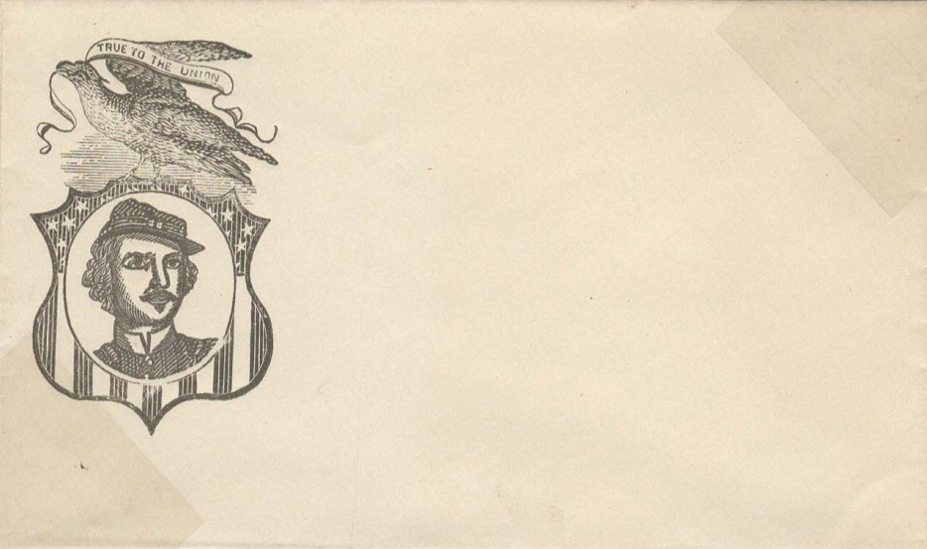

Slide 42
Postally used example
As found by me. Guaranteed genuine.
J. M. Bartels, Oct. 10, 1928

Slide 43
The Chicago Philatelic Society issued a set of 3 cacheted covers in 1957 honoring Ellsworth and the “Fire Zouaves.”

Slide 46
This 1955 publication featured an article that follows about the New York Zouaves and depicted two Ellsworth covers.

Slide 49
The End
Scanning, design and page layout by Tom Fortunato

