Slide 1
eBay – RPA Presentation 1/9/2020 by Charlie Adrion
Interactive
Online

Slide 2
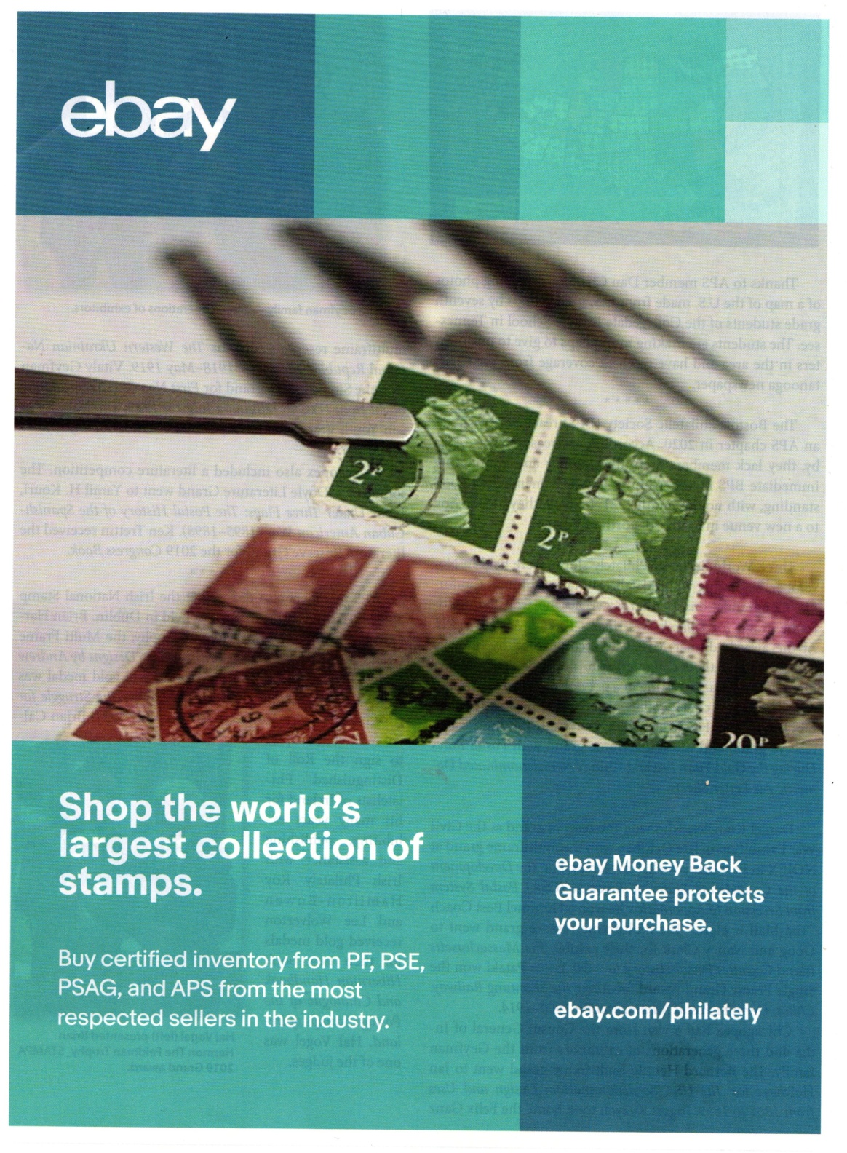

Slide 3
Survey for the Club…
Have you heard of eBay?
Do you spend time online?
Do you eBay buy?
Do you eBay sell?
Do you like your eBay experience?

Slide 4
eBay – What is it?
Worldwide - and makes 10 billion/year
Sellers/buyers - 25 million / 183 million
Many products - second to Amazon in visits
Auction/BIN/Make Offer
Protections – favors BUYERS
Influence on stamps marketplace - massive

Slide 5
Features…
Searching
History
Sold prices versus Offering prices
Sorting
Feedback

Slide 6
Issues with listings…
Ridiculous
Sublime
Misidentifications
Thievery
NARU

Slide 7
Types of sales offerings…
Auction
Buy it now
Make offer

Slide 8
Kinds of sellers who are you dealing with
Not eBay regulars
Professional stamp dealers ckstamps
Professional eBay agents noblespirit
Knowledgeable collectors haydavet
Clueless collectors gigisales
Crooks mnats195278

Slide 9
Sniping - Esnipe and others
the action of shooting at someone from a hiding place, especially accurately and at long range

Slide 10
Paying Methods - PAYPAL (and others)
safe
easy
fast
international
fairly inexpensive

Slide 11
Sample Live Searches…
US 630
US C14
US 73
Penny Red
British Guiana
Audience suggestions

Slide 12
Alternatives to eBay…
Brick and mortar
Online
APS
Hipstamps
Delcampe

