Slide 1
Stamps that Show or Reflect the Details of the Artwork
David Farnsworth
Rochester Philatelic Association
November 12, 2020

Slide 2
Some stamps show the artists’ media in the stamps’ images. To illustrate the idea, five examples are displayed. They involve
Engraving
Photography
Oil Painting
Watercolor
Drawing

Slide 3
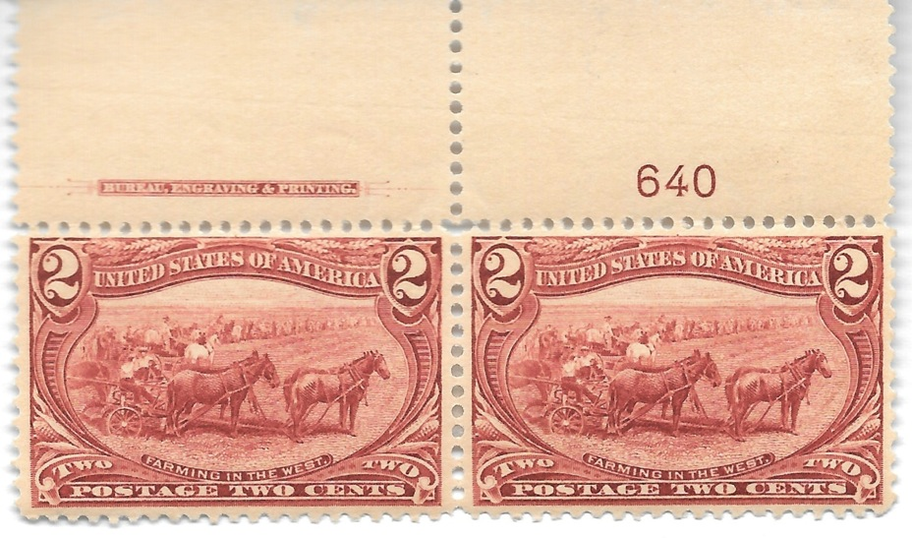
Engraving: USA, 1898

Slide 4
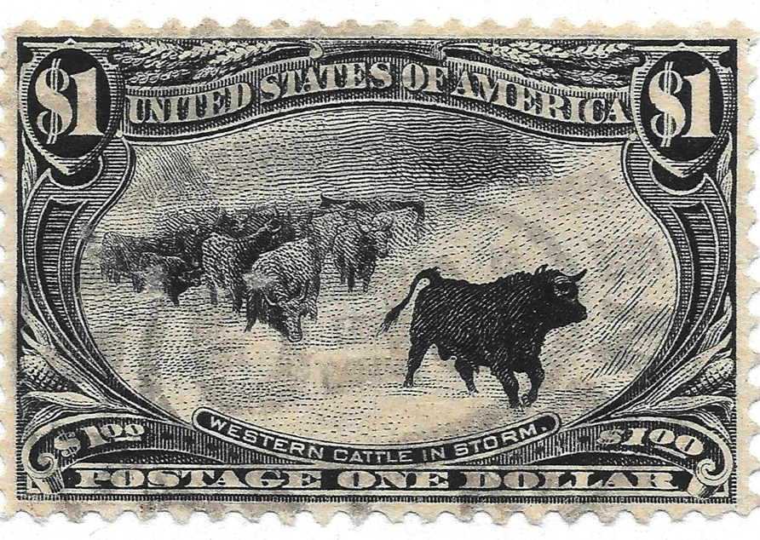

Slide 5
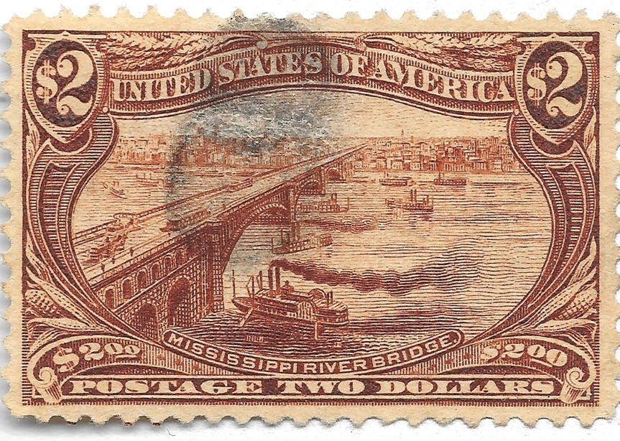

Slide 6
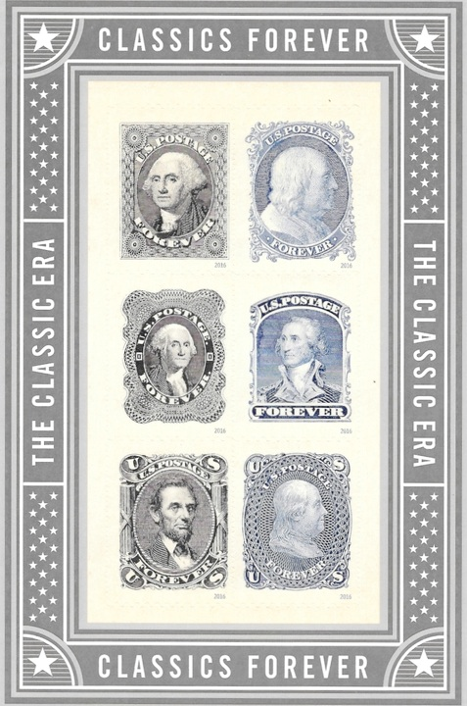
Classics, 2016

Slide 7
Many revenue stamps are examples.

Slide 8
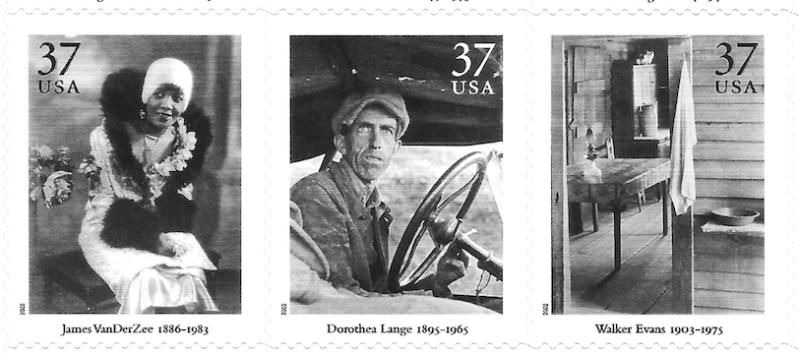
Photography: USA, 2001

Slide 9
Oil Painting: USA, 2020

Slide 10
Watercolor: Greece, 1926

Slide 14
Drawing: USA, 1962

Slide 15
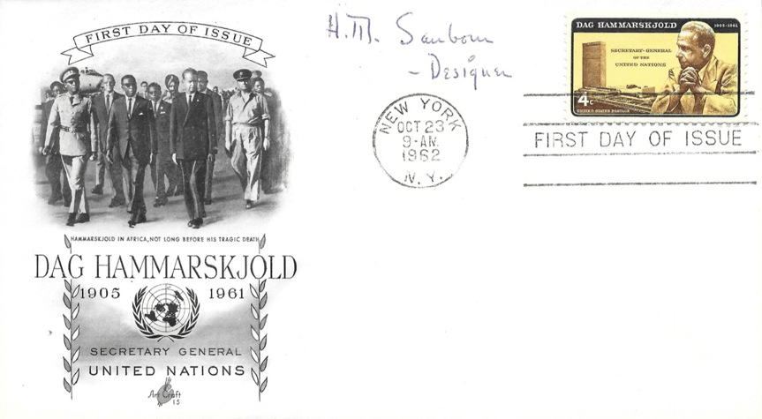

Slide 16
The following were considered, but rejected for this presentation:
1. The US Peter Max poster stamp of 1974 could have been included without much argument, but usually, when seen in person, the method of production, such as silk screen, is apparent, but not on the stamp.
2. Many stamps showing Roy Lichtenstein works almost made it, but, when seen in person, his art is not as flat as the stamps’ designs.
3. The US contemporary Christmas stamps of 2007 are images of holiday knits and also appear like simple vintage cards’ designs, but dimensionality is not present.

Slide 17
4. The US early memories of black & white TV screen pictures of 2009 may be OK to accompany the American Masters of Photography sheet. The US Katharine Hepburn photo stamp of 2010 is much like a photograph, as well.
5. The US Christmas Contemporary Family Scenes and the separate skaters stamp of 1996 almost show the use of watercolor, like the Greek C1-C4 do.

Slide 18
6. Some comics on stamps were candidates. US Peanuts stamp showing Snoopy flying on his dog house of 2001, Marvel Comics Super Heroes sheet of 2007, the Bugs Bunny stamp of 1997, the Sunday Funnies set of 2010, the art of Disney sets of 2005, 2006, 2007, and 2008, the Rudolph the Red-Nosed Reindeer Christmas set of 2014, and the Charlie Brown Christmas set of 2015 are examples, among many. But the artists’ hand or medium is not as apparent as the criterion calls for.

Slide 19
7. Starting in about the year 2000, some counties – some regular countries are included besides the usual for profit producers – have attached pieces of flock filigree, embroidery, felt, beads, and silk that were integrated into the design. Also, some stamps are made from lace or embroidery. Some are printed on wood, so that the wood’s grain compliments, or is somewhat integrated into, the printed design. Today, I have limited the presentation to more standard production methods for stamps.

Slide 20
THE END

