Slide 1
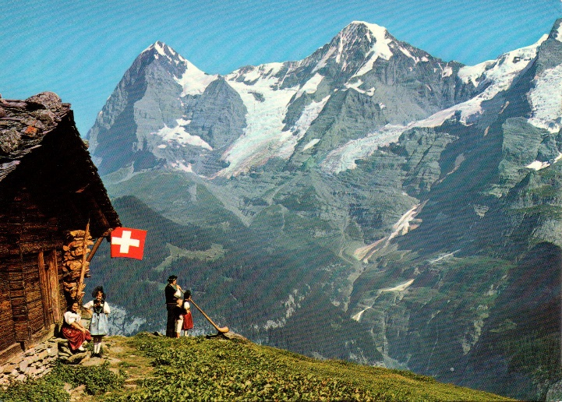
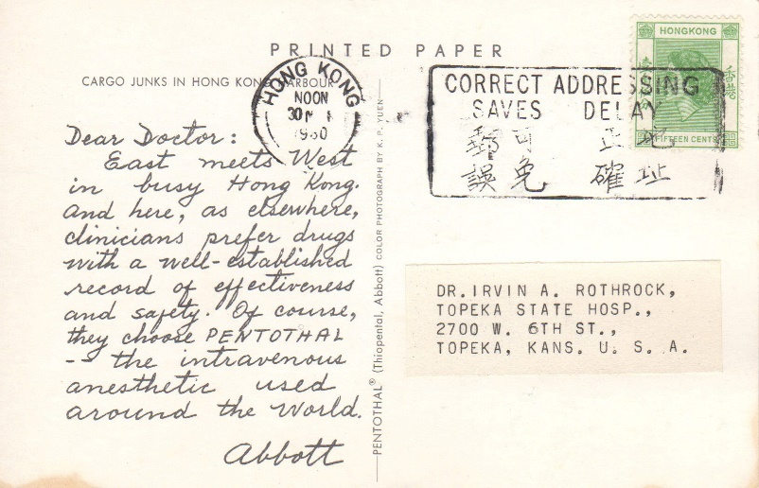
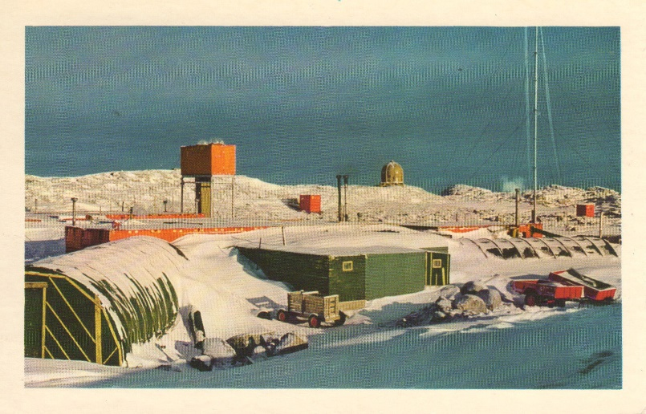
Fun with Abbott Labs Dear Doctor Postcards
By Tom Fortunato
A 2020 presentation for the Rochester Philatelic Association
See more about them at http://www.deardoctorpostcards.com

Slide 2
You may have seen these postcards before in dealers boxes and wondered what they were. Commonly called “Dear Doctor” postcards they were sent out by drug manufacturers to doctors and medical personnel advertising specific drugs. Each was mailed from an exotic locale with an interesting native scene on the front and the sales pitch on the reverse, typically starting with the salutation “Dear Doctor,” hence their nickname. Abbott Labs headquartered in Chicago, Illinois sent theirs out between 1956 and 1968. Over 180 face-different postcards in 10 languages and sent to 36 countries and territories have been documented to date with subtle and not-so-subtle differences found on the message side. They’re now over 50 years old!
This presentation will introduce you to the wealth of variety among them. Plan to have fun!

Slide 3
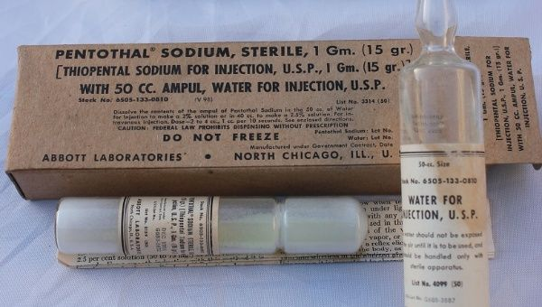
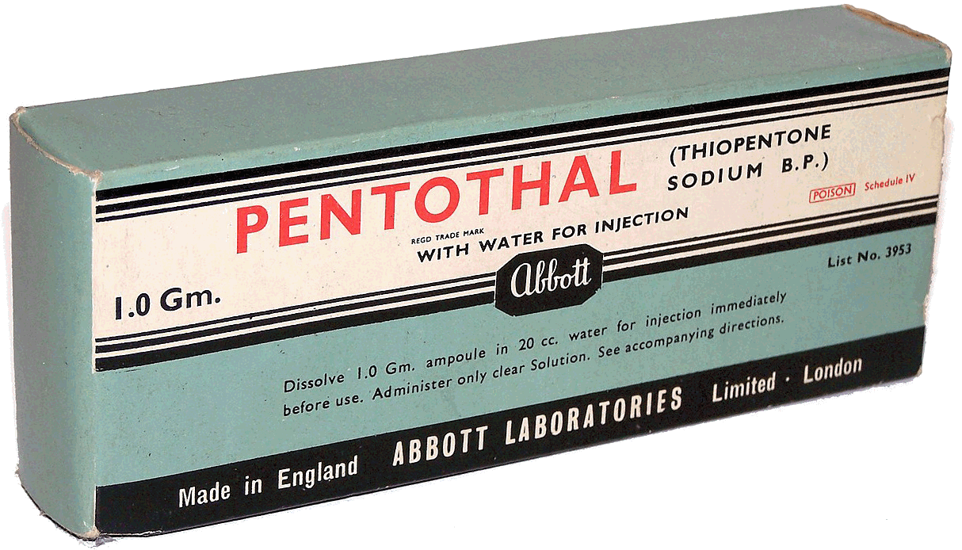
All Abbott postcard mailings advertised one barbiturate drug, trademarked “Pentothal,” their brand name for thiopental sodium. It was widely used as an anesthetic injection used to put pre-op patients to sleep. It may be more familiar as “truth serum” to the spy-era generation of the 1950s and 1960s.
Each Abbott postcard mailing was sent to as many as 250,000 recipients. Most were trashed as junk mail, while others kept them as curiosities--thankfully!

Slide 4
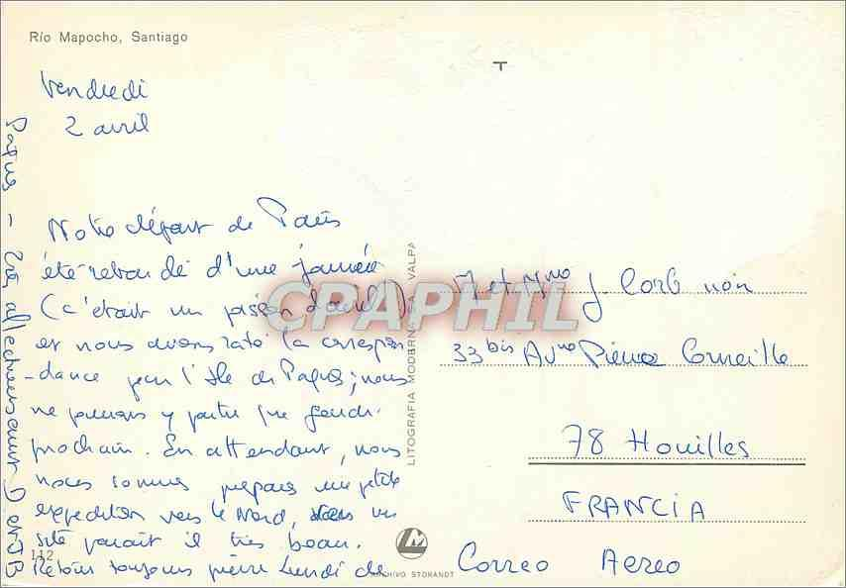
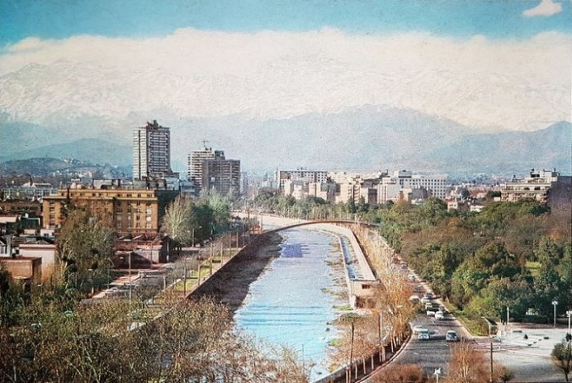
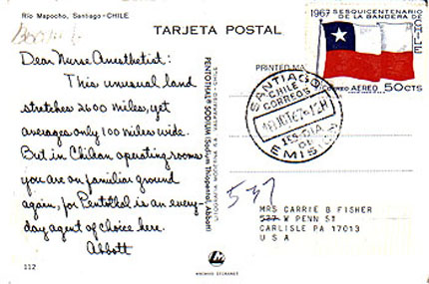
Let’s first look at a postcard’s deltiological differences. All mailings used native cards originally printed in their country of use. Here’s an example of a card used from Chile showing Rio Mapocho in the capital of Santiago. Abbott printed their own message and other details over these. That included the postcard’s left half and sometimes the text in the center vertical section, as you can see on the card on the right.
original back, used
common front
Abbott back
Abbott’s overprinting is the source of Dear Doctor card non-philatelic differences and varieties.

Slide 5
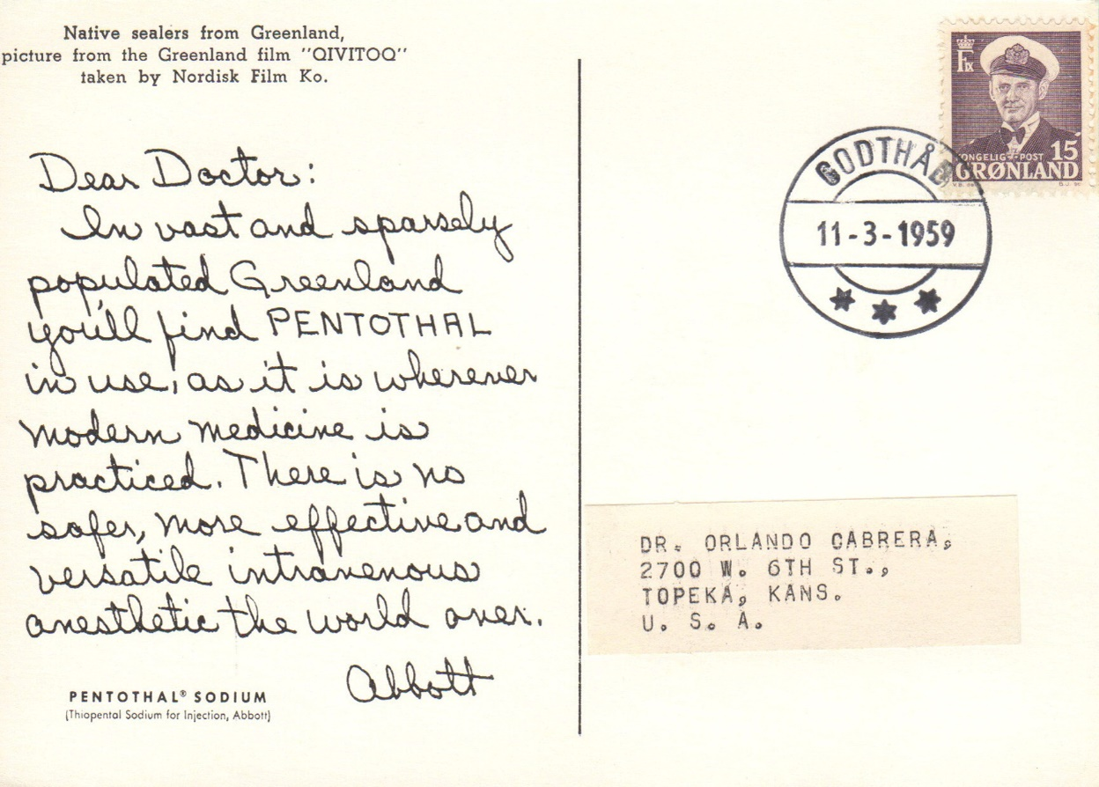
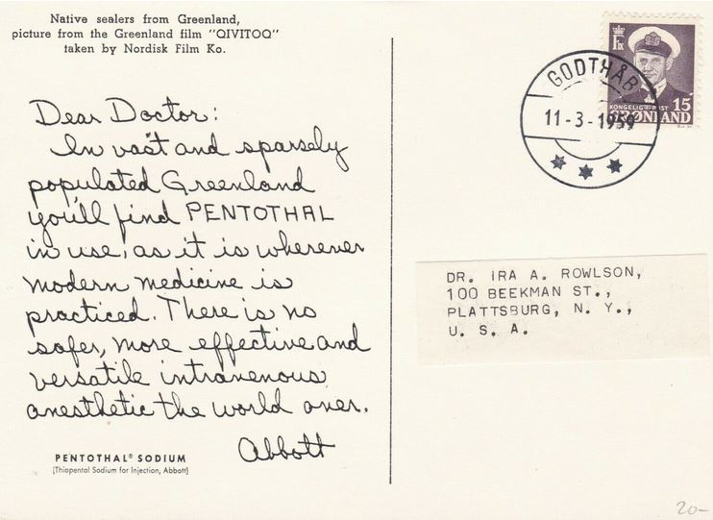
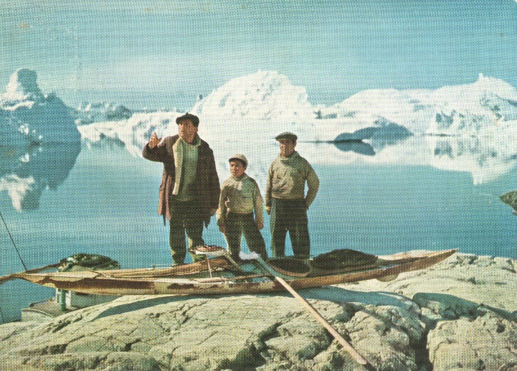
We’re going to start out with an easy one. Look closely at these two cards. Other than the person each is addressed to, what’s different about them?

Slide 6
Absolutely nothing! The complete mailing of these cards from Greenland was accomplished on only one day using the same stamp and postmark.

Slide 7
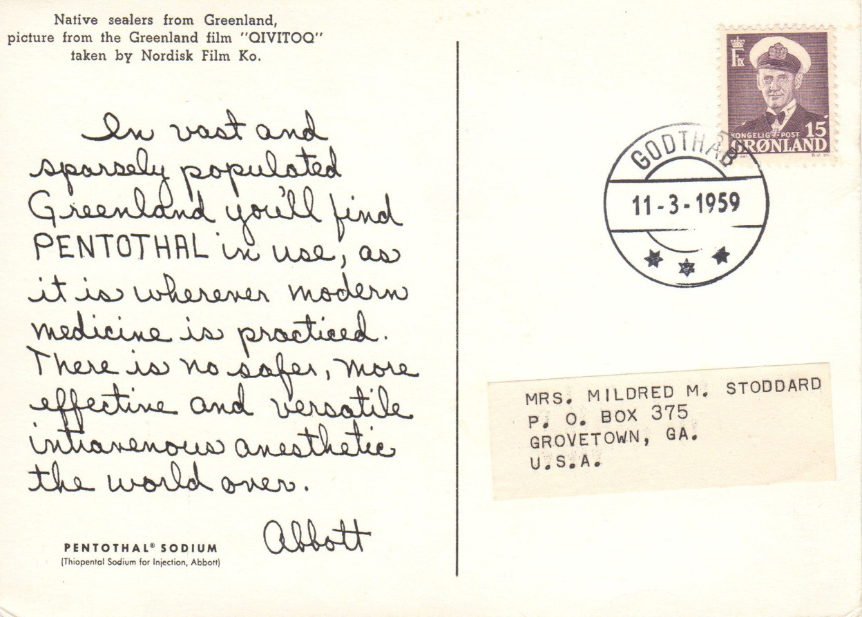
Same card on the left, different card on the right. Any difference between these two?

Slide 8
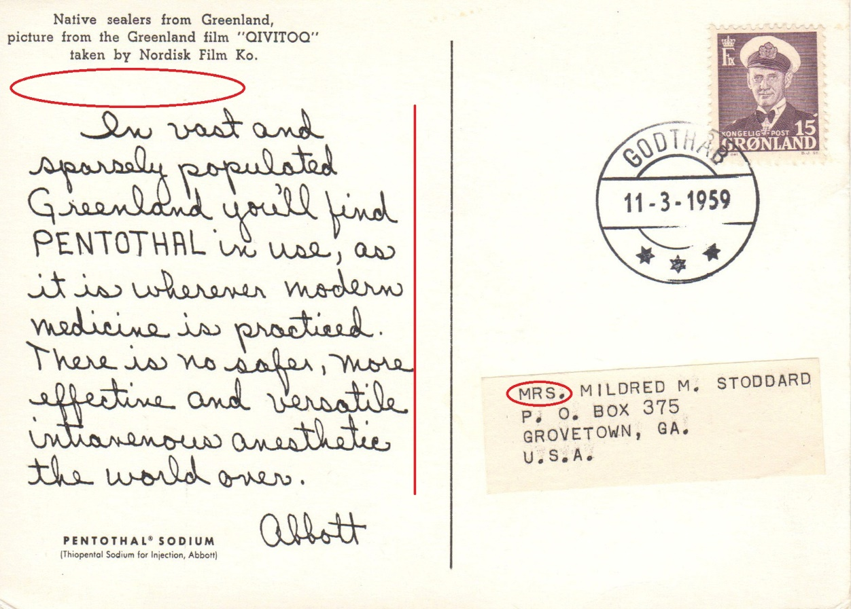
The written message is the same and in the same handwriting, but spaced differently. The right card is missing “Dear Doctor” and was sent to a nurse. “Nurse” was used on later mailings.

Slide 9
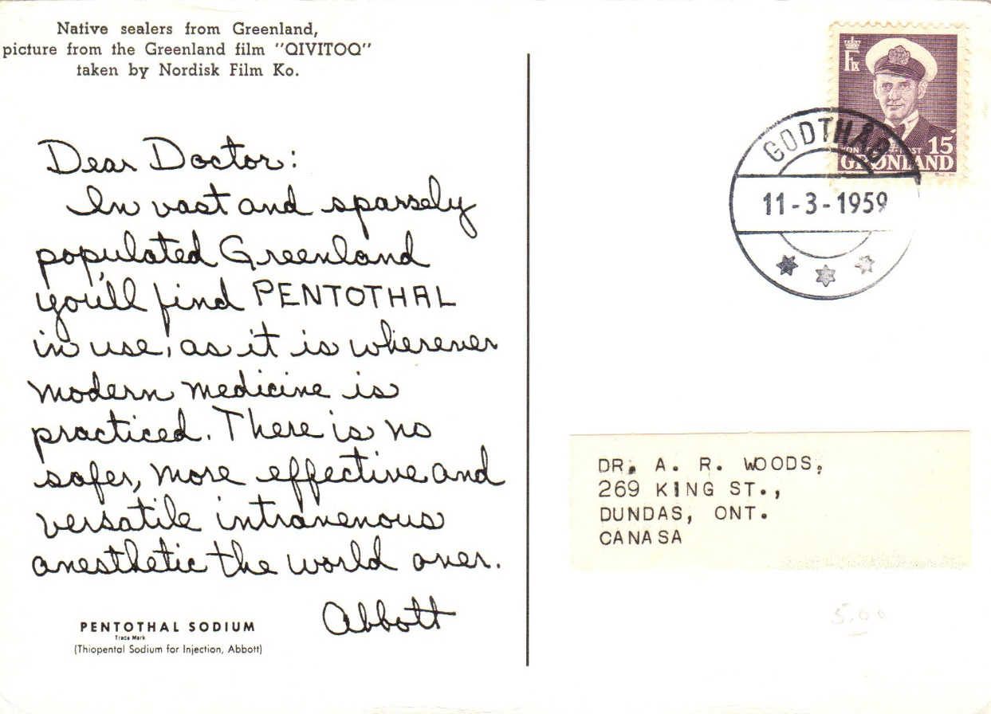
Same card on the left, different card on the right. What’s the difference?

Slide 10
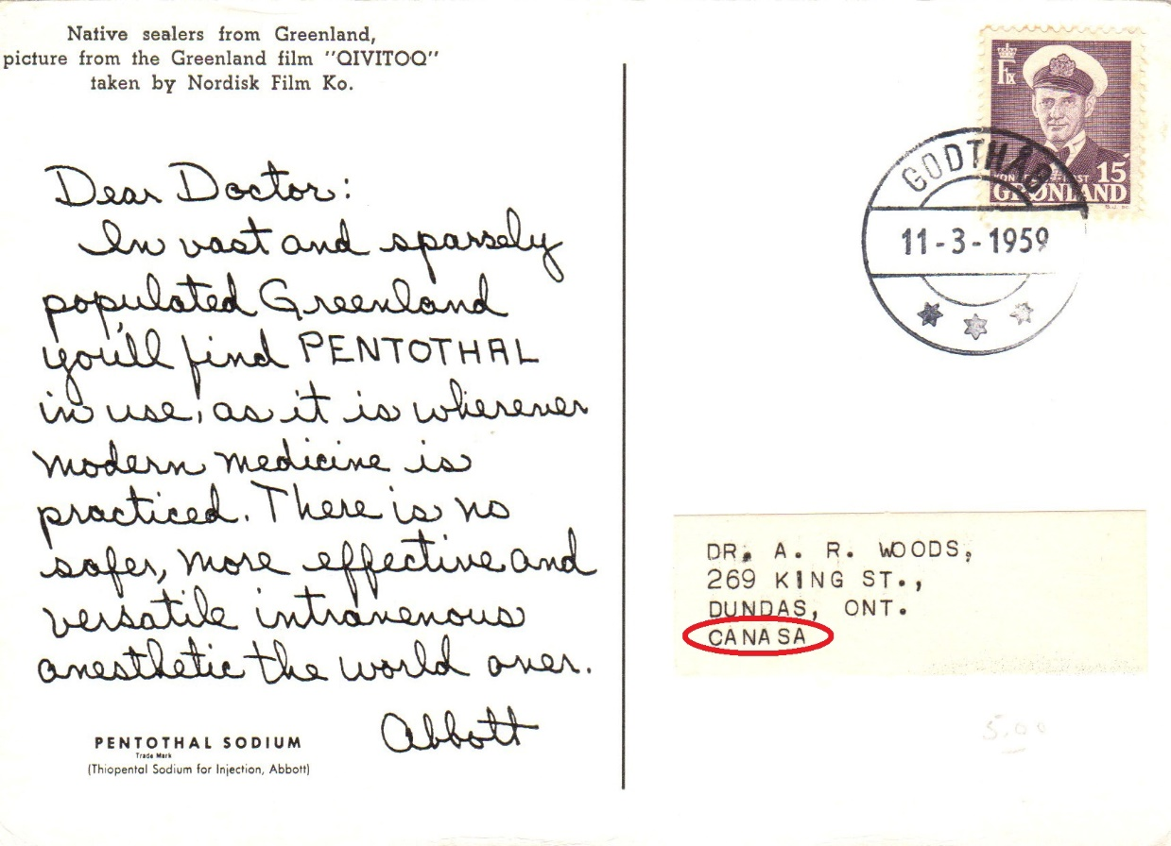
The right card was sent to Canada, and yes, Canada is spelled wrong! None the less it arrived at its destination. There’s one more difference between these. Did you catch it?

Slide 11
“Trade Mark” was added under the drug name on the card sent to Canada.

Slide 12
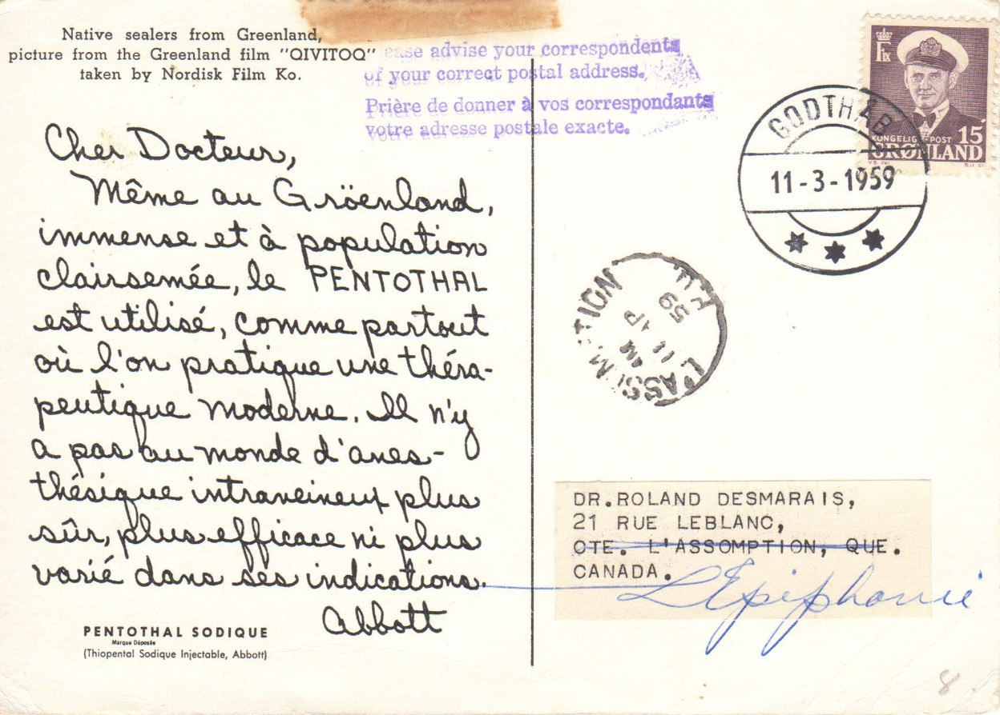
Here’s an easy one, both mailed to Canada. What’s the difference?

Slide 13
Parles vous français? Even if you don’t read French, the recipient of the right postcard was expected to. The doctor had also moved!

Slide 14
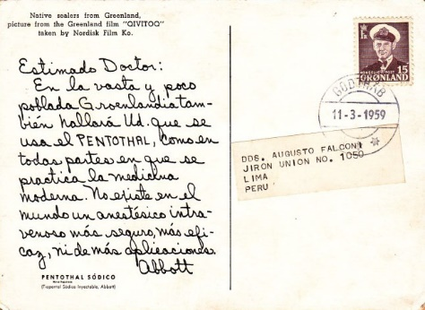
Perhaps you prefer Spanish, as in this example to Peru? Other postcards from this mailing are known to have been sent to Argentina, Belgium, the Belgian Congo, Germany, Italy, and Sweden.

Slide 15
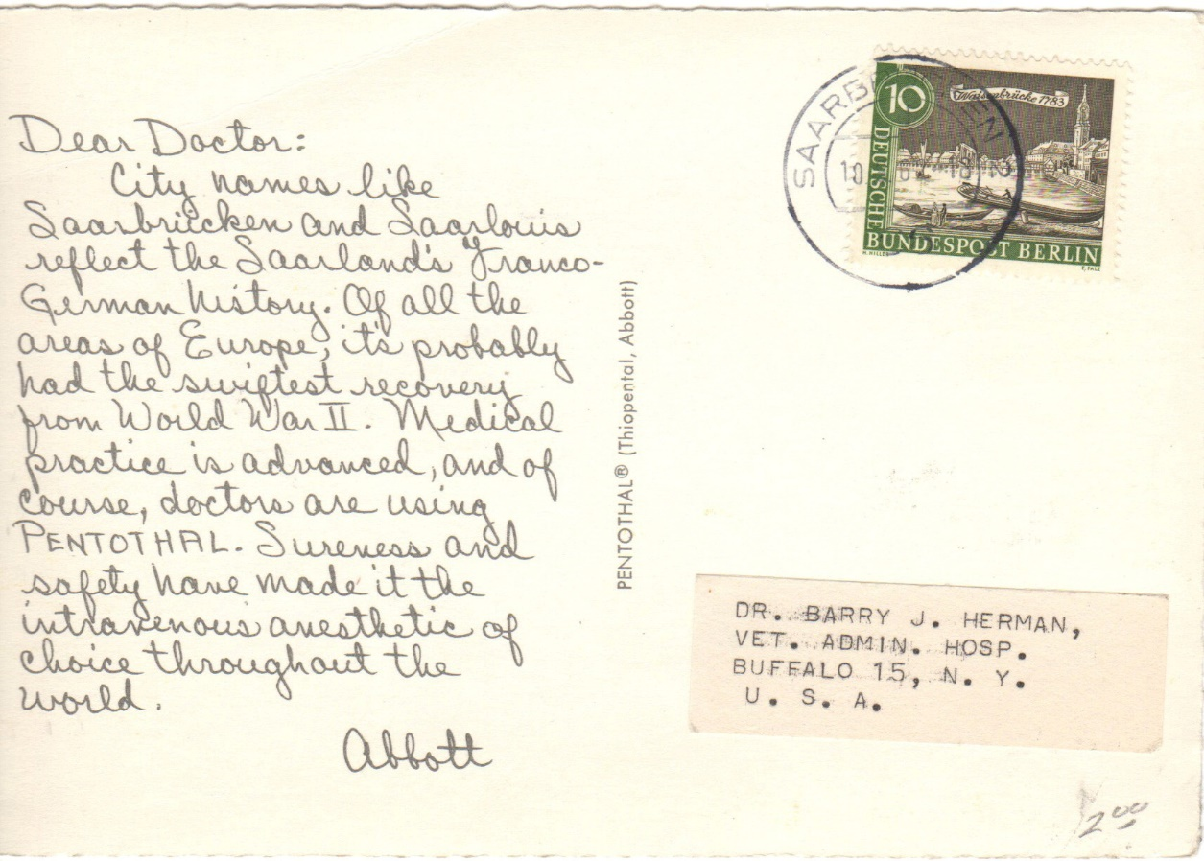
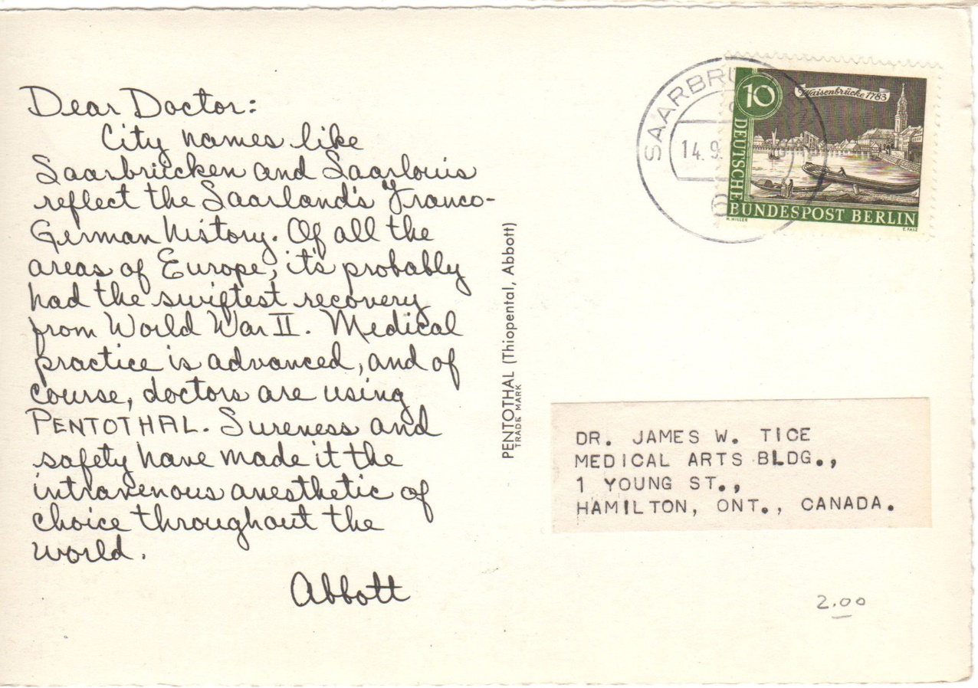
Can you spot what’s different between these two cards, one to the US and one to Canada, other than the text of one appearing darker than the other?

Slide 16
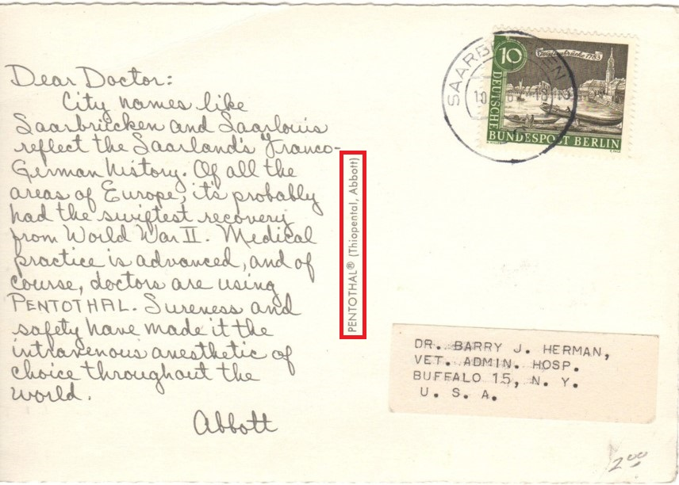
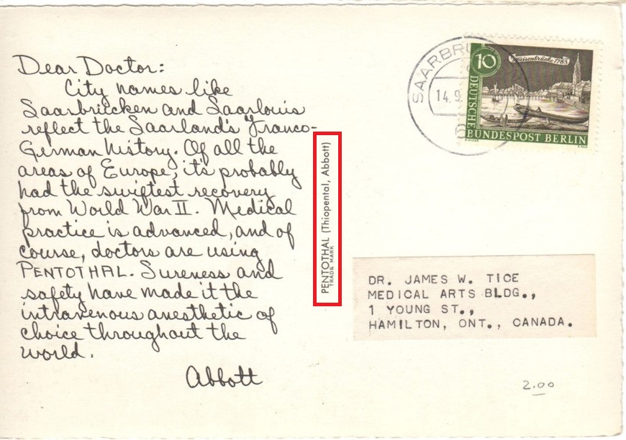
Again, there is a difference showing a registered mark on the US card and “Trade Mark” text on the Canadian card, but now on the vertical dividing line.

Slide 17
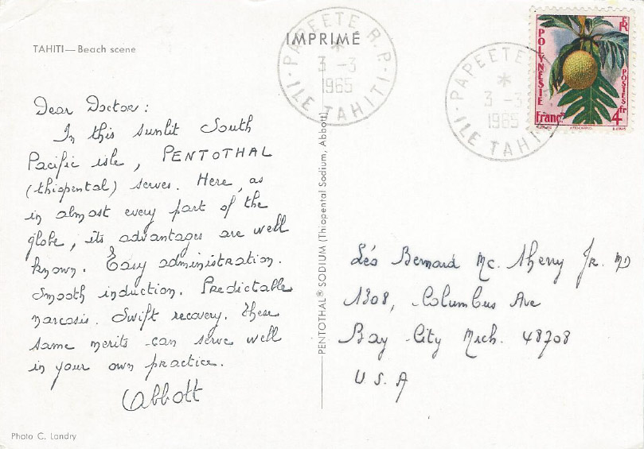
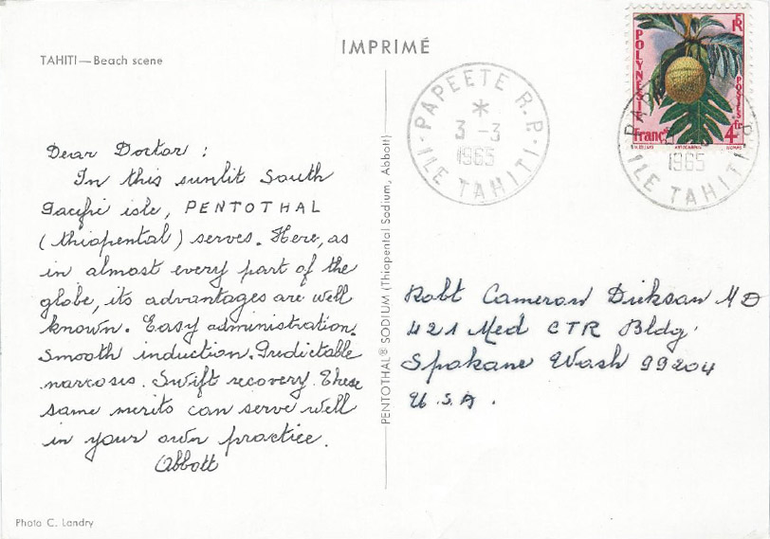
This mailing was sent from the warmer climate of French Polynesia and the island of Tahiti. What’s the difference?

Slide 18
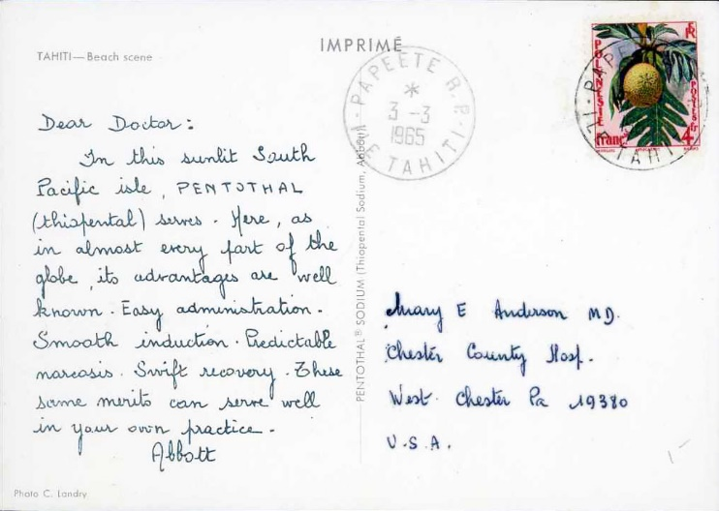
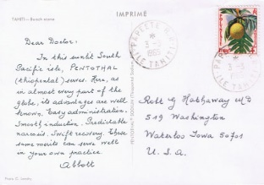
You’re right if you noticed a difference in message “handwriting.” In fact, four are known. This part of each card was printed, not handwritten! Addresses appear mimeographed on, also in different “fonts.”

Slide 19
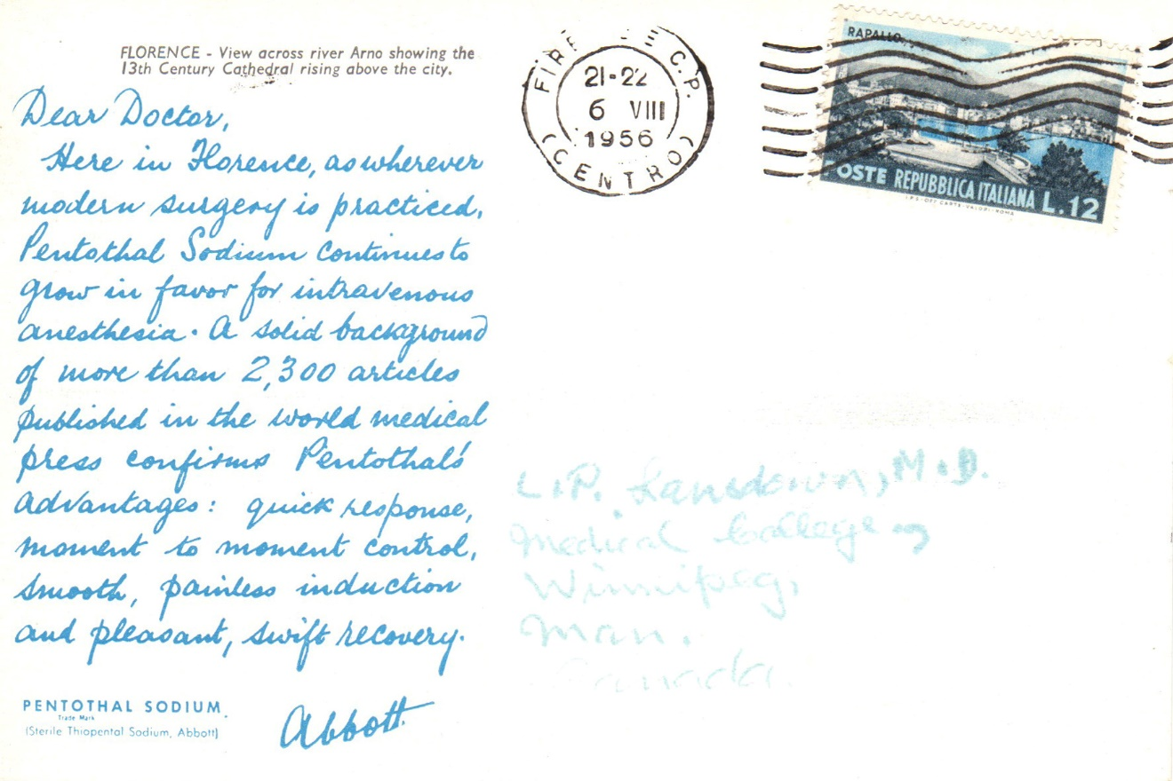
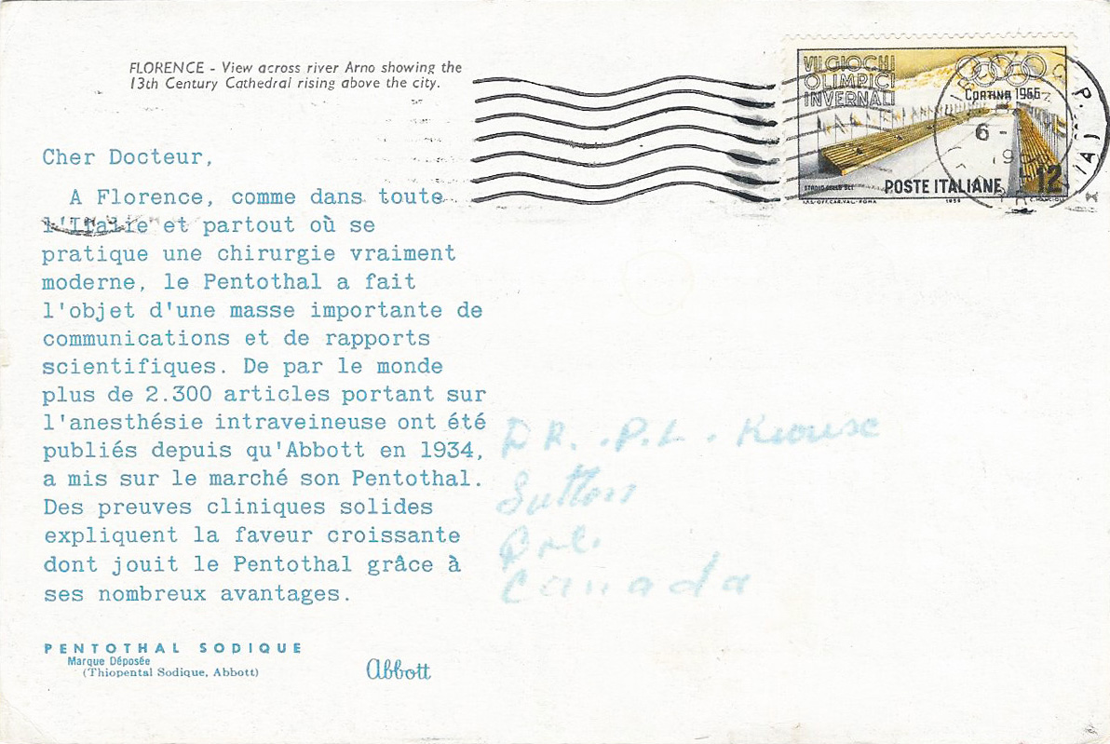
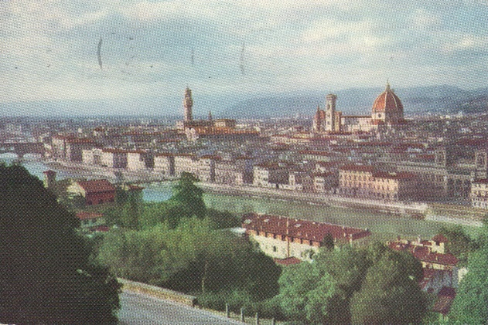
Both of these cards from Florence, Italy were sent to Canada, one in English, one in French. But why is one message in script and the other typed? Not sure. The French text goes into a bit more detail.

Slide 20
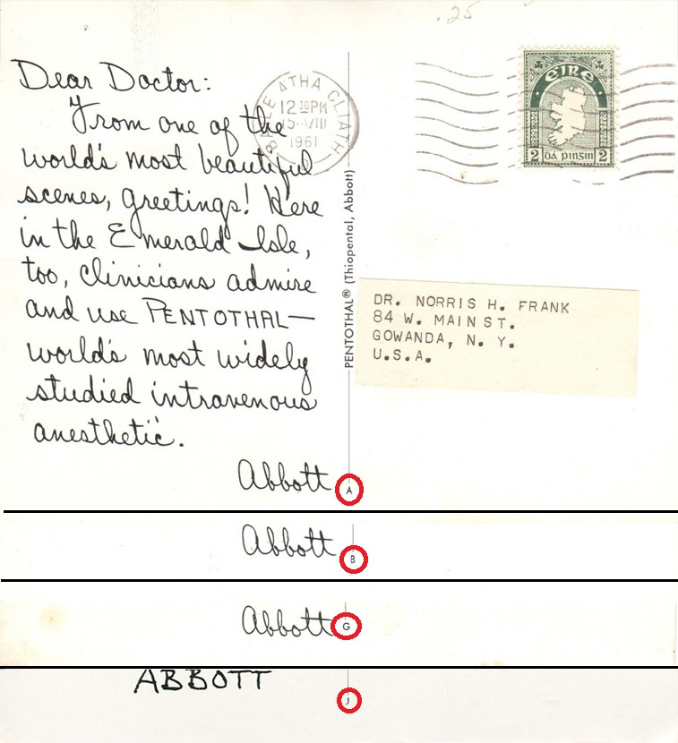
Pay attention to the center dividing line on the message side. In some cases you will find a small letter at the bottom of it that relates to the language of the card. With a very few exceptions here they are…
A = English text to doctors or hospitals in USA
B = English text to doctors in Canada
C = English text (no salutation) to nurse-anesthetists in USA
D = French text
E = Dutch text
F = Greek text or German text
G = Italian text, Spanish text, or Portuguese text
H = Spanish text
I = not recorded/reported
J = Swedish text
K = Swedish text
S = Swedish text
as compiled by Roger Cichorz of Boulder, Colorado

Slide 21
If you’ve been paying attention so far, you’ll remember to look for the following that may differentiate one card from another based on deltiological aspects…
Salutation present or missing
Language of the message
Message “handwritten” or typed
Address label used or printed directly on the card
Image found on the picture side of the card
But there are plenty more philatelic varieties to look for among Dear Doctor postcards! Philatelists, there is real postal history here!

Slide 22
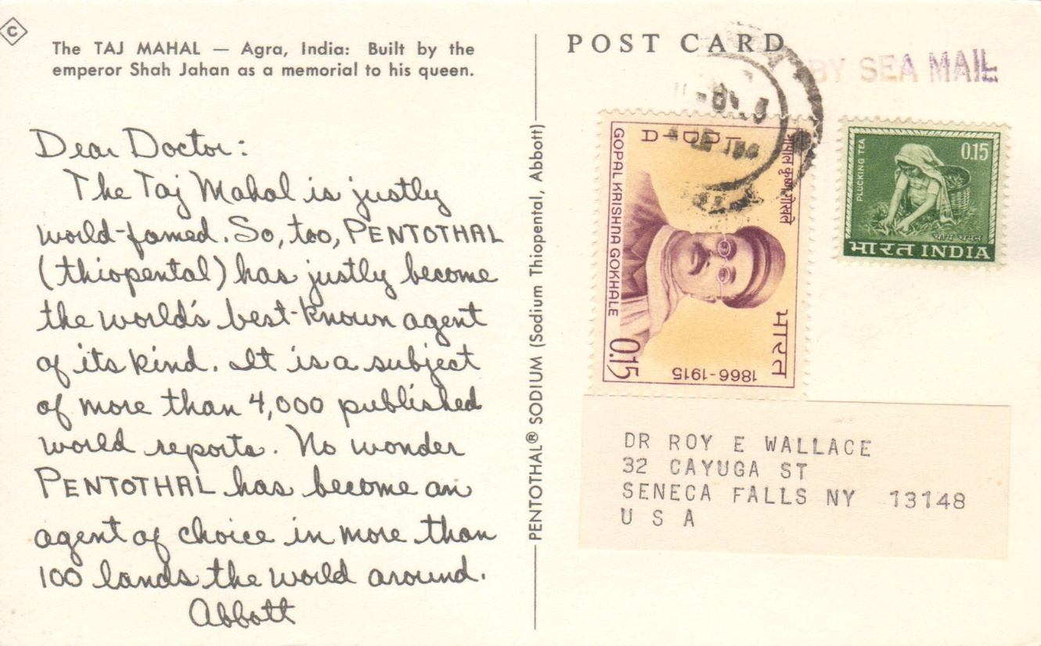
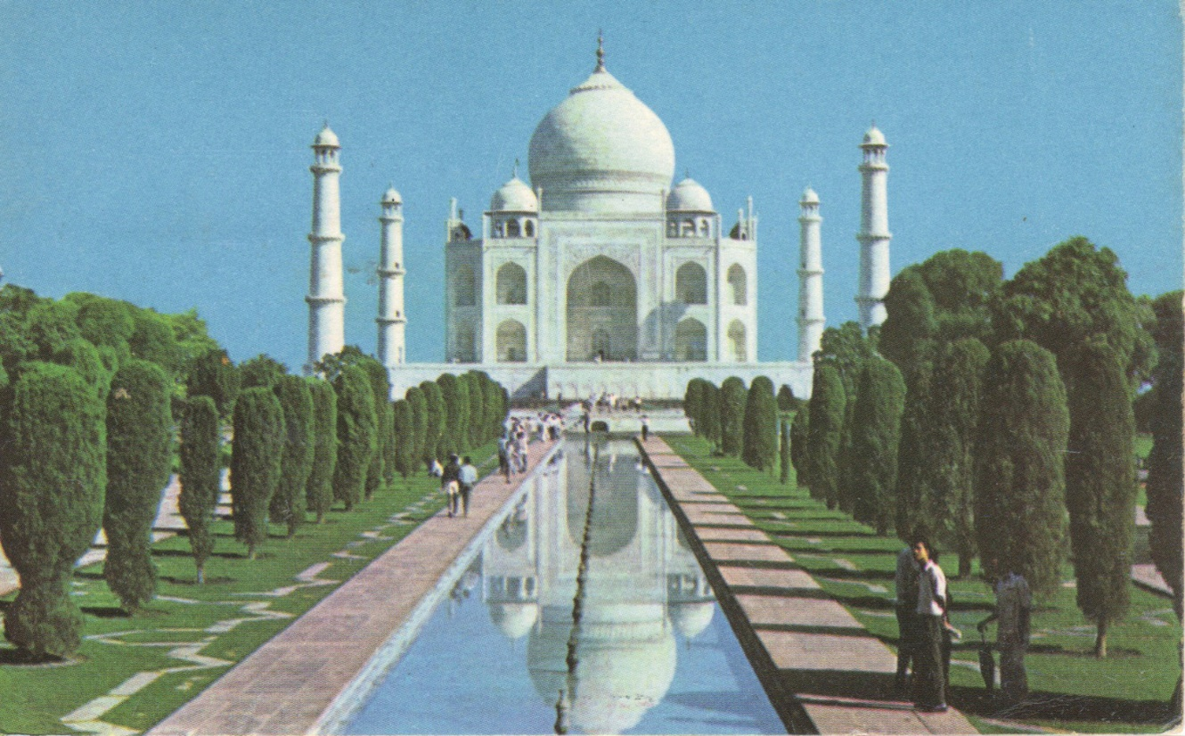
Although only postcards sent from India were endorsed “BY SEA MAIL,” all Dear Doctor postcard mailings were sent at the surface rate, the least expensive method of posting to reduce costs.

Slide 23
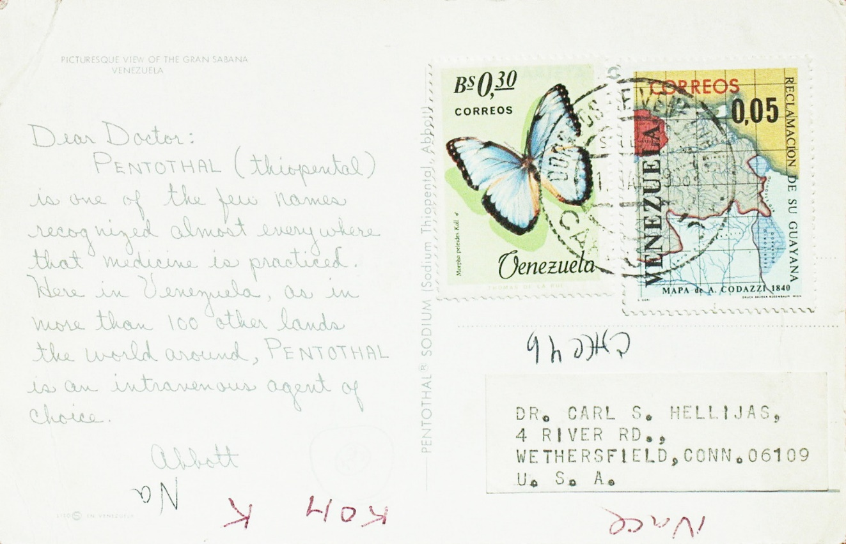
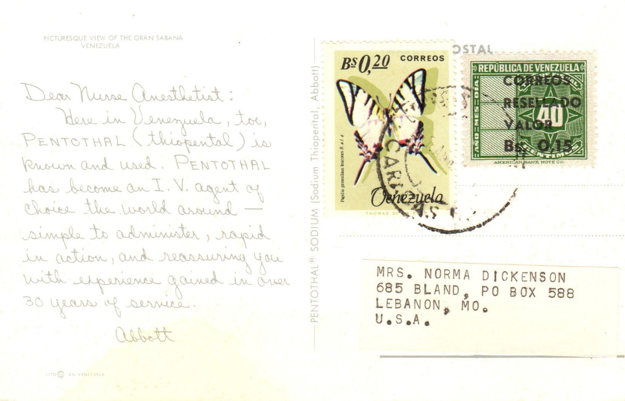
Sometimes different stamps were used bearing the same postage total going to the same country, as shown here. Also note the use of the “Dear Nurse Anesthetist” salutation on this 1966 mailing instead of being absent on pre-1964 mailings. There was a different message to doctors versus nurses.

Slide 24
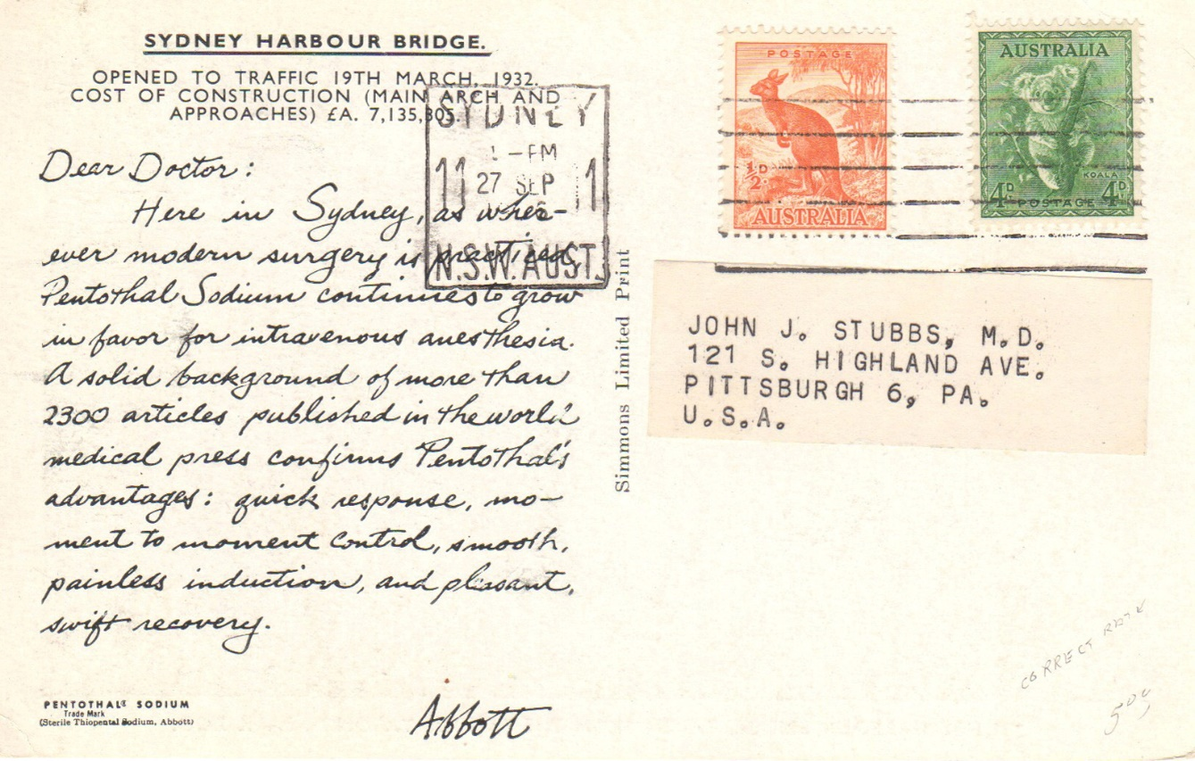
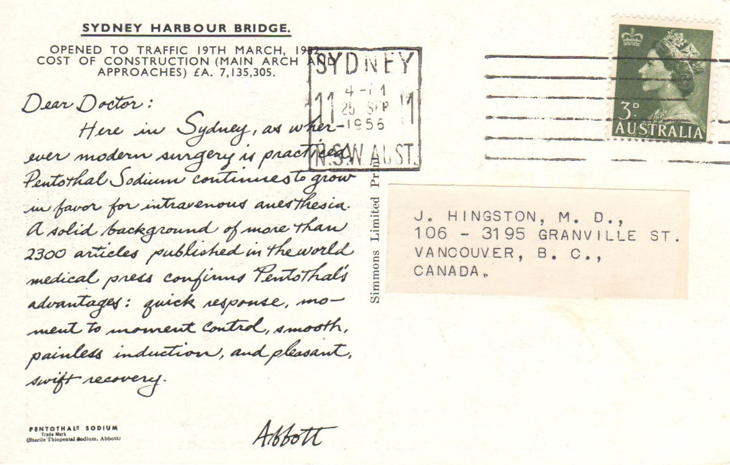
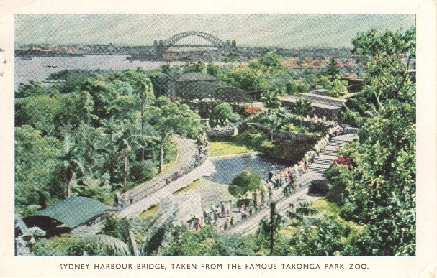
Look closely. Why might the left postcard have 4½d postage from Australia while the one on the left have only 3d?

Slide 25
As part of the British Commonwealth, mail from Australia to Canada was able to travel at a reduced rate, in this case at a 33% discount from the US rate. Most Abbott mailings took place over several days rather than just a single day like this one.

Slide 26
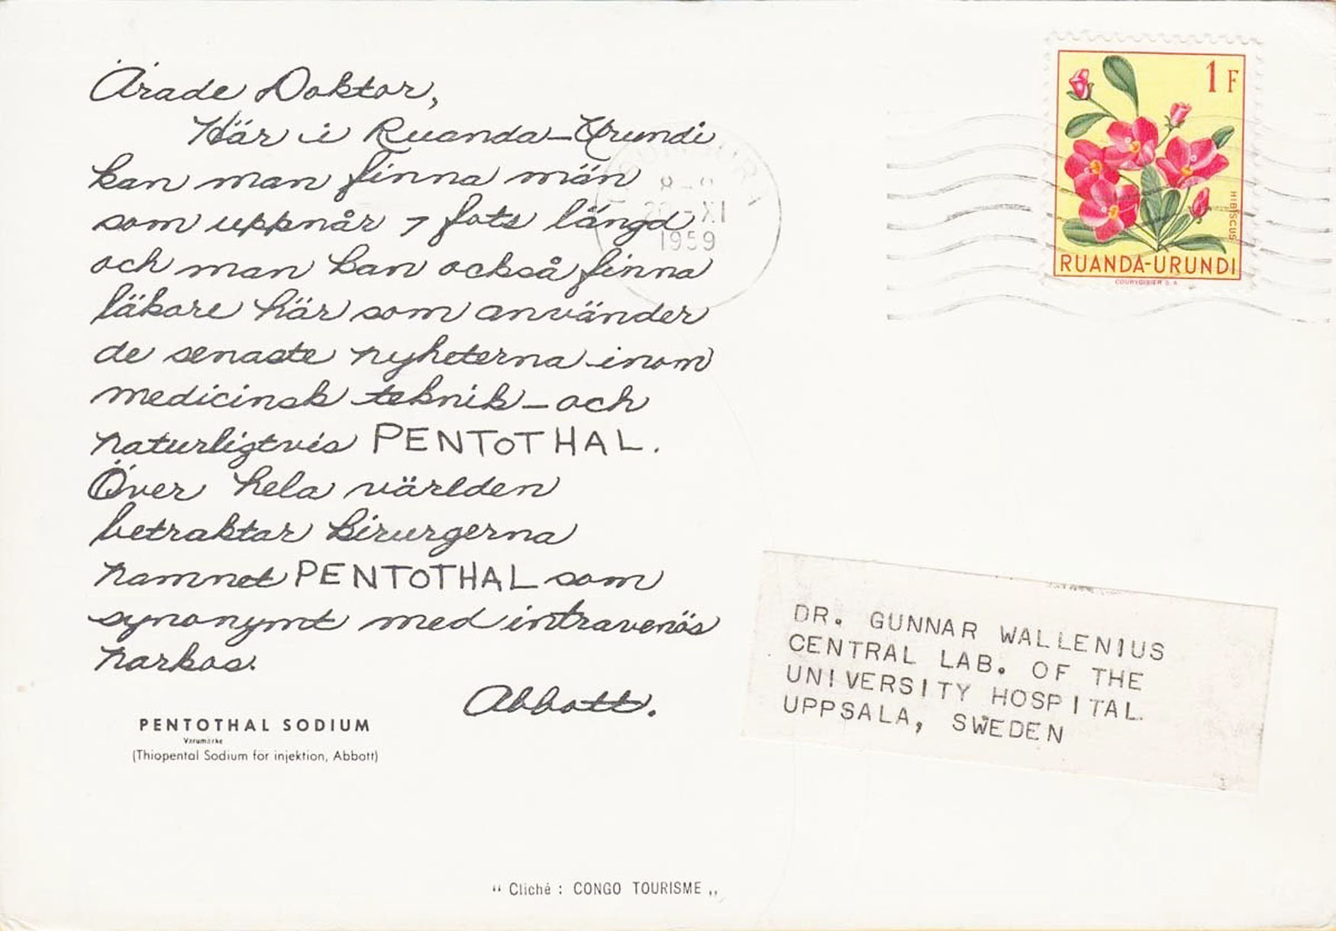
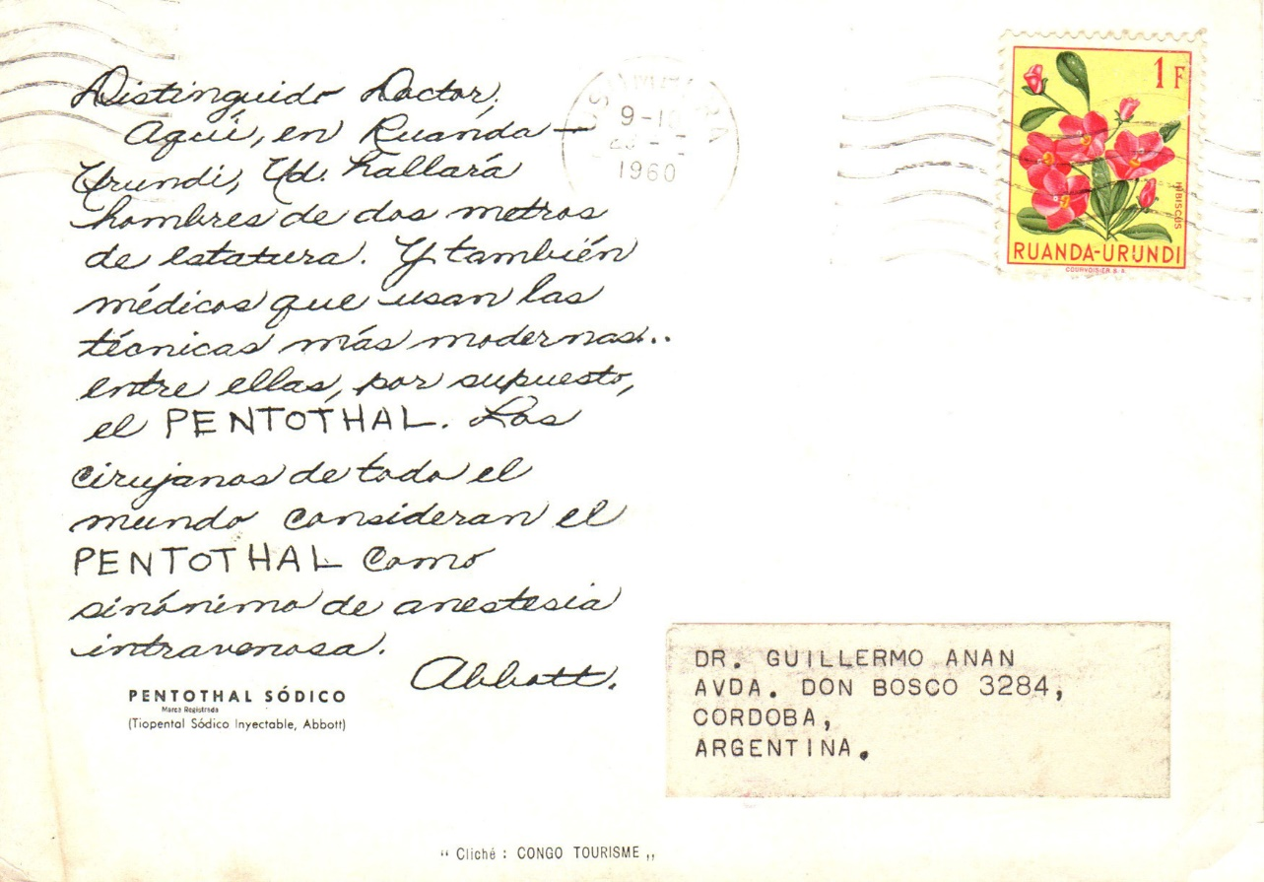
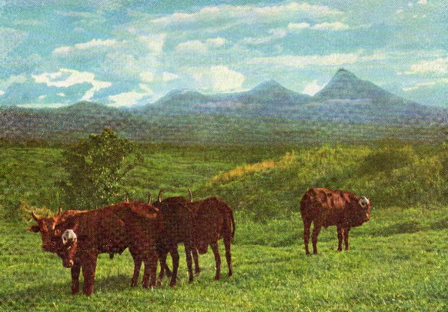
Are you up for a challenge? Specialize in one of the Abbott mailings that took place over an extended time. Mailings from Ruanda-Urundi are recorded as posted between July 17, 1959 to October 9, 1960.

Slide 27
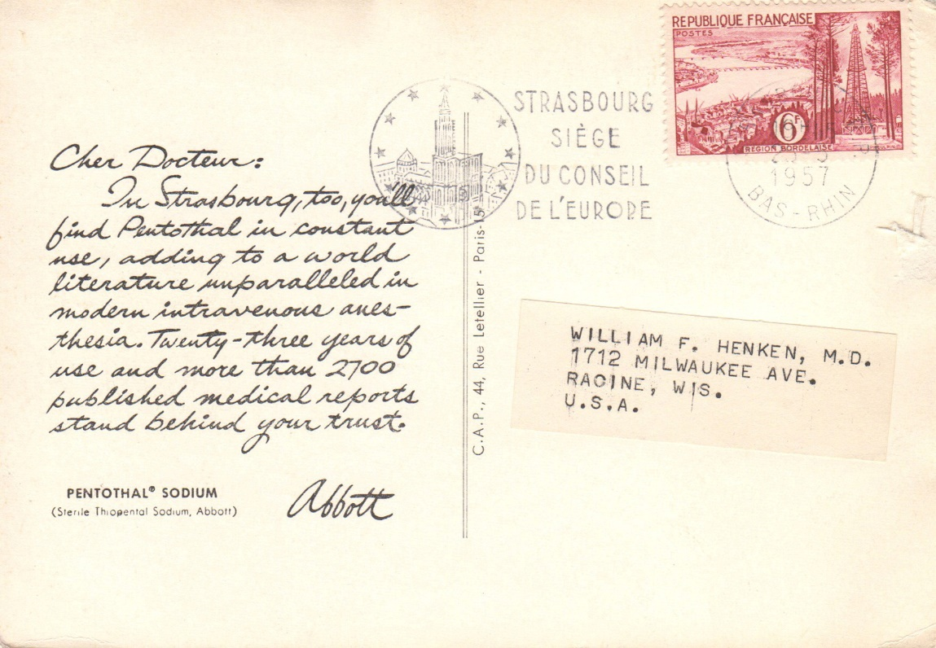
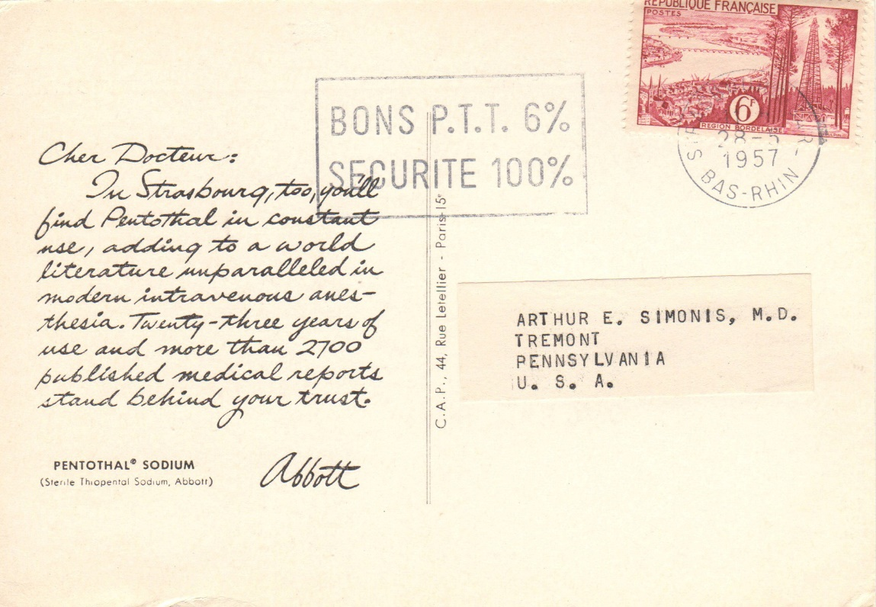
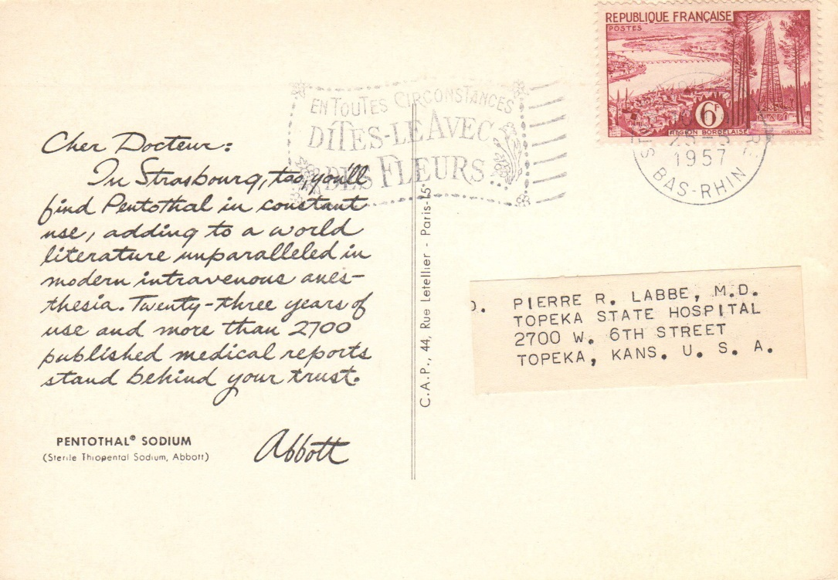
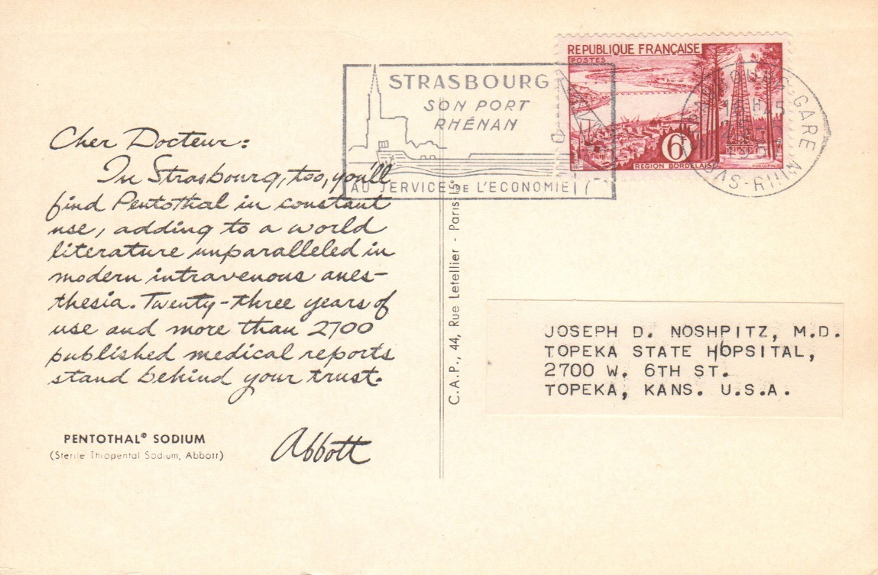
Postmark collectors will find a wealth of varieties.

Slide 28
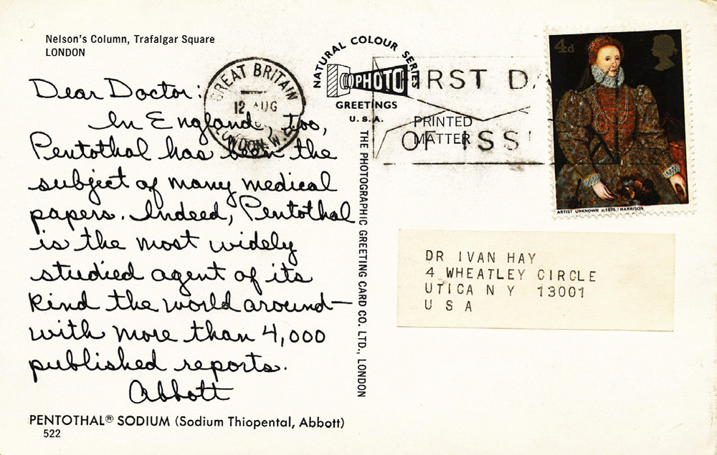
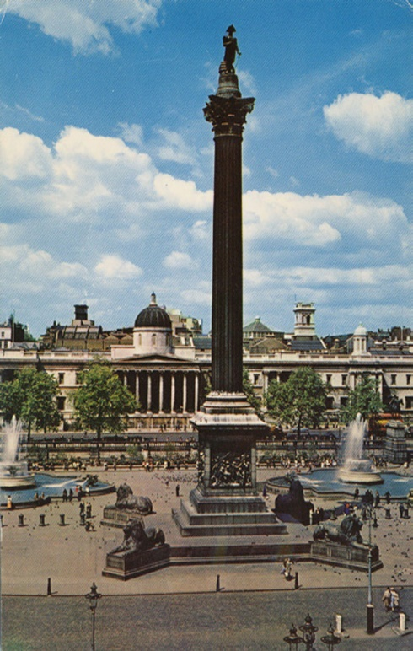
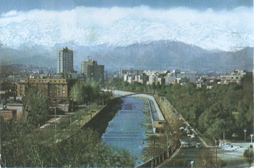
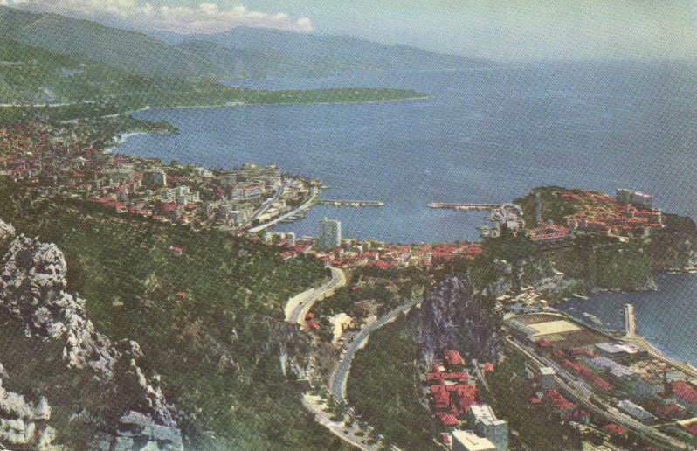
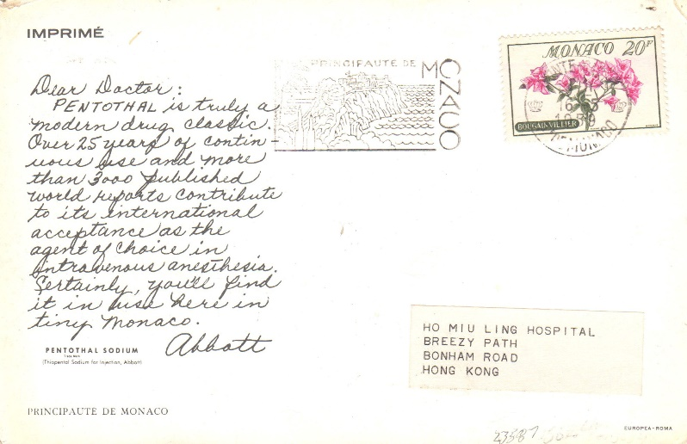
First day cover collectors will find material, too!

Slide 29
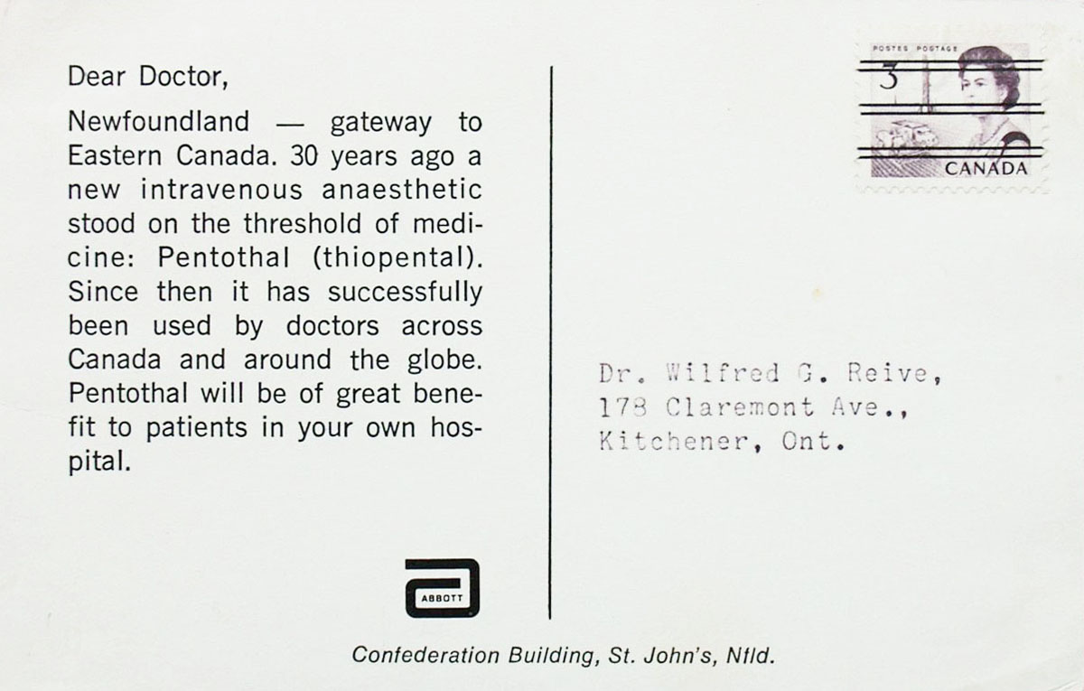
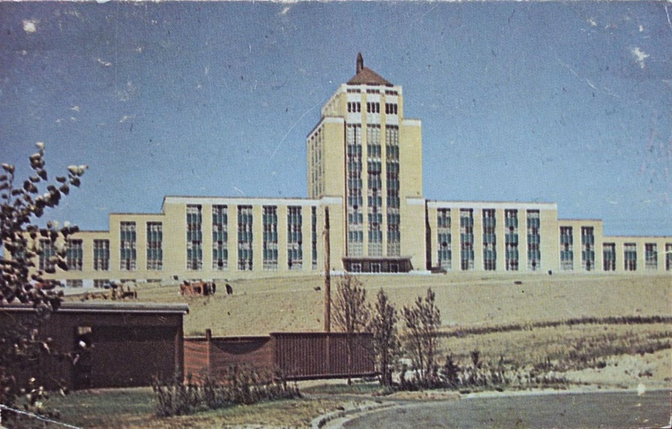
As will precancel and meter collectors.

Slide 30
Finding postcards with auxiliary markings of any kind are a plus, especially those that can help determine how long it took a card to reach its addressee.

Slide 31
Let’s summarize some of philatelic aspects to look out for…
Stamps used
Destination country
Rate of the postcard mailing
Cancellation used
Date of the cancellation
Auxiliary markings of any kind

Slide 32
Now for bloopers! Yes, even postcard printers make goofs.

Slide 33
Someone mixed up western Canada with South America!

Slide 34
Ooops, did anyone de-dupe the mailing list? Some recipients
saved everything! Note that one
of these was postmarked at 9 AM
and two in the
same hour, 6 PM.

Slide 35
A favor mailing, including a handwritten tag line and address?

Slide 36
I hope you found this presentation interesting. Perhaps you may be the next person to get hooked on collecting “Dear Doctor” postcards! Check out the web site!

