Slide 1
Introduction to “Dear Doctor” Postcards:
Junk Mail from Exotic Lands
By Tom Fortunato, January, 2016
for the Rochester Philatelic Association

Slide 2
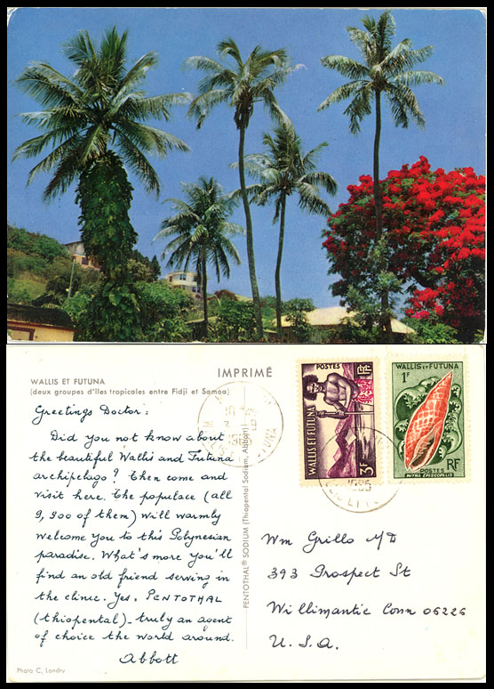
I’ll bet you’ve seen postcards like this before and wondered about them. This presentation is meant as an introduction to this fascinating area of postal history. They’re commonly known as “Dear Doctor Cards” based on their salutation.

Slide 3
In days before the Internet, email and spamming, mail was used as the primary form of cheap advertising by companies looking to sell their products and services.
Perhaps no other business exploited this marketing strategy more than the drug industry.

Slide 4
Postcards were the rage at the turn of the 20th century and drug manufacturers started sending out mailings to doctors touting the latest and greatest pharmaceutical medicines they made.
Mailings sent from exotic lands proved to be especially eye-catching to the recipient for both the pictures found on one side and the stamp and message on the other.

Slide 5
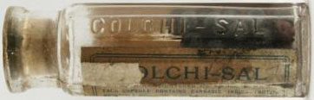
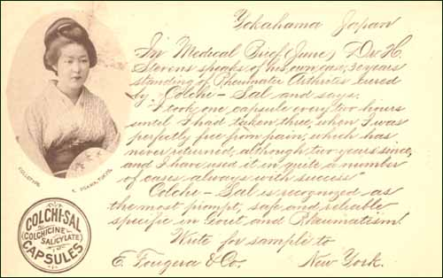
One of the earliest of these mailings was sent in November and December 1898 by the New York City based drug firm E. Fougera & Company. Their postcards introduced Colchi-Sal capsules to doctors as a remedy for gout, rheumatism, and rheumatic arthritis. Its major ingredient- cannabis.
http://www.deardoctorpostcards.com/art-1980japanesephilately.html

Slide 6
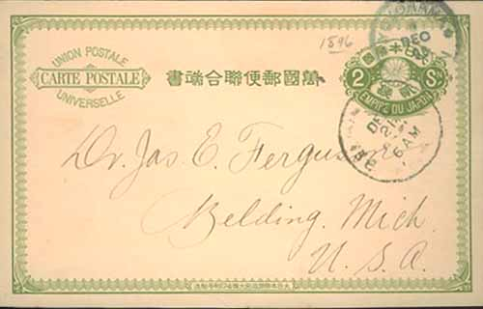
* Int’l post card rate from Japan to the U.S.- 2 sen (1.0316 cents)
* U.S. domestic postcard rate- 1¢
If the cost to print the messages on these cards was less expensive in Japan than the U.S.,
it would have been cheaper to mail these from Japan than within the U.S. itself!

Slide 7
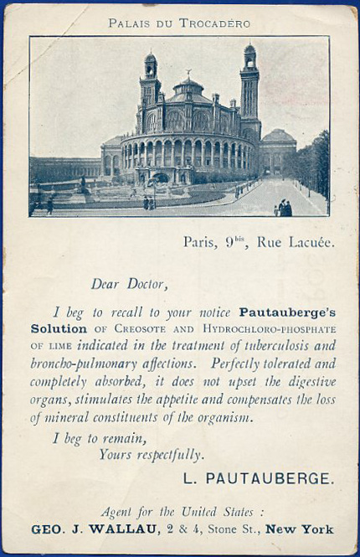
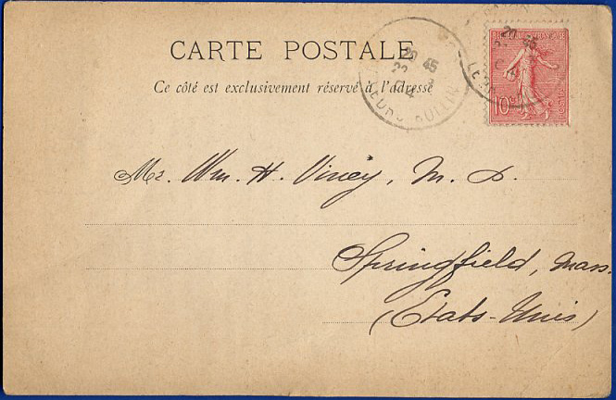
First known use of the salutation “Dear Doctor.”
Pautauberg’s Solution was a well-prescribed treatment for tuberculosis for at least 20 years before this postcard was mailed in August 1904 from company headquarters in Paris to a doctor in Springfield, Massachusetts.

Slide 8
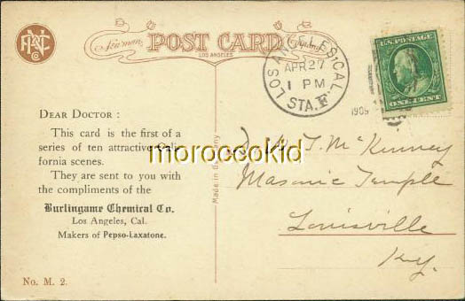
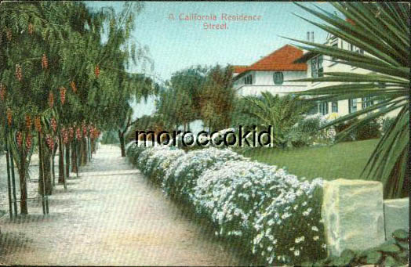
Not all cards were sent from overseas. Here is Card #1 mailed April 27, 1909 of a series of 10 cards sent by the Burlingame Chemical Company of Los Angeles advertising Pepso-Laxatone, a digestive laxative that contained 14% alcohol. The series depicted “attractive California scenes.”

Slide 9
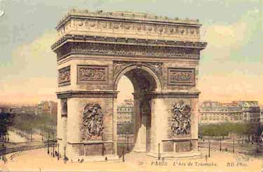
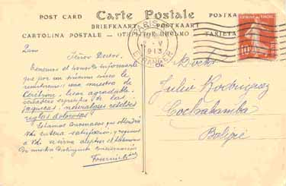
Postmarked May 2, 1913 in Paris, this card was written in Spanish and sent to a doctor in Bolivia. It touts a drug called Ceribrine, for neurological pain by the French company Fournier. It is one of at least seven sent 1911-1916 depicting different French tourist sites sent to doctors in Argentina, Bolivia and Uruguay.
http://www.deardoctorpostcards.com/art-2008fournier.html

Slide 10
Mailed April 4, 1917 by Laboratories Ch. Couturieux in France to Rosario, Argentina, , this card advertises “Levurina extract” as a medication for skin infirmities of all kinds, including acne, eczema and herpes. Note the military themed image, as WWI was nearing an end.

Slide 11
A different drug mailing,
again to Argentina,
also with a military
theme-“The War 1914-
1915” of men preparing
trenches. An anti-tuberculosis drug, “Acherol, despite the war, is still being manufactured and sold.” By an unknown drug company.

Slide 12

Fournier is known to have sent a military series of
cards. Here the Battle of
The Somme is seen, a joint British and French offensive in 1916 against the Germans, marked by the first battle using tanks. Sent September 20, 1918. The company’s Paris return address is in the upper left.
http://www.deardoctorpostcards.com/art-2008fournier.html

Slide 13
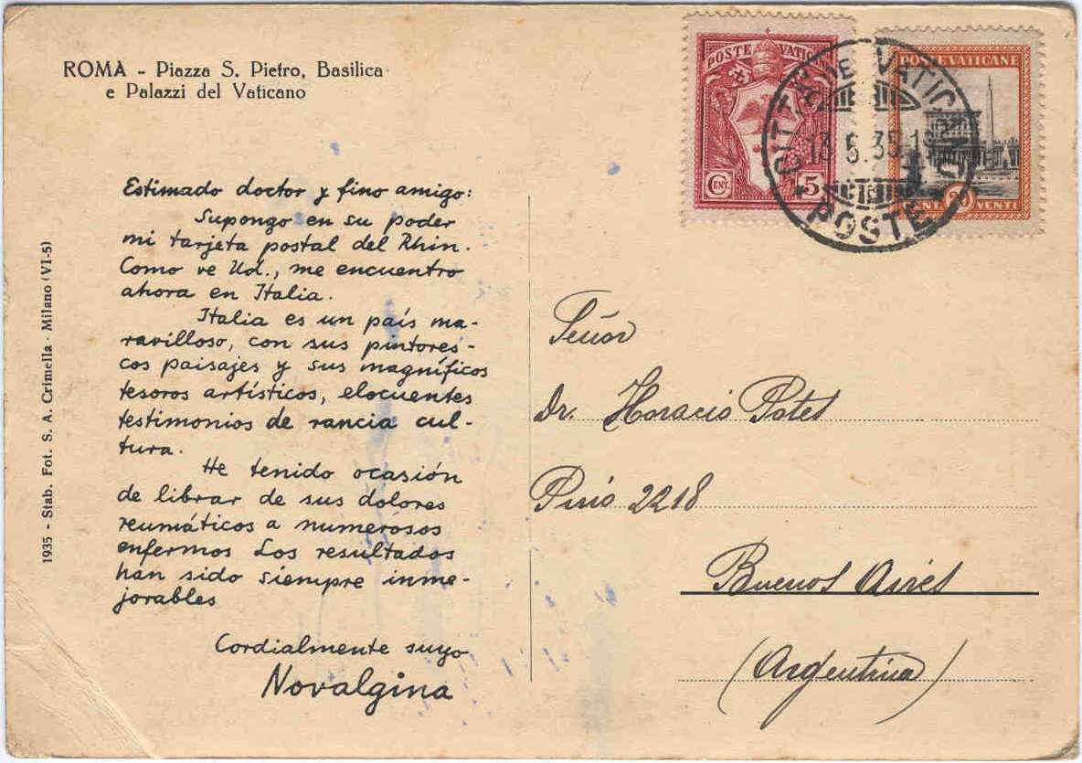
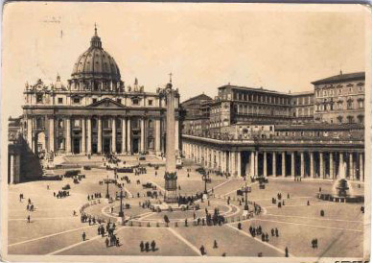
Postmarked September 13, 1935, this card mailed from the Vatican in Spanish to a doctor in Buenos Aires, it advertises the drug Novalgina (diperona) as a pain and fever reducer originally developed in 1922 as “Novalgin” by the German company Hoechst.

Slide 14
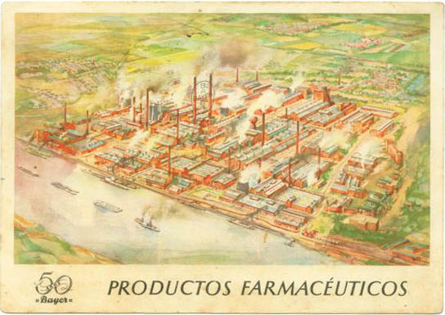
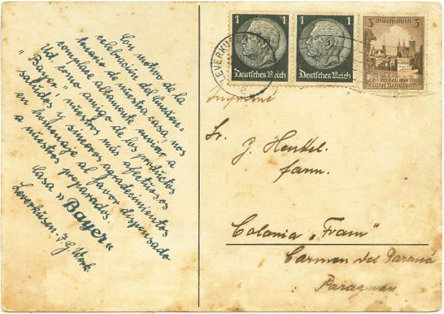
Everyone has heard of Germany’s Bayer. 1937 marked the company’s 50th anniversary. Here’s a card in Spanish mailed from the company’s headquarters in Leverkusen to a doctor in Paraguay. It’s main plant is depicted along the Rhine river.

Slide 15
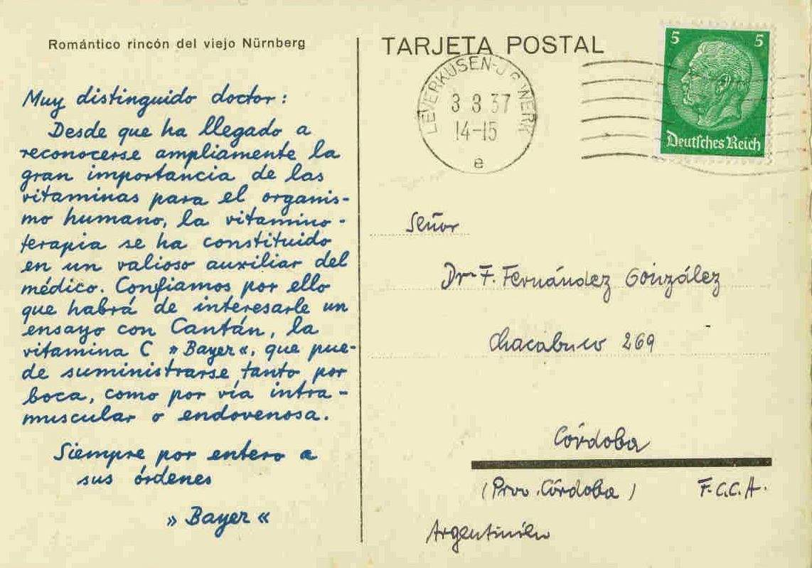
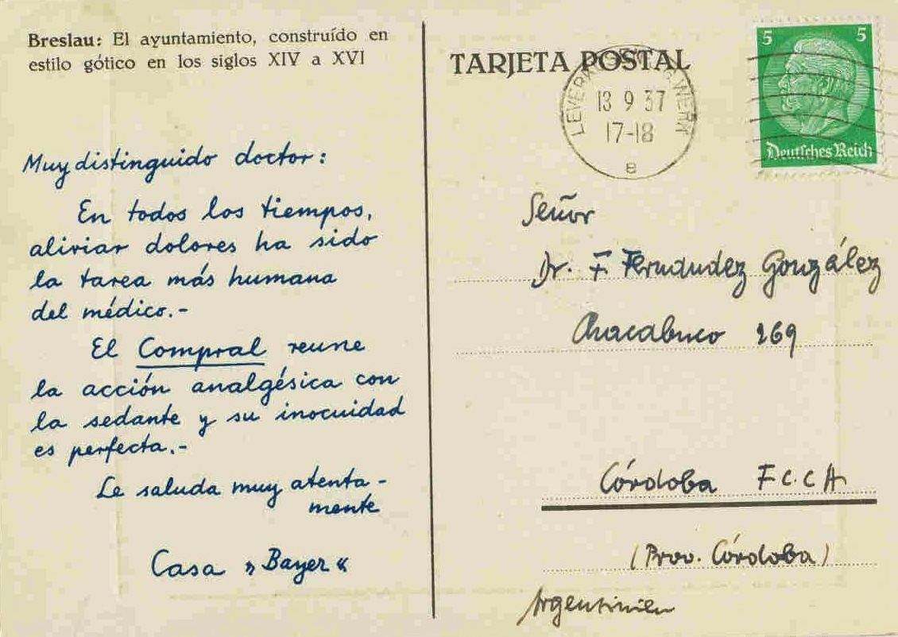
Here are 2 of 4 known cards mailed in 1937 from headquarters in Leverkusen to doctors in Argentina. All depict historic sites of Germany, mailed on:
Nuremberg- March 3 Frankfurt- May 28 Wurtzburg- June 25 Breslau- September 13
http://www.deardoctorpostcards.com/art-2005bayer.html

Slide 16
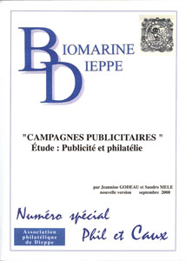
Headquartered in Dieppe, France, famous for its healing mineral waters, Laboratoires La Biomarine produced Dear Doctor cards for many decades from 1947 to 1966 advertising three major drugs they produced, all with a sea-water base:
> Marinol –calcium and phosphorus
> Ionyl - phosphorus, manganese and magnesium
> Plasmarine – calcium, phosphorus and manganese
This company took to postcard promotional campaigns like no other, relying on mail from exotic lands to capture the attention of French-speaking doctors in France and abroad.
Catalog of La Biomarine postcard campaigns

Slide 17
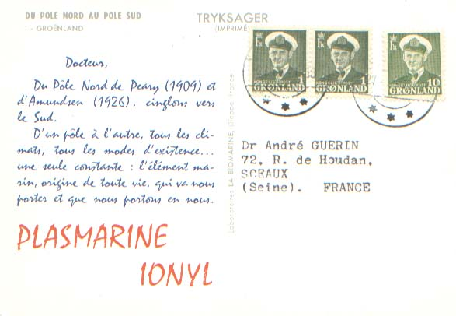
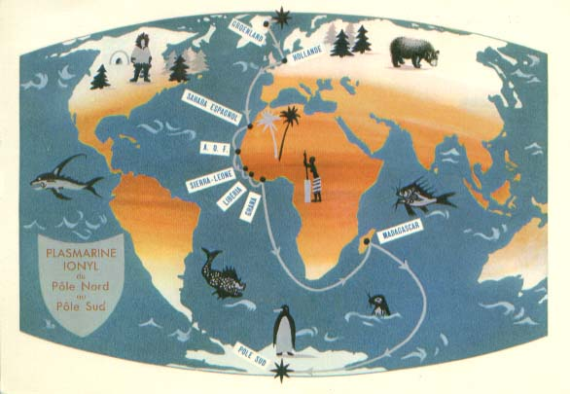
Their advertising division, “Publimer,” created mailings sent to doctors from 6 to 16 countries in various mini-tours, with starting and ending points, along with story lines that flowed from one stop to another.
Tour 12 - North Pole to South Pole Tour: 1958-1959 from Greenland to French Southern and Antarctic Territories

Slide 18
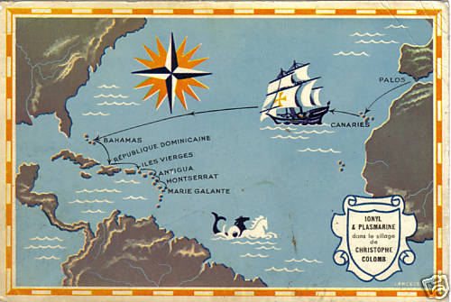
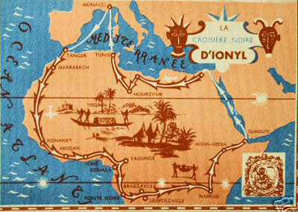
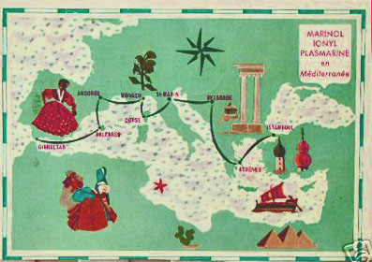
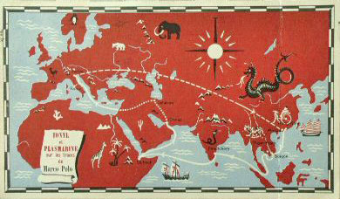
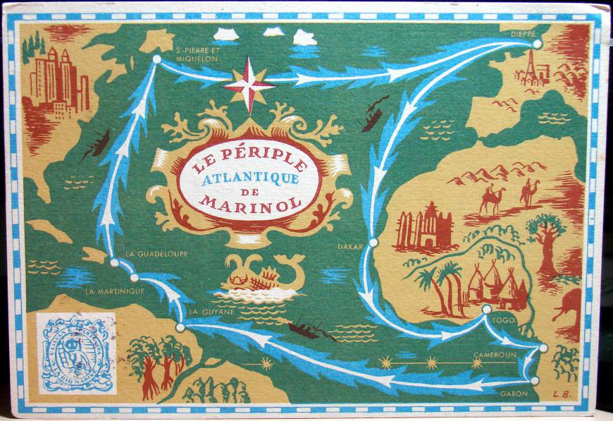
All of these “tours” started with Card #1 that was always a map showing the countries planned to be visited.

Slide 19
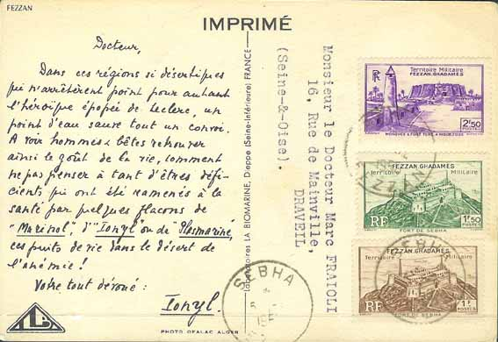
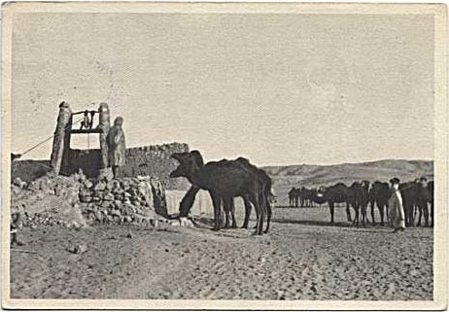
La Biomarine tours took pride in highlighting locales around the various French colonies and foreign possessions.
Philatelic or not, mail sent from the French military post of Fezzan in southwestern Libya is very rare.

Slide 20
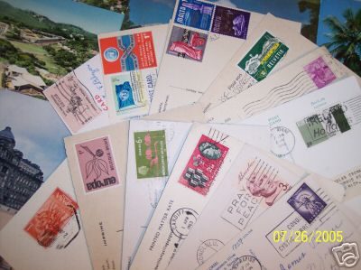
Here in the U.S. collectors may be most familiar with “Dear Doctor” cards from Abbott Labs. Their numerous postcard mailing campaigns ran from 1956 to 1968. Over 193 face-different cards have been recorded to date, with a wealth of varieties in each type.

Slide 21
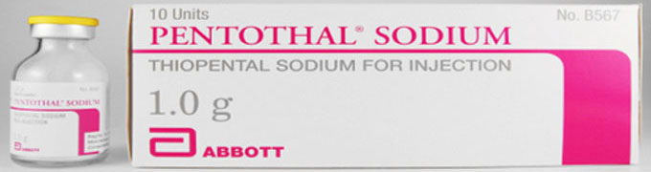
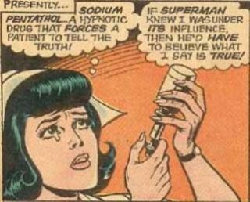
All card advertise only one of their many drugs—pentothal sodium—a fast acting intravenous anesthetic used primarily in operating rooms. It was invented in 1936 by an Abbott scientist, Ernest Volwiler, who later became president of the multi-national company.
The trademarked drug was also know as “truth serum,” especially during the Cold War era and is typically mis-spelled, as in this Superman cartoon.

Slide 22
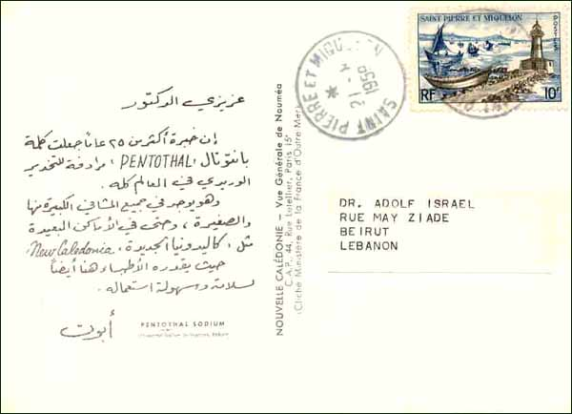
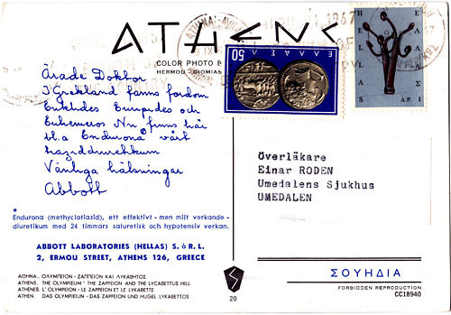
Cards have been found in 10 languages: Arabic, Dutch, English, French, German, Greek, Italian, Portuguese, Spanish, and Swedish…

Slide 23
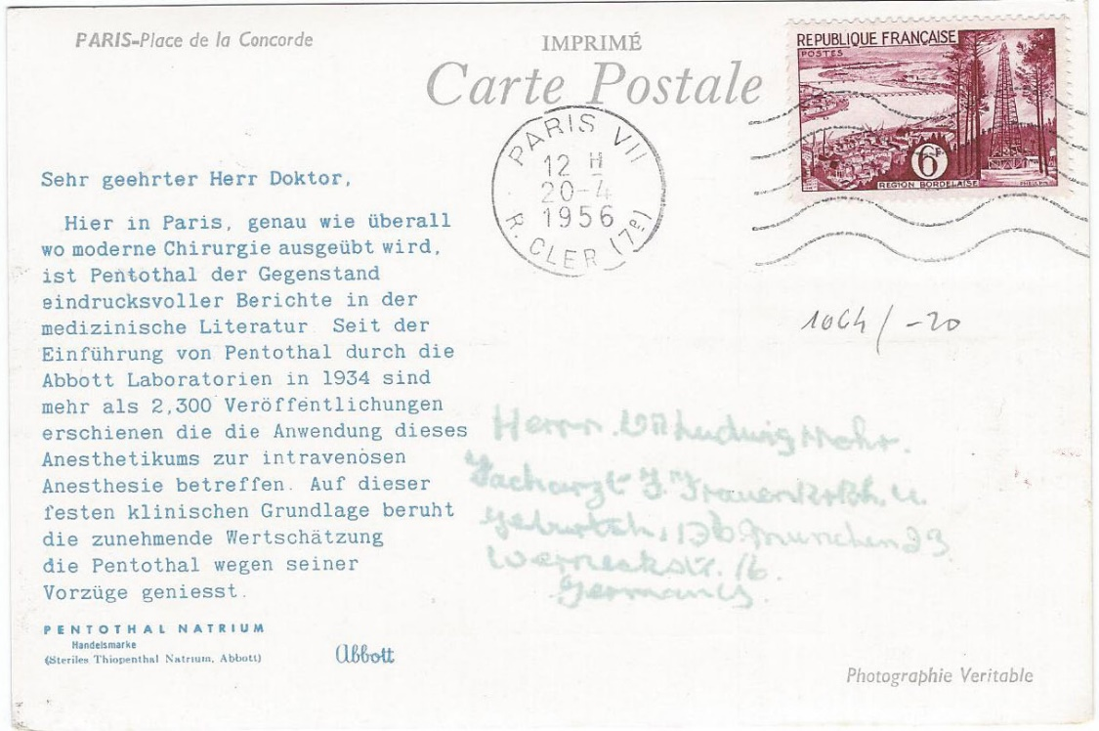
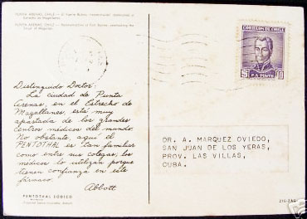
And sent to these 30 countries and territories: Algeria, Argentina, Australia, Belgian Congo, Belgium, Brazil, Canada, Canal Zone, Chile, Cuba, France, Germany, Greece, Hawaii (pre-statehood), Hong Kong, Italy, Lebanon, Luxembourg, Mexico, Netherlands, Nicaragua, Peru, Philippines, Portugal, Puerto Rico, South Africa, Sweden, Switzerland, Uruguay, USA

Slide 24
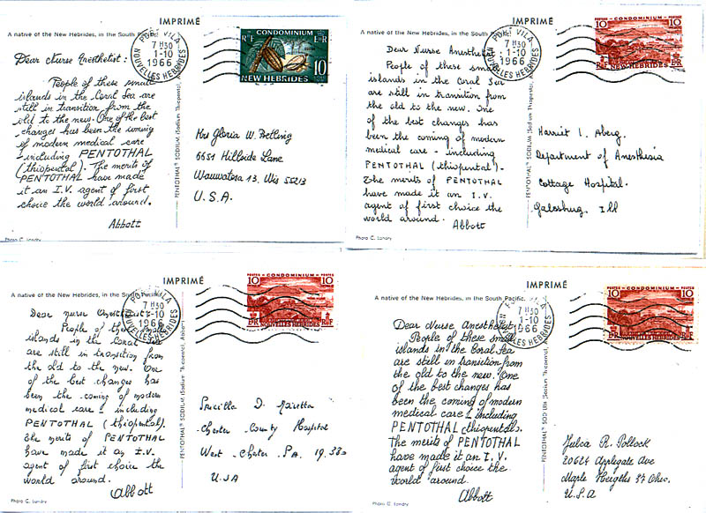
An interesting variety on some Abbott cards deals with the handwritten message itself. While the text is identical, the printed handwriting among cards can be different, as seen here in this 1966 mailing from the New Hebrides.

Slide 25
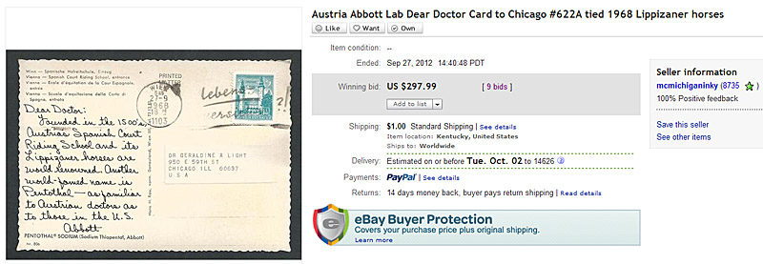
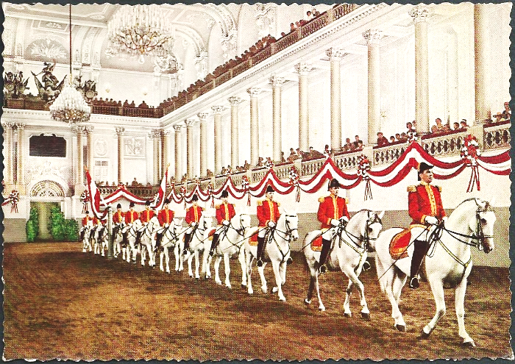
Some cards, especially those of the later series, are scarce and in high demand.

Slide 26
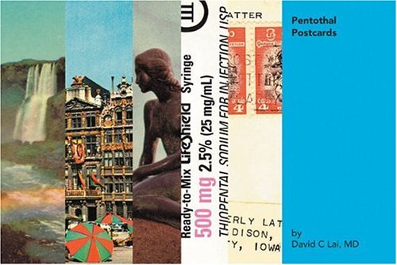
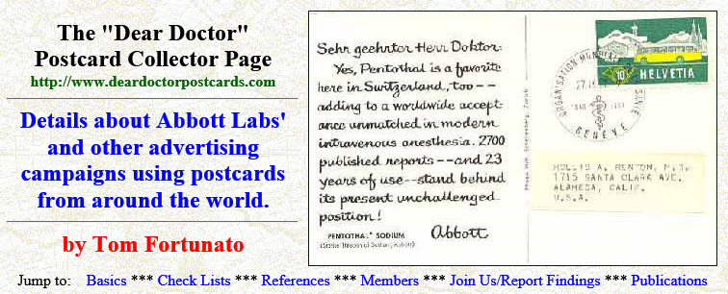
There are several resources for Abbott postcard collectors. An illustrated book provides images of the front and backs of many cards.
The Dear Doctor web site provides articles and an extensive checklist of all types of advertising cards, nearing 1,000 in all, including counts of each seen and reported.

Slide 27

Remind yourself again that these advertising postcards were sent in a time before the Internet, email, and text messaging. Mail was the primary way to get information into the hands of a targeted audience, and several other drug companies used postcards through the decades in their advertising plans.

Slide 28
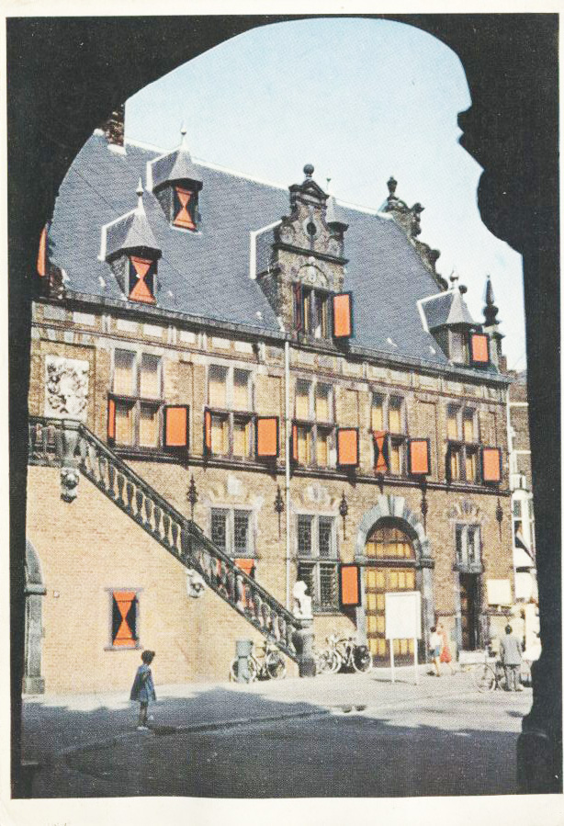
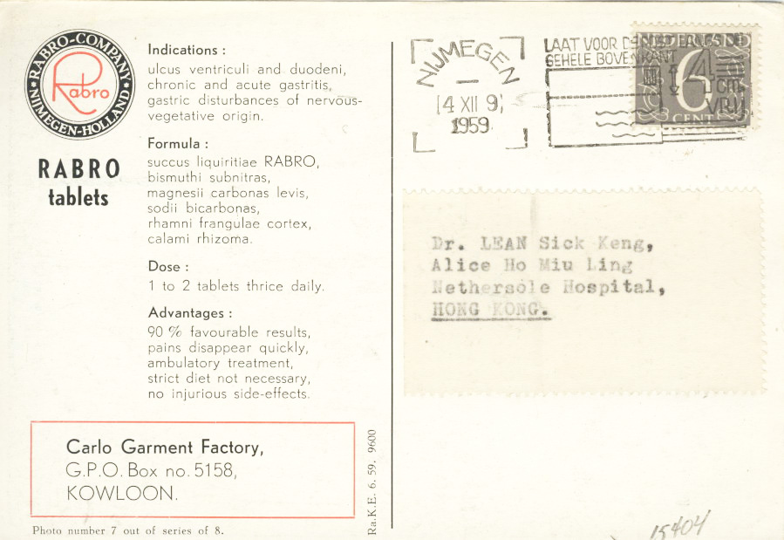
An antacid, rabro tablets were made by the company of the same name in the Netherlands. It’s interesting to note that the Hong Kong agent for the firm was based in a garment factory!

Slide 29
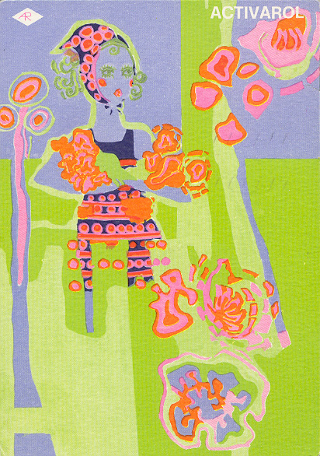
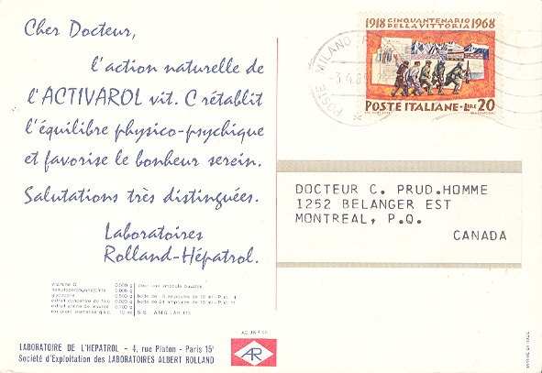
Laboratories Rolland-Hepatrol of Paris sent this card in 1969 about Activarol, an anti-fatigue liquid medicine of glycine, vitamin C and dried yeast.

Slide 30
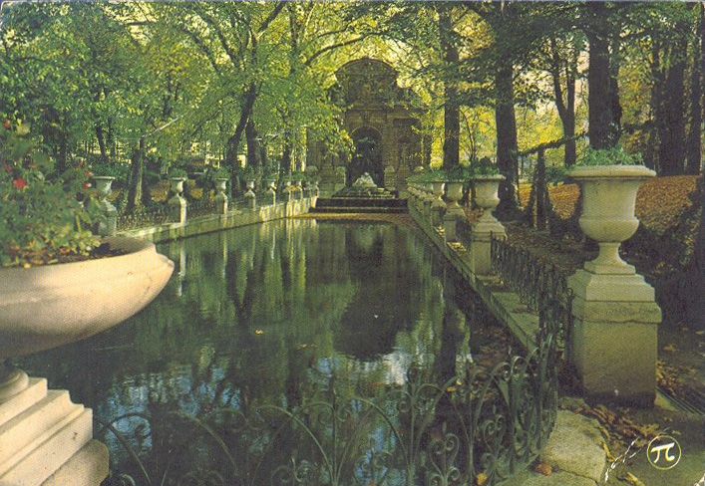
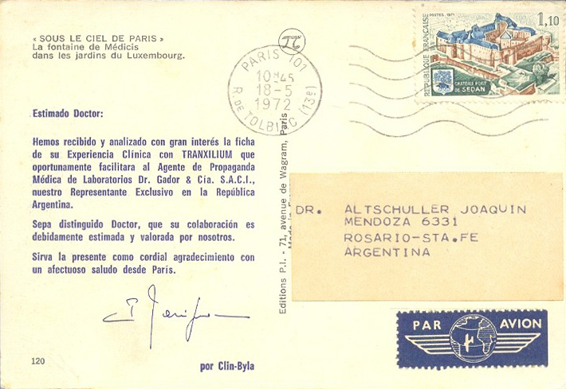
Tranxilium is an anxiety drug, here in a postcard from its manufacturer, Clin-Byla in France, sent to a doctor in Argentina mentioning that country’s local representative.

Slide 31
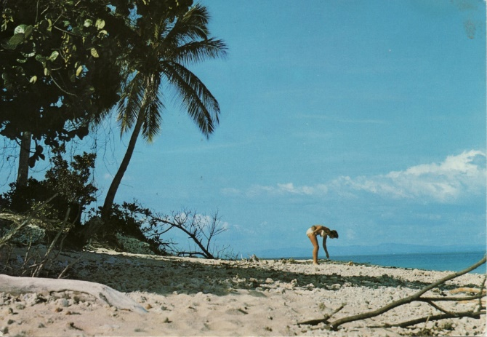
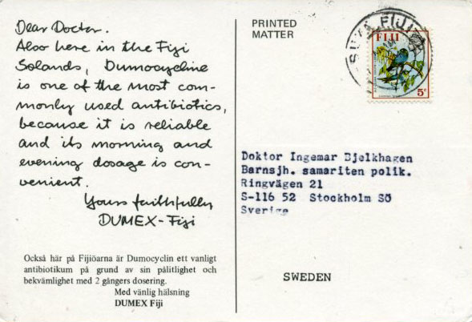
Between 1971 and 1972 Dumex created a series of postcards from exotic places. They tout Dumocycline, an antibiotic used to treat bacterial infections.
Most postcards found are known sent to doctors in Sweden. The native language of the country depicted was used in the upper text, with a Swedish note below.

Slide 32
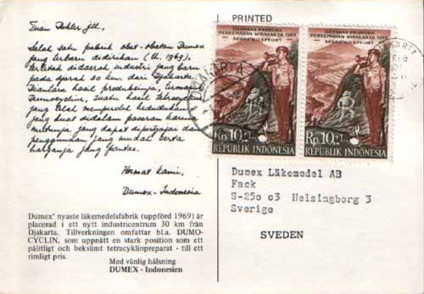
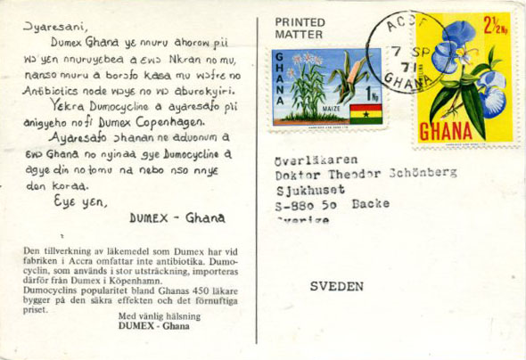
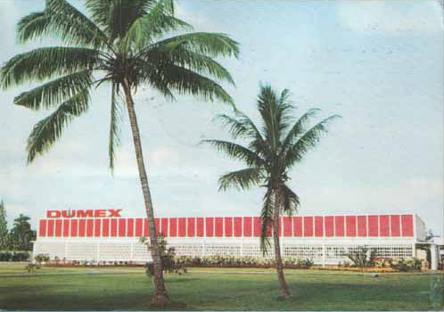

Ghana to Sweden
Indonesia to Sweden

Slide 33
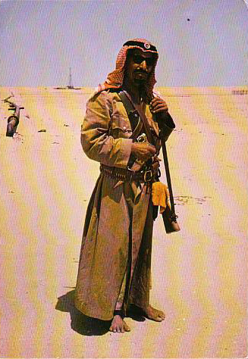


Jersey to Iceland
It’s not known why this card depicting a Kuwaiti native was mailed from Jersey, Channel Islands instead.
Also note the lower text is in Swedish, not Icelandic.
Ethiopia to Sweden

Slide 34


The Netherlands pharmaceutical firm Organon mailed a series of postcards from its Argentine division to doctors in that country in 1973. They advertised docabolin, a hypotension medication.
Iguazu Falls, Argentina

Slide 35


Interesting that this postcard depicts a neighbor’s famous attraction but was mailed domestically instead of from Brazil.
Copacabana Beach in Rio de Janeiro, Brazil

Slide 36




I hope you’ve enjoyed this brief introduction to Dear Doctor postcards.
This just touches the surface of the subject. Additional presentations will be made dealing with Abbott Lab postcard varieties and errors, domestic postcard drug advertising campaigns, and non-drug postcard mailing series.
Check out my site for more information:
http://www.deardoctorpostcards.com

