Slide 1
Cypripediums
Lady Slipper Orchids

Slide 2
Cypripedium calceolus is the yellow lady’s-slipper orchid, and the type species of the genus Cypripedium. It has a widespread distribution from Europe east through Asia from Spain to the Pacific, including almost every country in Europe plus Russia and northeastern China and Japan’s Rebun Island.
Cypripedium calceolus sensu stricta (“in the strict sense”) does not occur in North America. The closely related Cypripedium parviflorum and C. pubescens are often still referred to as subspecies or varieties of C. calceolus.

Slide 3
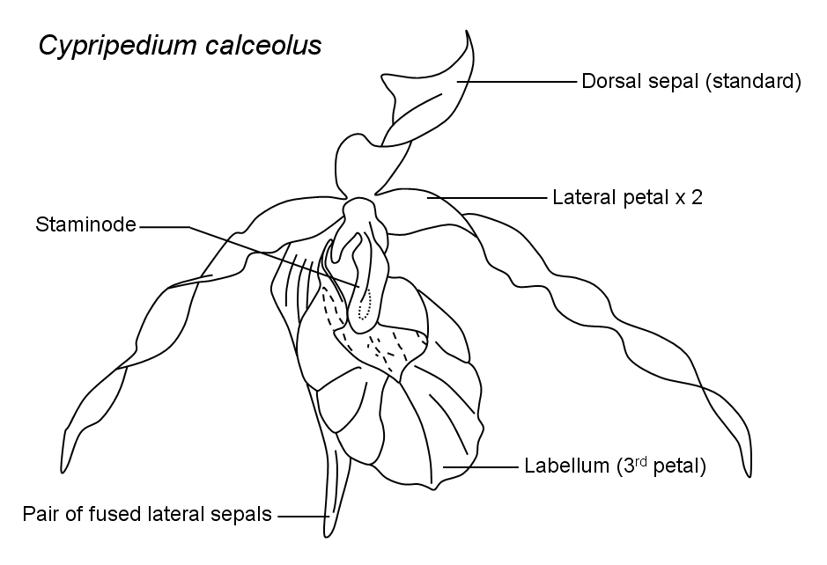
Diagram of Orchid Flower

Slide 4
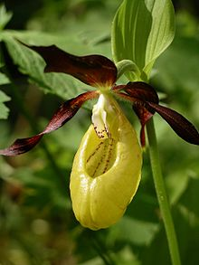
Cypripedium calceolus

Slide 5
Great Britain 1786, 2662

Slide 6
Romania 3465i, 4015

Slide 7
Denmark 923

Slide 8
Grenadines of St. Vincent 476a

Slide 9
Hungary 3087

Slide 10
Cypripedium calceolus
Latvia 550
Lithuania 425

Slide 11
Cypripedium calceolus
Slovakia 551
Slovenia 672

Slide 12
Cypripedium calceolus
Norway 972
Sweden 1419b

Slide 13
Cypripedium calceolus
Mongolia 2277
Russia 5994

Slide 14
U.N.-Vienna 196

Slide 15
Cypripedium calceolus
Malagasy 1273
Uganda 954a

Slide 16
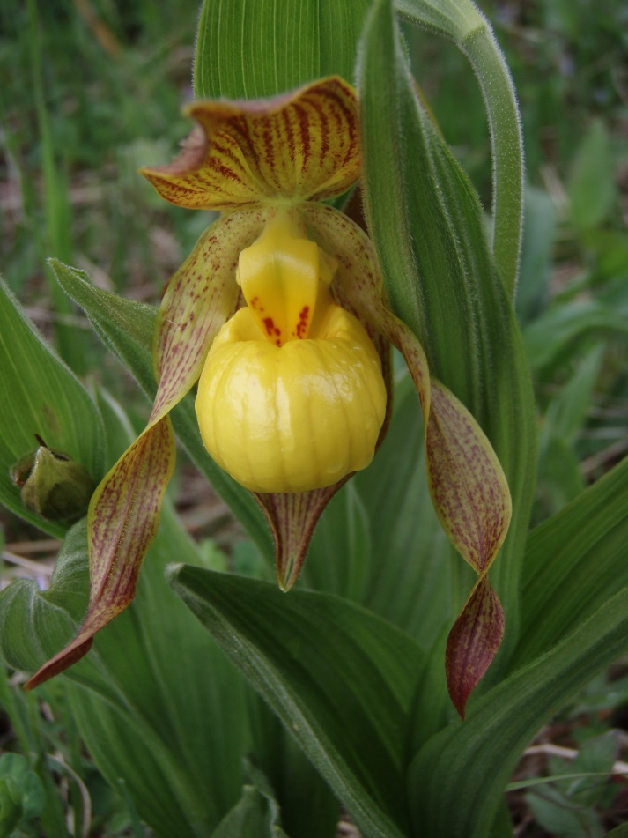
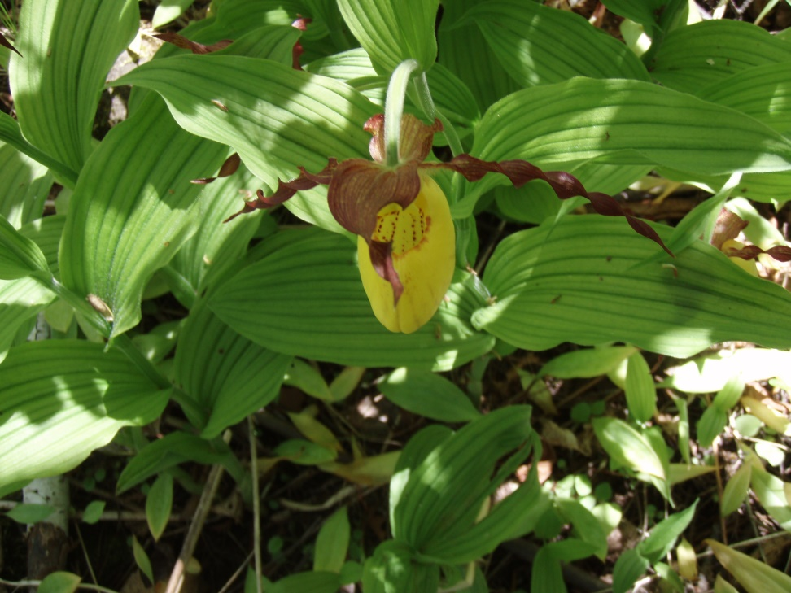
Cypripedium
parviflorum
pubescens

Slide 17
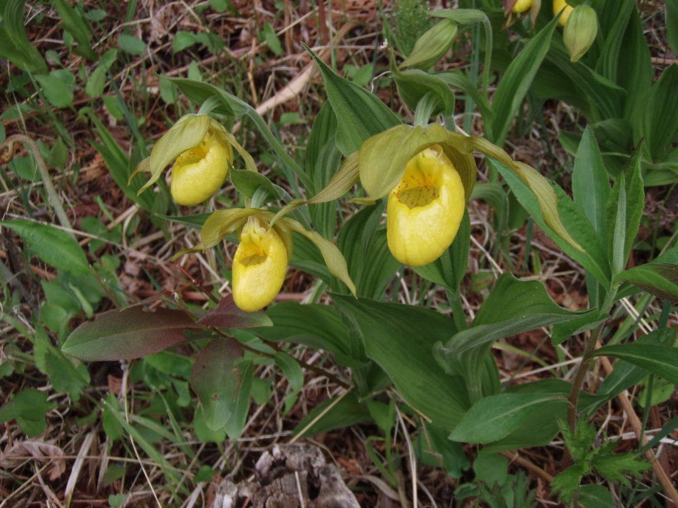
Cypripedium planipetalum

Slide 18
Cypripedium parviflorum & pubescens (?)
Canada 1790
U.S. 2077

Slide 19
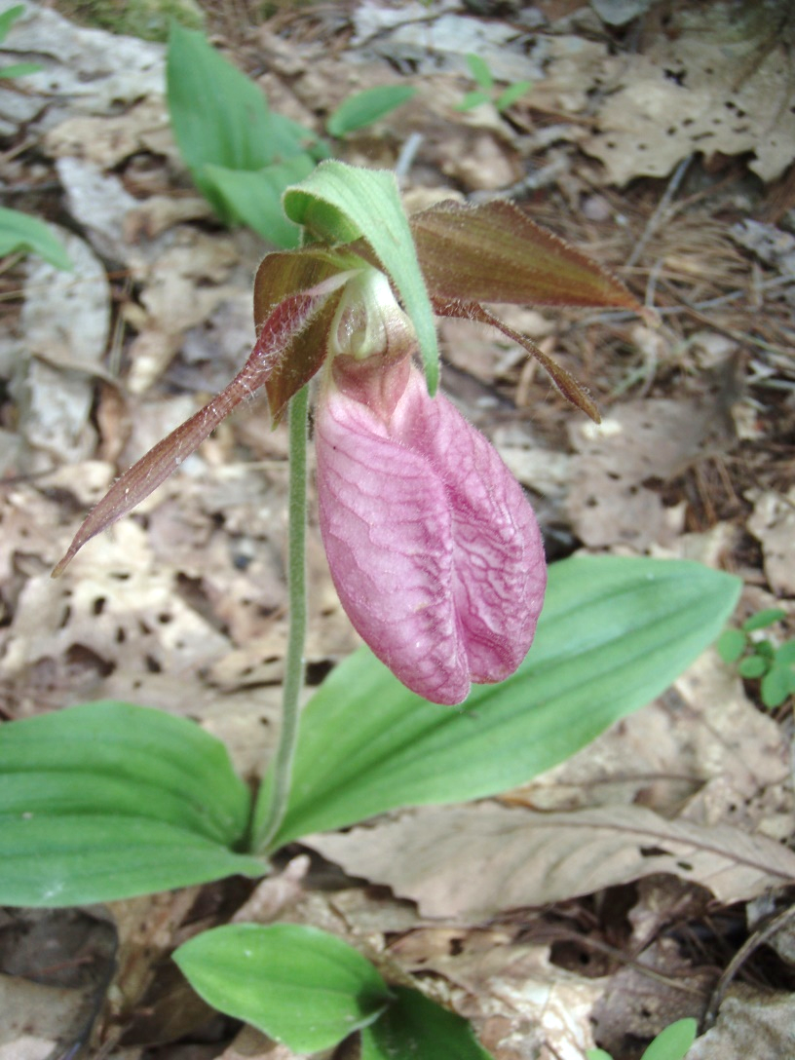
Cypripedium acaule

Slide 20
Cypripedium acaule
Canada 424
St. Pierre & Miquelon 360

Slide 21
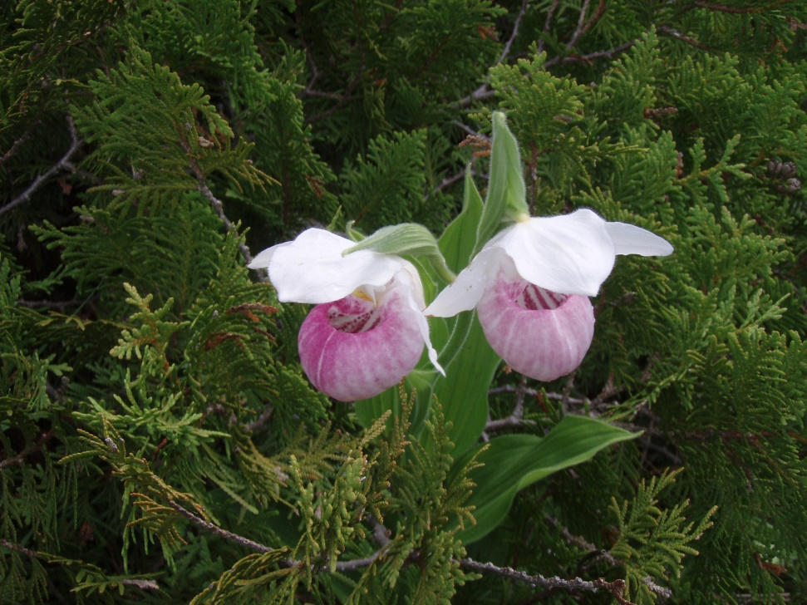
Cypripedium reginae
U.S. 1376

Slide 22
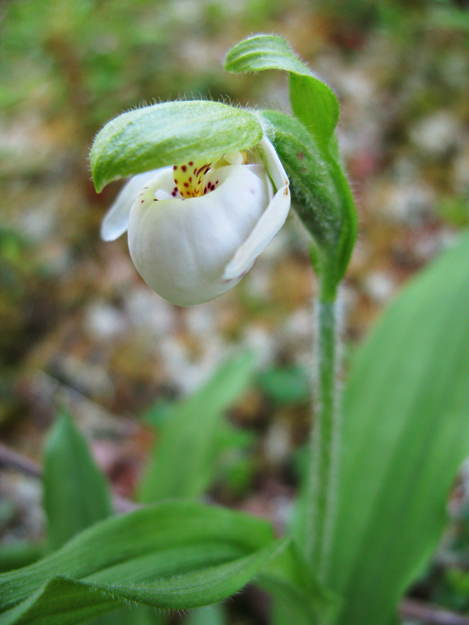
Cypripedium passerinum
Carl Linhart, Pukaskwa NP
Canada 710

Slide 23
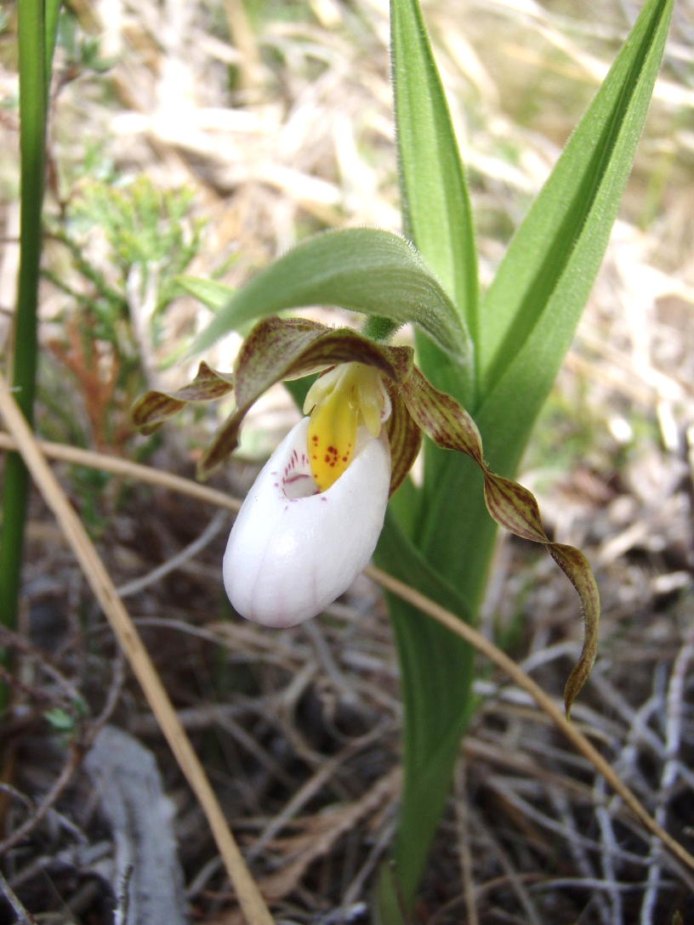
Cypripedium candidum

Slide 24
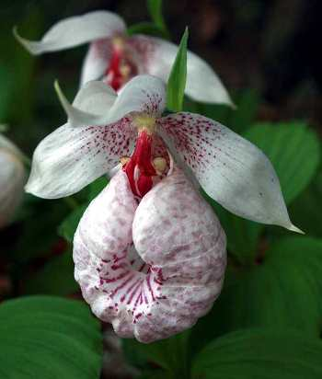
Cypripedium formosanum
China Rep. 3992

Slide 25
Cypripedium japonicum
Japan Z165

Slide 26
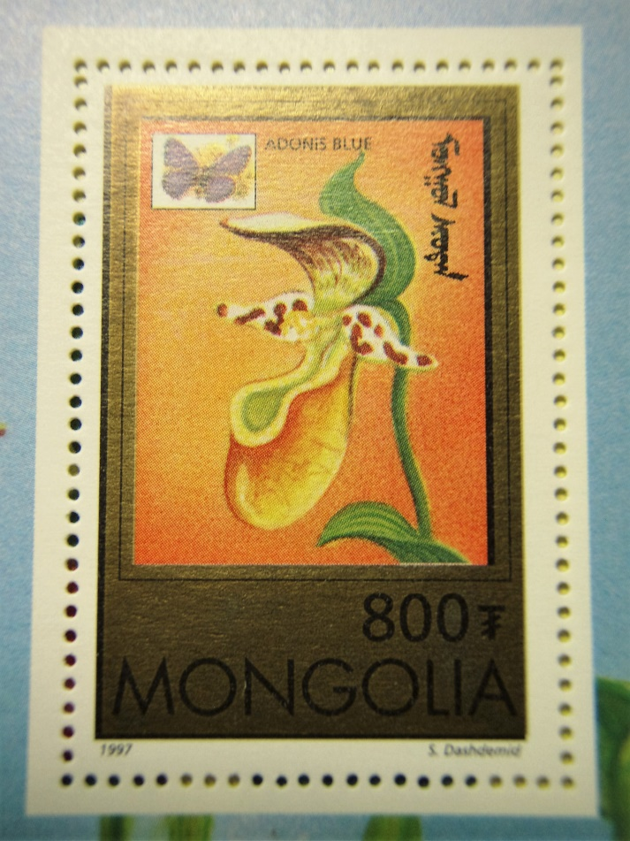
Cypripedium guttatum
Mongolia 2279
Malgasy 1276

Slide 27
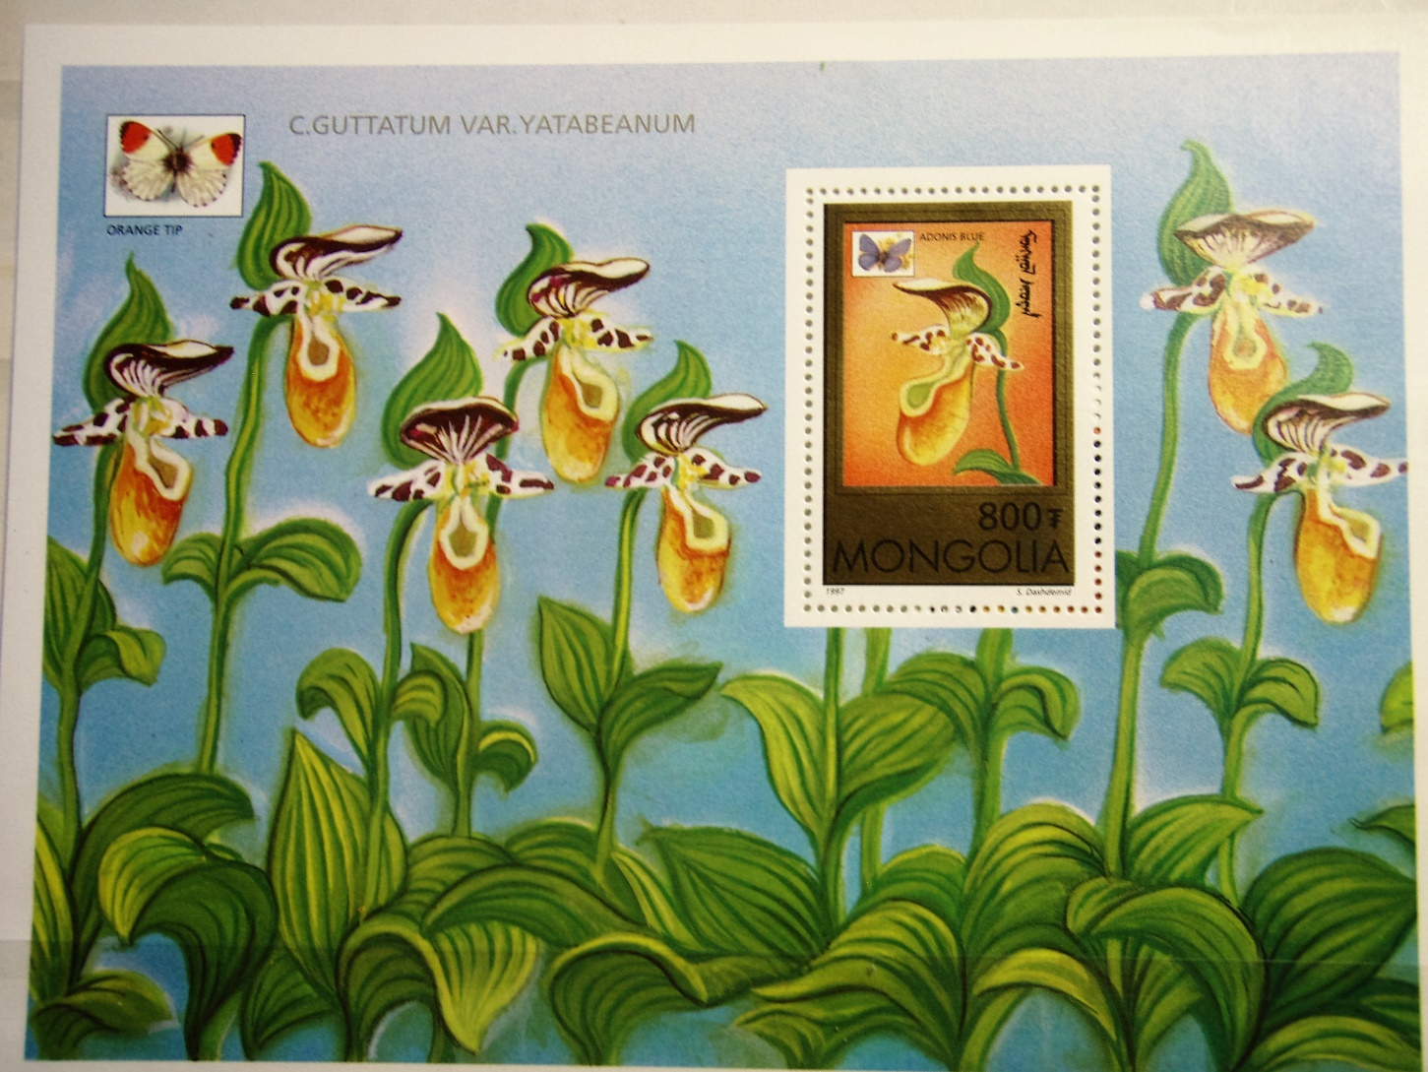
Cypripedium guttatum
Mongolia 2279

Slide 28
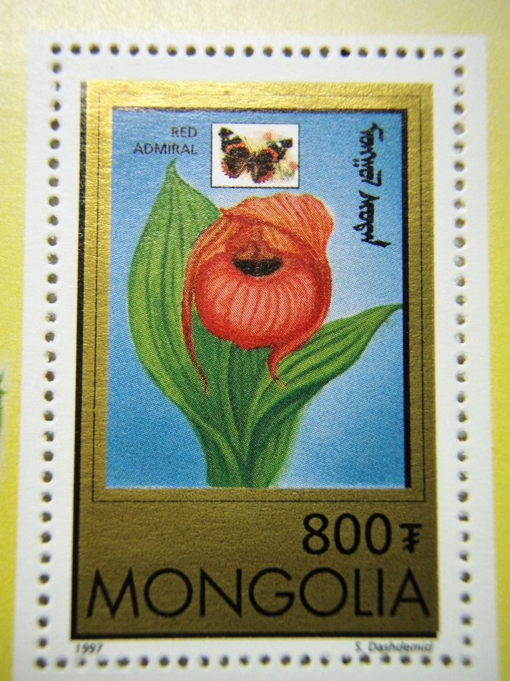
Cypripedium macranthum
Mongolia 2278
Malagasy 1278

Slide 29
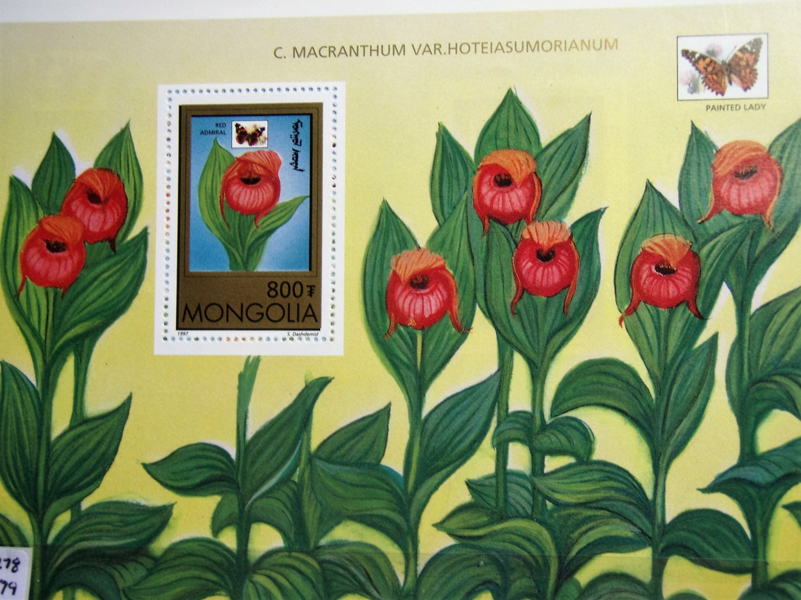
Cypripedium macranthum
Mongolia 2278

Slide 30
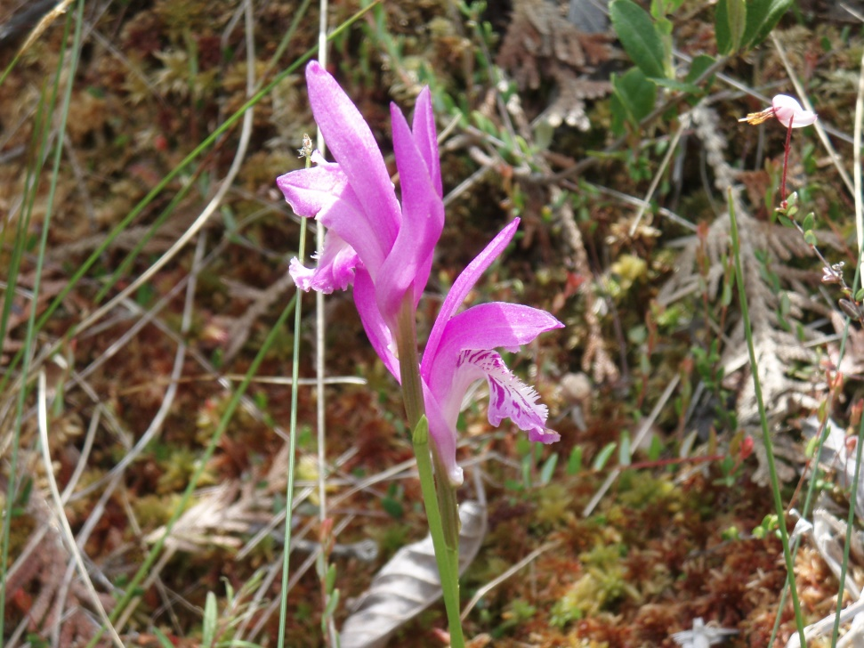
Arethusa bulbosa
U.S. 2076

Slide 31
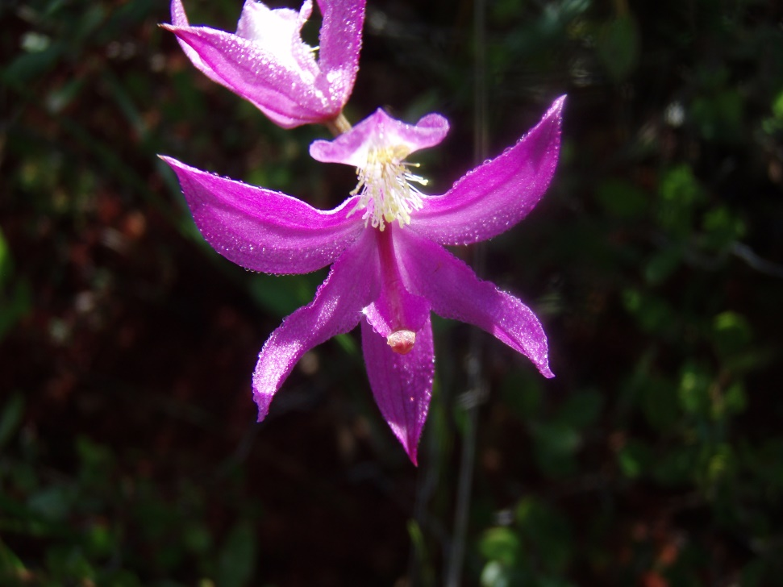
Calopogon pulchellus
U.S. 3611j

Slide 32
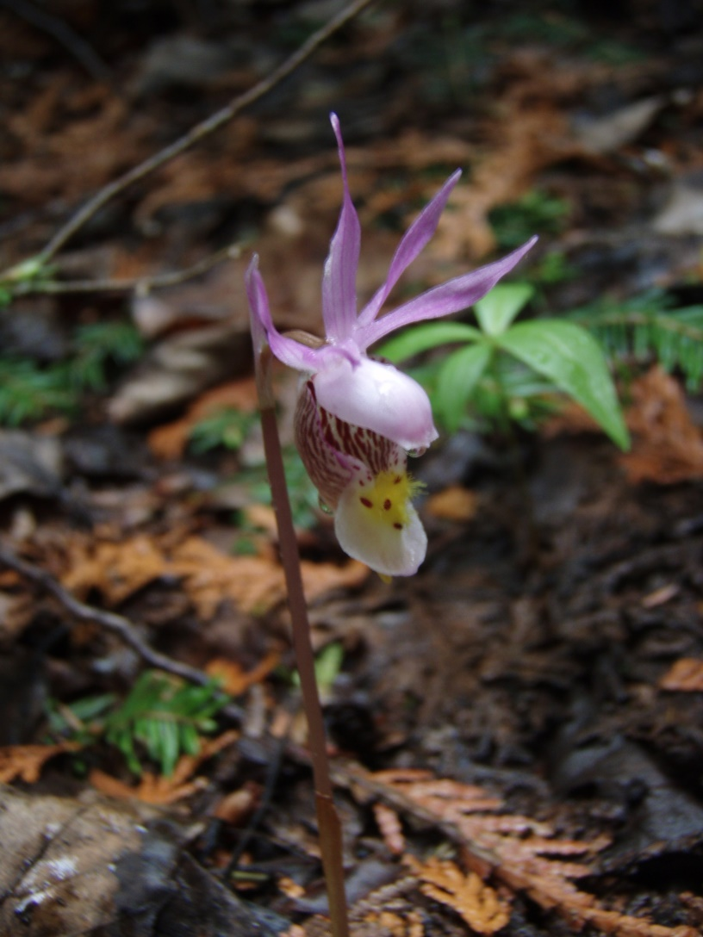
Calypso bulbosa
U.S. 2079

Slide 33
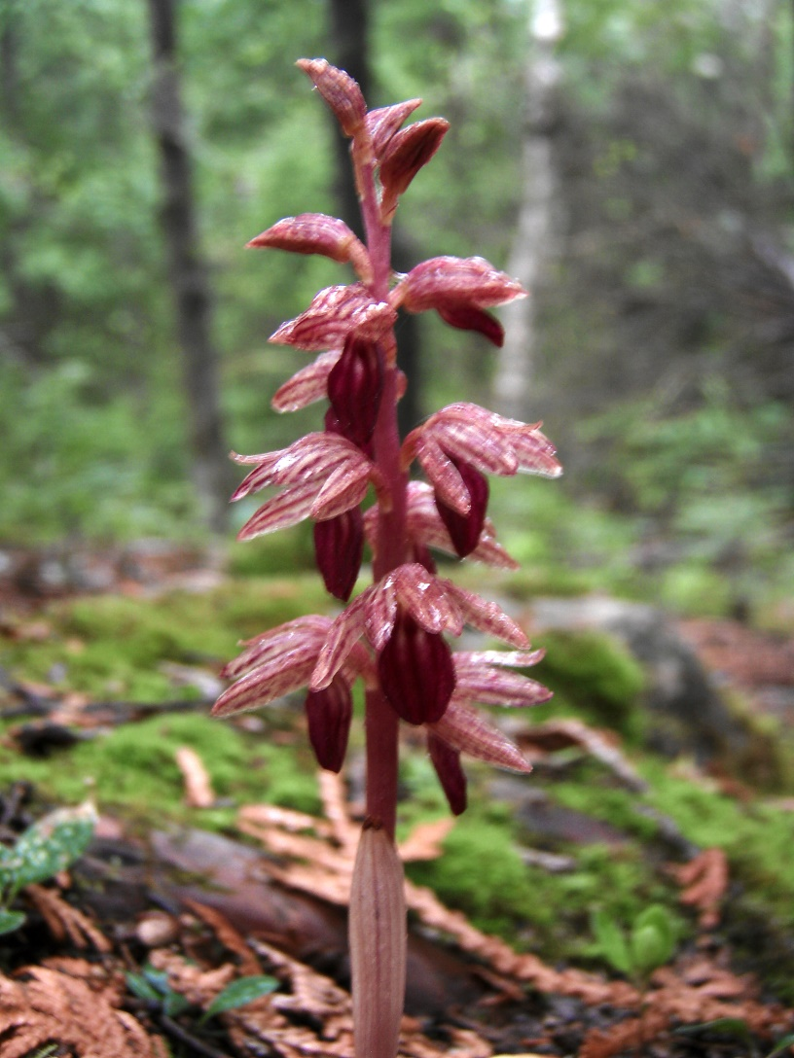
Corallorhiza striata
Canada 2187

