Slide 1
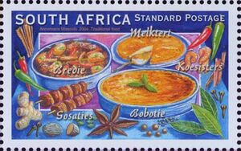
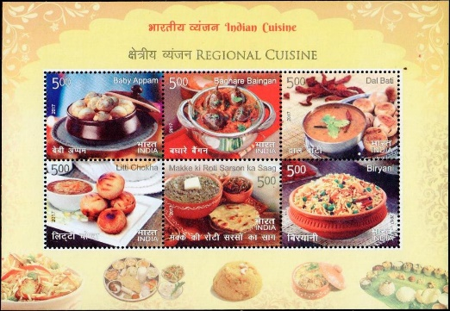
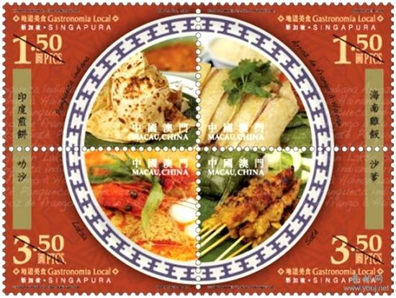
Creating Better Philatelic Websites
A Recipe for Success through the APS Star Route Website Competition
by Tom Fortunato
for the Rochester Philatelic Association
ALLPPT.com _ Free PowerPoint Templates, Diagrams and Charts

Slide 2
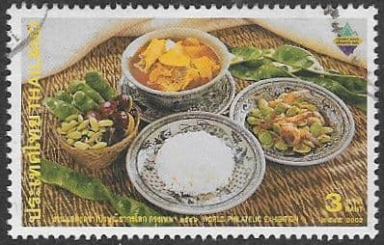
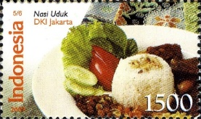
I had the privilege to be one of five judges for the 2023 American Philatelic Society Star Route Website Competition, an annual contest that critiques philatelic websites made by stamp club chapters and affiliate organizations associated with the APS.
The judging panel included a diverse group of APS members with experience in creating websites, publishing and social media representing collectors young and older alike.
Creating a website is much like cooking. It starts by selecting good ingredients, then preparing and combining them into a hearty meal for everyone. Diners are looking for food that’s both eye-appealing and satisfying. So are website viewers!
This brief presentation summarizes our findings to allow all to share in best practices used by fellow webmasters. The goal of the competition is to help improve both content and web design across the board, present the best that our hobby has to offer to a worldwide audience and reward those whose work we see.

Slide 3
Food for thought…
Why does any group have (or want) a website to begin with? Here are three reasons:
Promotion of the organization’ collecting interests and specialties.
Gain new members.
Keep current members informed about programs and services offered.
Why is someone visiting the website?
The person already has an interest in philately and is seeing what your group has to offer.
The person is already a member and looking for an update about a program or service.
The person has no knowledge of philately and is seeking for information about something owned.
Matching the interests of the viewer with content as easily as possible is the key.

Slide 4
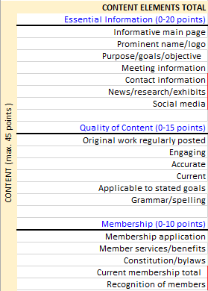
Scoring for the competition was done on a point basis covering a wide variety of line items broken down in two main categories, Content and Design, with a few additional points awarded as a bonus. Review “Content” items here to the right. Both categories were broken down into sub-categories in blue, each with various line items.
Judges reviewed all 34 website entries on their own, rating each line item from 1 (non-existent or needs improvement) to 5 (excellent). Those were added up and pro-rated against the maximum points in the sub-category. For example: If the rating sum of all 6 line items in the Quality of Content sub-category was 15 out of the maximum of 30, 50% of the 15 maximum rating would result in a score of 7.5 points. It’s not as complicated as it seems!
Sub-categories
Line items

Slide 5
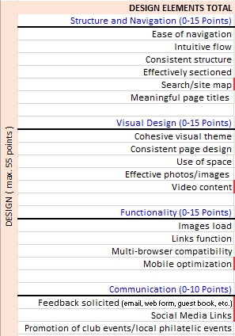
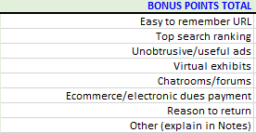
Here are the competition’s “Design Elements” sub-categories and line items to the right, along with Bonus section below.
The scoring sub-categories and line items continue to change from year to year to better reflect the evolution of web technology and website content.
Take a closer look at these on the upcoming slides.

Slide 6
CONTENT ELEMENTS – Essential Information
These line items cover the most important info for viewers. The best websites briefly answer these questions up front:
1. What does the club specialize in or collect?
2. How long has the club been around and how many current members are there?
3. If local, where, when and how frequently does the club meet?
4. What are the benefits of membership and how can I join?
5. Where is the organization located?
6. Who can I contact if I have a question?
Linked pages can give further details about these as well as provide additional content, like news, upcoming events, exhibits and presentations. Social media links show viewers this group uses the latest communication tools!

Slide 7
CONTENT ELEMENTS – Quality of Content
Websites get “stale” quickly or just “rot” if the content is rarely changed. A guarantee of “freshness” is easy by adding “Last Updated…” on the home page or placing dates elsewhere on meaningful content, like newsletters, photos, calendar of events, etc.
No one likes to see typos or read poorly written text. Having someone else review content before posting online, or immediately after posting, can quickly catch these glitches.
An engaging web site is one that gives viewers a sense of craving more! This is totally subjective, but original and unique content raises a site’s “it’s got it” factor.

Slide 8
CONTENT ELEMENTS – Membership
A website should be a group’s primary recruitment tool with the general public. Give prospects what they want!
Almost all organizations have bylaws or rules of how the club manages itself. Posting these imply stability and order.
Viewers should know how many members there are now. Finding member references in words and pictures throughout the site displays a sense of family and comradery.
A downloadable PDF or online application is a must along with instructions on how dues are to be collected.

Slide 9
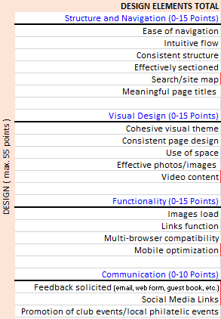
DESIGN ELEMENTS – Structure and Navigation
Design covers abroad spectrum when it comes to web sites, but is broken down into four sub-categories for simplicity.
Structure and navigation is rather self-explanatory. It should be easy to maneuver from page to page throughout the site no matter the start or end point.
Like chapters in a book, a website is best divided into easy to understand sections with appropriately titled sub-pages.
Lastly, inclusion of a search engine or site map will help visitors find what they need quickly.

Slide 10
DESIGN ELEMENTS – Visual Design
Eye appeal is important in grabbing the attention of viewers.
Use of color, images and backgrounds uniformly among the pages is important. They should compliment one another.
Cluttered pages with too much in text and/or images are to be avoided. Having too little on a page is equally a turn-off.
Posting relevant videos (created by the organization or originating on other sites) can add interest and “longer eyeballs” on a site.

Slide 11
DESIGN ELEMENTS – Functionality
Everyone expects a website to work properly. All images should appear as expected and in a timely fashion. Clickable links also should take you to the correct and functioning web page.
Viewing the same website using different browsers on the same screen can bring about slight differences in appearance, but should not be disruptive to viewers.
Websites can look different on a computer screen versus a tablet or cell phone. Newer HTML computer code can detect the viewing screen size and adjust the layout to optimize its appearance, with varying levels of success. Sites written in older code display without this customization feature.

Slide 12
DESIGN ELEMENTS – Communication
Every opportunity to encourage web-based communications, whether it be member-to-member or with the general public in some way, can only bring about positive results.
Guest books used to be a “must-have” on websites. While they are still available to gain feedback, more responsive social media technologies have overshadowed their use. Even so, email remains the easiest and most prolific tool used today. Email contacts should be easily found.
Groups that do not actively promote meetings, activities and events on their sites are really missing out!

Slide 13
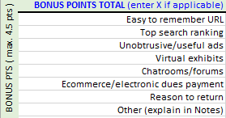
BONUS POINTS – Miscellaneous Line Items
This section is a catch-all for a variety of line items that don’t fall into the Content or Design categories, or are not necessarily vital or apply to every philatelic organization, but enhance a user’s experience.
Short and relatable URLs (web addresses) are best.
Several factors affect algorithms that put a web site at the top of a search engine’s results. Some can be influenced by the site’s coding, others by displayed and hidden key words.
Paid ads from dealers and others can help defray website management costs and help members obtain material.

Slide 14
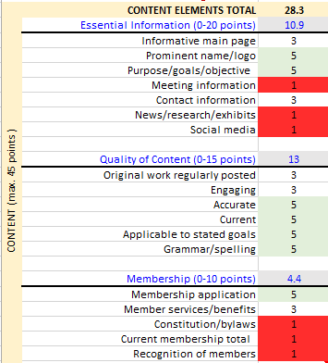
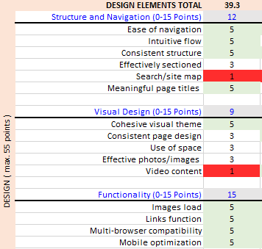
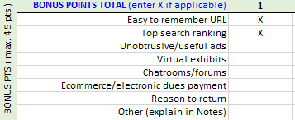
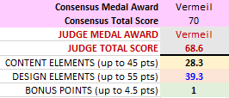
So now let’s mix these “ingredients” and really cook! Here are my ratings of a contestant’s website that came very close to the overall five judge average. Remember, line item ratings are from 1 (not present or needs improvement) highlighted in red to 5 (excellent) in green. My resulting score total was 68.6 points versus the consensus average score of 70.

Slide 15
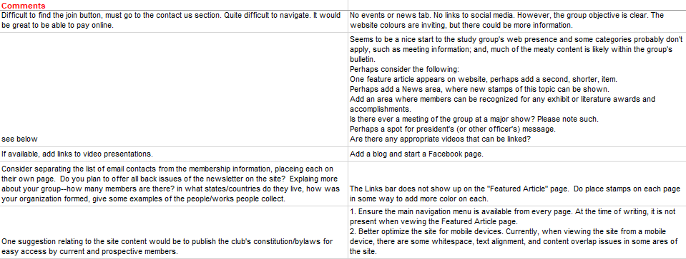
Each total score equates to an award medal level as follows: Silver <54 pts, Large Silver 55-64 pts, Vermeil 65-74 pts, Large Vermeil 75-84 pts, Gold 85-89 pts, Large Gold 90+ pts.
Feedback from all five judges for this entry is here:

Slide 16
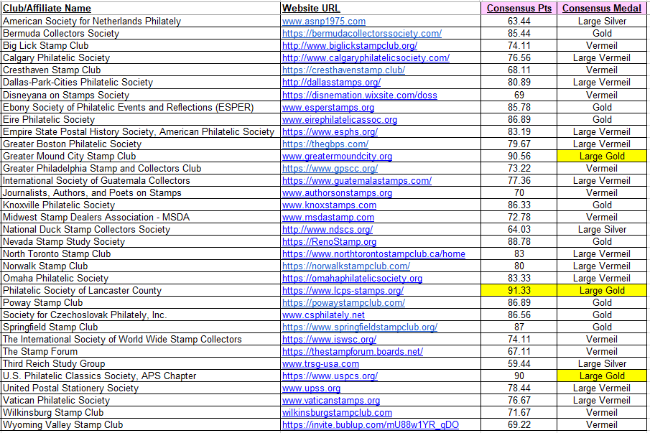
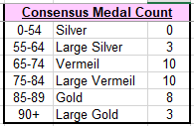
Here are the 2023 APS Star Route Website Contestants and results. Congratulations, all!

Slide 17
Doggie Bag Take-Aways…
As is customary, the five judges were invited by APS contest coordinator Nora Bryson at the contest’s conclusion to discuss the overall process and results. All agreed it was a worthwhile experience, although time consuming with 34 entries.
It is clear that philatelic groups with a member having website expertise, or resources to hire someone to construct and post updates, have a leg-up. But it is getting easier for non-techie types to make impressive websites by using online creation applications, some of which are free.
An interesting discussion took place about whether content or design was more important. The younger judges’ comments were design-centric, especially when it comes to the importance of having a mobile-friendly site, while those judges with a bit of grey favored content. In the end, finding a balance is the right solution.

Slide 18
A home page should be kept uncluttered and informative. One that is engaging and colorful welcomes the viewer to explore more of the site. Logos, photos and images are great, but the introductory text is equally importance. It should not overwhelm, but briefly address most of the “Essential Information” line items mentioned earlier.
How can any philatelic web site not display some kind of philatelic item or element on their home page? Images relevant to a club or collecting specialty trump others.
Is a copyright symbol and year necessary? Some sites display a copyright (©) symbol along with a year at the bottom of their home page and subsequent pages. In fact, it’s not needed if the web site contains original content, which is automatically protected. Listing only one year either represents the year the site went live or that of its latest update.

Slide 19
Quick tips for a better web site (not in any particular order)
Content
• Having presentations and exhibits adds to viewer interest
• Always post a PDF membership application and/or link to an online membership form
• Having an online payment system for dues or merchandise is a convenient feature
• Link to a calendar of upcoming events—meetings, stamp shows and such
• Post officer names, titles and give their contact details
• A sample newsletter to download is a plus, preferably one from the past 6-12 months
• Describe what’s behind a Members Only area for those who cannot access it
• Adding or linking to informative videos will gain greater interest of the viewer

Slide 20
Quick tips continued…
Content
• Check all links regularly to make sure they work- use an online tool like www.brokenlinkcheck.com or an older application called Xenu http://home.snafu.de/tilman/xenulink.html to validate they function
• A search feature allows visitors to quickly find what they need - check out https://www.freefind.com/ or another free application like it
• Use interactive Google or similar maps to pinpoint locations that allow viewers to customize information they need
• Offering members of the public a free evaluation (not formal appraisal) service for philatelic items before in-person meetings will draw their community’s attention to the club and bring in material possibly for sale

Slide 21
Quick tips continued…
Design
• Use home page images relevant to the club or collecting specialty
• Use high quality and high resolution images
• Font sizes should be uniform and large enough for the average (and older) viewer
• Every web page should display a consistent navigation menu
• If social media [Facebook, Twitter (X), etc.] or a blog is uzed, make sure the content is updated regularly
It’s now up to you!

Slide 22
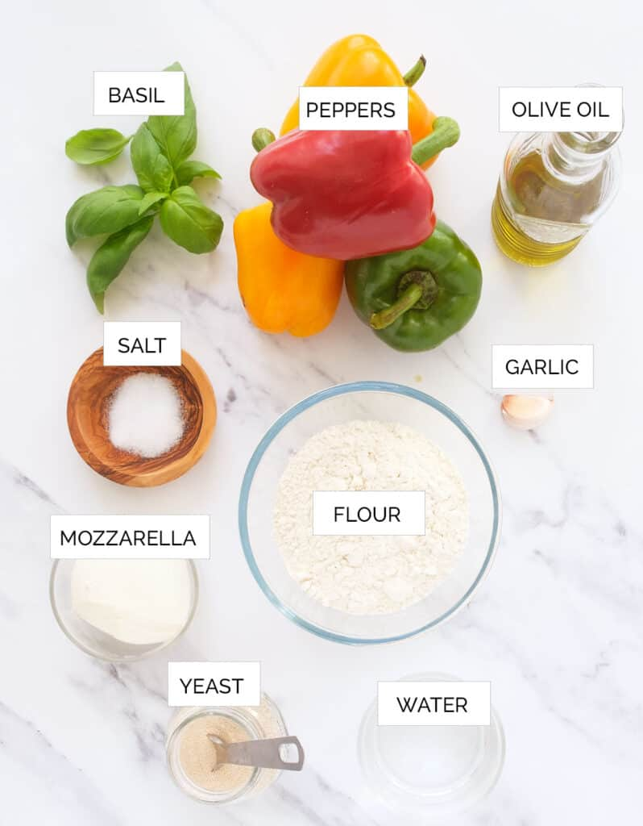
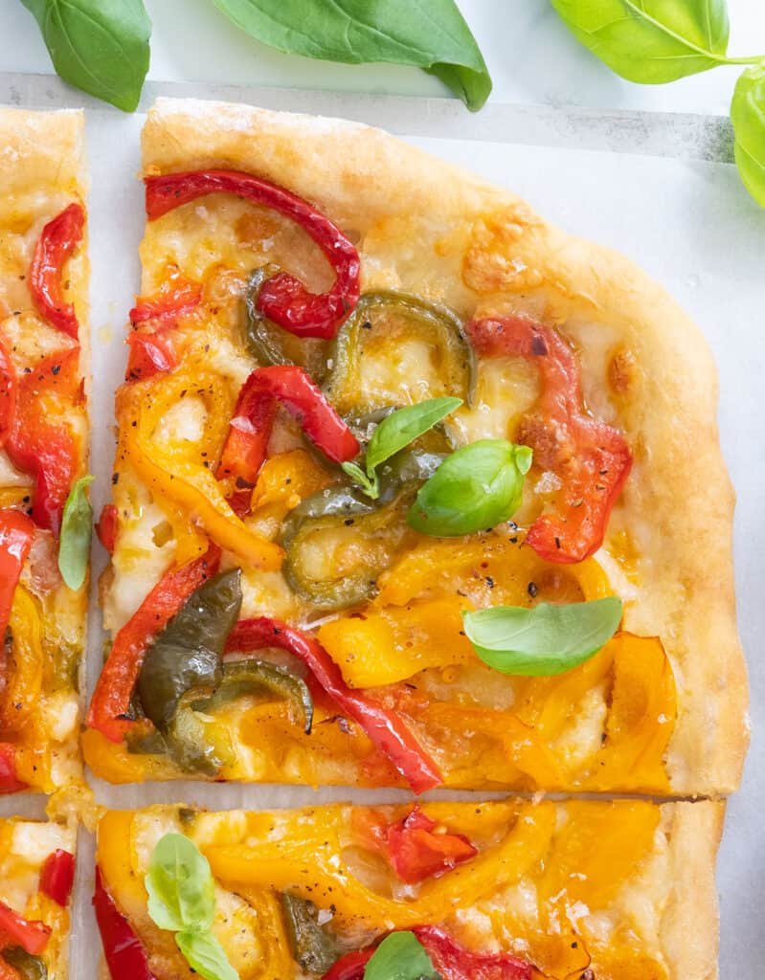
To paraphrase a popular jingle…
Better Ingredients…
Better Websites…
APS!

