Slide 1
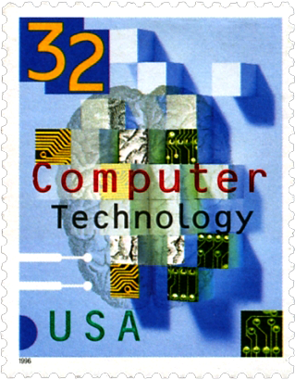
Computers & Philately Overview
Rochester Philatelic Association
George T. Fekete March 8, 2018

Slide 2
Computers & Philately Overview
Tools

Slide 3
Computers & Philately Overview Hardware Tools
Hardware
Computer
PC
Mac (Apple)
Custom
Scanner

Slide 4
Computers & Philately Overview Software Tools
Productivity Software
Microsoft Office (Best in Class)
Apple Office (Comes with Mac Computer)
Open Source
OpenOffice
LibreOffice
Other
Standalone
Cloud-Based
Standalone & Cloud-Based
Graphics Software
Adobe Creative Suite (Best in Class)
Photoshop Elements
Other

Slide 5
Computers & Philately Overview Hardware
Computer
Size
Footprint
Display
Peripherals
Keyboard
Connection Ports
Performance
CPU (Processing Speed)
RAM (Temporary Memory)
Storage
Internal
External
Disk and/or Solid State
Scanner
Resolution
Features
Size

Slide 6
Computers & Philately Overview Productivity Software
Inventory
Presentation
Text Editing/Word Processing
Productivity Software is Task-Dependent

Slide 7
Computers & Philately Overview Productivity Software
Inventory
Major Vendors
Microsoft Excel
Apple Numbers
Basic Spreadsheet
Advanced Spreadsheet
Macros
VBA (Visual Basic for Applications)
Database
Access
Filemaker

Slide 8
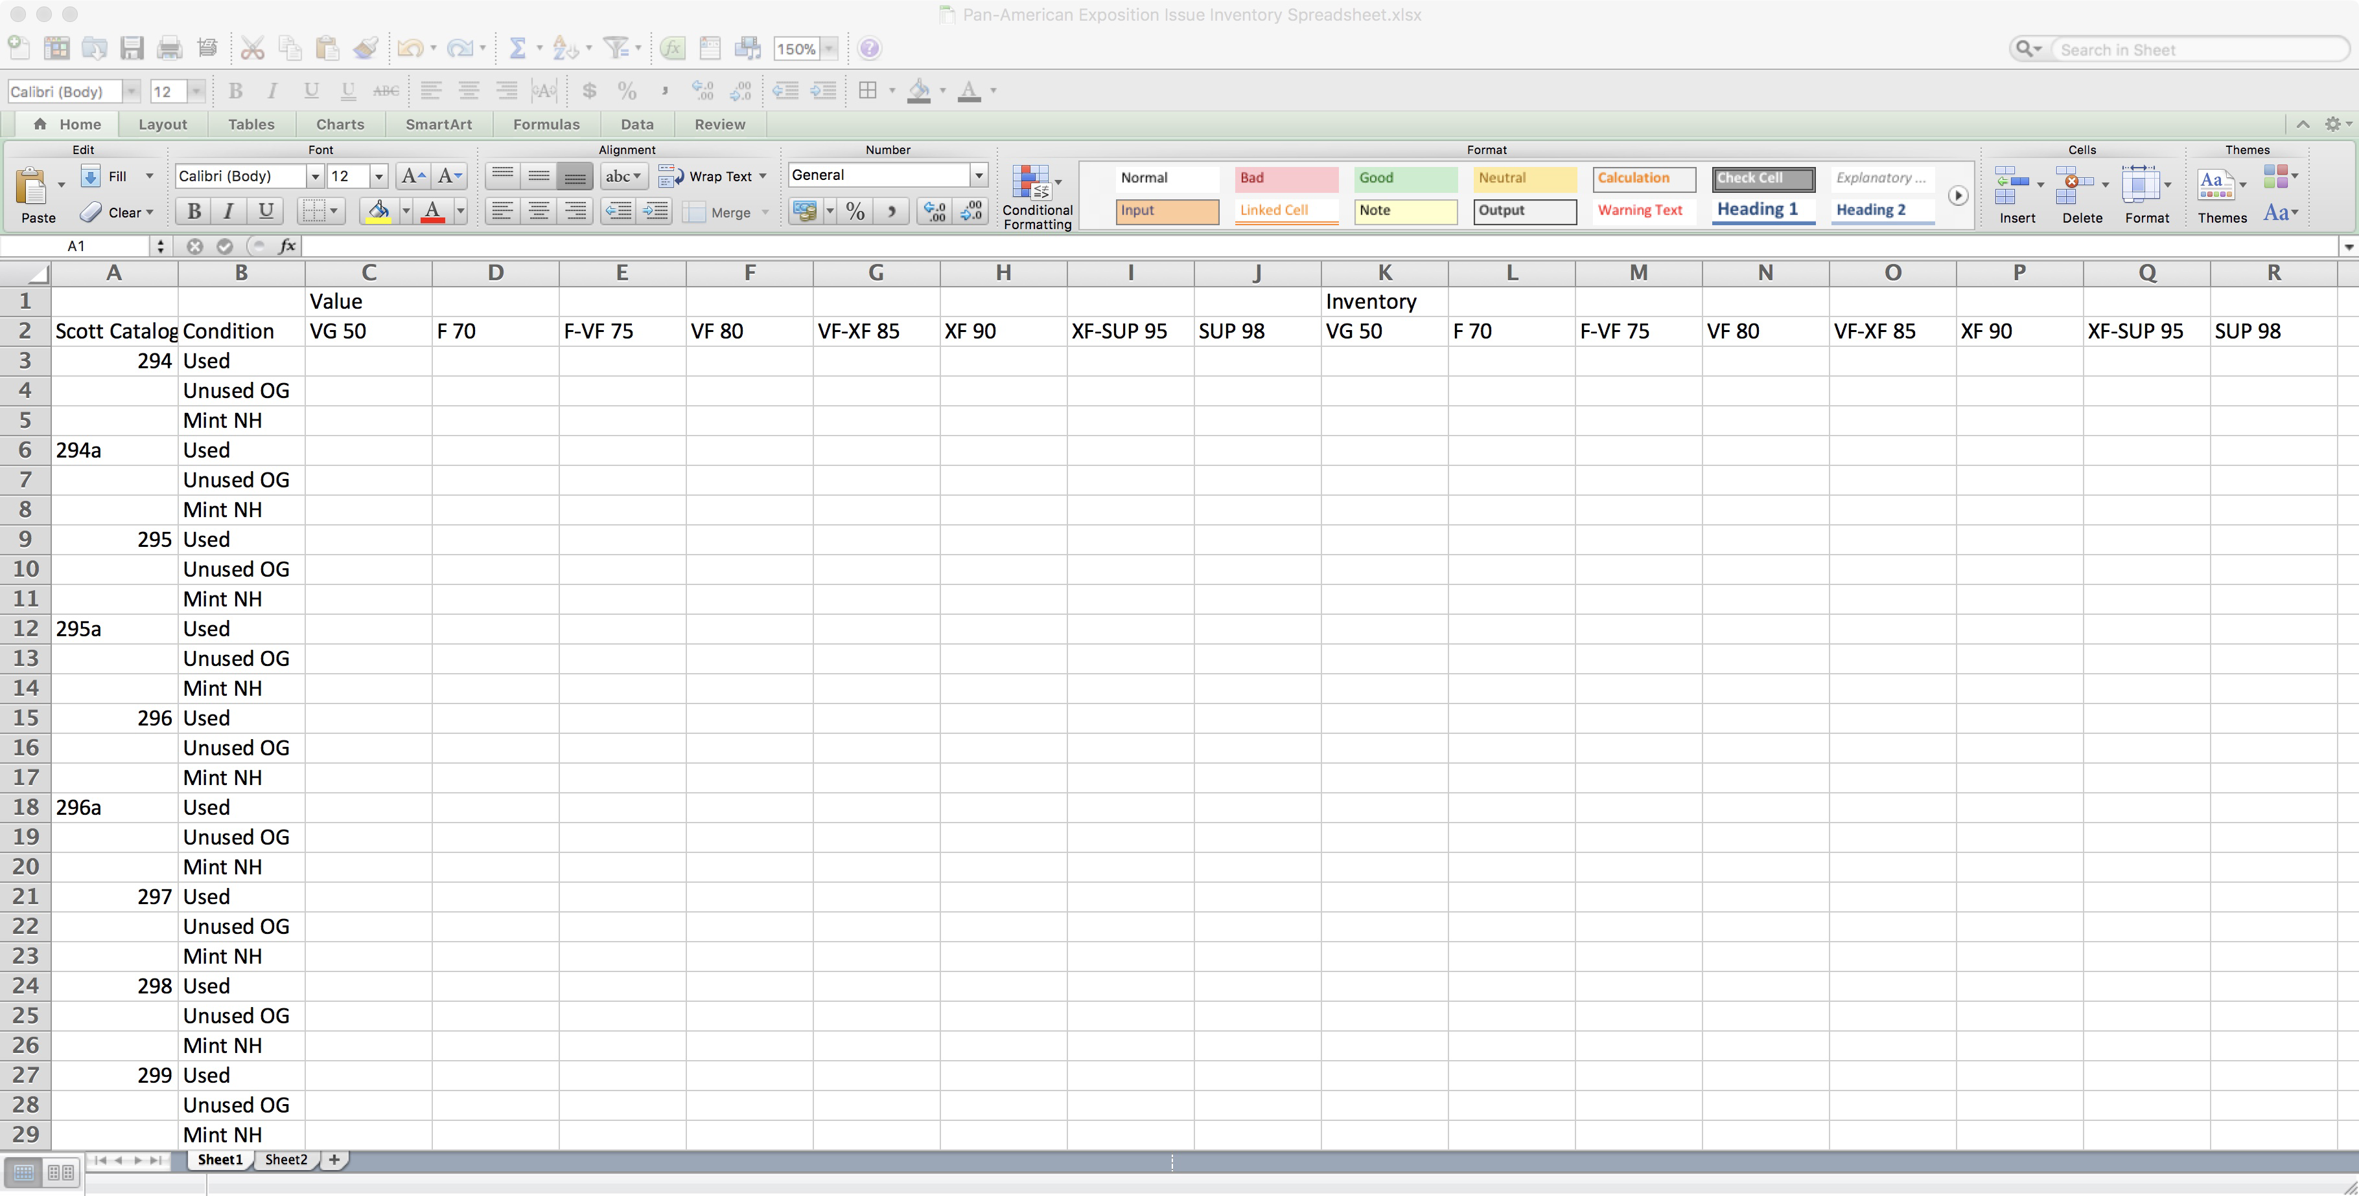
Computers & Philately Overview Inventory Spreadsheet Template

Slide 9
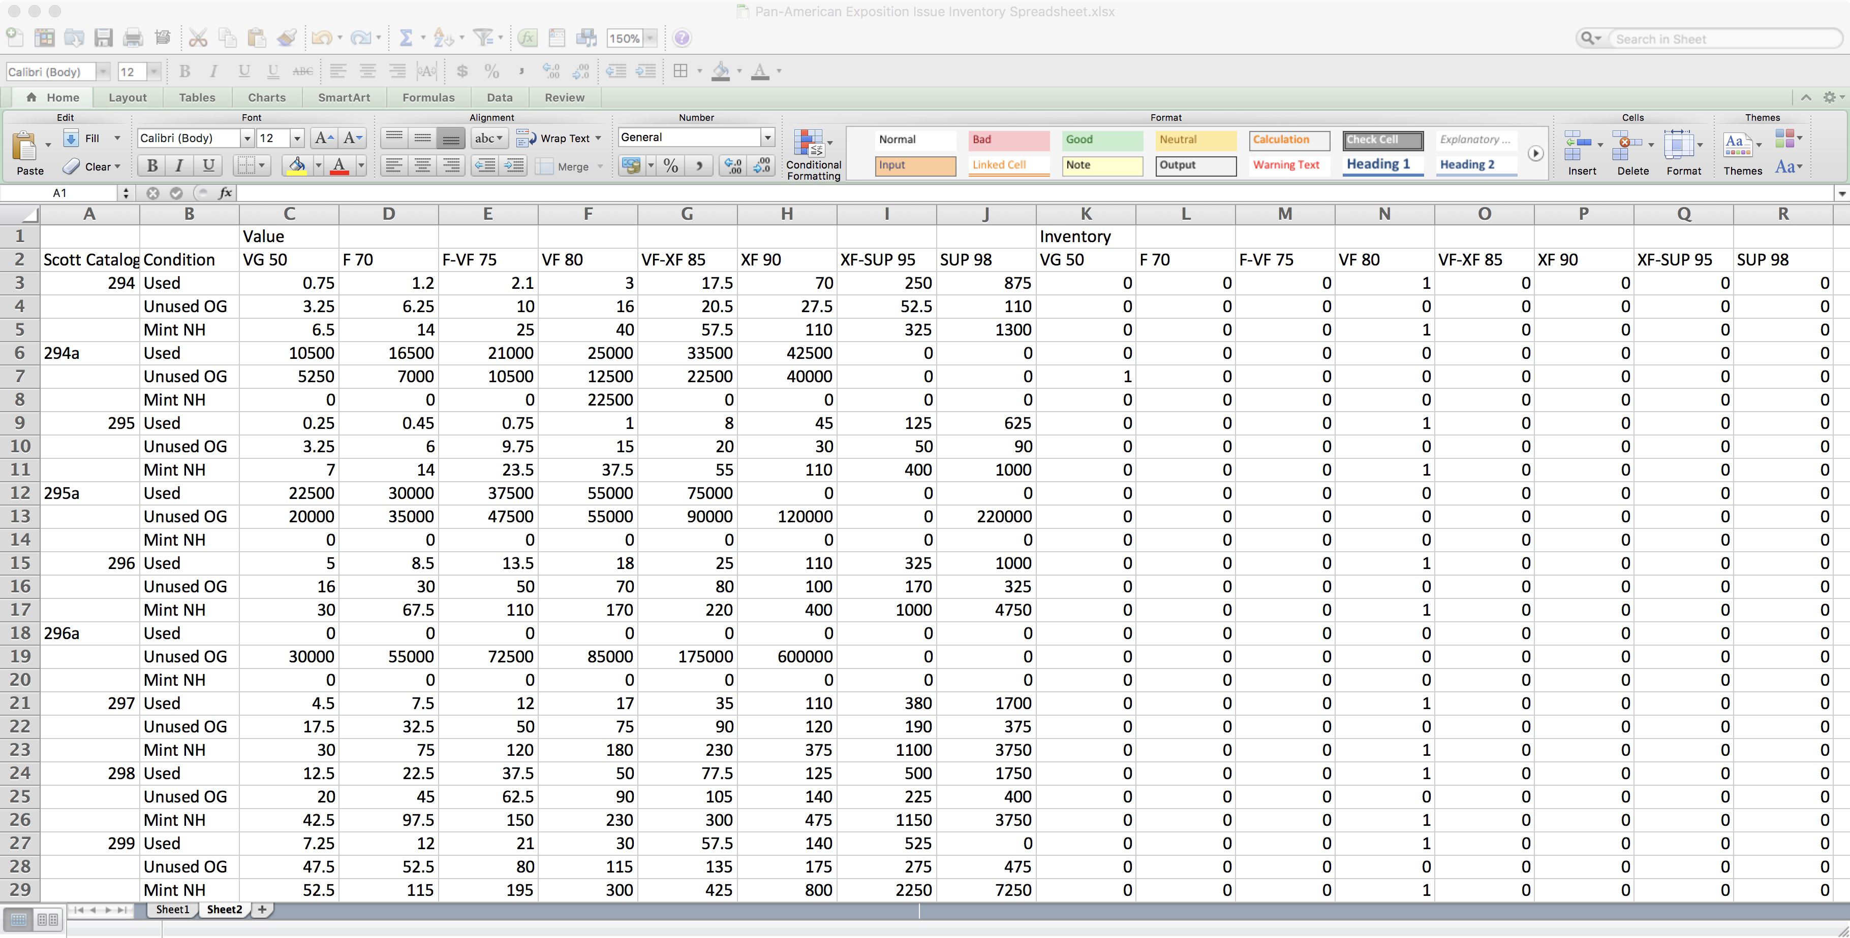
Computers & Philately Overview Inventory Spreadsheet with Data

Slide 10
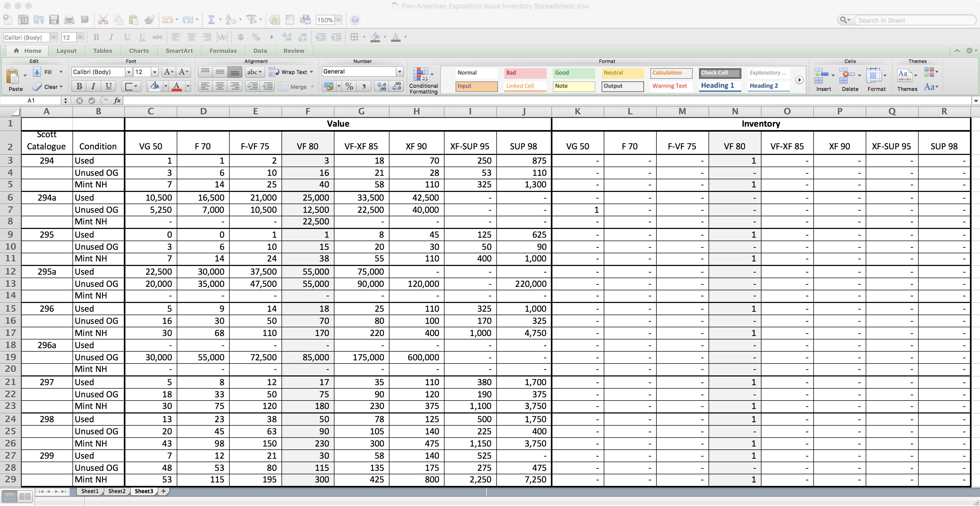
Computers & Philately Overview Inventory Spreadsheet Final Format

Slide 11
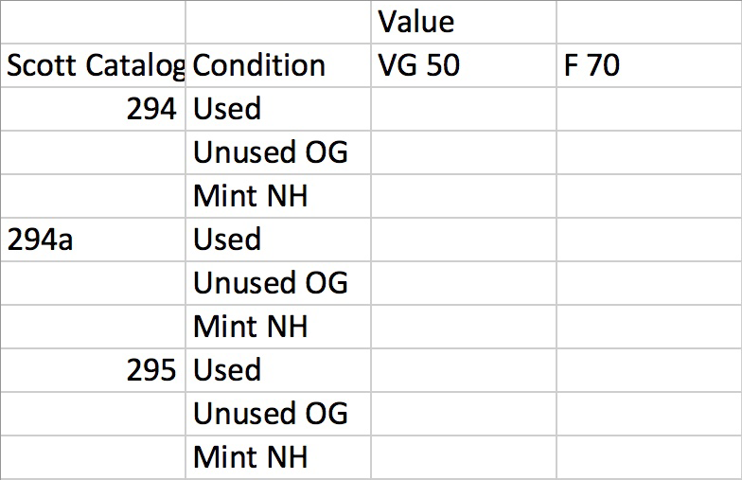
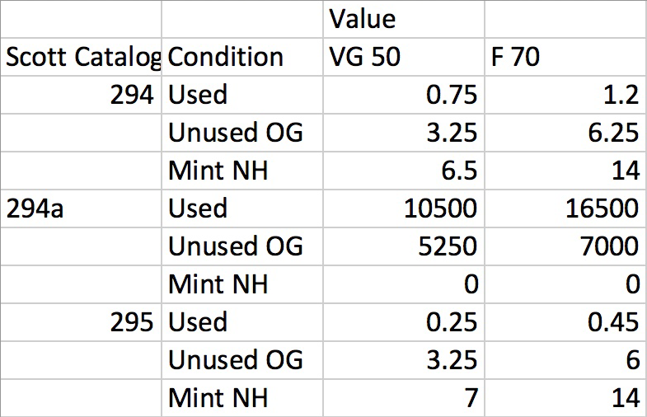
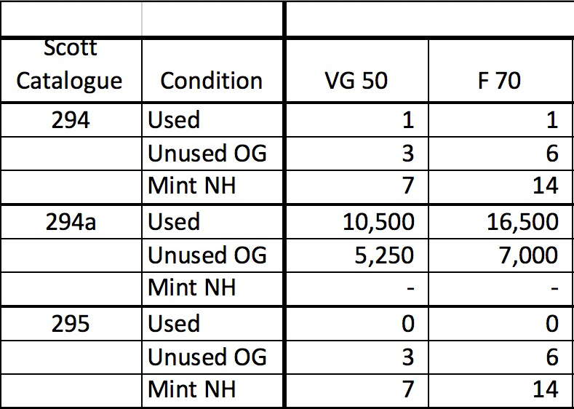
Computers & Philately Overview Inventory Spreadsheet Steps

Slide 12
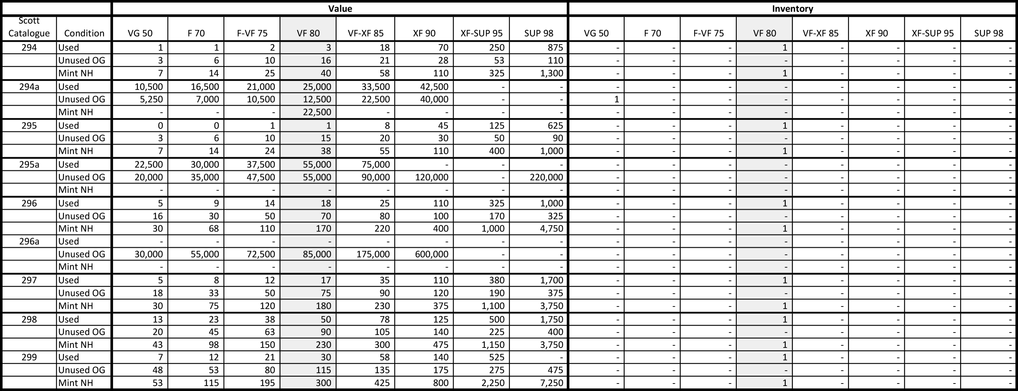
Computers & Philately Overview Inventory Spreadsheet Printed

Slide 13
Computers & Philately Overview Productivity Software
Presentation
Major Vendors
Microsoft PowerPoint
Apple Keynote

Slide 14
Computers & Philately Overview Text Editing/Word Processing

Slide 15
Computers & Philately Overview Productivity Software
Text Editing/Word Processing
Major Vendors
Microsoft Word
Apple Pages
Album Pages
Exhibit Pages
Publishing (e.g. Newsletters; Articles)

Slide 16
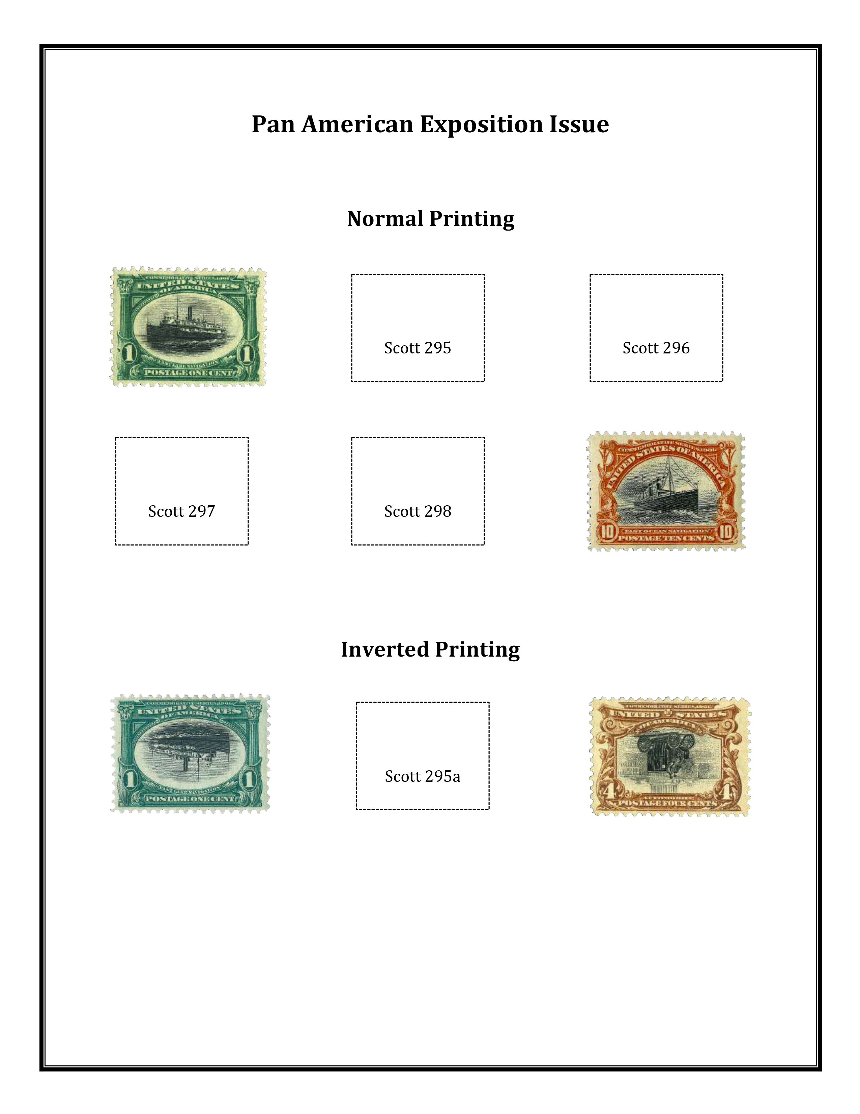
Computers & Philately Overview Text Editing/Word Processing
Notes
Acid-Free Paper
Moderately-Heavy Stock
Free Templates
Commercial Templates

Slide 17
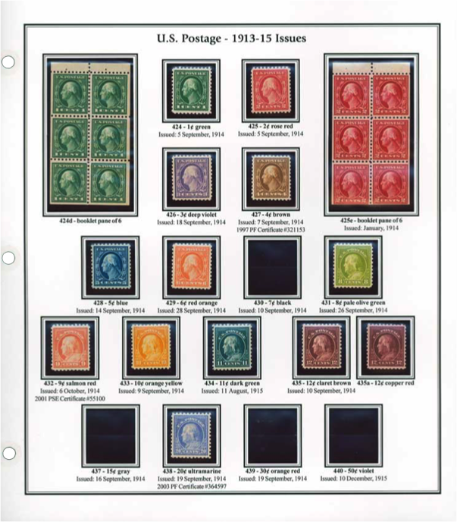
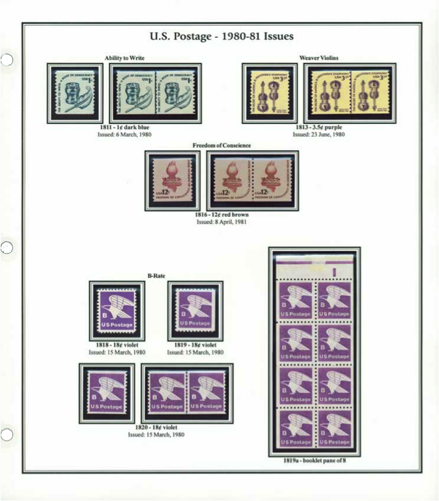
Computers & Philately Overview Text Editing/Word Processing

Slide 18
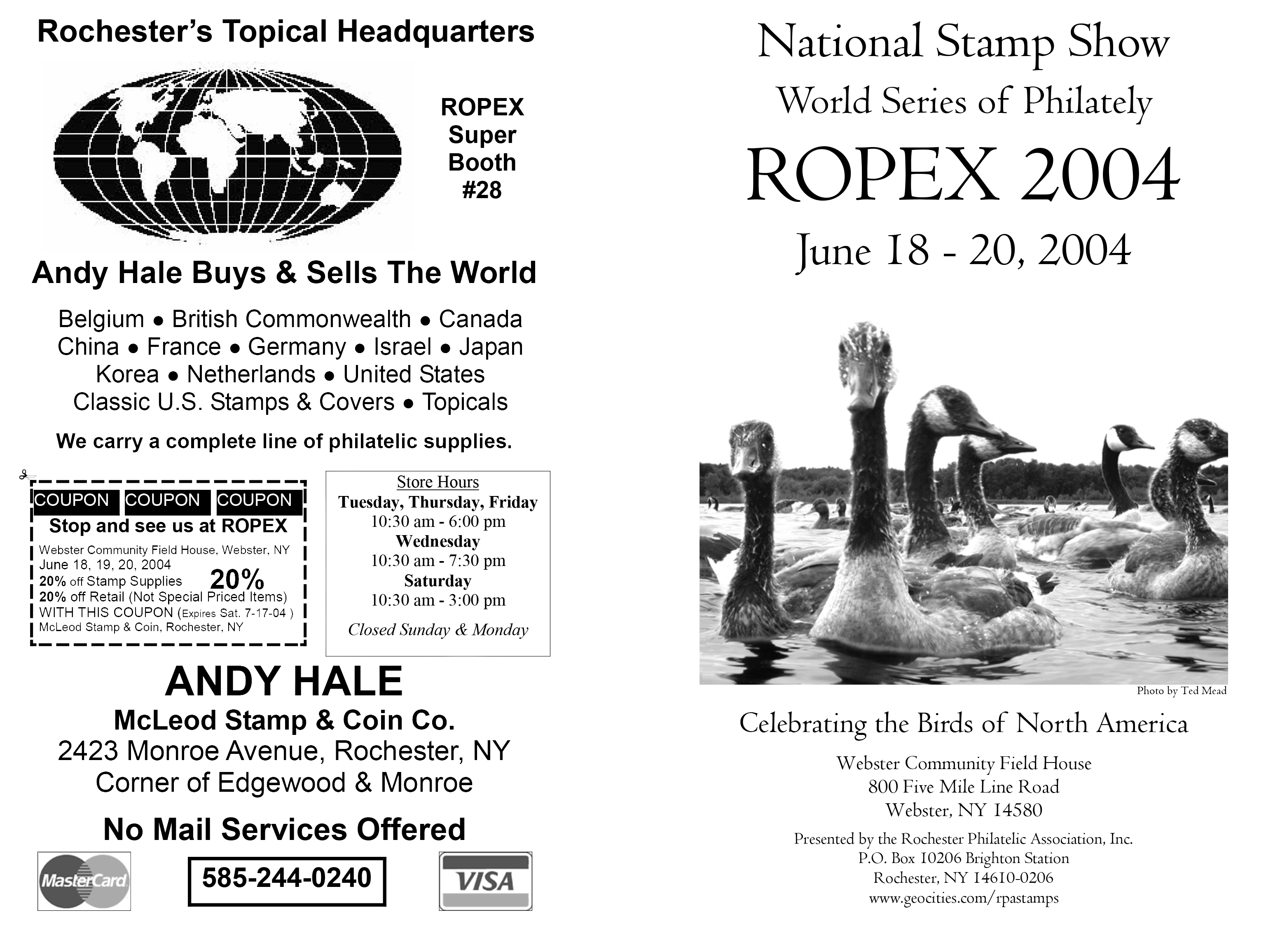
Computers & Philately Overview Text Editing/Word Processing

Slide 19
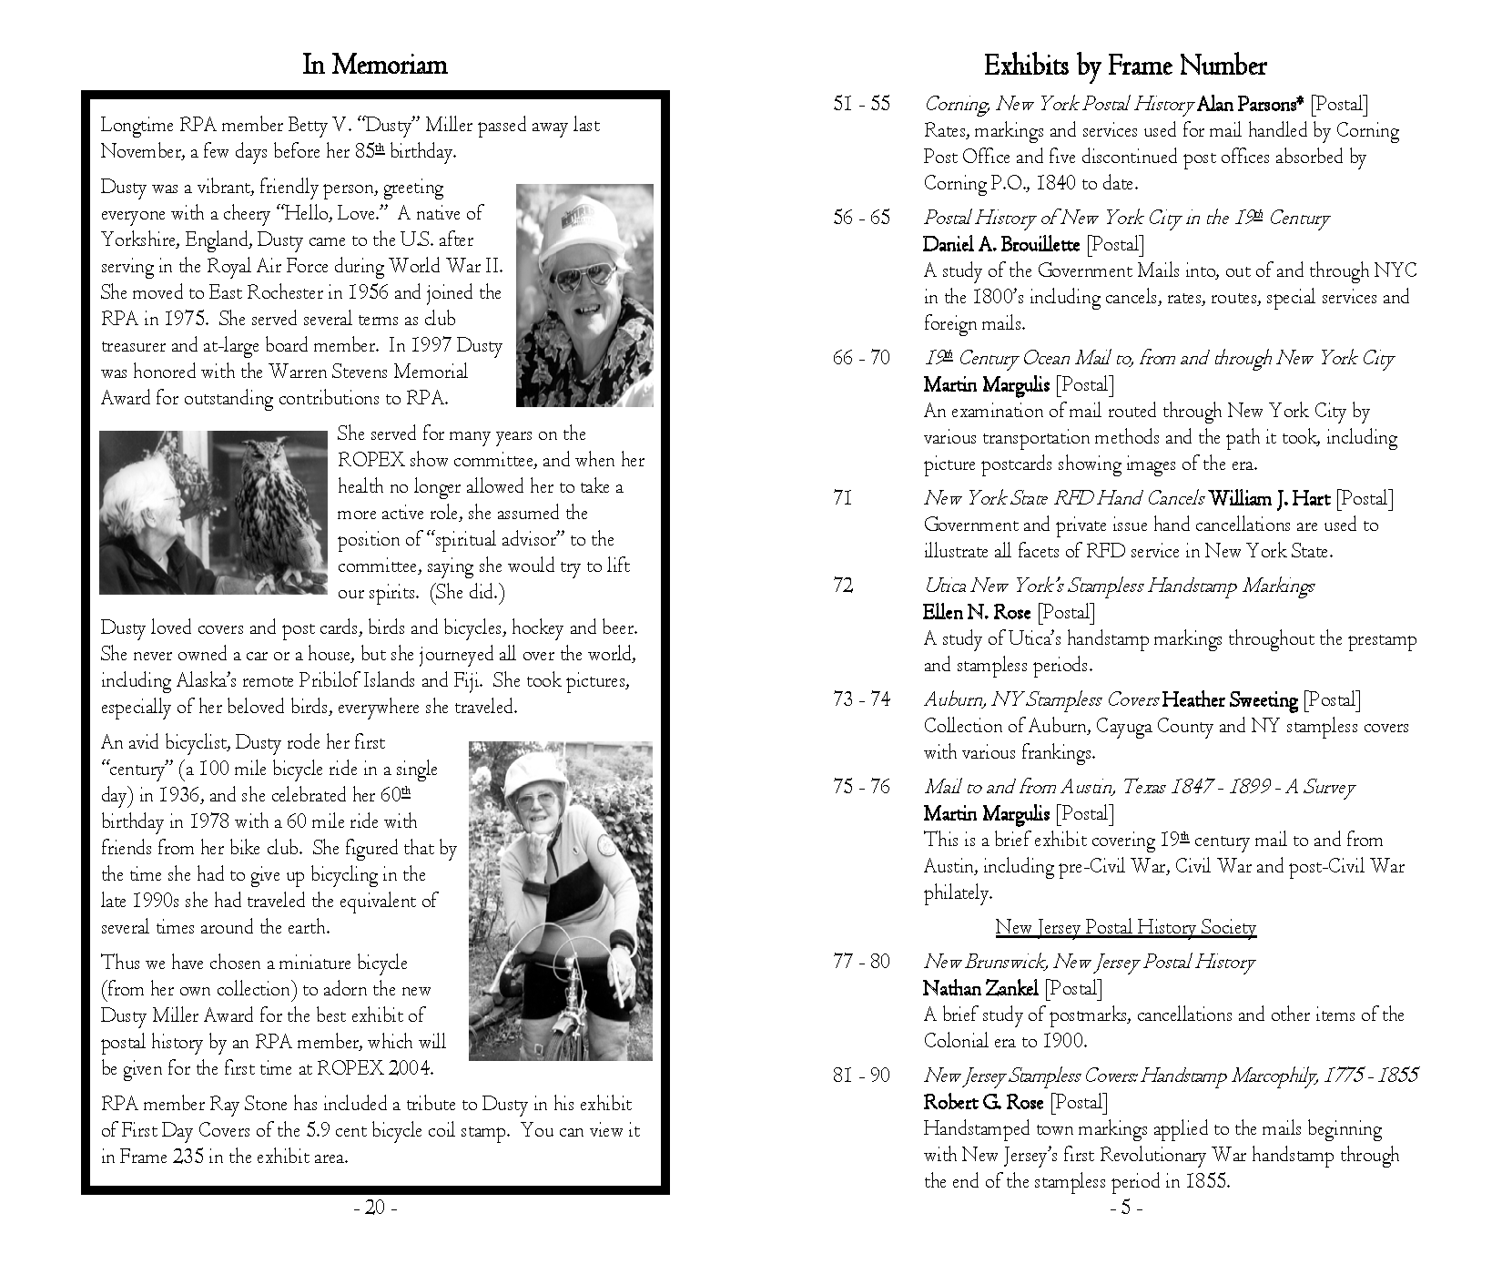
Computers & Philately Overview Text Editing/Word Processing

Slide 20
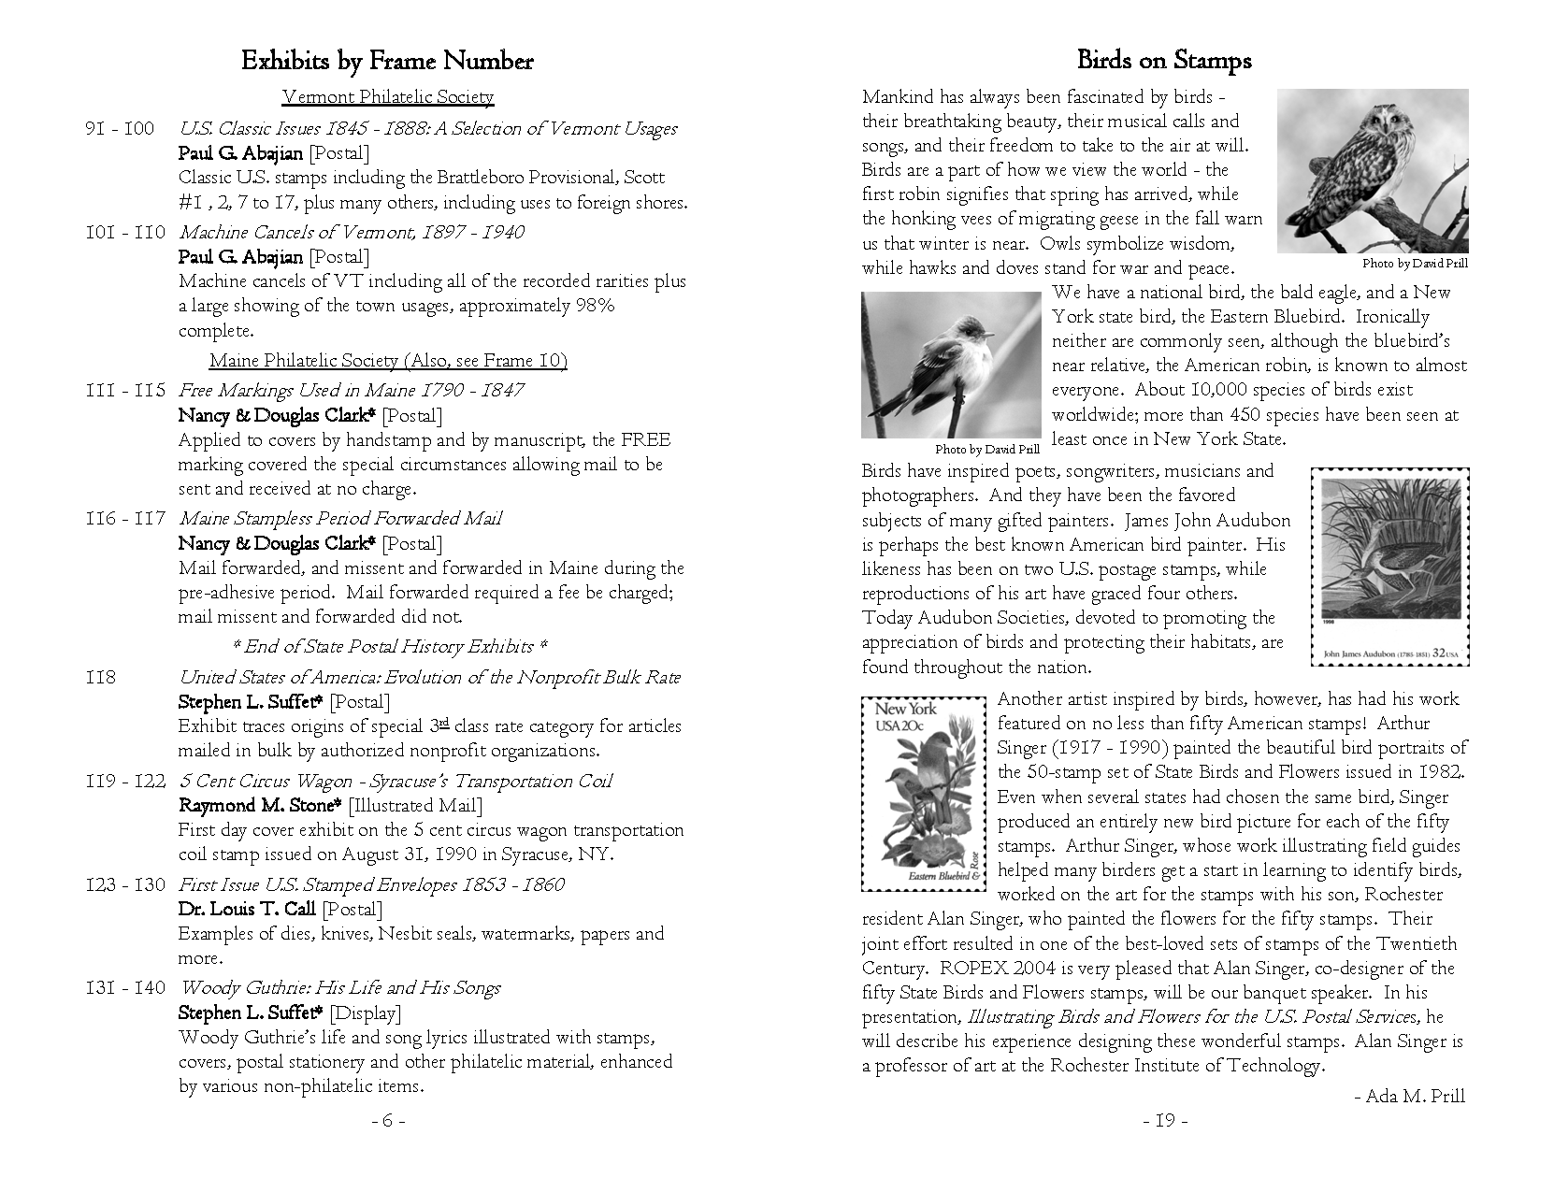
Computers & Philately Overview Text Editing/Word Processing

Slide 21
Computers & Philately Overview
Graphics

Slide 22
Computers & Philately Overview Graphics Software
Image
Raster (Pixel-Based)
Vector (Math-Based)
Tool
Adobe Creative Suite
Photoshop (Raster Graphics)
Illustrator (Vector Graphics)
InDesign (Publishing)
Other (e.g. Dreamweaver)
Photoshop Elements (PSE)
Format
JPEG
PDF
PNG
GIF
PSD

Slide 23
Computers & Philately Overview Graphics Lingo
Pixel
Tiny Colored Square
~72 Pixels Per Inch
Color
RGB, Grayscale or Black & White
CMYK for High Quality Printing
Professional Level Software

Slide 24
Computers & Philately Overview Image Lingo
Resolution
Pixels Per Inch (ppi)
Typically, Each Pixel Represents
One of 16.7 Million Colors
One of 256 Shades of Gray
Measure of Monitor Pixel Density
Dots Per Inch (dpi)
Measure of Printed Image Density
Printers & Scanners
Often (Mistakenly) Used Interchangeably with ppi

Slide 25
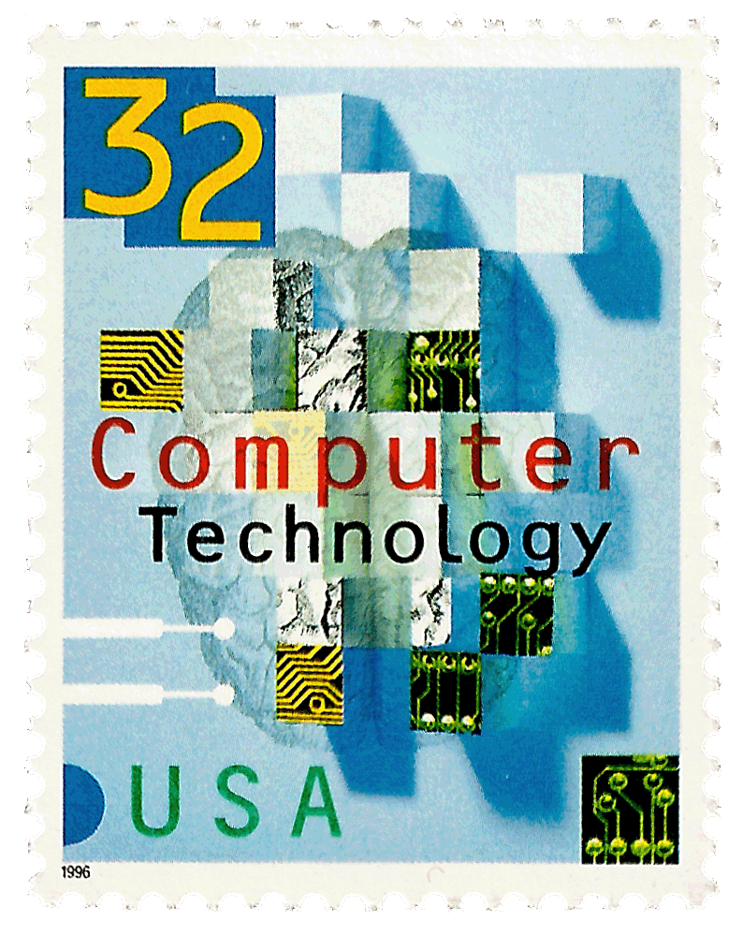
Computers & Philately Overview Pixelation
Resolution: 600 dpi
Resolution: 72 dpi
Resolution: 36 dpi

Slide 26
Computers & Philately Overview Typical File Types
 | TIFF | PNG | JPEG | GIF
Full Name | Tagged Image File Format | Portable Network Graphics | Joint Photographic Experts Group | Graphical Interchange Format
Compression | Lossless | Lossless | Lossy | Lossy
Editing | Retains Clarity | Retains Clarity | Loses Clarity | Loses Clarity
Color Palette | 16.7 Million | 256 | 16.7 Million | 256
When To Use | Scanning Desktop Publishing | Photos Images Transparency | Photos Images Background | Photos Images Transparency
Primary Use | Printing | Web | Multimedia | Web
Other
PSD (Photoshop File): typically the working document in Photoshop or Photoshop Elements
PDF (Portable Document Format): generally used to share documents with others who have different software or platforms

Slide 27
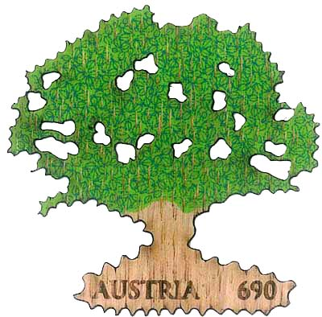
Computers & Philately Overview Image File Types
File Type: PDF
Dimensions: 48╳47
Size: 496 KB
File Type: JPEG
Dimensions: 400╳394
Size: 162 KB
File Type: GIF
Dimensions: 400╳394
Size: 209 KB
File Type: PNG
Dimensions: 400╳394
Size: 369 KB

Slide 28
Computers & Philately Overview Typical Scanning Parameters
Resolution
Inkjet Printer
Typically 300–720 dpi
Laser Printer
Consumer: 600 dpi
High-End Production: 2400 dpi
Photographs
300 X Output Dimension in Inches
Mode
Color
Grayscale
Black & White
File Format
JPEG
TIFF
PDF
Capture Optimal Amount of Data! (Think Film)

Slide 29
Computers & Philately Overview Best Practices
Original File
High Resolution TIFF or PSD
Working File
Duplicate Original File
Image Manipulation
Enhancement
Use Layers Effectively
Final Image
JPEG
PNG
GIF
PDF

Slide 30
Computers & Philately Overview Useful Techniques
Basic Image Editing
Simple Editing
Perforations
Fake
Trimmed
Layers
Perforations
Fake
Advanced Image Editing
Background Removal
Cancel Isolation

Slide 31
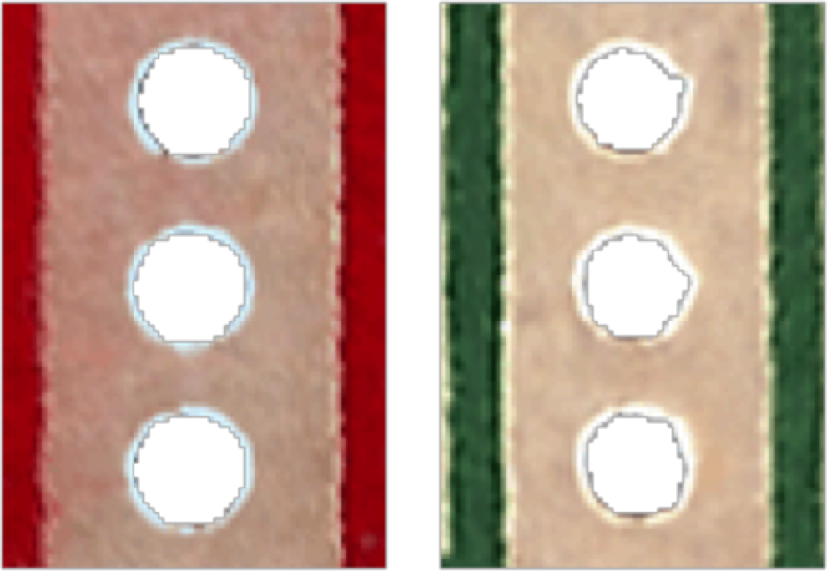
Computers & Philately Overview Fake vs. Genuine Perforations
Round Circles
Erose Circles

Slide 32
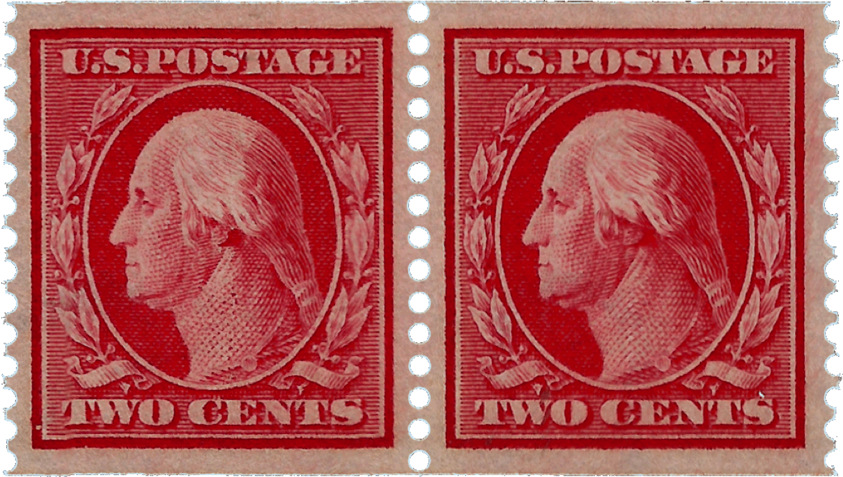
Computers & Philately Overview Scott 387 Fake Perforations

Slide 33
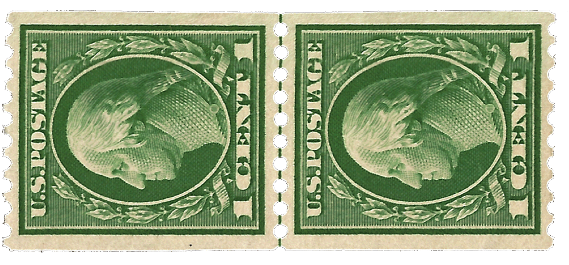
Computers & Philately Overview Scott 441 Trimmed Perforations

Slide 34
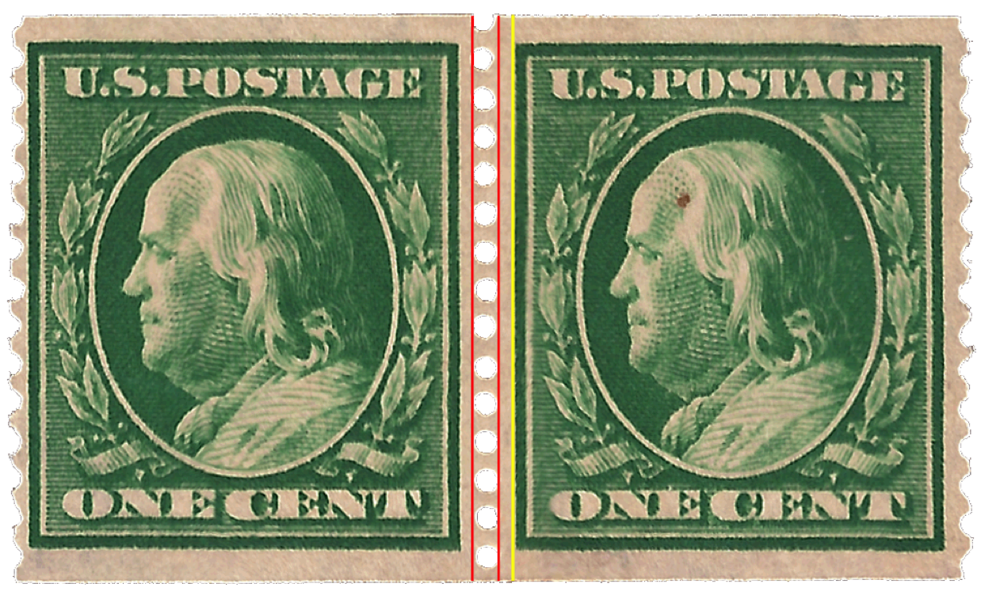
Computers & Philately Overview Scott 387 Fake Perforations

Slide 35
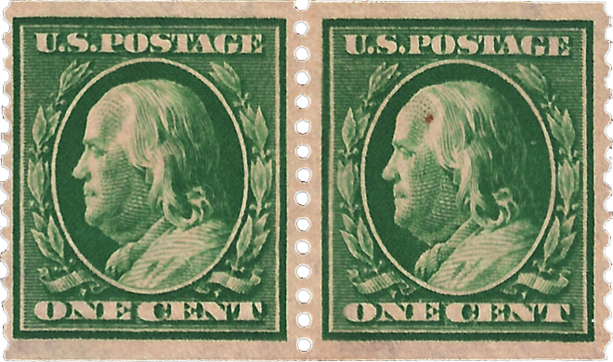
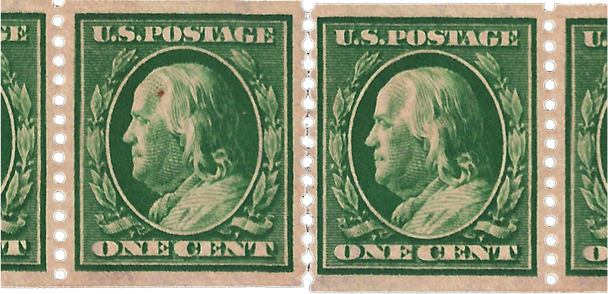
Computers & Philately Overview Scott 387 Fake Perforations

Slide 36
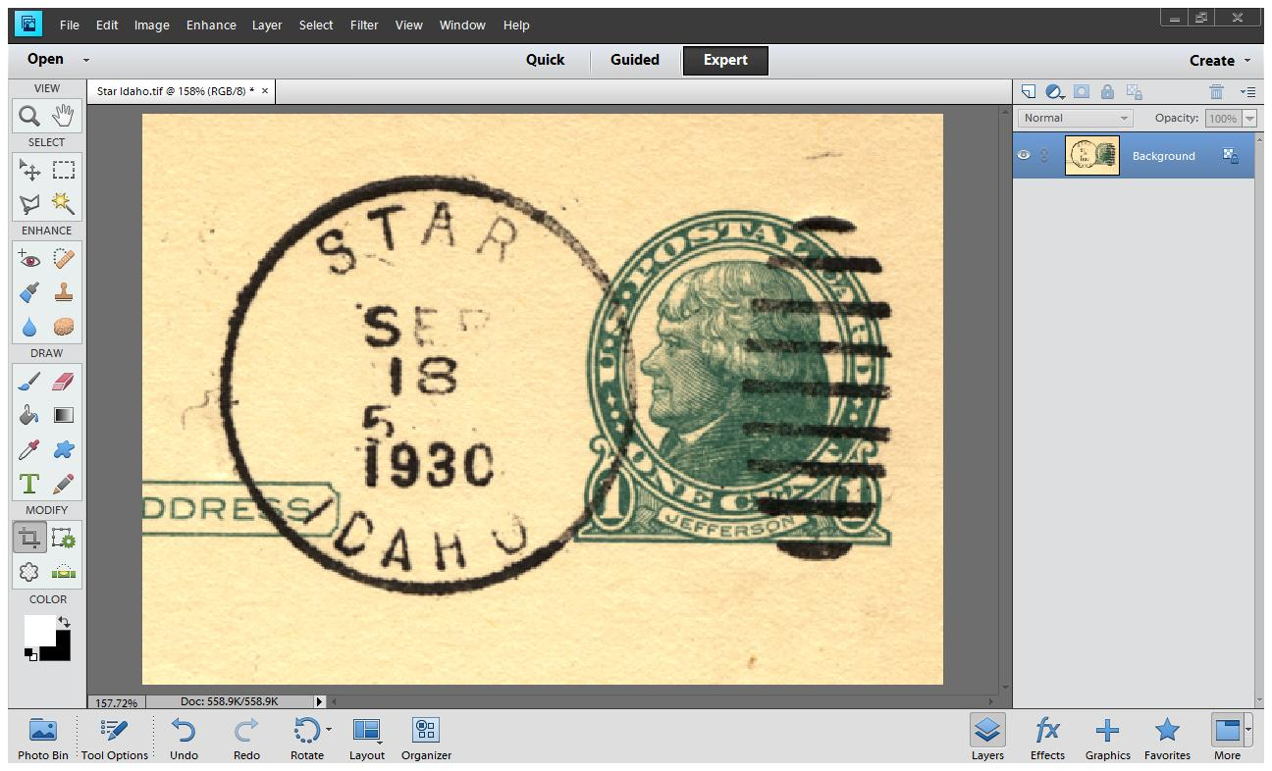
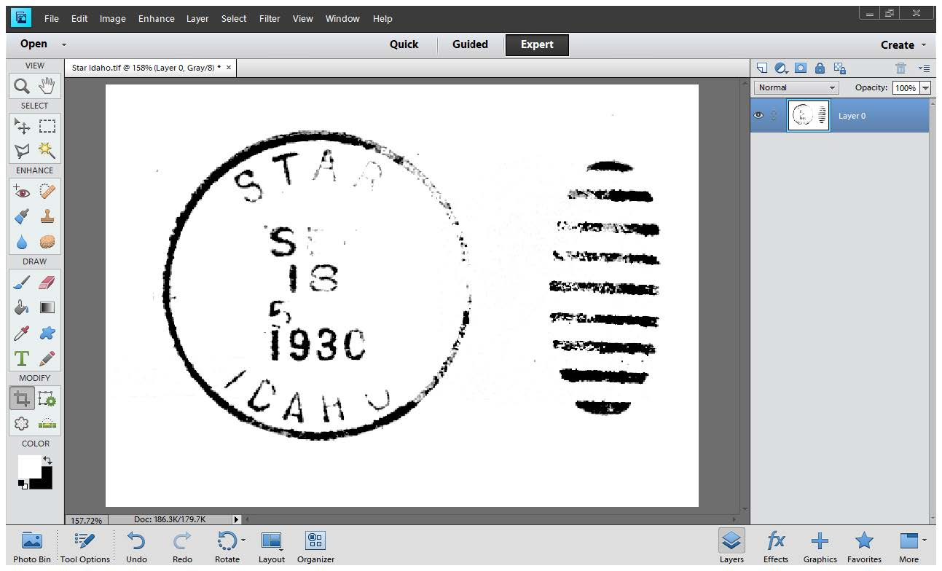
Computers & Philately Overview Background Removal
Cropped Original
Isolated Cancel

Slide 37
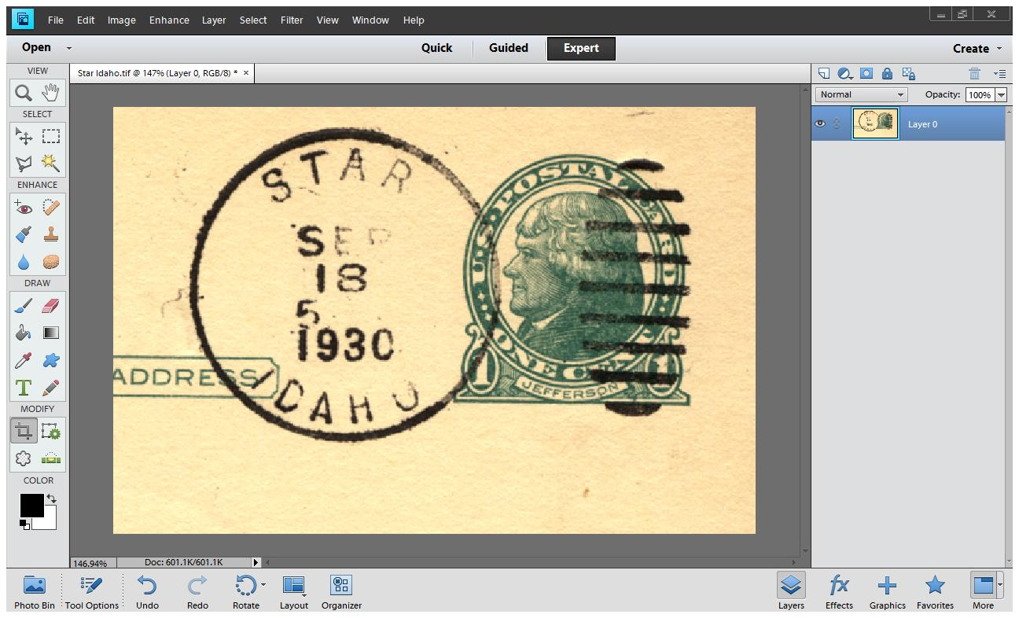
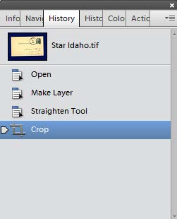
Computers & Philately Overview Background Removal
Crop Original

Slide 38
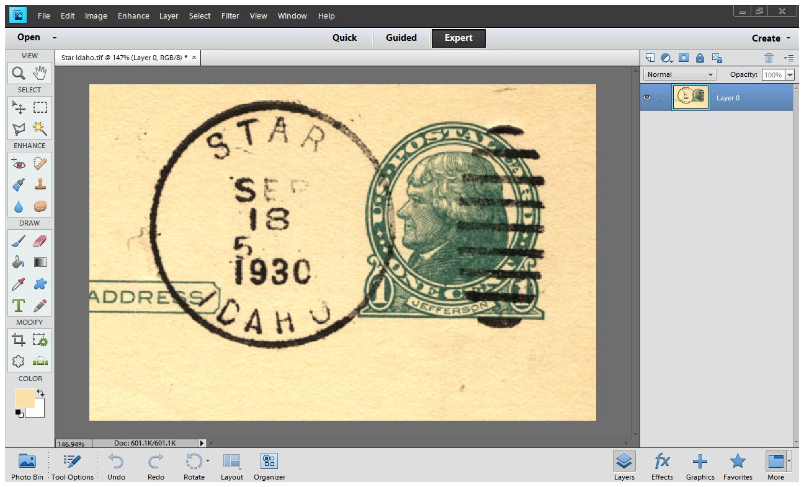
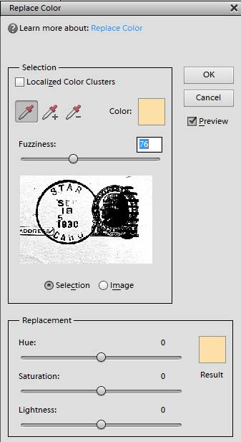
Computers & Philately Overview Background Removal
Remove Beige

Slide 39
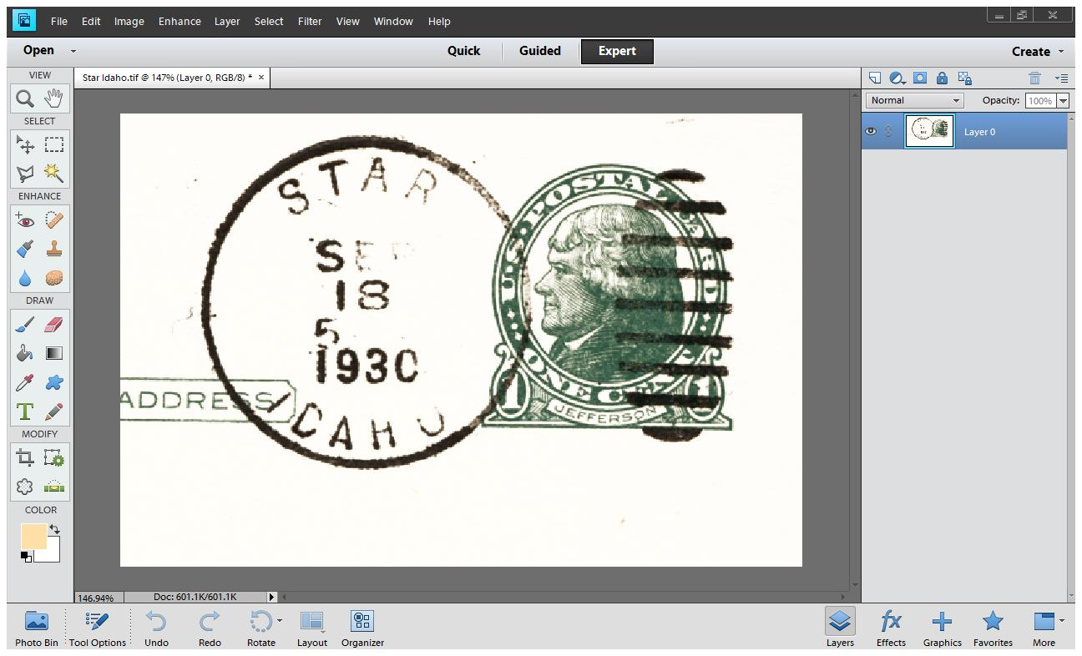
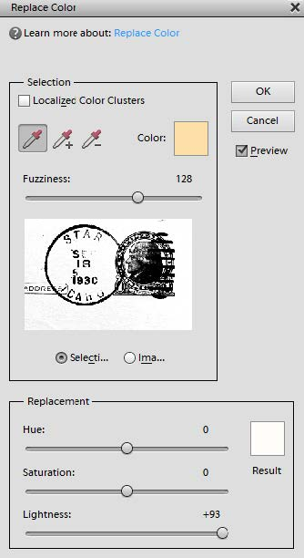
Computers & Philately Overview Background Removal
Lighten Image

Slide 40
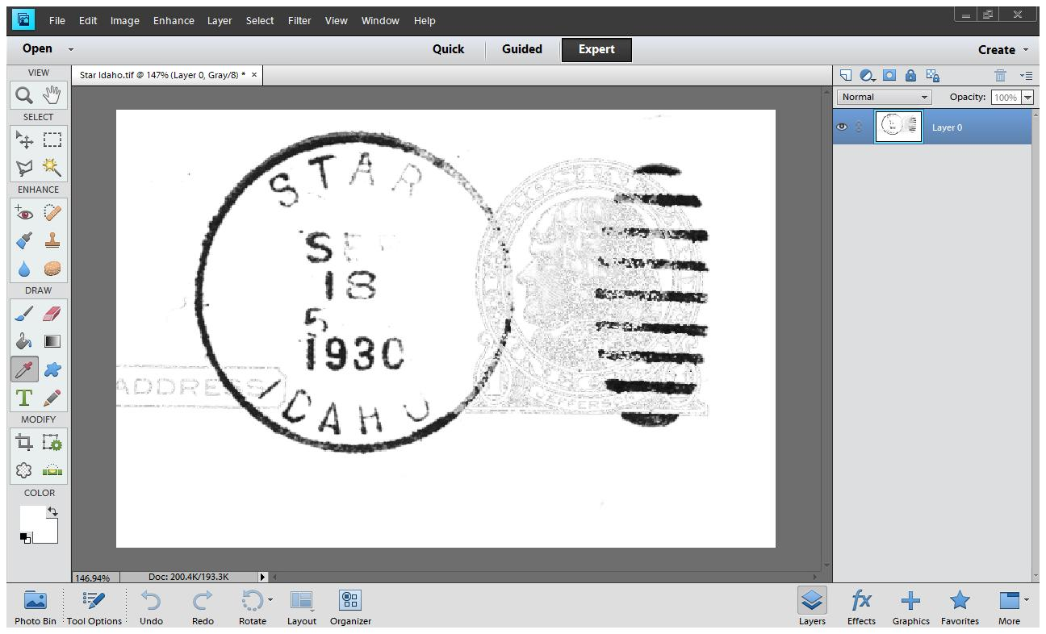
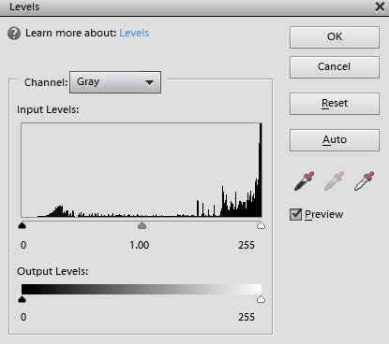
Computers & Philately Overview Background Removal
Gray Channel

Slide 41
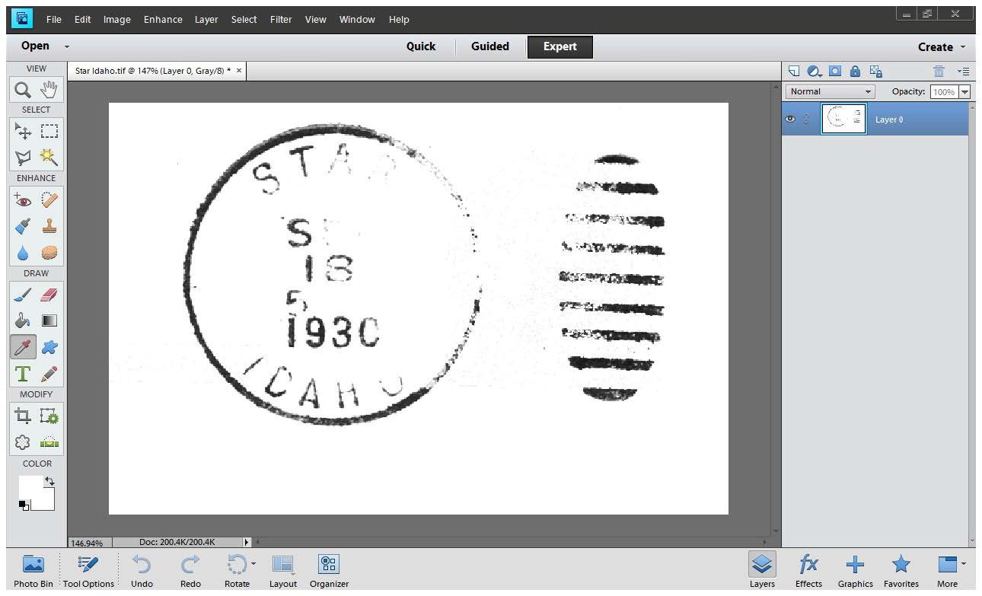
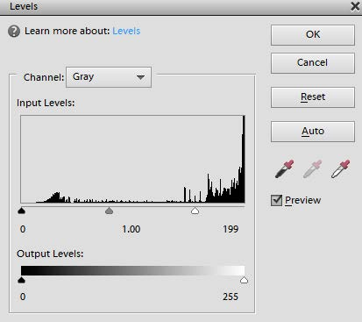
Computers & Philately Overview Background Removal
Reduce
Whites

Slide 42
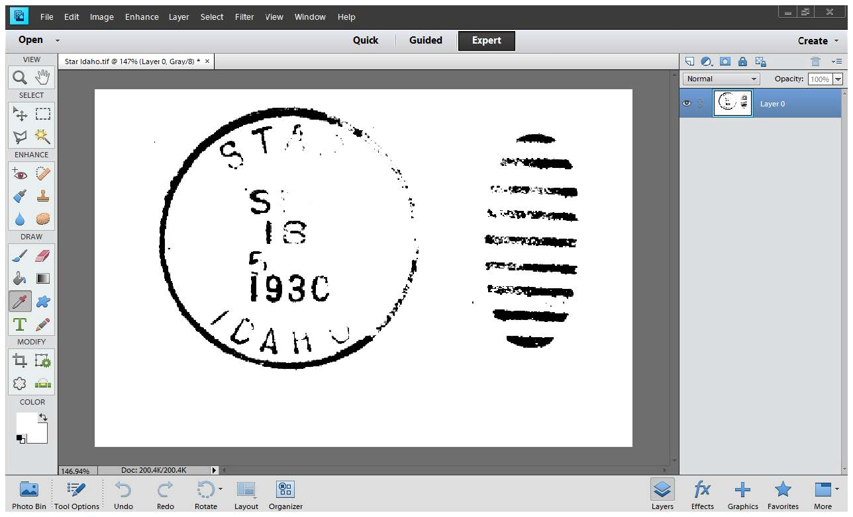
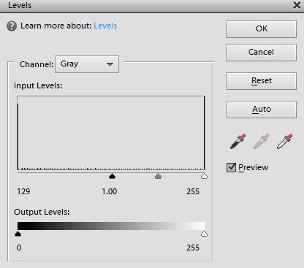
Computers & Philately Overview Background Removal
Reduce Blacks

Slide 43
Computers & Philately Overview Background Removal
Final Image

Slide 44
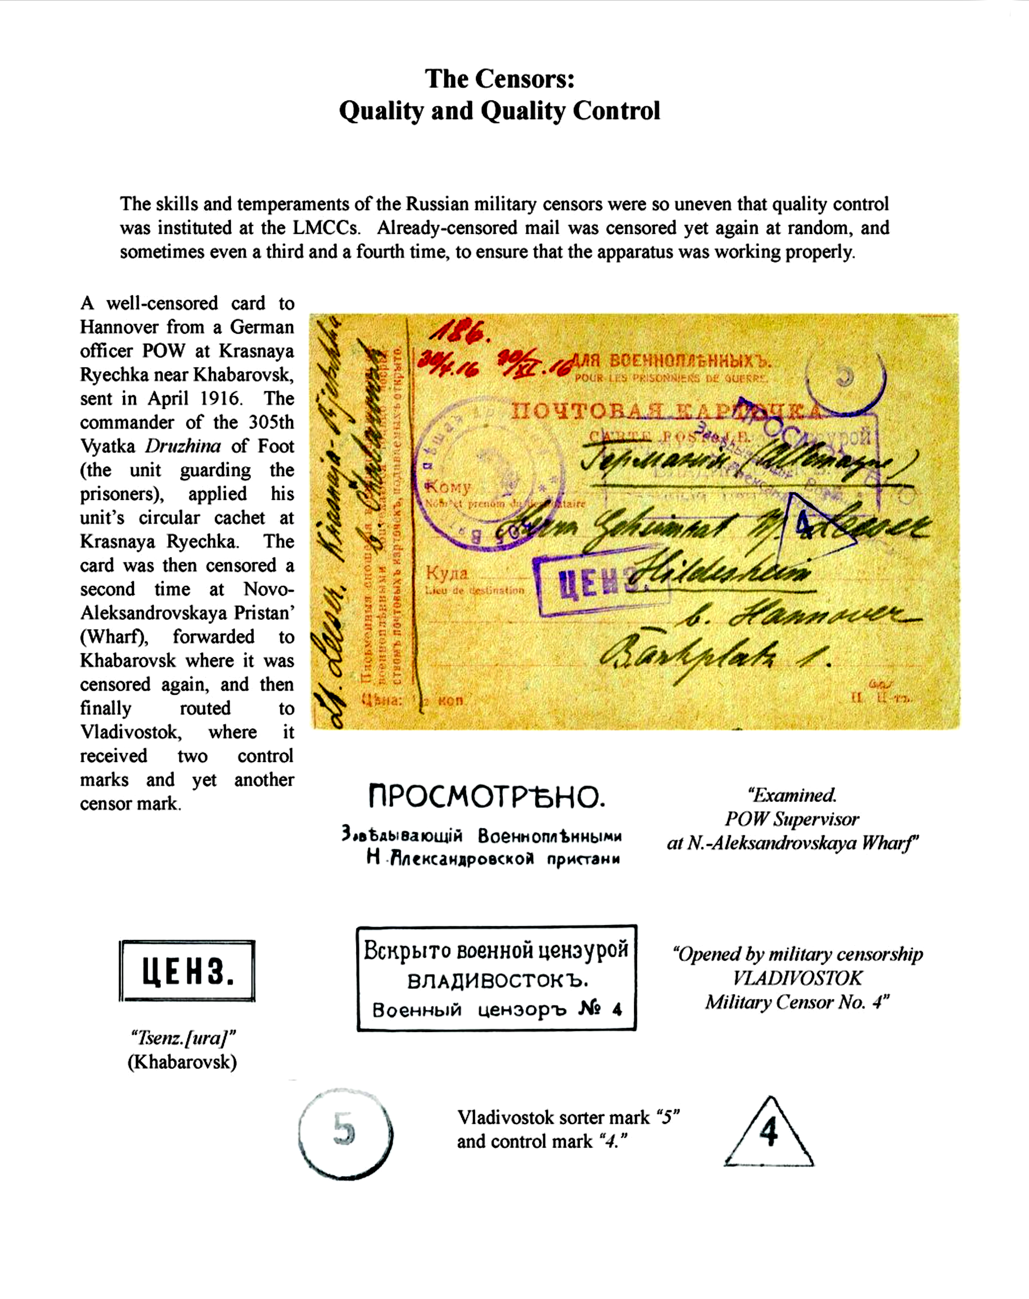
Computers & Philately Overview Background Removal
Source: Exponet
Military Censorship in Imperial Russia 1904–1917
by
David M. Skipton

Slide 45
Computers & Philately Overview Reference
Scott Specialized Catalogue of United States Stamps & Covers (2018)
Website: Stamp Smarter
www.stampsmarter.com/1847usa/1847Home.html (Formerly www.1847USA.com)
Comprehensive U.S. Stamps Resource
Years: 1847–2016
Basic Information, Plating, Fancy Cancels, Checklist, Washington-Franklin Identifier, Perfin Census & Much More
Website: Exponet
http://www.exponet.info/index.php?lng=EN
Extensive Online Collection of Exhibits
Website: Jim’s Stamp Album
album.dweeb.org
Excellent Examples of Custom Album Pages
Years 1883–2008

Slide 46
Computers & Philately Overview Reference
Barb Boal: American Philatelic Society Scanning & Elements 11 Presentation

