Slide 1
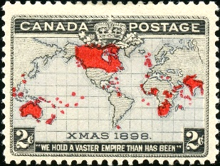
The 1898 Canadian MAP stamp
A study of its printing and varieties. Robert Lighthouse

Slide 2
What’s with the 2¢ 1898 Canadian map stamp– the first Christmas stamp?
The issue date was December 25, 1898, meant to illustrate the British Empire dominions, colonies and protectorates across the globe. Printed by the American Banknote Company (Ottawa), 20 million were ordered, 19,927,500 were delivered, presumably spoilage accounted for the difference.
The goal of this presentation is to detail the purpose of the map stamp, summarize the four issued plates, discuss the issue’s unique production process and inherent resulting flaws, and give examples of its use.
Shown will be singles, multiples, imperforate varieties and usages on cover, with emphasis on identifying varieties.
Research has taken me over 35 years examining thousands of these stamps, comparing each to known platings, varieties and re-entries identified by experts in philatelic journals from around the world, and making some of my own along the way. Come see why I enjoy collecting Scott #85 and #86 so much!

Slide 3
Background
At the Imperial Conference on Postal Rates conference on postage matters held in London in July 1898, William Mulock, Postmaster General of Canada, proposed an Imperial penny postage rate for a half-ounce letter to or from any member country as an affordable way of increasing mail volume and uniting the far-flung nations. The plan was adopted by the group (except for Australia and New Zealand) and slated for implementation at the start of the new year.
This was also of interest to the Universal Postal Union, a body of over 100 member countries around the world based in Bern, Switzerland, providing advisory, technical assistance and mediation on all matters dealing with the mail. The British Empire at the time made up a large part of the organization.
Thus was born the need for a 2c (equal to 1d) Canadian Imperial postage stamp.
December 7, 1898 – Canadian post offices started receiving the new stamp
December 25, 1898 – First day of issue for the map stamp on Christmas Day
January 1, 1899 – First day of the new British Empire international surface rate

Slide 4
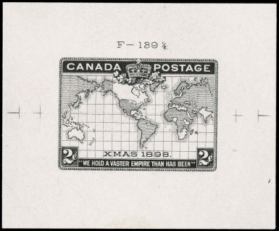
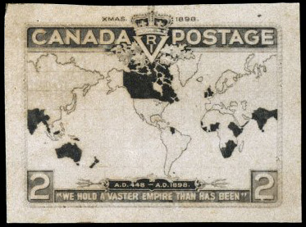
Design
The design of the stamp was recommended by Mulock himself using a “Mercator Projection,” an image projected into a box-like structure, exaggerating the map features the further north and south one goes.
Die proof of the accepted black engraving
Engraver’s Essay

Slide 5
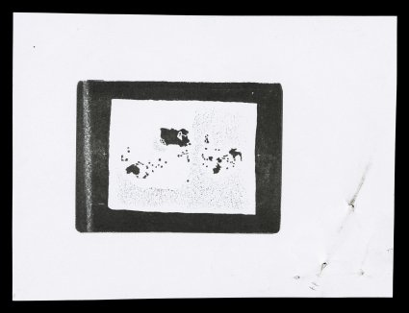
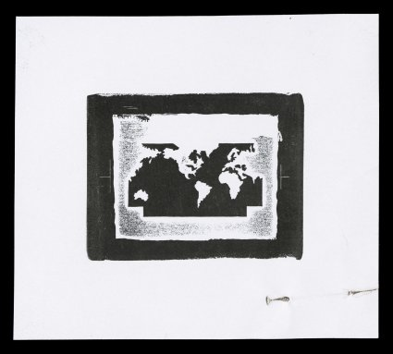
Design
The map stamp was especially impressive as it would be tri-colored. Carmine would be used to color the various British possessions, and lavender then blue in later printings for the seas. Below are the typographed die proofs of each.
British Possessions (98x73 mm) Oceans (85x73 mm)
ex-American Bank Note Company Archives
(ex-American Bank Note Co. Archives)

Slide 6
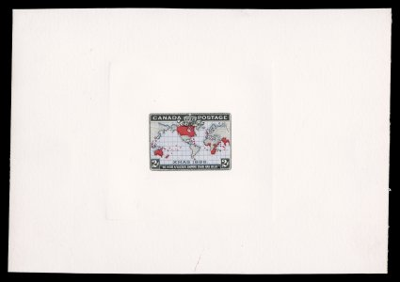
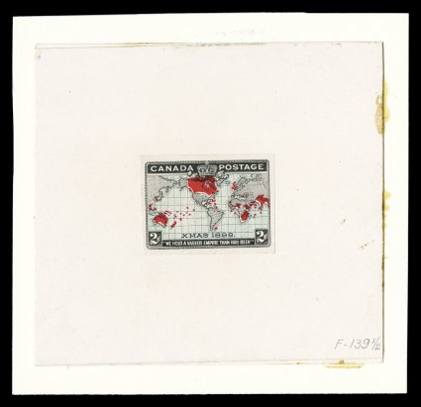
Design
The seas were printed in two colors, lavender at first, then blue.
Hybrid large die proof (150 x106 mm) Hybrid large die proof (91 x 83 mm)
lavender, black and carmine blue, black and carmine
Ex- T. Gillian 1999 Greene Foundation certificate
(ex-American Bank Note Co. Archives)

Slide 7
Production – Engraved (Intaglio) Map
With the design finalized, a hardened master die of the map part was made. That “negative” image was pressed on the transfer roll creating a “positive” and rocked into place one at a time on the plate, creating a 10 stamp by 10 stamp “negative” grid. Five separate plates of 100 were made, numbered 1 to 5.
When the initial rolling left an imperfect image, a new transfer of that image was impressed over the old. If the match was not exact, part of the old image could be seen along with the new, creating a “transfer error.” Several of these consistent varieties exist “plated” by specialists who proved from which plate number and which position (1 through 100) they were printed.
(ex-American Bank Note Co. Archives)

Slide 8
Production – Engraved (Intaglio) Map
Each stamp’s image was positioned manually on the plate using a series of scribed arcs that helped align the transfer roll exactly in place. Doing so left a small dot behind on the plate in addition to the arc itself.
The leg of the scribing tool then moved up to the freshly engraved arc, and the process continued on the plate. Any slight mis-positioning created a variety of where the dot impression appeared and its size. Some of these dots were burnished from the plates before being used, but others remained. Differences in the dots are most noticeable near the island of Hainan. Compare the dot’s location and size found on Plates 1, 2 and 3 on the diagram above.
(ex-American Bank Note Co. Archives)

Slide 9
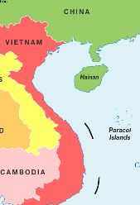
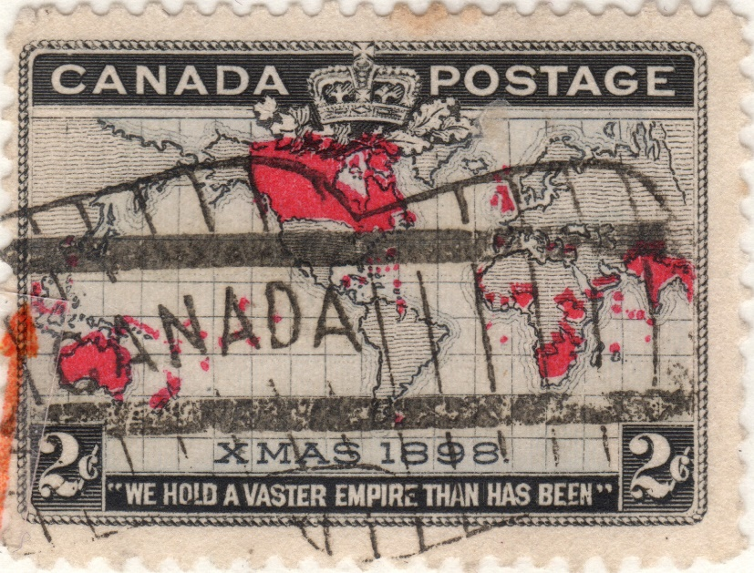
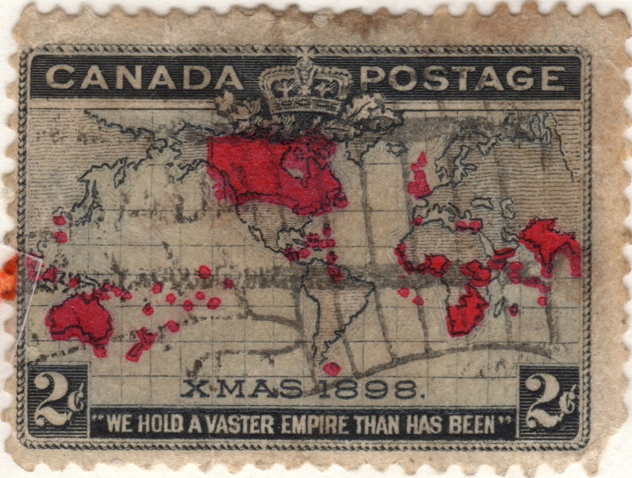
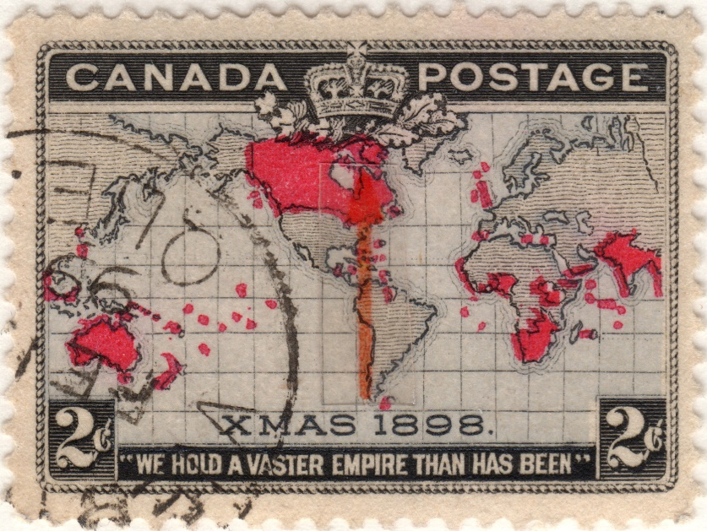
Production – Engraved (Intaglio) Map
Samples of dot
placements.
P1-13 P1-79 P2-55
(ex-American Bank Note Co. Archives)

Slide 10
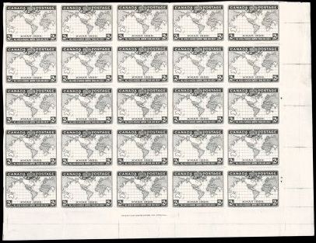
Production – Engraved (Intaglio) Map
Five different production
plates of 100 were
created, numbered 1
through 5. However
Plate 4 was deemed
unusable and never put
into production. The
remaining plates were
used simultaneously
during printing.
imperforate progressive
plate proof in black,
quarter sheet, unknown
plate number
ex-American Bank Note Company
archives, 1991 Greene Foundation
certificate, largest known multiple
(ex-American Bank Note Co. Archives)

Slide 11
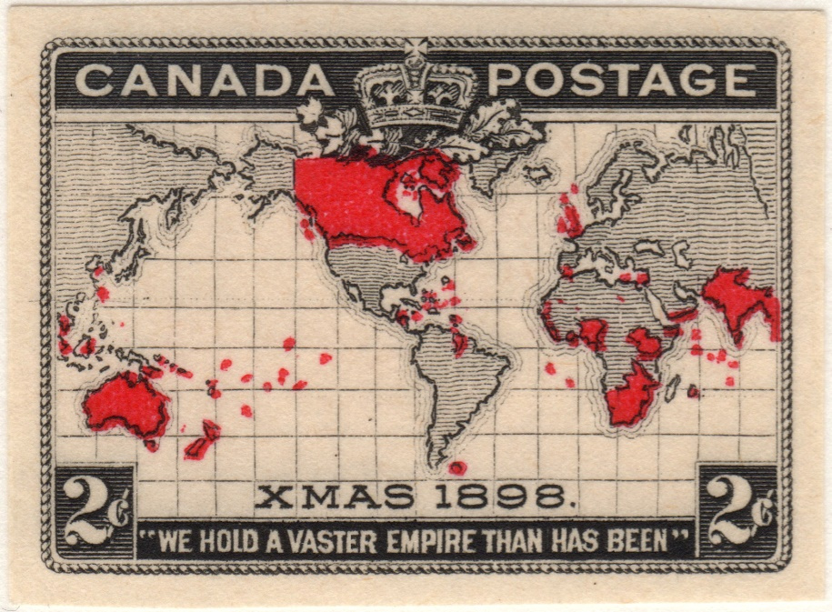
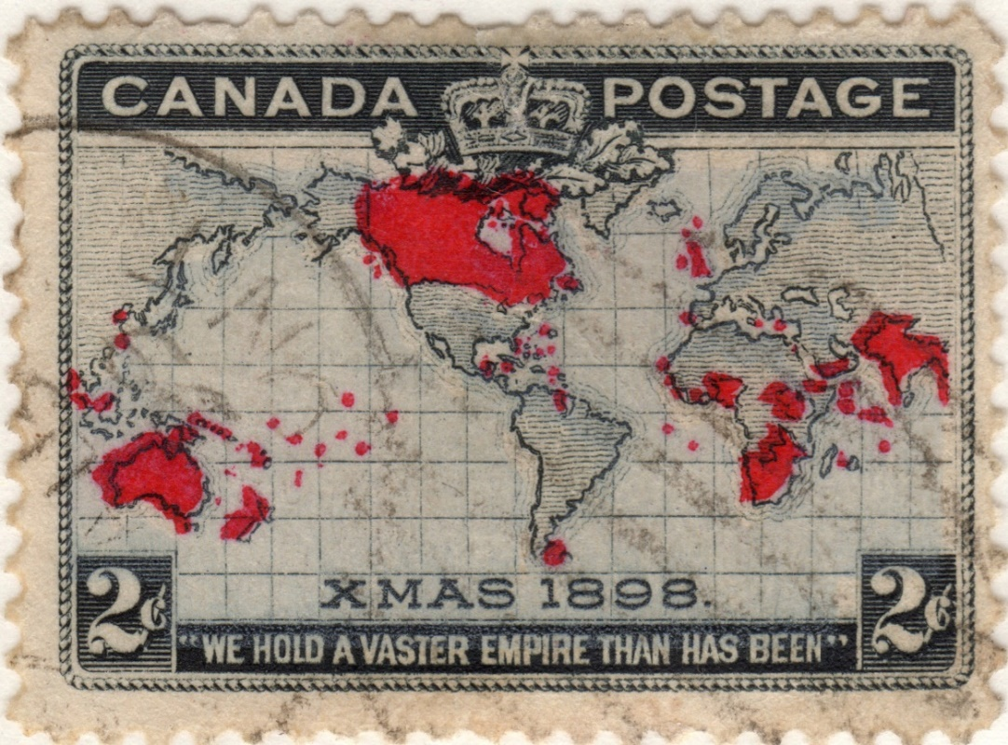
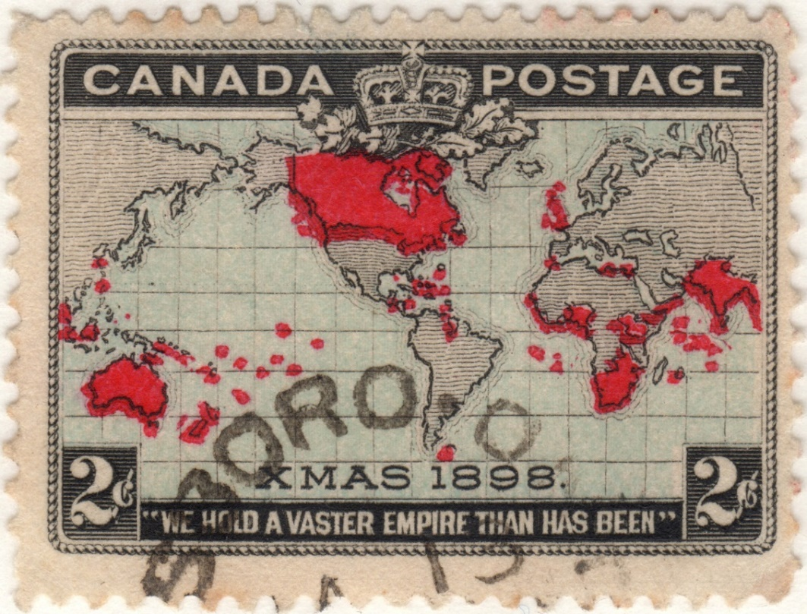
Production – Additional Color Passes
Once the black map sheet was printed, two more passes were needed to apply the additional colors for the seas and Empire territories. Unlike the black map printed by engraving, which left ink raised on the stamp’s surface, the colors were printed by typography. Ink was applied to the paper’s surface by rollers with the design forced into the paper, leaving the surface flat. Color alignment was tough!
Progressive Plate Proof
(ex-American Bank Note Co. Archives)

Slide 12
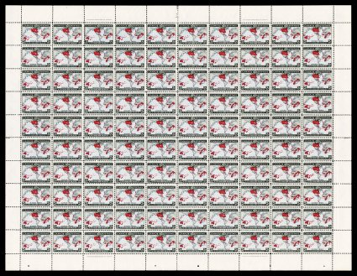
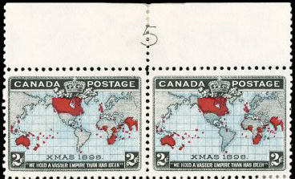
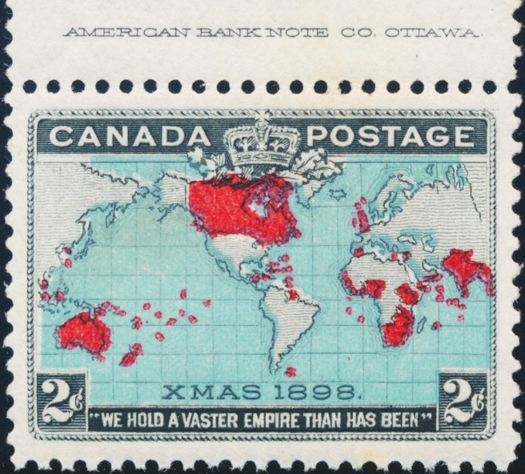
Production – Sheet Layout
Plate Number Center Top
Complete Sheet, Plate 1 Printer Mark P03,P08,P93,P98
(ex-American Bank Note Co. Archives)

Slide 13
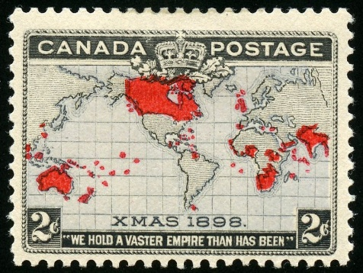
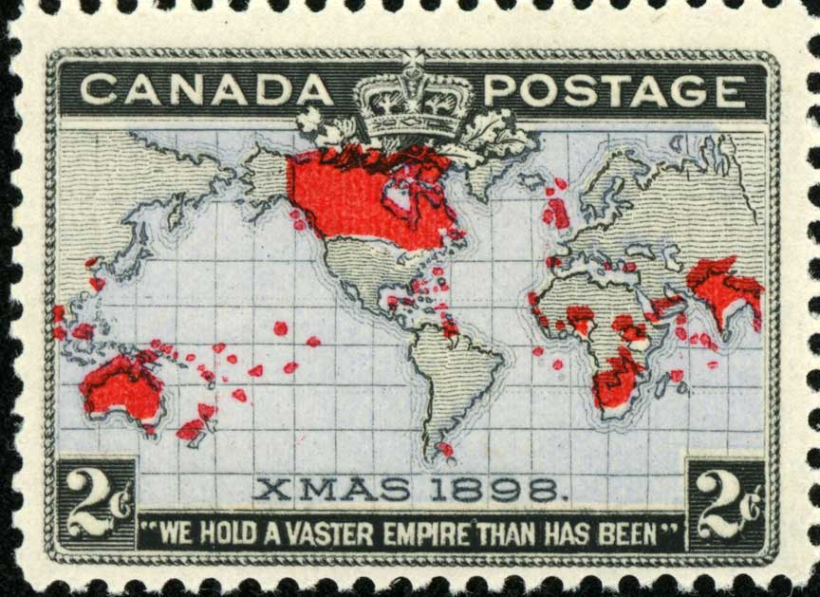
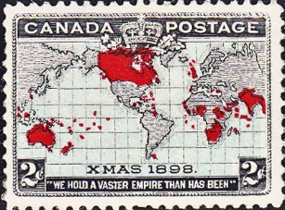
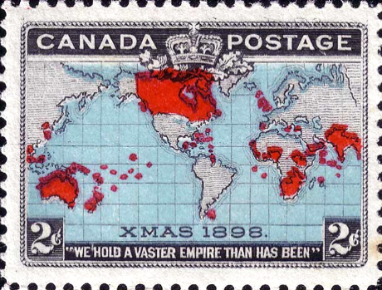
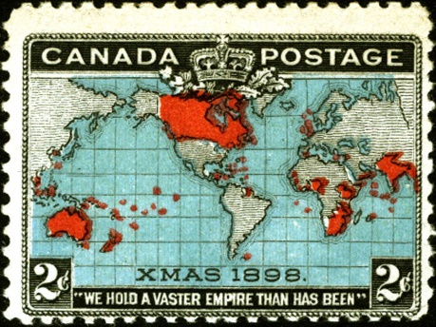
Production – Seas Color Varieties
Controversy remains whether the sea colors were intended to be in two different colors, lavender and blue, or experimented with when printed. Color varieties and shades abound.
Plate Ocean Color Earliest Known Date % Produced
1 Lavender December 7, 1898 10%
1 Pale Blue Green December 16, 1898 8%
1 Deep Blue Green December 23, 1898 8%
2 Very Deep Blue Green January 1, 1899 21%
2 Lavender February 11, 1899 10%
3 Lavender March 7, 1899 24%
5 Lavender March 27, 1899 6%
5 Bright Blue Green March 27, 1899 13%

Slide 14
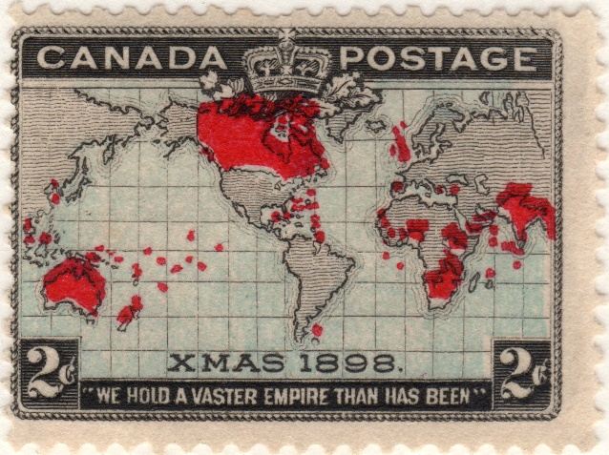
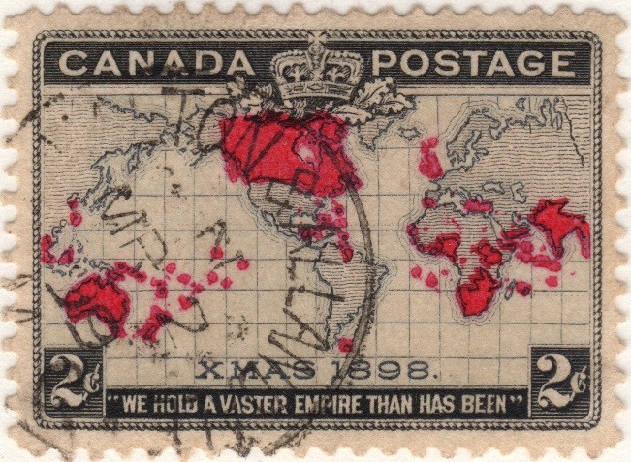
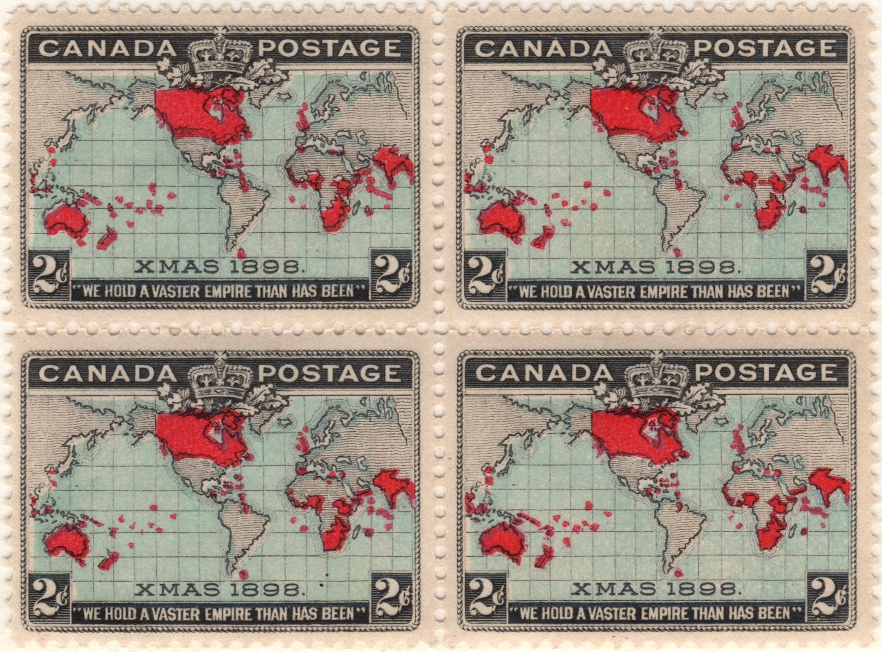
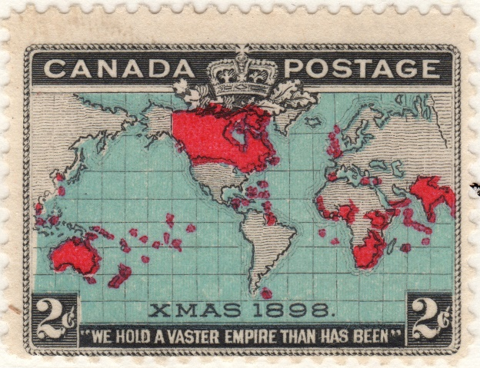
Production – Seas Color Varieties
Color varieties from Plate 1.
P1-03 Lavender Sea P1-39 Greyish Sea
P1-41,42,51,52
Pale Blue Green Sea
P1-41 Deep Blue Green Sea
(ex-American Bank Note Co. Archives)

Slide 15
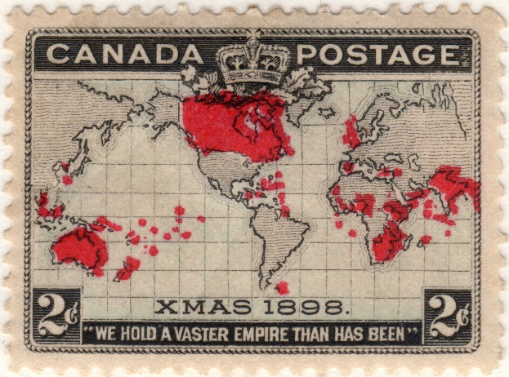
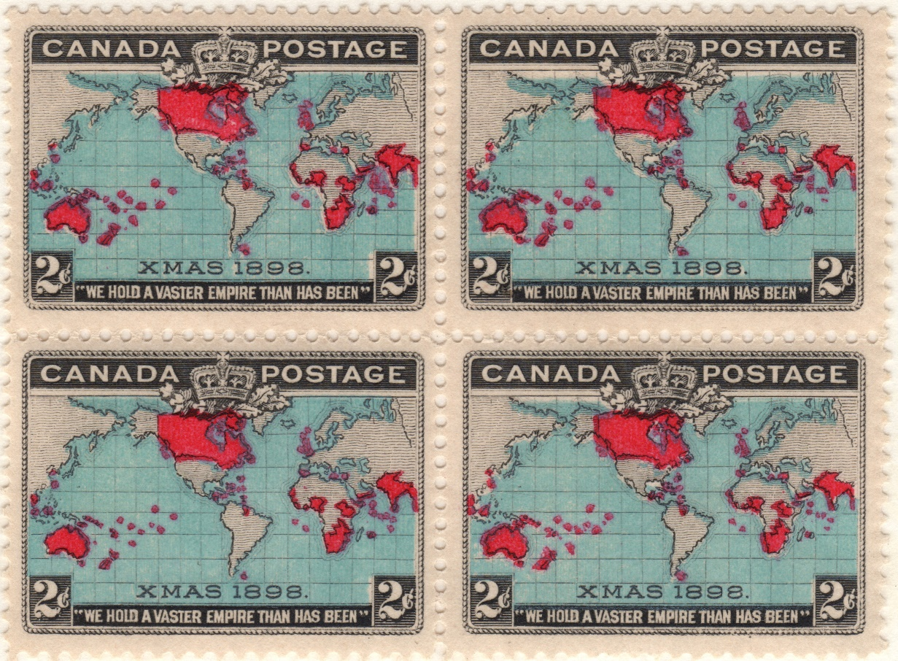
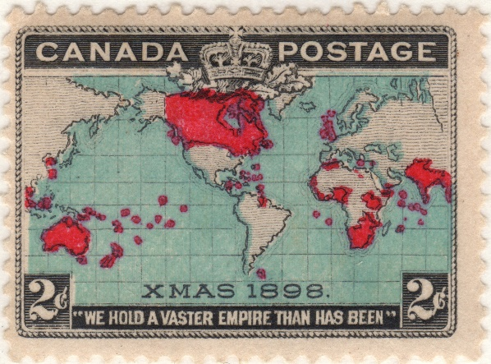
Production – Seas Color Varieties
Color varieties from Plate 2.
P2-71 Lavender Sea
P2-89,90,99,100 Very Deep Blue Green Sea
P2-93 Deep Blue Green Sea
(ex-American Bank Note Co. Archives)

Slide 16
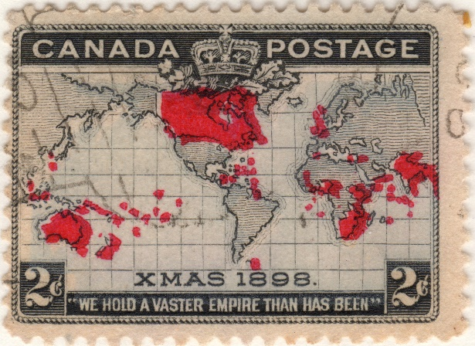
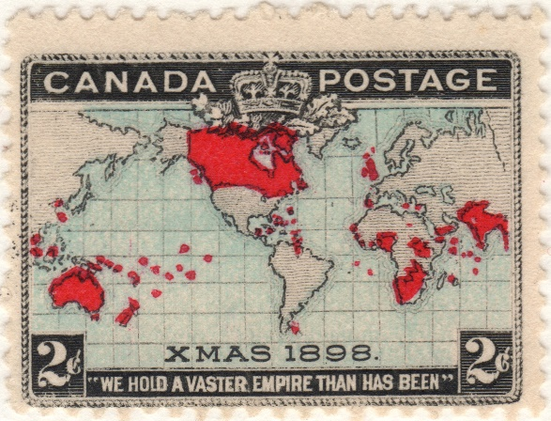
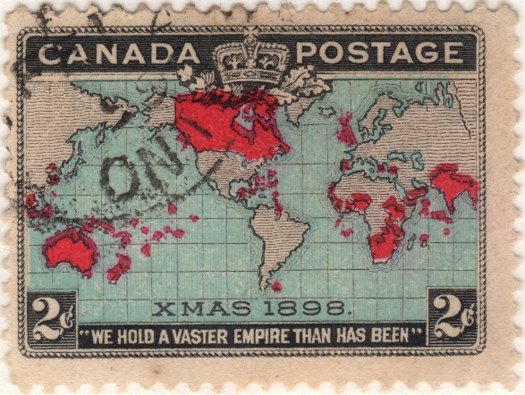
Production – Seas Color Varieties
Color varieties from Plate 3 and 5.
P3-11 Lavender Sea
P5-09 Lavender Sea P5-09 Bright Blue Green Sea
(ex-American Bank Note Co. Archives)

Slide 17
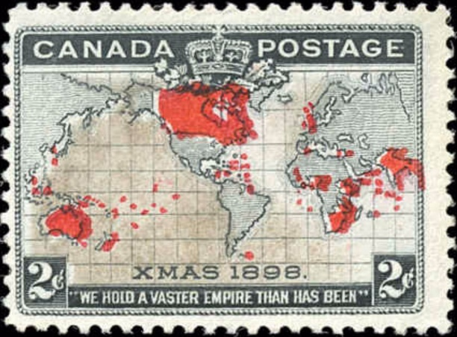
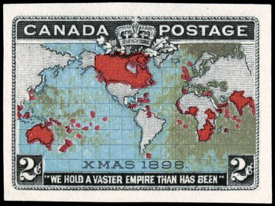
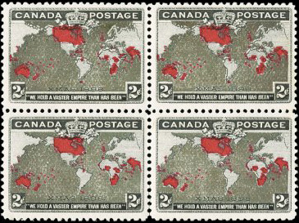
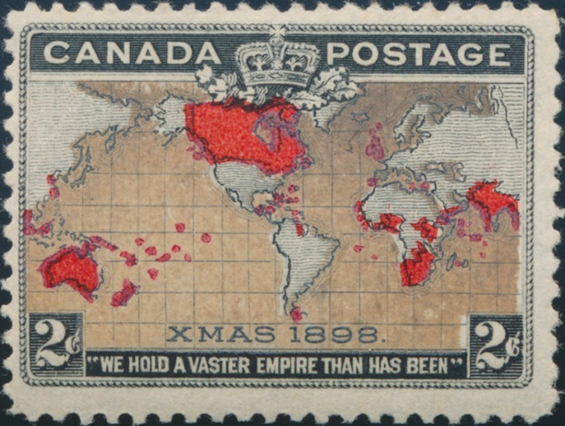
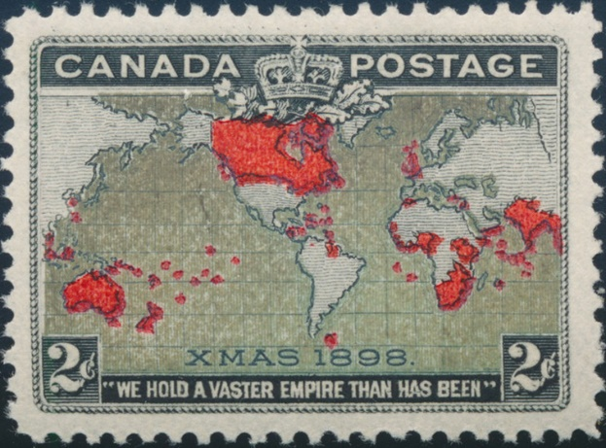
Production – Seas Color Varieties
Known as the “Muddy Waters” variety, this color is due to the oxidation of the sea’s ink. This ink toning can be found on both lavender and blue sea shades in various degrees, but it is uncertain whether they came from certain ink batches.
(ex-American Bank Note Co. Archives)

Slide 18
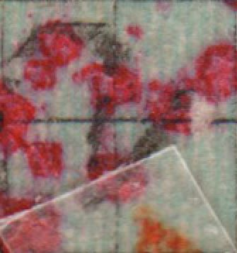
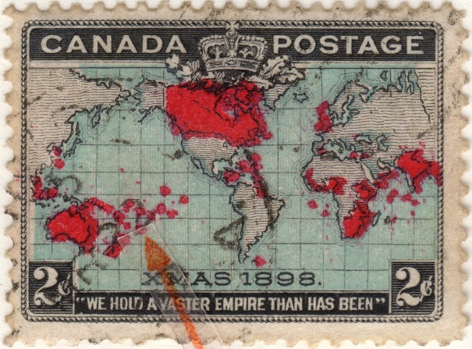
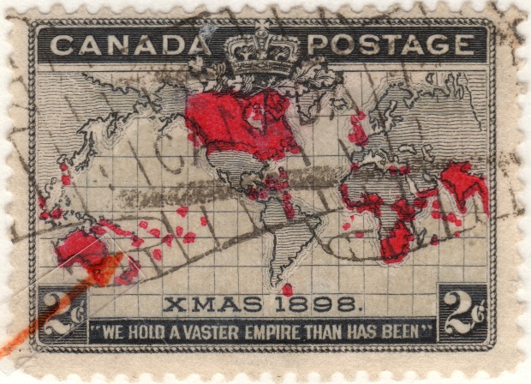
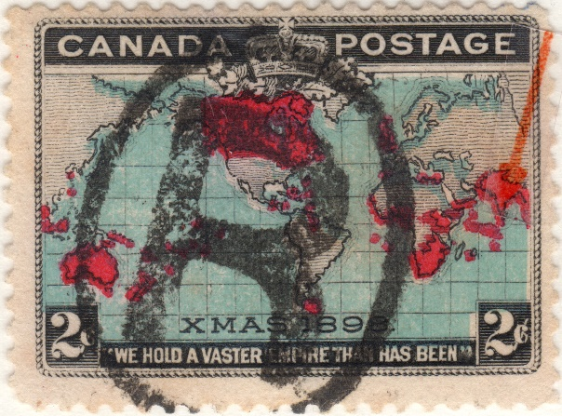
Production – Red Territories
The typographic printing process used to print the red color was fraught with technical problems with an assortment of results. Two red plates were used.
P1-10 Pacific Island P1-17 Pacific Island P1-79 Indian Ocean
Group- Extra Island Group- Odd Shaped Island Group- Islands Large
and Fused
(ex-American Bank Note Co. Archives)

Slide 19
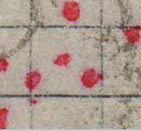
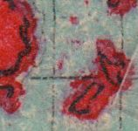
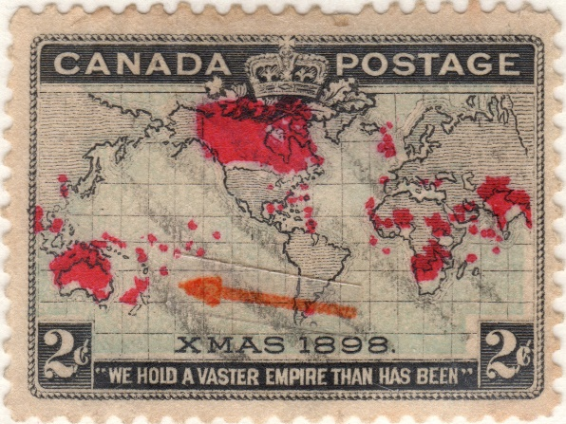
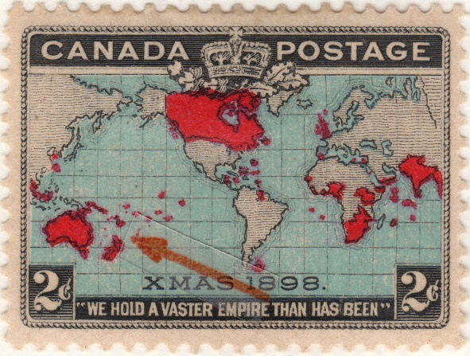
Production – Red Territories
A few additional red color anomalies.
P3-43 Under-inked P1-26 New Zealand P2-43 Three Dots
with Distinct Horns Between Australia/NZ
(ex-American Bank Note Co. Archives)

Slide 20
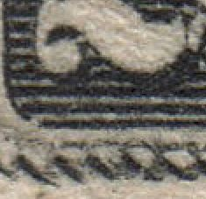
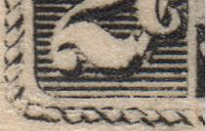
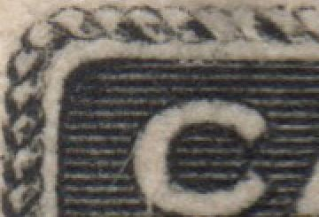
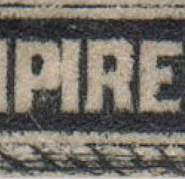
Production – Plate Re-Entries
Plates 2 and 3 wore down excessively during production, especially the cable link border around some impressions, which needed re-engraving, sometimes a minor manual re-touch. These created a wealth of varieties.
P5-73 Top Left Spurs P2-78 Lower Left P2-19 Top Left P3-100 Re-entry of
and Value Tablet Cable Links Cable Manually “PIRE” and also at
Manually Re-cut Manually Re-cut Re-cut Lower Right Side
(ex-American Bank Note Co. Archives)

Slide 21
Production – Plate Re-Entries
Re-entries required re-engraving of both lateral guidelines and lower part of each worn cable. The worn image was not always fully erased, leaving part of the old engraving behind when a new transfer roller impression was made.
P2-95 Lower Left P2-39 “We Hold” P3-96 Lower Right
Spurs Re-entry Re-entry
(ex-American Bank Note Co. Archives)

Slide 22
Production – Plate Re-Entries
Researchers have proved these by comparing the engraved plate proofs with stamps and finding specific examples of re-touches or re-engravings that happened during the production process. Here’s one match up. The top corner is weakly engraved in the proof, but strengthened in the stamp. Note the position of the guide dots in both cases.
Proof
Stamp
Plate Proof Position 21 P5-21
(ex-American Bank Note Co. Archives)

Slide 23
Production – Plate Re-Entries
This is the most famous of all the map stamp re-entries. There is extensive doubling throughout the entire image, particularly in “CANA” of CANADA. The lower cable is retouched with spurs under “Hold.” There is doubling of “XMAS” and the lines of latitude above.
P5-91
(ex-American Bank Note Co. Archives)

Slide 24
Production – Errors, Freaks and Oddities
Production problems did create an assortment of EFOs. Here are a few examples.
(ex-American Bank Note Co. Archives)

Slide 25
Post-Production
With the stamps printed, several “add-ons” were applied to them…
Specimen (in purple) Various Toronto Precancels
Perfin- Sun Life Assurance Company, Montreal Perfin- W.J. Gage & Company, Toronto

Slide 26
Usages – First Day
Special commemorative envelope for Christmas Day, 1898 bearing the new multi-colored map stamp (Plate 1) and a Berlin, Ontario first day favor cancel. The envelope was issued in multiple colors, as can be seen on the next cover, postmarked February 13, 1899 but not with the map stamp.

Slide 27
Usages – Third Day of Use
This cover from Plate 1 has a visually striking franking of a ½ cent Queen Victoria Maple Leaf stamp, a ½ cent Queen Victoria Jubilee stamp and a 2 cent map stamp totaling 3 cents. December 27, 1898 postmark from Campbell, Ontario, sent to Saginaw, Michigan. On January 1, 1899, the letter rate to US addresses was reduced from 3 to 2 cents per 1/2 ounce. The basic half-ounce Canadian domestic letter rate also was reduced that day from 3 to 2 cents.

Slide 28
Usages – Bisect
An unusual bisect usage, cutting the 2¢ stamp value in half to 1¢, paying the local drop rate for printed matter. Postmarked Montreal, February 25, 1899.

Slide 29
Usages – Early Uses of Plate 1
P1-83 Lavender Sea
January 11, 1899
Bathurst St., Toronto, Ontario
P1-79 Pale Blue Green Sea P1-76 Pale Blue Green Sea
February 19, 1899 January 28, 1898 (error in slug year, 1899 correct)
Namino, British Columbia Halifax, Nova Scotia

Slide 30
Usages – Early Uses of Plate 1
P1-39 Lavender Sea
March 2, 1899
Trenton & Allandale RPO
P1-08 Blue Green Sea
March 1, 1899
Antigonish, Nova Scotia

Slide 31
Usages – Early Uses of Plate 2
P2-98 Lavender Sea P2-34 Very Deep Blue Green
January 10, 1899 January 13, 1899
Montreal, Quebec Montreal, Quebec
P2-49 Very Deep Blue Green Sea P2-80 Very Deep Blue Green Sea
January 19, 1899 January 21, 1899
Canfield Junction & St Thomas RPO Toronto & Ottawa CPR Railway

Slide 32
Usages – Early Uses of Plate 2
P2-96 Very Deep Blue Green Sea
January 28, 1899
Montreal, Quebec
P2-07 Very Deep Blue Green Sea P2-89 Pale Blue Green Sea
February 28, 1899 February xx, 1899
Woodstock, Ontario New Glasgow, Nova Scotia

Slide 33
Usages – Early Uses of Plate 2
P2-33 Very Deep Blue Green
June 15, 1899
St. Catharines, Ontario
P2-24 Very Deep Blue Green Sea P2-64 Lavender Sea
September 1, 1899 October 5, 1899
Montreal, Quebec Toronto, Ontario

Slide 34
Usages – Early Uses of Plate 2
P2-87 Lavender Sea
November 24, 1904
Not-so-early use, pair on registered cover to Peterboro, Ontario
2¢ ½ ounce letter rate plus 5¢ registration fee

Slide 35
Usages – Early Uses of Plate 3
P3-04 Lavender Sea
January 13, 1899
Montreal, Quebec
P3-80 Lavender Sea P3-61 Lavender Sea
March 10, 1899 March 24, 1899
Carlton St. Post Office, Toronto, Ontario Port Perry, Ontario

Slide 36
Usages – Early Uses of Plate 3
P3-31 Lavender Sea
April 19, 1899
Ottawa, Ontario
P3-43 Lavender Sea P3-24 Lavender Sea
November 28, 1899 October 20, 1899
Moncton, Nova Scotia Hamilton, Ontario

Slide 37
Usages – Early Uses of Plate 5
P5-14 Lavender Sea
April xx, 1899
Ottawa, Ontario
P5-91 Lavender Sea P5-73 Lavender Sea (“Muddy Waters” changeling)
September 28, 1899 April 10, 1899
London, Ontario Hamilton, Ontario

Slide 38
Imperforates
Evidence suggests imperforate map stamps were created for use as presentations to dignitaries or to commemorate special events. Many were pasted on post office walls and then removed, resulting in thinned or partially damaged copies.
P1-13,14 Lavender Sea
P2-100 Blue Green Sea
P1-35,36 Lavender Sea

Slide 39
Conclusion
I hope you enjoyed this brief look at a truly fascinating stamp issue. There is much
more to the story. For further investigation I can recommend the best masterwork on the subject, the four volume “The Canadian 1898 Christmas Map Stamp- A Definitive Plating Study” Volumes 1-4 by Ken Kershaw and Roger Boisclair.
Scanning and Layout by Tom Fortunato

