Slide 1
The Stamps of Bohemia and Moravia, Including the
Theresienstadt Parcel
Admission Stamp
By Richard Spinelli
Past President, Rochester Philatelic Association
April 11, 2019

Slide 2
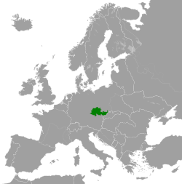
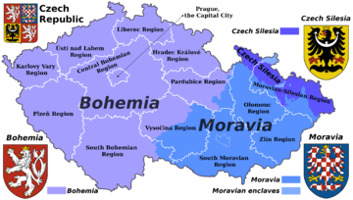
The Protectorate of Bohemia and Moravia
was a protectorate of Nazi Germany established on 16 March 1939 following the German occupation of Czechoslovakia on 15 March 1939.

Slide 3
The Treaty of Versailles, Signed 6 June 1919, six months after fighting in the Great War ceased:
How Did The Protectorate of Bohemia and Moravia Originate?
Required Germany to disarm
Make ample territorial concessions
Pay REPARATIONS to certain countries
In 1921 the total cost of these reparations was assessed at 132 billion marks (then $31.4 billion, roughly equivalent to $442 billion in 2019).

Slide 4
In order to meet this sum:
Germany could pay in cash
or kind: coal, timber, chemical dyes, pharmaceuticals, livestock, agricultural machines, construction materials, and factory machinery.
The German economy was so weak that only a small percentage of reparations was paid in hard currency.
The payment of this small percentage of the original reparations placed a significant burden on the German economy.

Slide 5
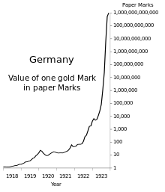
Hyper-Inflation!

Slide 6
By August 1923, the value of the German Mark fluctuated from day to day.
Designing and printing new postage stamps was out of the question.
Beginning in August and proceeding through October of 1923, the postal service began applying re-valuation overprints to existing stocks of lower denomination stamps.
The re-valuations ranged from 5,000 Marks to 2,000,000 Marks.

Slide 7
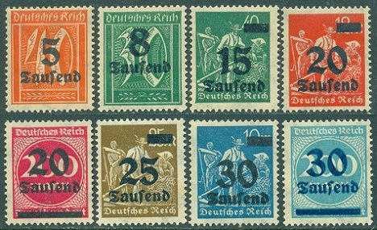
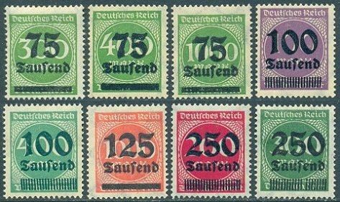
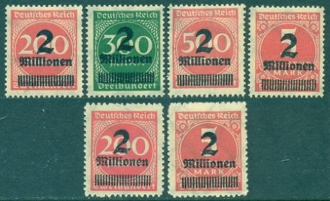
German Inflation Stamps

Slide 8
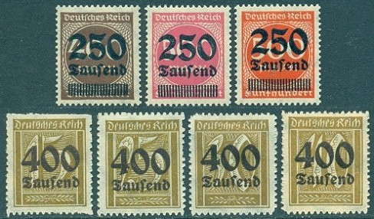
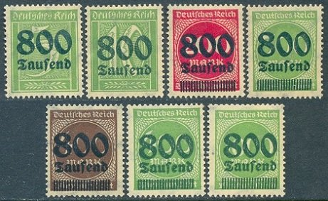
German Inflation Stamps

Slide 9
Germany: 1920’s – 1930’s
In the aftermath of the Great War, Germans struggled to understand their country’s uncertain future.
Germany blamed the near-collapse of their economy on the treaty of Versailles
Citizens faced poor economic conditions, skyrocketing unemployment, political instability, and profound social change.

Slide 10
Germany: 1920’s – 1930’s
Political Unrest
Many political parties. Many had their own paramilitary units to attack opponents and intimidate voters.
Right–wing fear of a Communist revolution spreading from the Soviet Union.
People were looking for more than they were receiving.

Slide 11
Make Germany Great Again!
Adolf Hitler: Undisputed leader of the National Socialist German Workers Party—known as Nazis—since 1921.
In 1923, imprisoned for trying to overthrow the government.
Trial brought him fame and followers.
Used jail time to dictate his political ideas in a book, Mein Kampf—My Struggle.

Slide 12
Nazi Party (and Adolph Hitler):
Downplayed more extreme goals
Offered simple solutions to Germany’s problems
Exploited people’s fears & frustrations, in hopes of winning broad support.

Slide 13
Through the late 1920s and early 1930s
Nazi’s gathered enough electoral support to become the largest political party in the Reichstag
Hitler's blend of political acuity, deceptiveness and cunning converted the party's non-majority but plurality status into effective governing power in 1933.
1933: Named Chancellor of Germany
1934: Named himself Feurer of Germany

Slide 14
In 1938, in violation of the Treaty Of Versailles, Germany began acquiring new territories using the threat of war.
Between 1938 and June 1941 the German army invaded and occupied many countries, including:
The Netherlands
Belgium Greece
Luxembourg Norway
France Western Poland
Yugoslavia Denmark
Czechoslovakia.

Slide 15
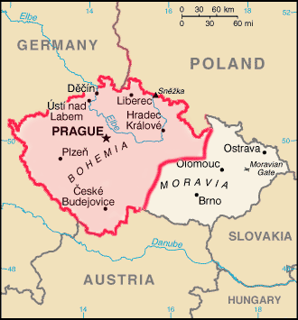
On 15 March 1939, the German Wehrmacht moved
into the remainder of Czechoslovakia and
Hitler proclaimed Bohemia and Moravia the
”Protectorate of Bohemia and Moravia”
The German invasion of Western Poland on
1 September 1939 led
to the start of the
Second World War.

Slide 16
The German government justified its intervention Into Czechoslovakia:
That Czechoslovakia was descending into chaos
The country was breaking apart on ethnic lines
The German military was seeking to restore order in the region
Although Czechoslovakia had pursued
a pro-German foreign policy:
They submitted to Germany's demands
Agreed that Germany would decide the fate of the Czech people.

Slide 17
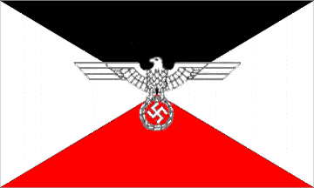
And thus, The Protectorate of Bohemia and Moravia
Became a nominally autonomous Nazi-administered territory which the German government considered part of the Greater German Reich.

Slide 18
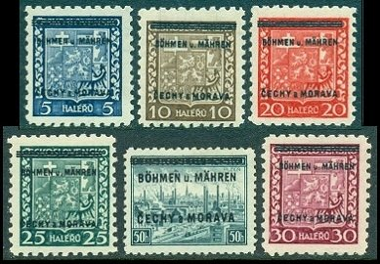
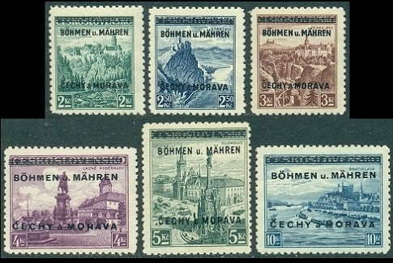
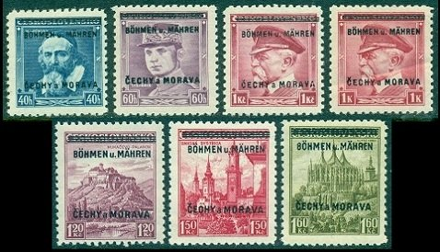
Bohemia and Moravia began to issue postage stamps in 1939, at the beginning of the German occupation. Due to the very sudden German occupation, there was no time to design and print a new series of postage stamps. As a result, beginning in July 1939, the contemporary stamps of the former nation of Czechoslovakia were overprinted for use in the new Protectorate of Bohemia & Moravia.

Slide 19
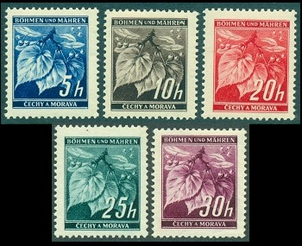
At the end of July 1939, the Protectorate of Bohemia and Moravia began issuing their own postage stamp designs.
The new designs at the top depict linden leaves with closed buds.
The second set designs show the Castle at Zvikov, Karlstein Castle, St. Barbara's Church in Kutna Hora, and the Cathedral of Prague.

Slide 20
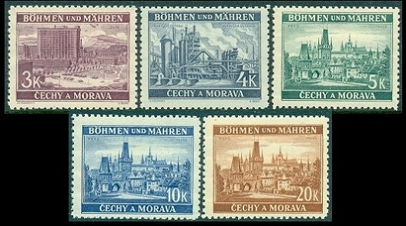
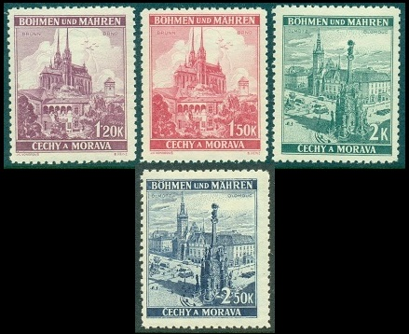
The designs in the third image depict the Cathedral of Prague and the Town Square in Olomouc.
The designs in the fourth image depict a view of Zlin, the Iron Works at Moravska Ostrava, and a view of Prague.

Slide 21
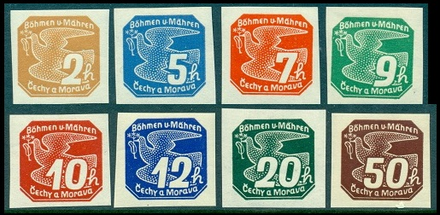
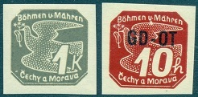
In August 1939, a new set of Newspaper postage stamps, in nine denominations was issued, as shown in the images below. The stamp designs all feature a carrier pigeon with the denomination at the right. The stamps were typographed and imperforate.
In December 1939, the 10 H. denomination was overprinted in black with "GD-OT", which stood for "Geschaftsdrucksache" - "Obchodni Tiskopis". These were issued for use by commercial firms.

Slide 22
The triangle stamps shown above were issued in December 1939. The Michel Catalog refers to the blue stamp at the left as a Special Delivery Stamp. The red triangle stamp at the right is referred to as a Postage Due Stamp.

Slide 23
In early 1940, a new linden leaf denomination and three new engraved designs were added to the 1939 definitive series. They are shown below, and they have the same printing attributes as the 1939 definitive stamps.
The new engraved designs depict Neuhaus, Pernstein Castle, and Pardubice Castle.

Slide 24
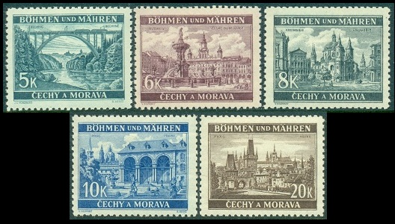
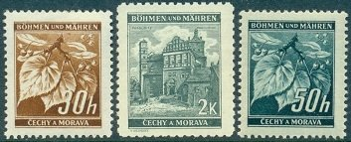
1940 -1941
The Protectorate of Bohemia and Moravia issued the two charity stamps shown above on June 29, 1940 to publicize and raise money for the German Red Cross. The two stamps depict a Red Cross worker tending to a wounded soldier.
Beginning in October 1940, the new definitive postage stamps shown above were issued, utilizing the design types of the 1939 linden leaves and landscapes stamps. These stamps have the same printing attributes as those of the 1939 issue.
April 20, 1941 saw the issue of another set of stamps publicizing and raising money for the German Red Cross

Slide 25
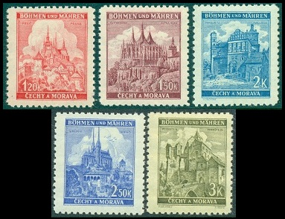
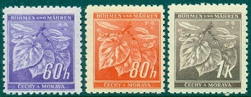
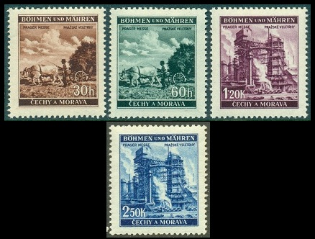
1941
In July1941, eight more stamps of the 1939 linden leaves and landscapes definitive design were issued.
The four stamps shown in the image above were issued on September 7, 1941 to publicize the Prague Fair.
These stamps commemorate the
100th Anniversary of the birth of Antonin Dvorak (1841-1904), the world renowned Czech composer.

Slide 26
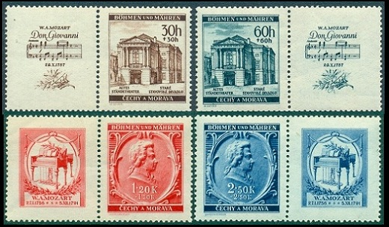
1941
The final stamps of 1941 were issued on October 26 to commemorate the 150th Anniversary of the Death of Wolfgang Amadeus Mozart.

Slide 27
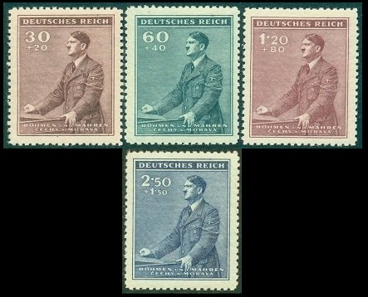
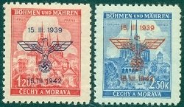
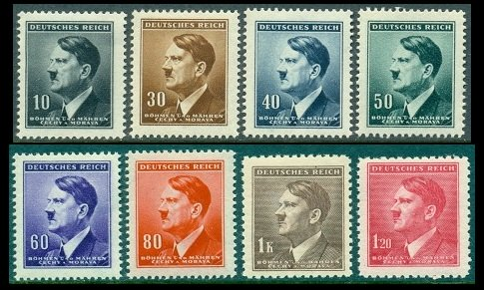
1942
These four stamps celebrate the 53rd Birthday of Adolph Hitler. The stamps depict Adolph Hitler giving a speech.
The Third Anniversary of the Protectorate of Bohemia and Moravia.

Slide 28
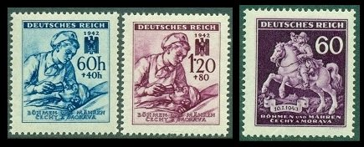
1942
The two stamps shown above left were issued on September 1, 1942 to publicize and raise money for the German Red Cross. Instead of having labels with the Red Cross emblem between the stamps, on the emblem was printed on the stamp above the denomination.
The stamp at the upper right was issued in early January 1943 to publicize "Stamp Day". The design depicts a 17th Century Postal Messenger.

Slide 29
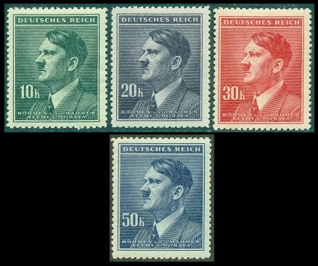
1942
The twenty-three Bohemia and Moravia definitive postage stamps shown in the images above were issued beginning in July 1942. They all depict the H. Hoffman portrait of Adolph Hitler.
Large stocks of these issues fell into the hands of the Allied occupation forces, after the war. Many of them were defaced and/or overprinted for local usage by postal officials during the period between the surrender of Germany and the re-establishment of the Republic of Czechoslovakia.

Slide 30
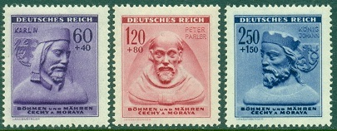
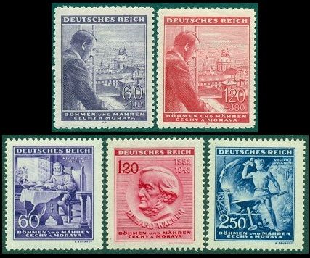
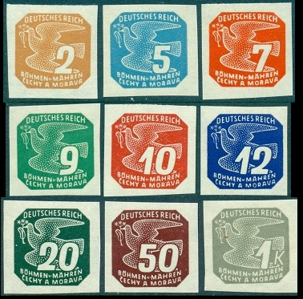
1943
January 20, 1943 to raise money for the German Winter Relief Fund.
New set of newspaper postage stamps was issued on February 15, 1943.
The two stamps at the top of the image above were issued on April 20, 1943 to commemorate the 54th Birthday of Adolph Hitler.

Slide 31
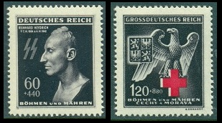
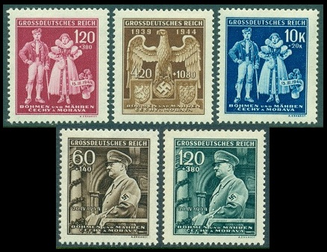
1943/1944
The stamp at the left was issued on May 28, 1943 to commemorate the first anniversary of the Death of Reinhard Heydrich, the Reichsprotektor of Bohemia and Moravia.
The stamp at the right was issued on September 16 to publicize and raise money for the German Red Cross.
The three stamps at the top were issued on March 15, 1944 to commemorate the 5th Anniversary of the Establishment of the "Protectorate". Two of the stamps depict a couple wearing native costumes, and the other stamp depicts the Nazi emblem along with the arms of Bohemia and Moravia.
The lower Hitler birthday commemoratives were released on April 12, 1944. It was his 55th… and last.

Slide 32
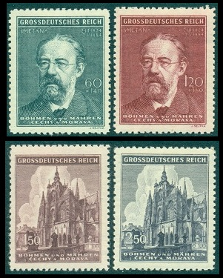
1944
The stamps at the top were issued on May 12, 1944 to commemorate the 60th Anniversary of the Death of Bedrich Smetana (1824-1884), a famous Czech composer and pianist.
The stamps at the bottom were issued on November 21, 1944 to commemorate the 600th Anniversary of St. Vitus Cathedral in Prague.

Slide 33
The Theresienstadt Parcel Admission Stamp
The best known Bohemia – Moravia postal item, and hardest item to procure, is a stamp issued FROM the Concentration Camp Theresienstadt, located in Bohemia – Moravia.
Theresienstadt was a military fortress and nearby walled garrison. The fortress was built by Austrian Emperor Joseph II (1741-1790) during the late 18th Century, and he named it after his mother, Austrian Empress Maria Theresa (1717-1780).

Slide 34
During World War II the Gestapo used the "large fortress" of Theresienstadt as a ghetto / concentration camp for Jews from Czechoslovakia, as well as many from Germany, Austria, the Netherlands, and Denmark.
More than 150,000 Jews were sent there, and although it was not an extermination camp, about 33,000 died in the ghetto, due to the appalling conditions caused by overcrowding.
About 88,000 inhabitants were deported to Auschwitz and other extermination camps. At the end of the war, there were a little over 17,000 survivors.

Slide 35
The Theresienstadt "camp-ghetto" existed for three and a half years between November 24, 1941 and May 9, 1945.
During its existence, Theresienstadt served three purposes:
First, Theresienstadt served as a transit camp for Czech Jews whom the Germans deported to killing centers, concentration camps, and forced-labor camps in German-occupied Poland, Belorussia, and the Baltic States.
Second, it was a ghetto-labor camp to which the SS deported and then incarcerated certain categories of German, Austrian, and Czech Jews, based on their age, disability as a result of past military service, or domestic celebrity in the arts and other cultural life.

Slide 36
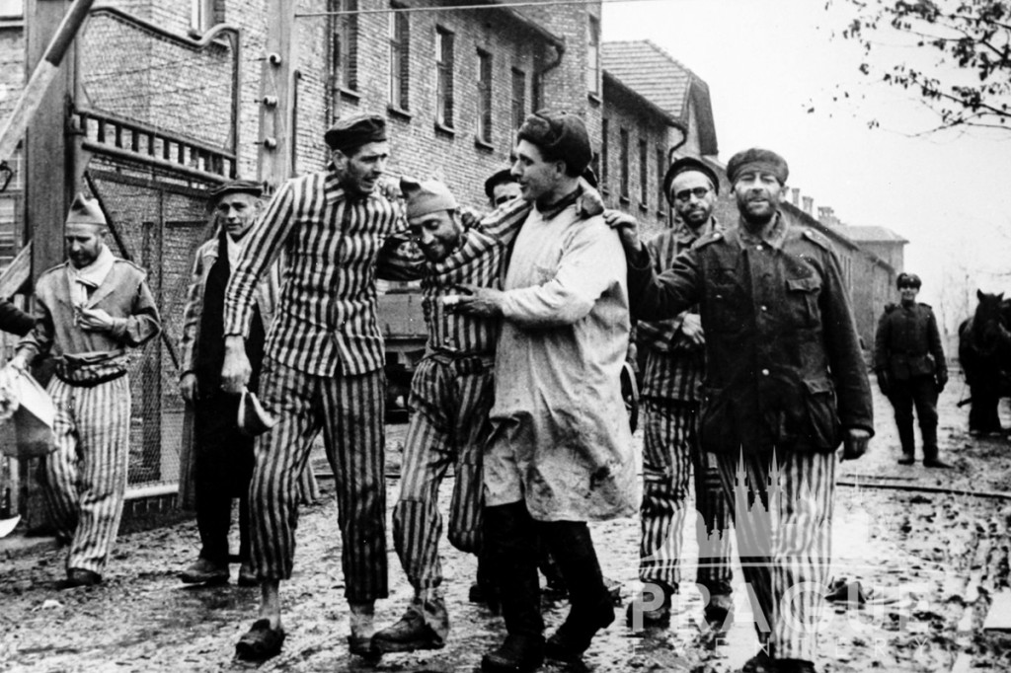
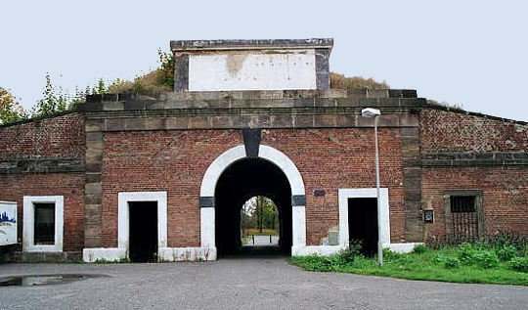
Third, Theresienstadt served as a holding pen for Jews in the above-mentioned groups. It was expected that that poor conditions there would hasten the deaths of many deportees, until the SS and police could deport the survivors to killing centers in the East.

Slide 37
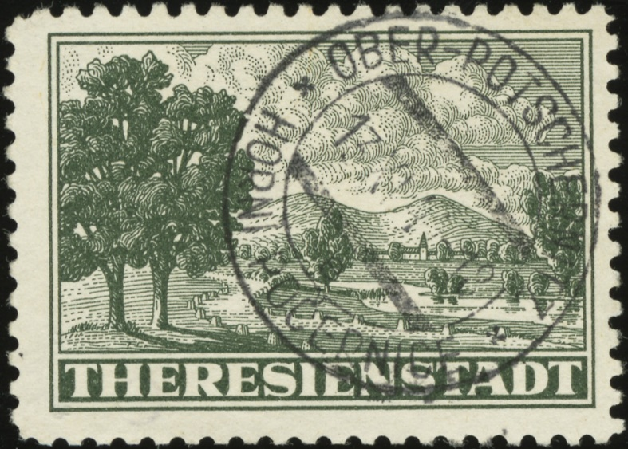
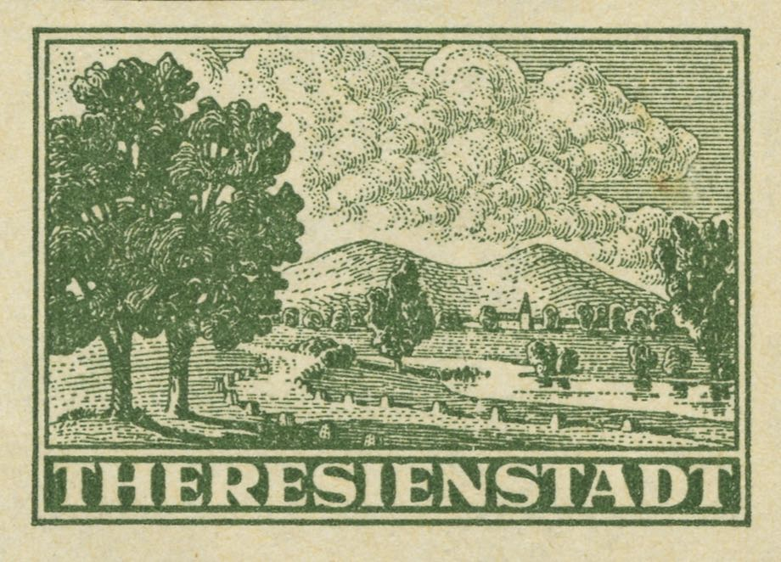
Theresienstadt Parcel Admission Stamp
Bohemia & Moravia
On 10 July 1943, authorities in Bohemia and Moravia began issuing this stamp for use on packages sent to the Theresienstadt concentration camp.

Slide 38
The stamp, printed in Prague, was designed by a Czech with the initials F. C. These initials can be seen with a magnifying glass among the roots of the first tree on the left. It is estimated that more than 75,000 copies of the stamps were used. These stamps were initiated in 1943 and intended for parcels from Bohemia and Moravia.

Slide 39
The Theresienstadt Parcel Admission Stamp

Slide 40
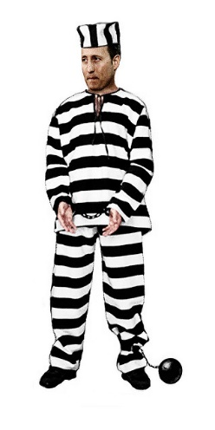
If a “resident” of the ghetto wished to receive a parcel, he could fill out a request every two months.
The request would be forwarded to the Jewish Council in Prague, who would then send a notice to the proposed sender of the parcel containing the admission stamp and instructions on its use.
Notice + Instructions
Sender
Request
+ Admission Stamp
Jewish Council, Prague
“Resident”

Slide 41
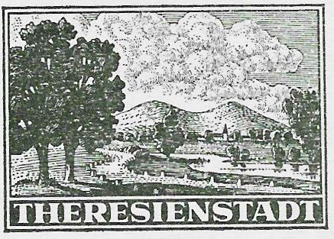
Characteristics of an original admissions stamp and the image of the Spinelli stamp.
Three dots in the left tail of the cloud
There is a window in the church tower + horizontal lines in steeple & roof. 2 windows in building on left & 1 window in building on right.
Initials of the designer (FC) can be seen in the roots of the tree at left
The road markers above “S” & “I” have six dots
The shadow to the left of the tree in the river is a line and a point right above to the right

Slide 42
Theresienstadt served an important propaganda
function for the Germans
The publicly stated purpose for the deportation of the Jews from Germany was their "resettlement to the east," where they would be compelled to perform forced labor.
Since it seemed implausible that elderly Jews could be used for forced labor, the Nazis used the Theresienstadt ghetto to hide the nature of the deportations.

Slide 43
In Nazi propaganda, Theresienstadt was cynically described as a "spa town" where elderly German Jews could "retire" in safety.
The deportations to Theresienstadt were, however, part of the Nazi strategy of deception.
The ghetto was in reality a collection center for deportations to ghettos and killing centers in Nazi-occupied eastern Europe.

Slide 44
In mid-1942, the German authorities began transforming the Theresienstadt ghetto of Bohemia Monrovia into a “show camp” in an effort to quell criticism within the international community.
A massive beautification project was undertaken in preparation for a visit in June 1944 by delegates of the International Red Cross and representatives of the government of Denmark.

Slide 45
Red Cross visit to Theresienstadt June 23, 1944
Delegates were given a guided tour in which they followed a red line on the ground and were not permitted to speak to most of the inhabitants.
Upon the conclusion of the visit, the delegates published positive reports of the visit. The Germans were ecstatic, going so far as to produce a propaganda film about the visit.
As part of the propaganda effort, souvenir sheets of the Theresienstadt Parcel Admission Stamp were produced for distribution to IRC delegates on official visits.

Slide 46
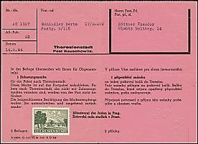
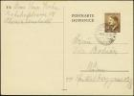
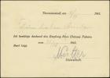
)
Upon receipt of the parcel, an inmate could send a pre-printed card acknowledging receipt of the parcel.
Reply Card (front)
Reply Card (back)
Parcel Card

Slide 47
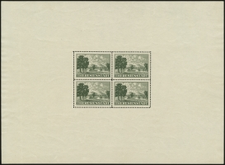
The parcel admission stamps were initially printed in sheets of 25. After most of the stamps were printed, two blocks of four were removed from the printing plate. These blocks were subsequently used to print sheets consisting of a single block of 4. Numerous perforation abnormalities and proofs can be found due to printing and perforating experiments that were conducted prior to the final printing process being determined. These including partial perforations and imperforate varieties which are believed to have been in remainder stock found at the close of WWII.

Slide 48
Sheets were found in remainder stocks post-war. They can be found in black, brown, and dark green, and were numbered sequentially.

Slide 49
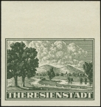
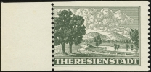
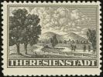
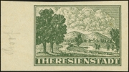
Proofs exist in black and green colors.

Slide 50
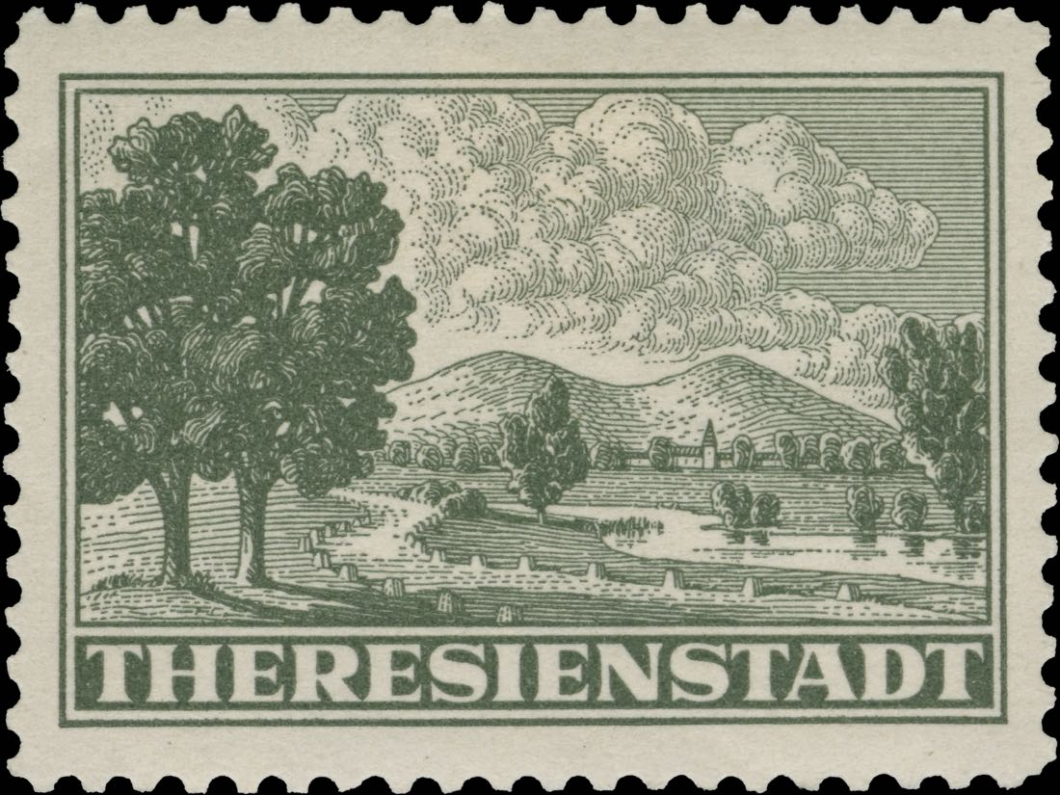

Slide 51
Bohemia and Moravia’s existence came to an end with the surrender of Germany to the Allies in 1945.

