Slide 1
Baseball on Worldwide Covers
A Presentation for the
Rochester Philatelic Association, 2019
by Luis Greiff, Jr.

Slide 2
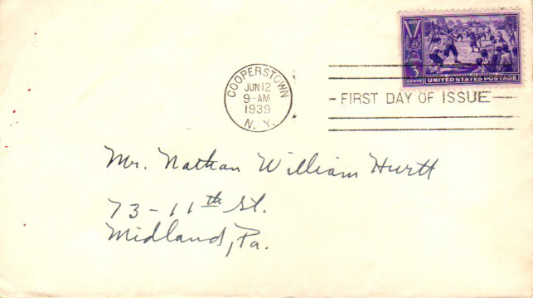
The first US sport stamp, village baseball by BEP artist William Roach.
1

Slide 3
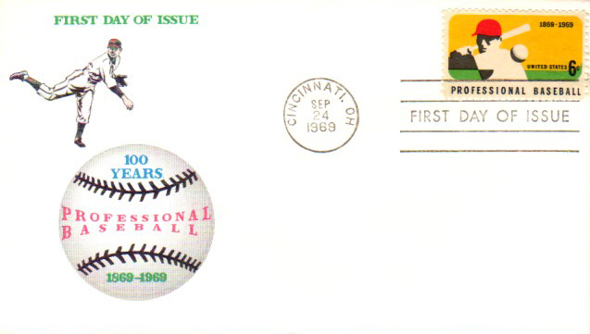
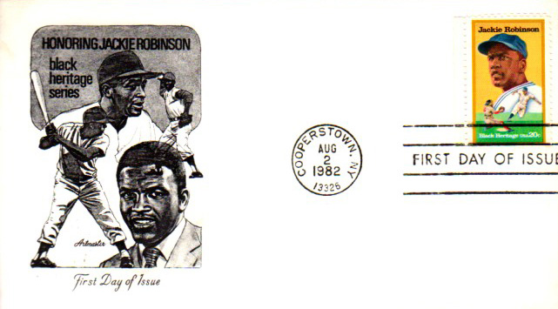
Pro baseball centennial and Jackie Robinson commemoratives.
Artmaster cachet
2

Slide 4
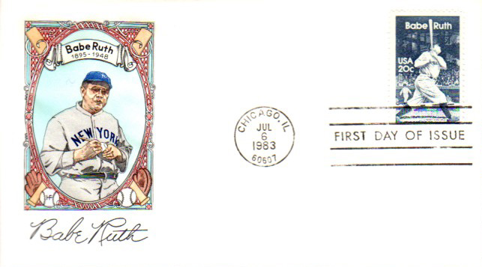
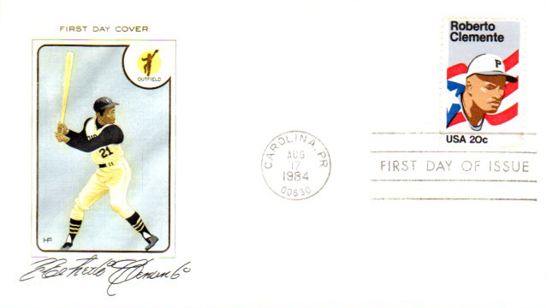
Babe Ruth and Roberto Clemente commemoratives.
HF cachet
HF cachet
3

Slide 5
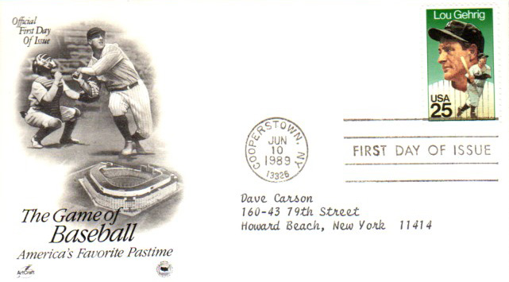
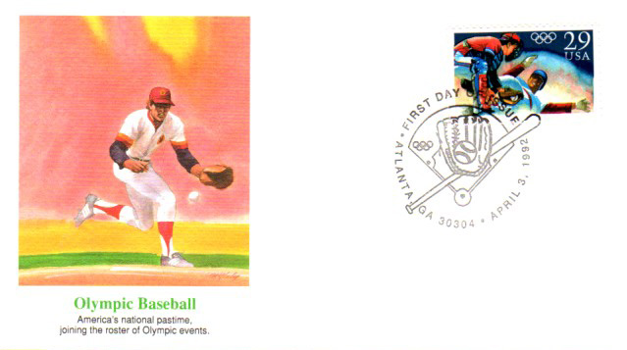
Lou Gehrig and Olympic baseball commemoratives.
Artcraft cachet
Fleetwood cachet
4

Slide 6
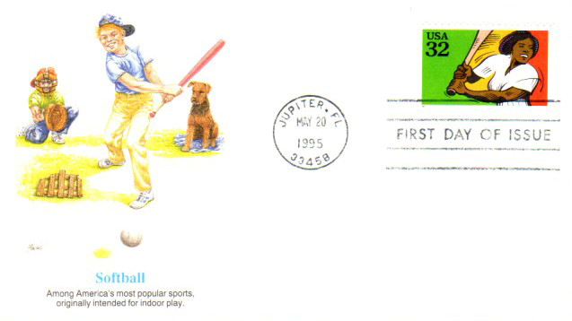
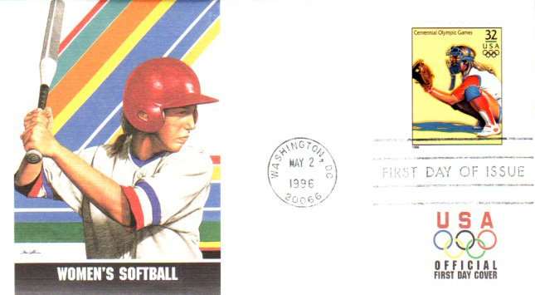
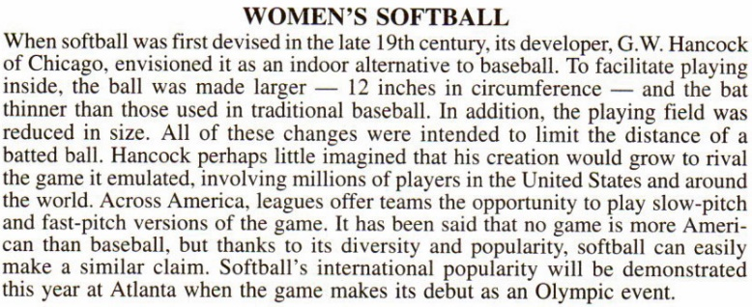
Softball issues, including the introduction of women's Olympic softball.
Fleetwood cachet
Fleetwood cachet
5

Slide 7
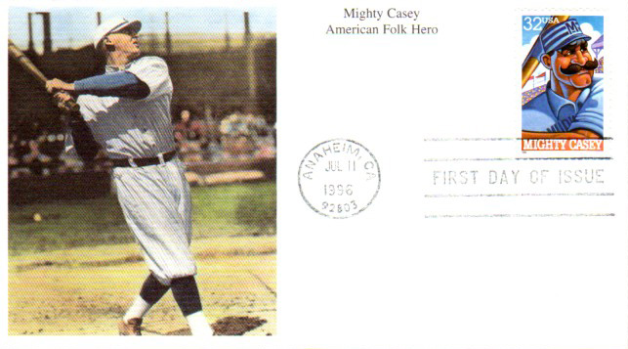
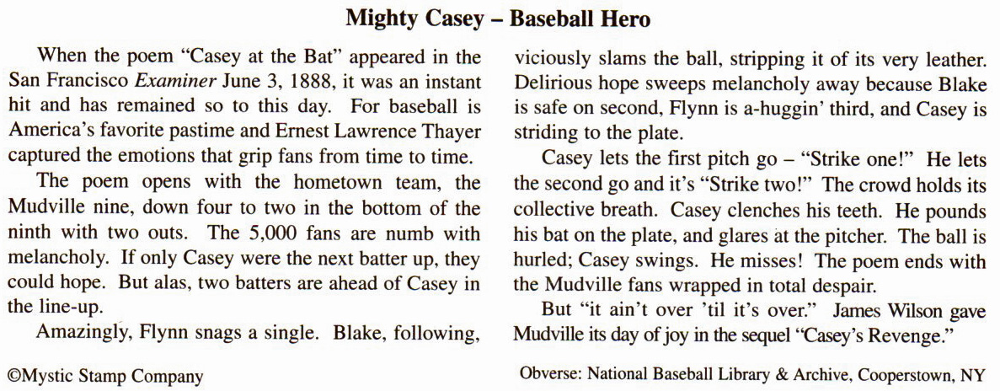
Casey at the Bat baseball poem written in 1888 by Ernest Thayer.
Mystic cachet
6

Slide 8
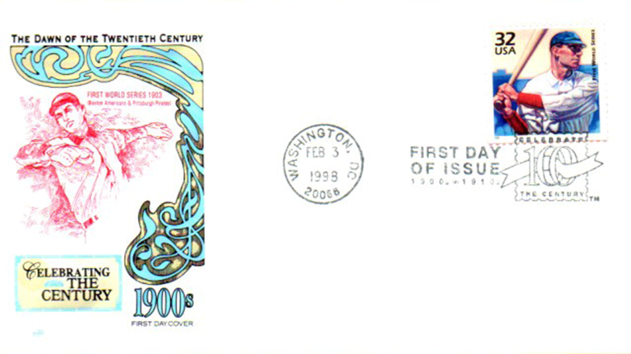
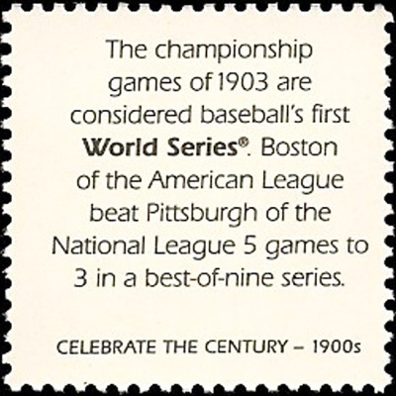
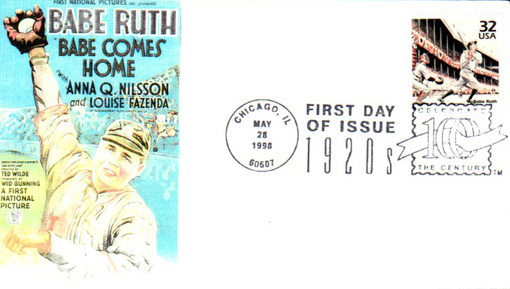
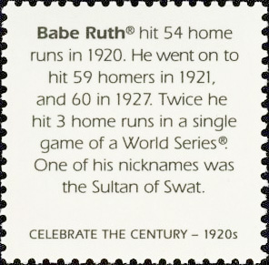
Celebrate the Century baseball issues.
HF cachet
Bonnie Fuson cachet, 7/10
7

Slide 9
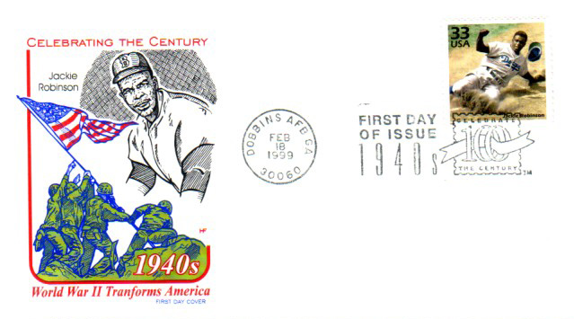
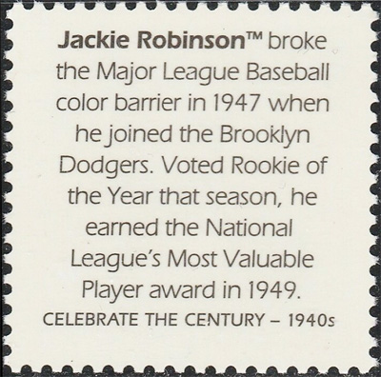
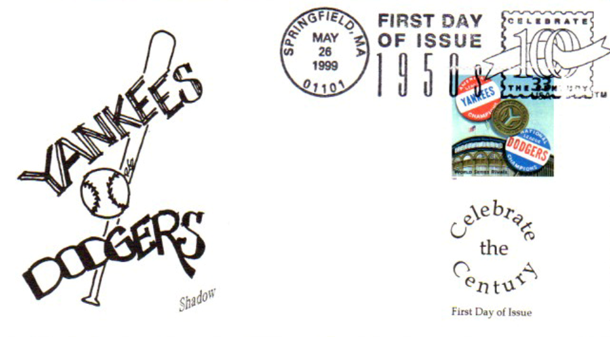
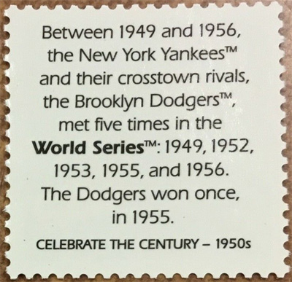
Celebrate the Century baseball issues.
HF cachet
Shadow cachet
8

Slide 10
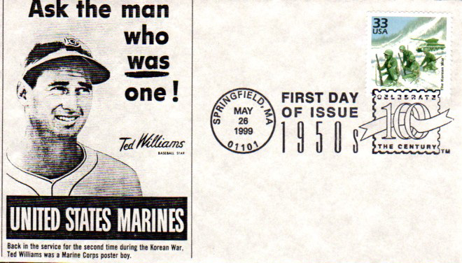
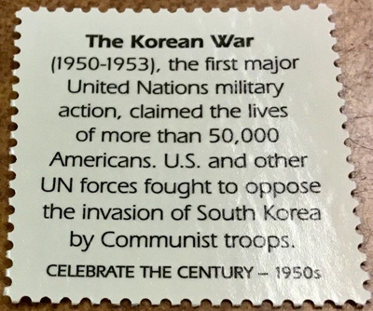
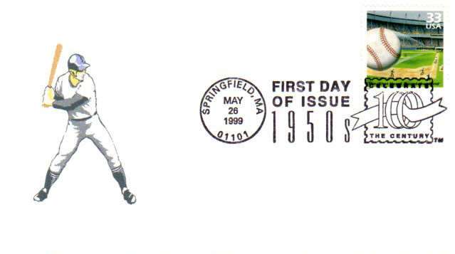
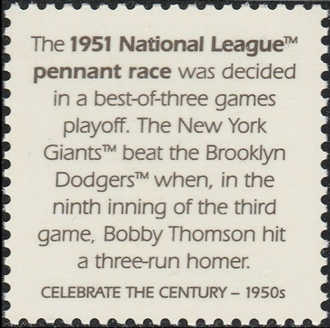
Celebrate the Century baseball issues.
9

Slide 11
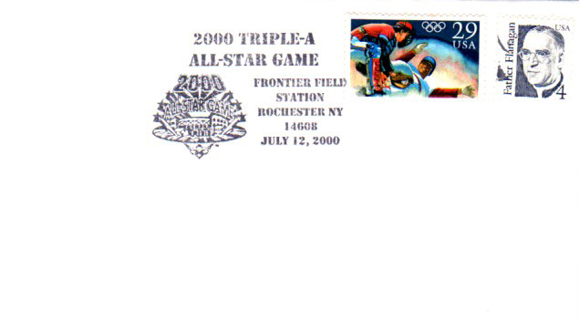
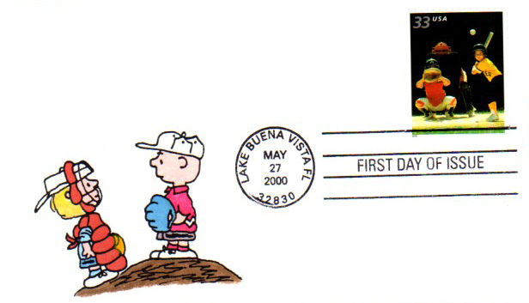
Minor league commemorative cancel and kids sports issues.
PMW cachet 5/5
10

Slide 12
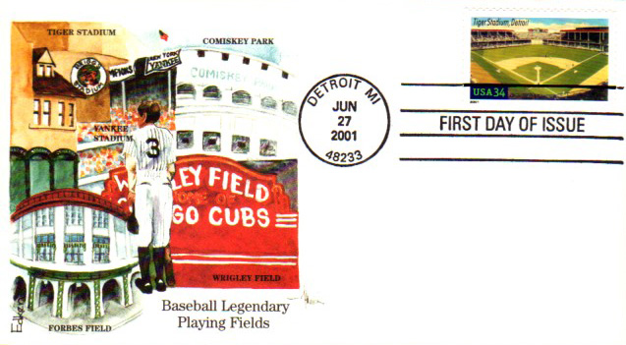
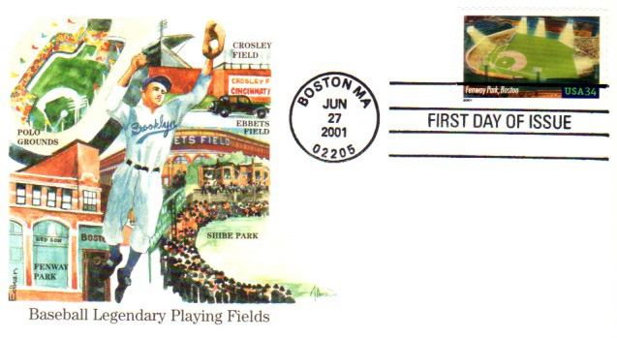
Baseball Legendary Playing Fields commemoratives set of 10.
Edken cachets
11

Slide 13
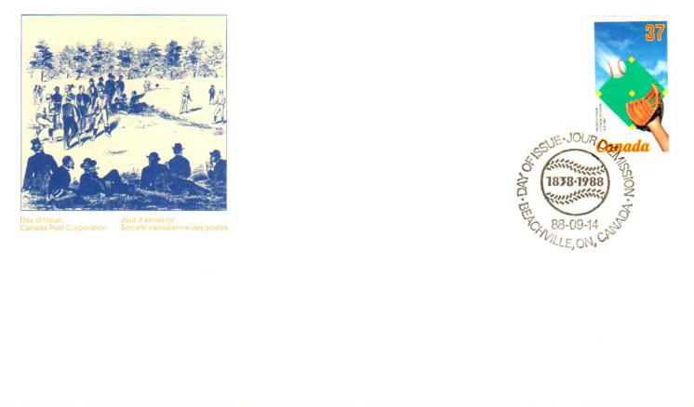
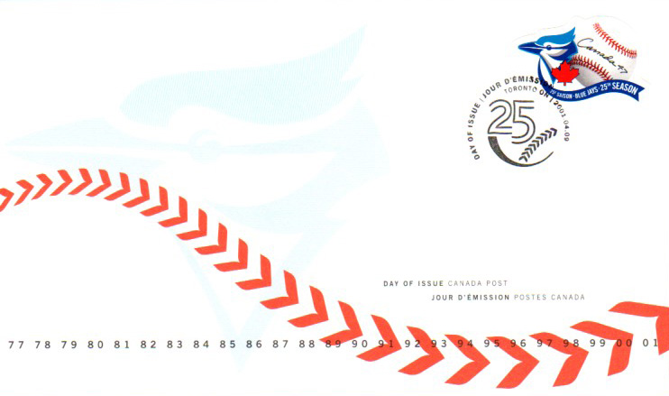
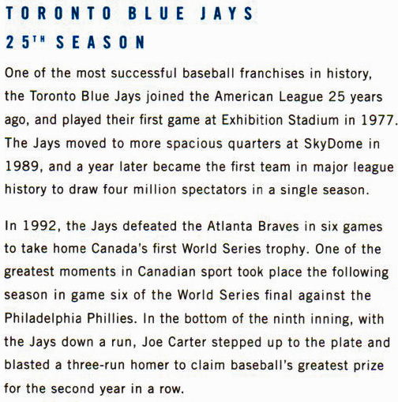
Canadian baseball- 150 years and 2001 Toronto Blue Jays 25th year.
Canada Post cachets
12

Slide 14
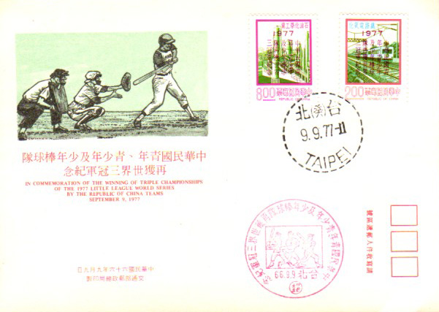
Chinese Taipei baseball- Little League champs 1975 and 1977.
13

Slide 15
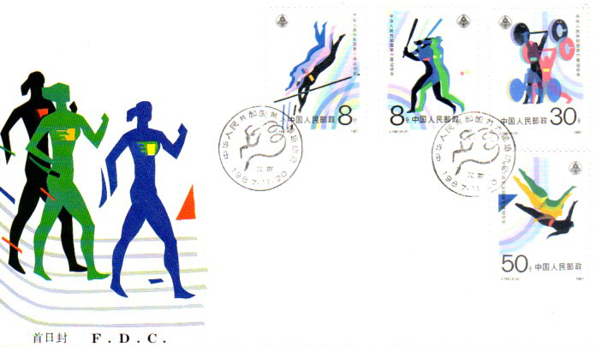
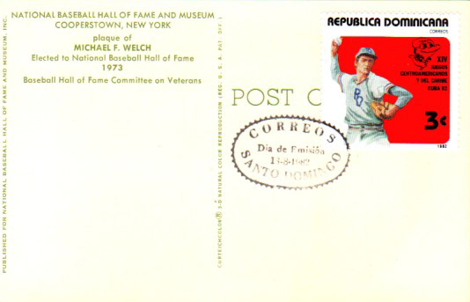
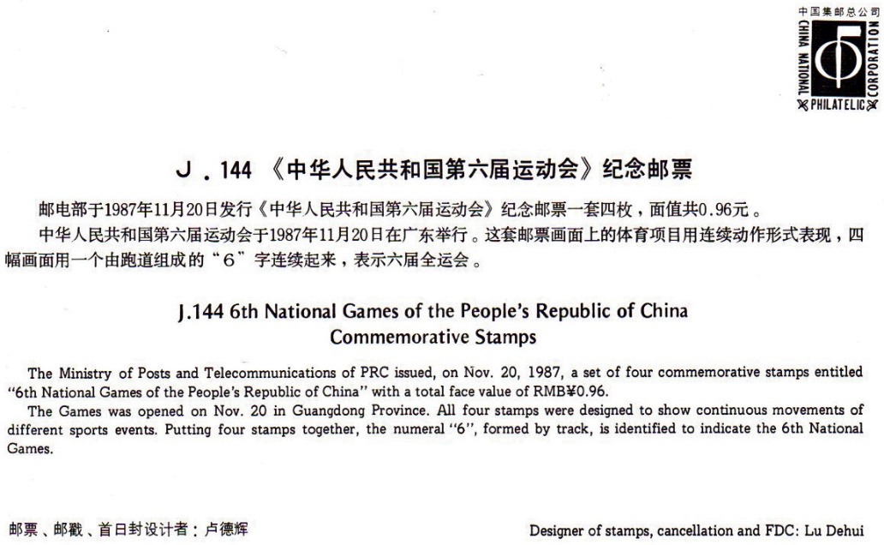
Peoples Republic of China and Dominican Republic issues.
14

Slide 16
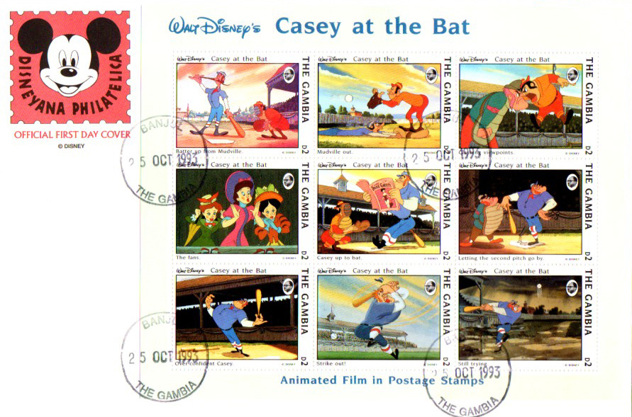
1993 Casey at the Bat animated Disney film set from The Gambia.
15

Slide 17
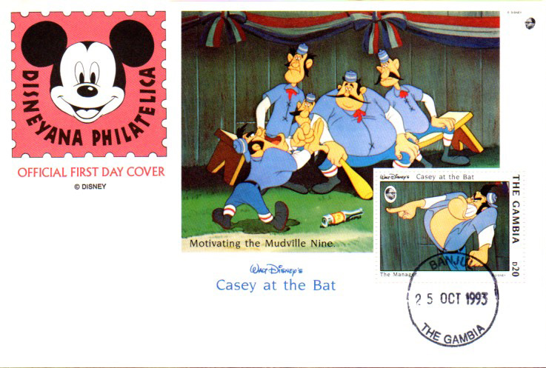
1993 Casey at the Bat souvenir sheet from The Gambia.
16

Slide 18
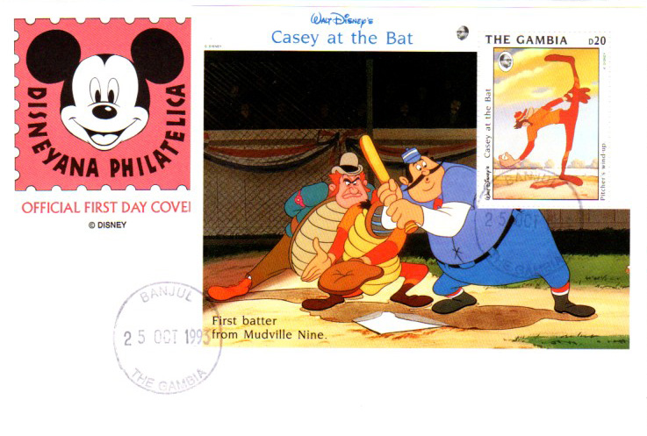
1993 Casey at the Bat souvenir sheet from The Gambia.
17

Slide 19
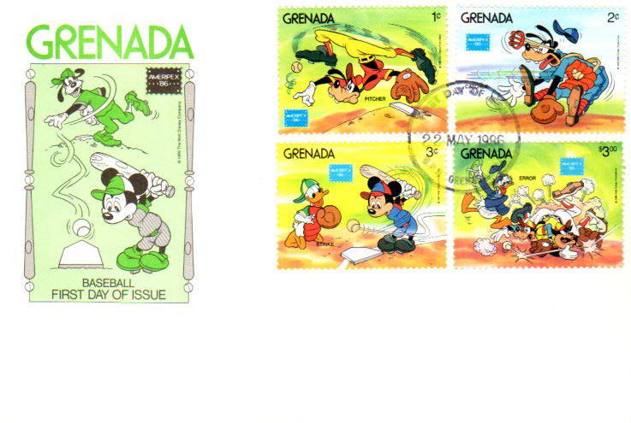
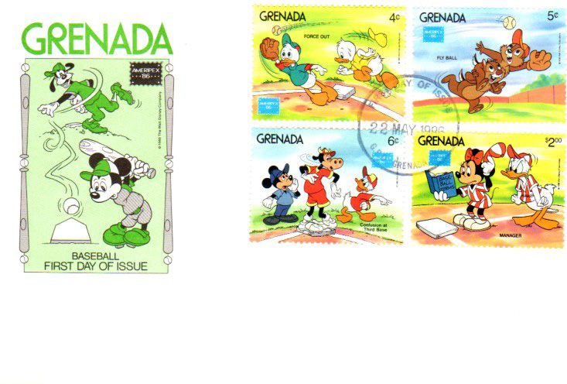
1986 Grenada Disney set issued for the Ameripex 1986 stamp expo.
18

Slide 20
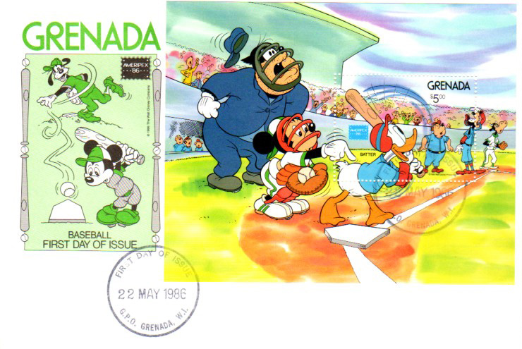
1986 Grenada Disney souvenir sheet issued for the Ameripex 1986 stamp expo.
19

Slide 21
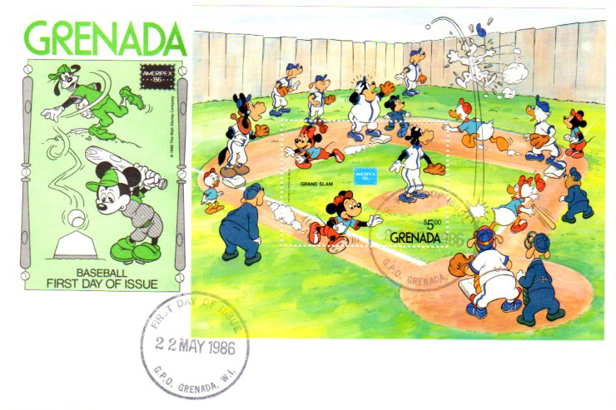
1986 Grenada Disney souvenir sheet issued for the Ameripex 1986 stamp expo.
20

Slide 22
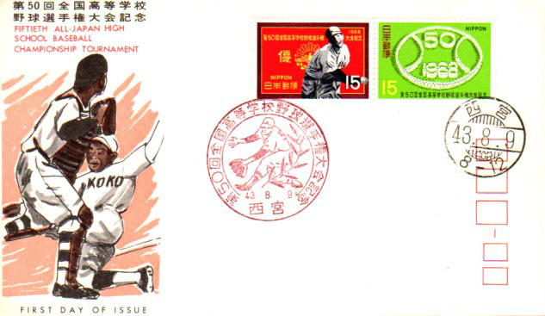
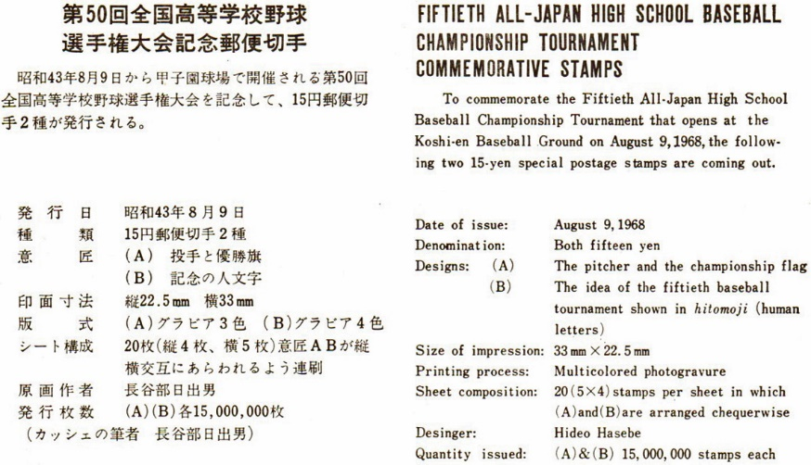
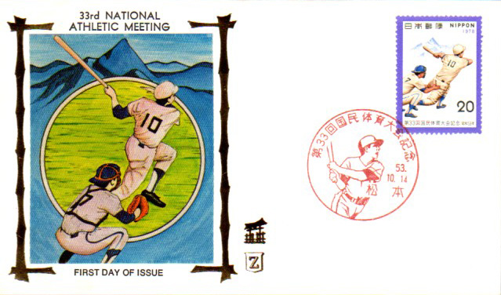
Japanese issues- 50th high school championship, 33rd national athletic meet
Japan Stamp Publicity Assn. cachet
Z Silks cachet
21

Slide 23
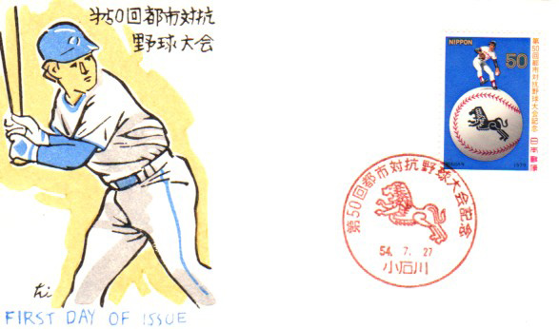
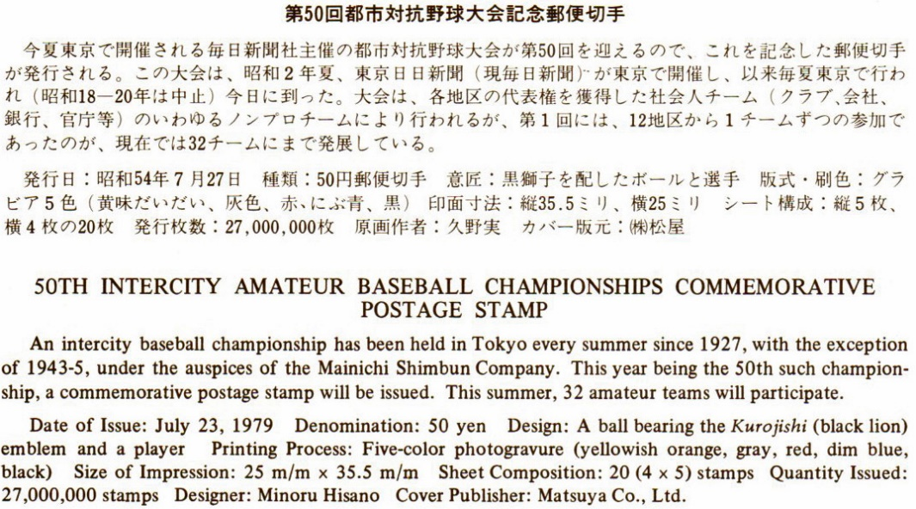
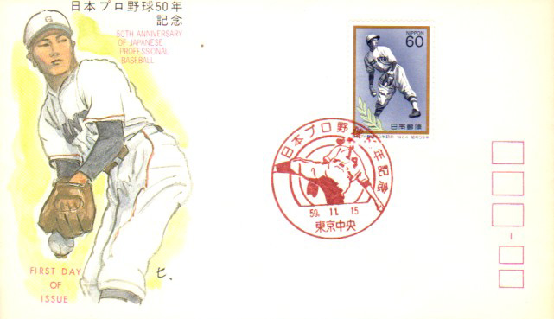
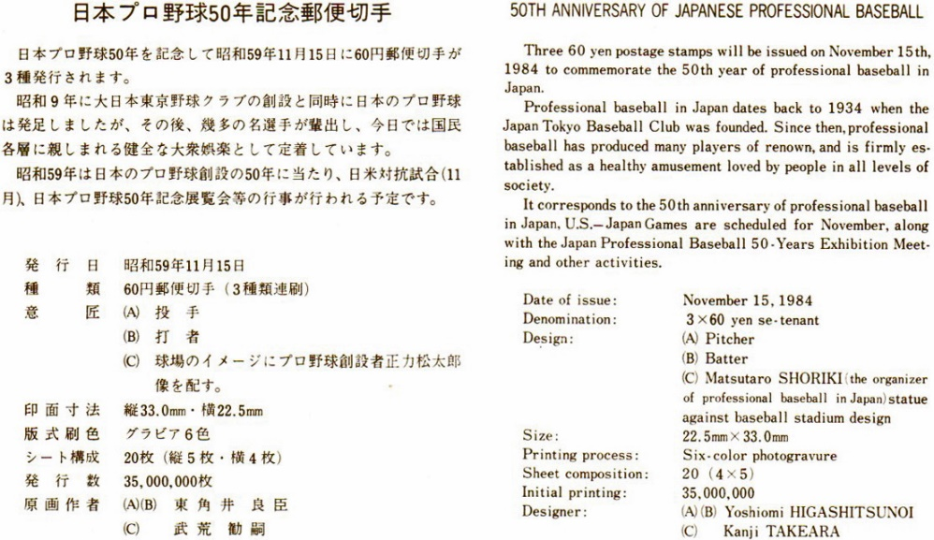
Japan issues- 50th Intercity championships, 50th Anniversary Pro Ball
22

Slide 24
Netherlands Antillies sports issue.
Netherlands Antillies Post cachet
23

Slide 25
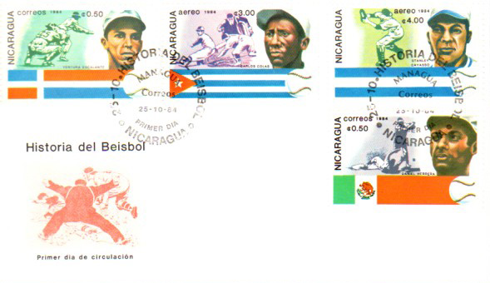
Nicaragua 1974 History of Baseball commemorative series.
24

Slide 26
Turks & Caicos Norman Rockwell issue, 1948 painting The Three Umpires
25

Slide 27
Combo cover for the 1998 Babe Ruth Celebrate the Century issue
LEB cachet
26

Slide 28
Canadian issue honoring the 1919 Vancouver Asahi Int. League Champs
27

Slide 29
For Further Information Online...
APS U.S. Baseball Album- https://stamps.org/Portals/0/albums/Baseball-2012.pdf
Smithsonian Exhibit- https://postalmuseum.si.edu/exhibits/upcoming/baseball/index.html
Ed Stephan's Baseball on Stamps- http://www.edstephan.org/webstuff/bbstamps/as.html
History of Baseball- http://baseballresearch.ca/wp-content/uploads/2018/12/Schulz18.pdf
Baseball Stamps & Postmarks Blog- http://baseballstamp.blogspot.com/
Thanks for Watching0
28 Scanning and layout by Tom Fortunato

