Slide 1
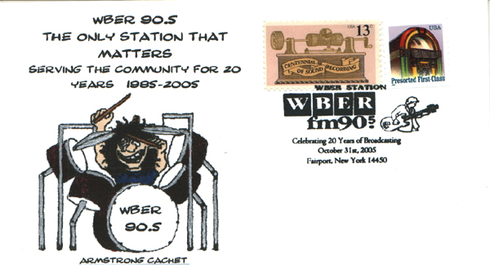
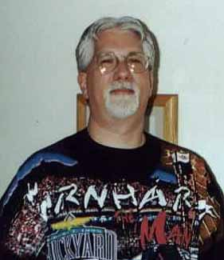
How I Got Into Cachet Making
By Kelly Armstrong April 2018
For the Rochester Philatelic Association

Slide 2
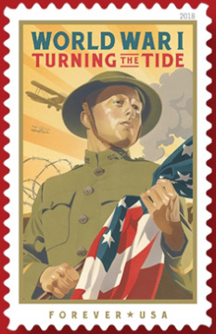
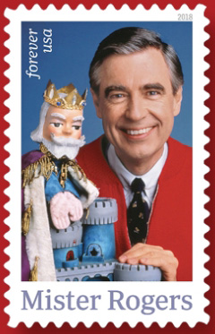
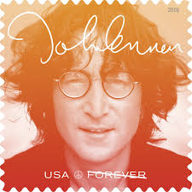
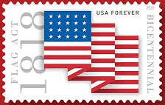
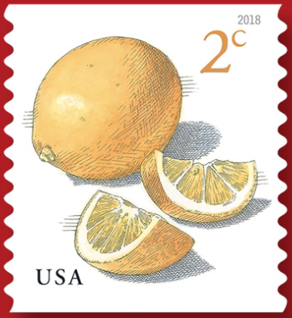
The process of making a cachet starts with researching stamp designs soon to be released by the Postal Service. Which will be popular, have copyright issues, or just
turn out to be lemons?

Slide 3
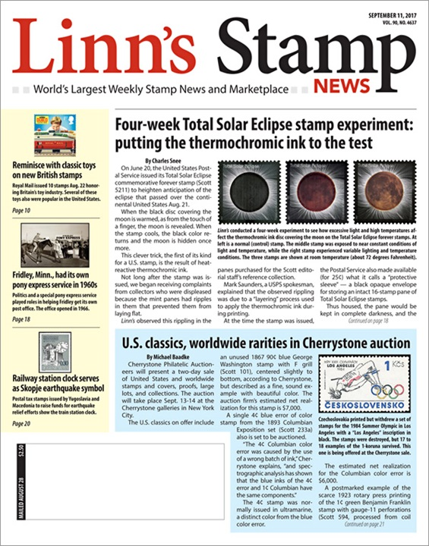
Where does this information come from?

Slide 4
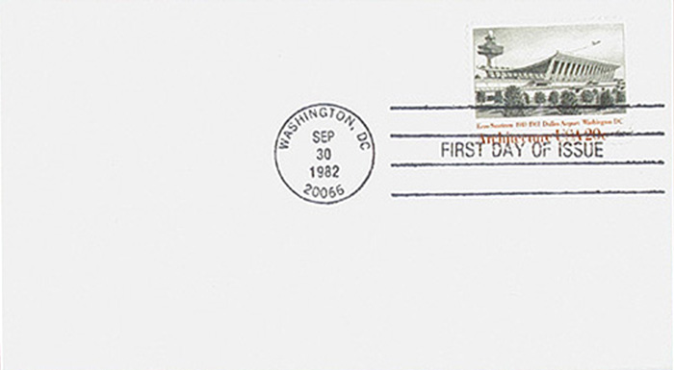
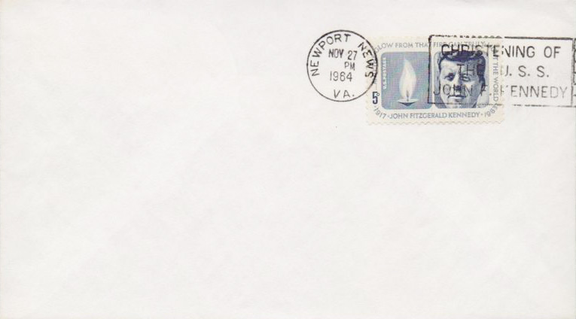
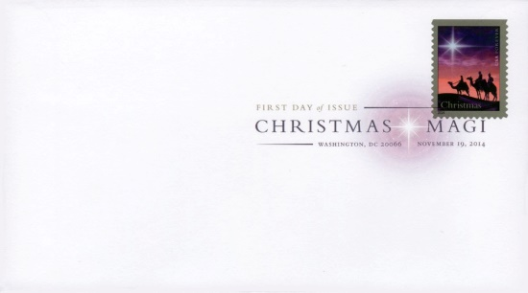
I also look for FDCs and other covers without a cachet to make my own designs on. These will become “add-on” cachets.

Slide 5
Here is a selection of my favorite current issue and local event covers.
1987 7.1c Tractor
1988 set of 4 Cats
2004 Henry Mancini
2005 WBER 20th Anniv.
2005 Oz Fest Station
2007 Gerald Ford
2013 Holiday Wreath
2017 Sky Writing

Slide 6
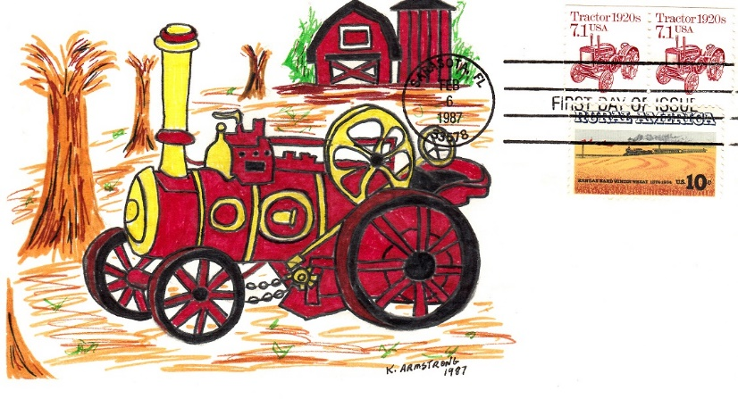

Slide 7
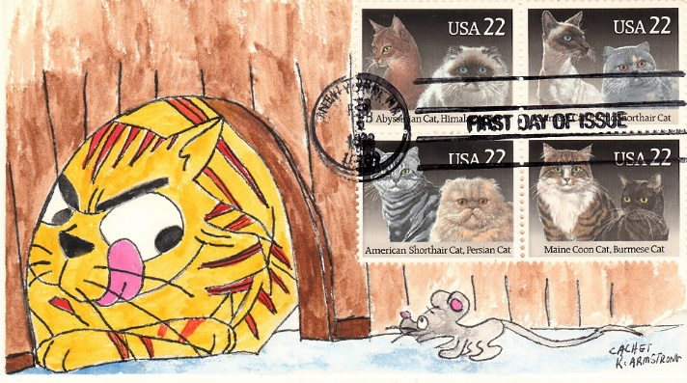

Slide 8
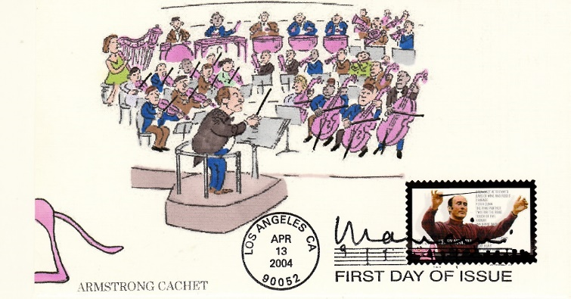

Slide 9
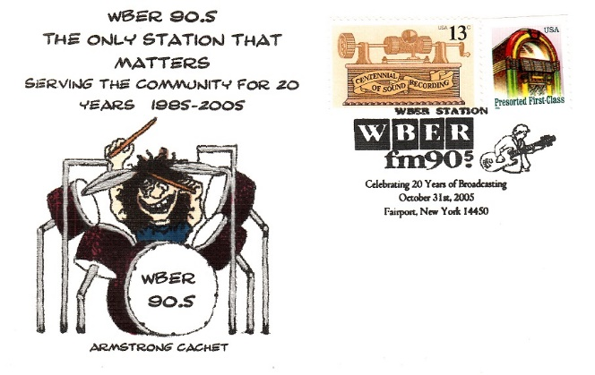

Slide 10
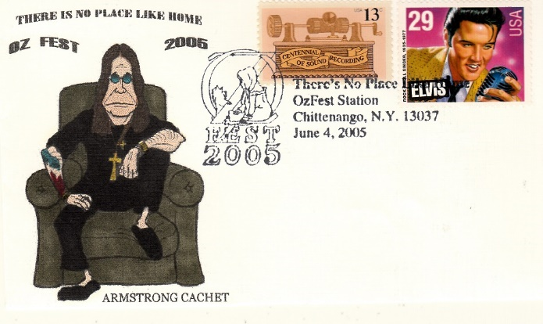

Slide 11
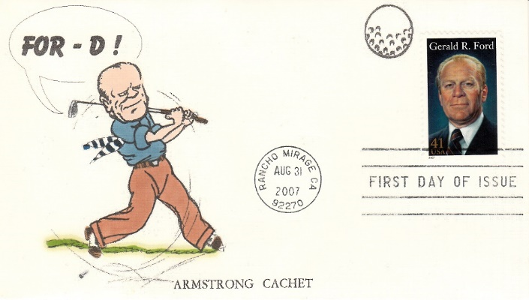

Slide 12
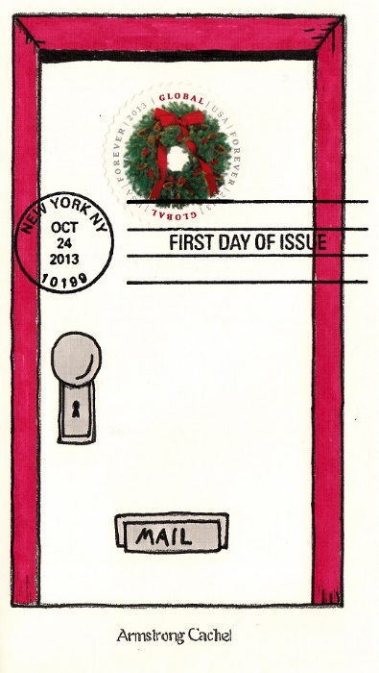

Slide 13
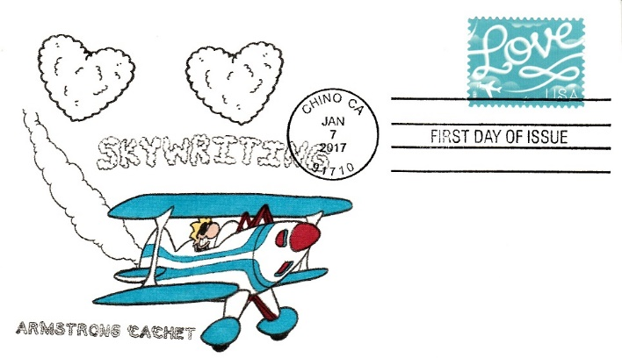

Slide 14
Here is a selection of my favorite add-on cachets.
1993 National Postal Museum
1998 American Folk Musicians
1999 American Glass
1999 Celebrate the Century- Slinky
2007 Love stamp-KISS
2009 Edgar Alan Poe
2014 Purple Heart

Slide 15
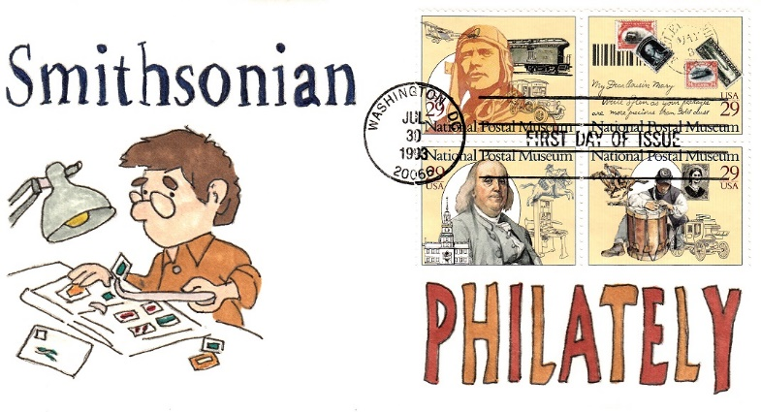

Slide 16
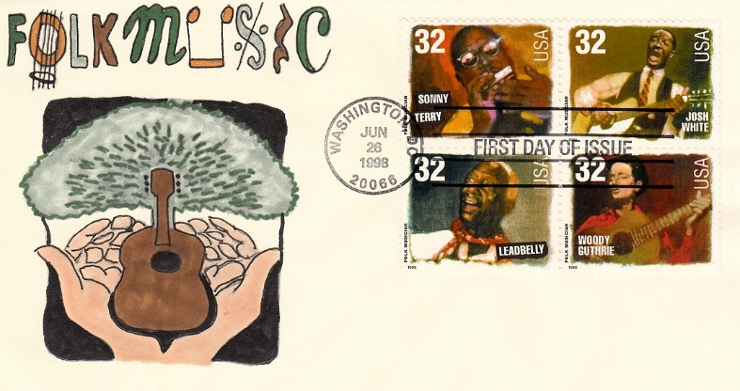

Slide 17
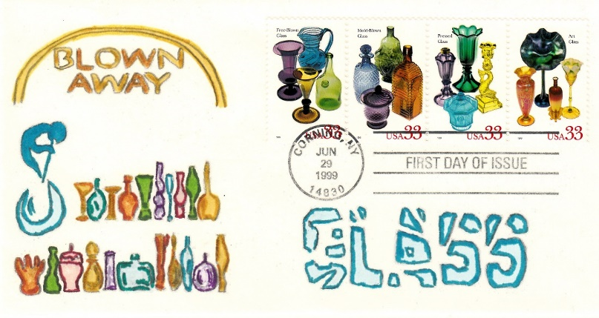

Slide 18
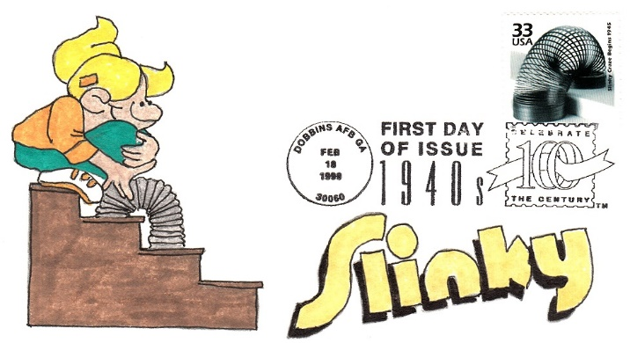

Slide 19
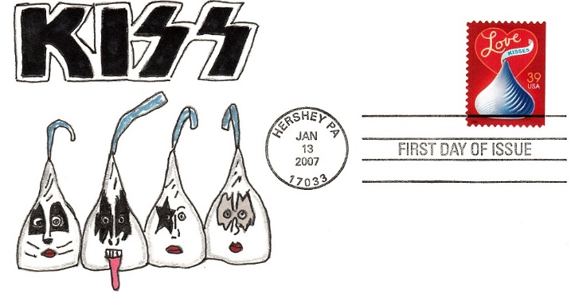

Slide 20
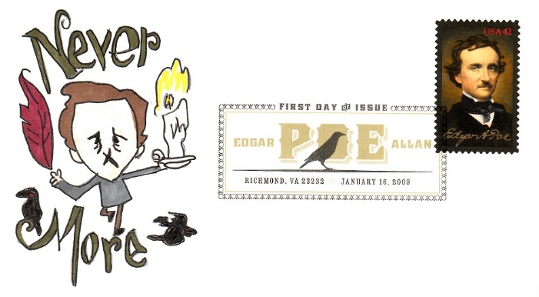

Slide 21
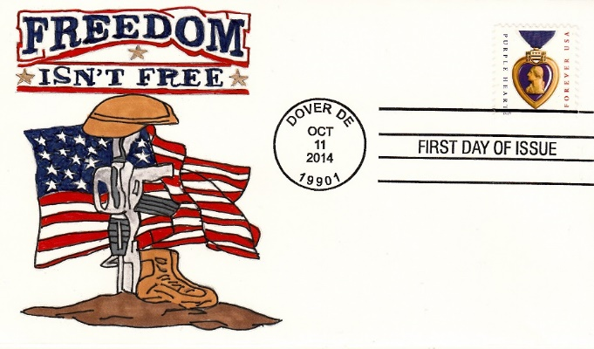

Slide 22
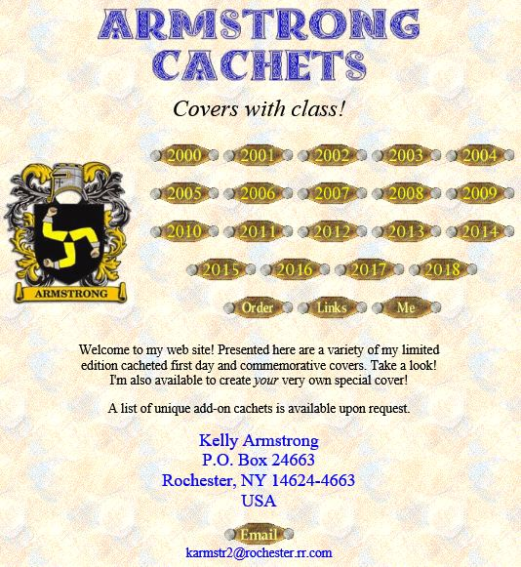
I hope you’ve enjoyed this
brief glimpse into my
cachet-making ventures.
Check out my web site
when you get a chance
to see more:
http://www.armstrongcachets.com

Slide 23
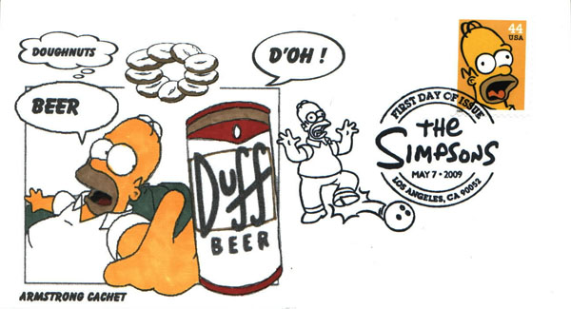
Time for a …
Design and Layout by Tom Fortunato

