Slide 1
Linn’s 2020 U.S. Stamp Popularity Poll
as voted by RPA members via email 12/09-31

Slide 2
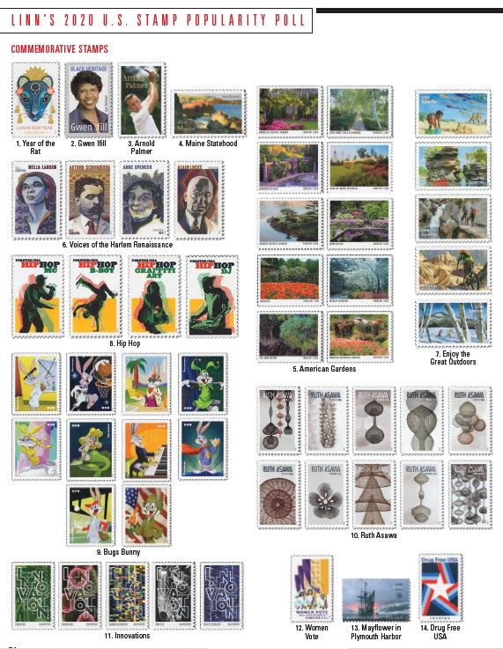
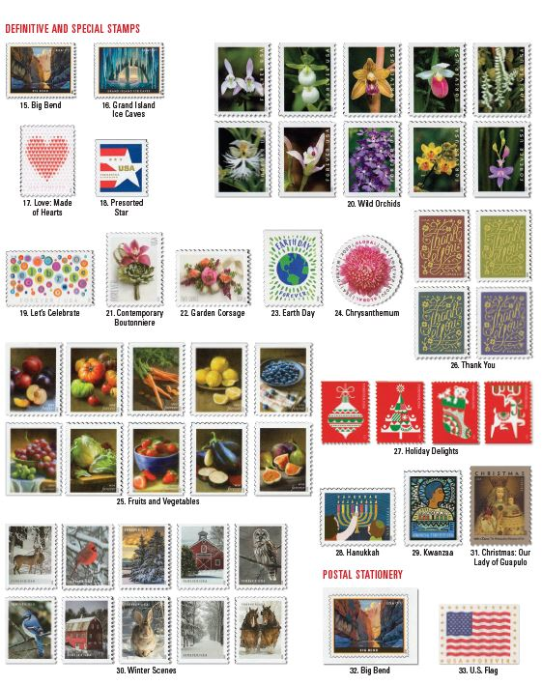
The 2020 Contestants…

Slide 3
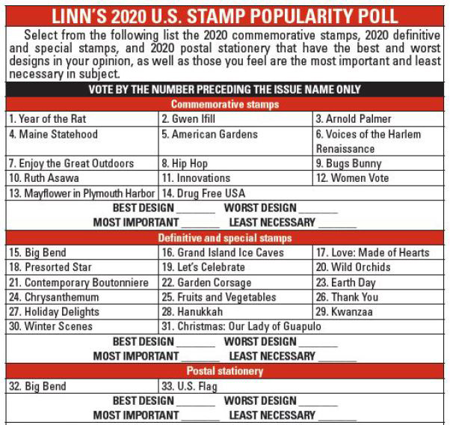
The Voting Categories and Ballot…

Slide 4
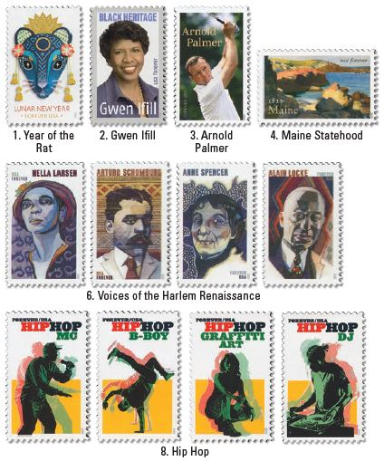
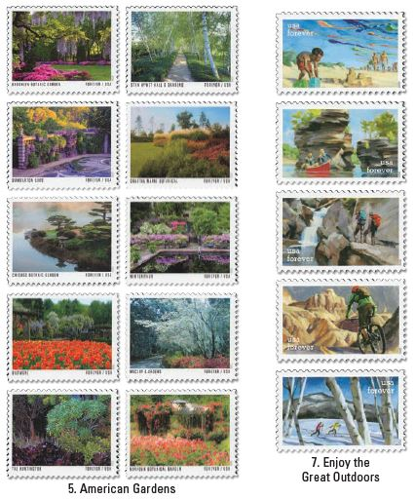
Commemorative Choices (page 1)…

Slide 5
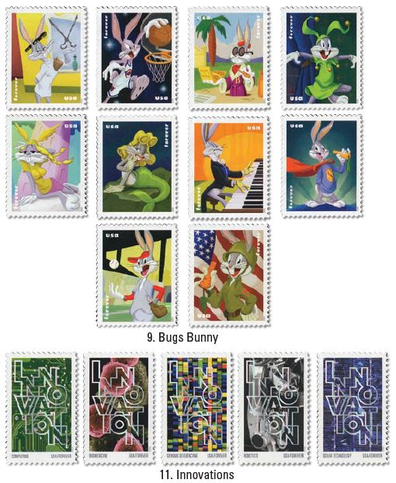
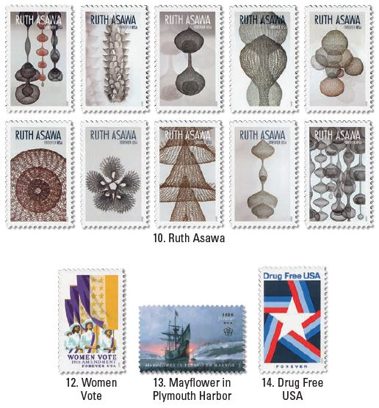
Commemorative Choices (page 2)…

Slide 6
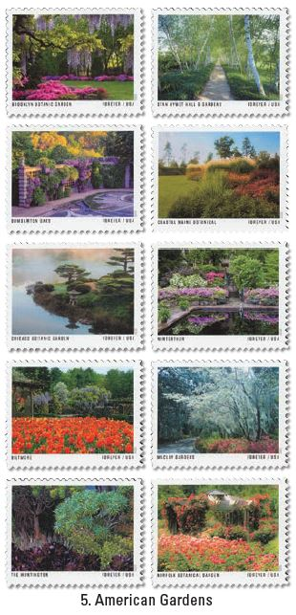
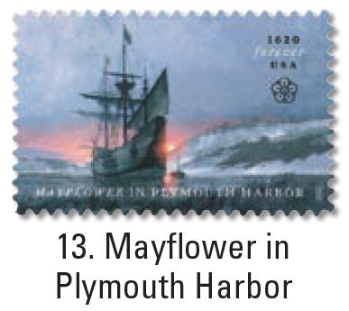
Best 2020 Commemorative Design
Tie: American Gardens and Mayflower

Slide 7
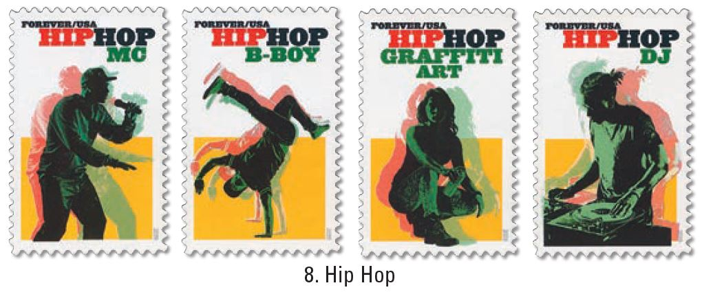
Worst 2020 Commemorative Design
Hip Hop

Slide 8
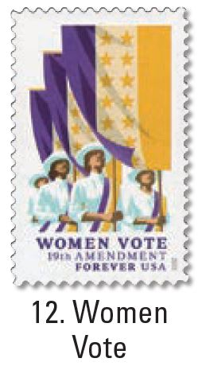
Most Important 2020 Commemorative Subject
Women Vote

Slide 9
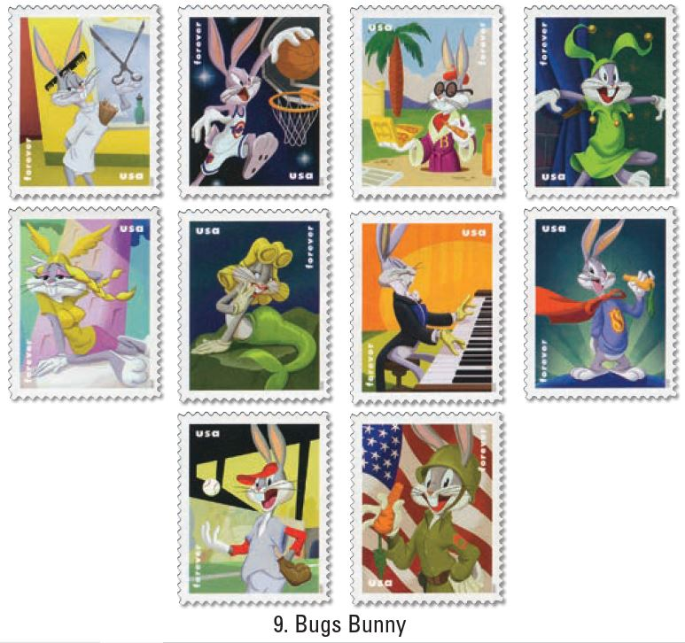
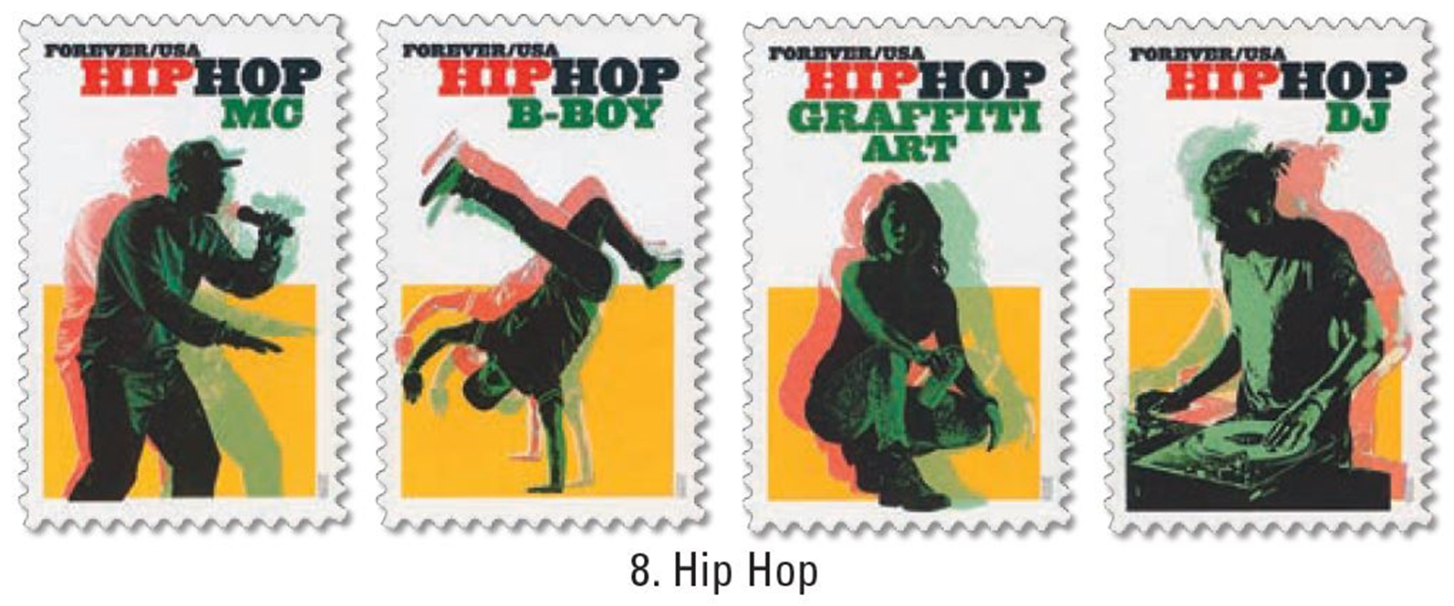
Least Important 2020 Commemorative Subject
Tie: Hip Hop and Bugs Bunny

Slide 10
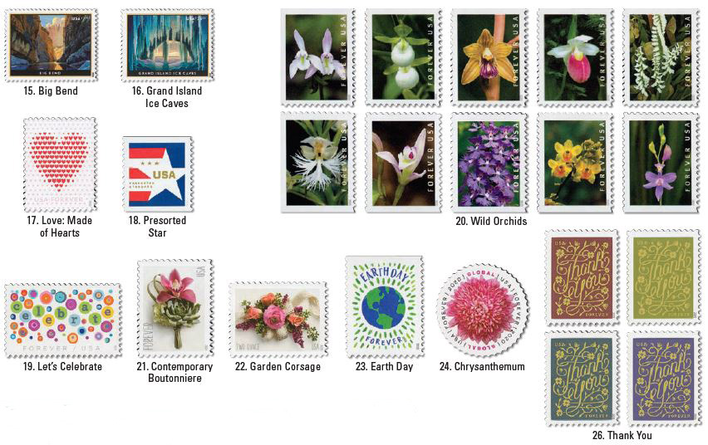
Definitive Choices (page 1)…

Slide 11
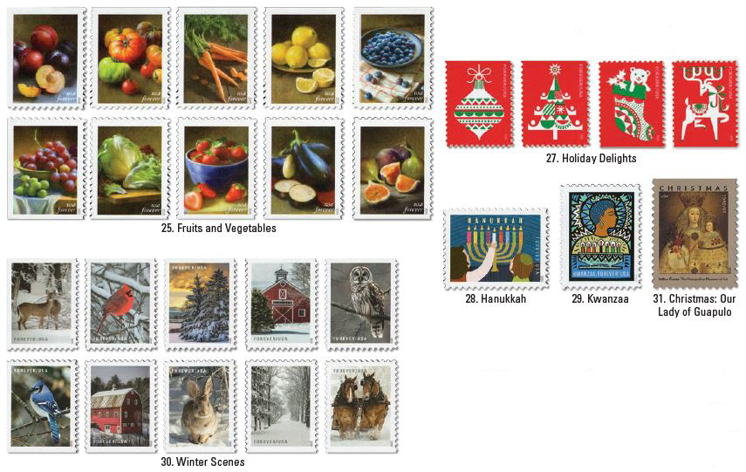
Definitive Choices (page 2)…

Slide 12
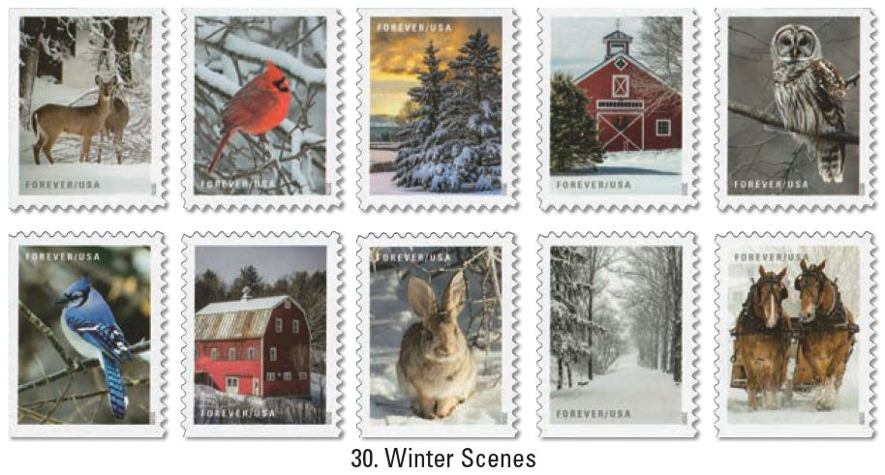
Best 2020 Definitive Design
Winter Scenes

Slide 13
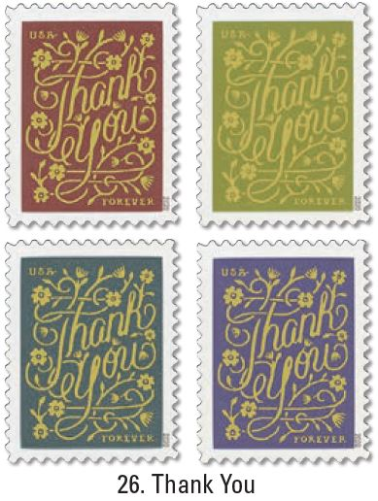
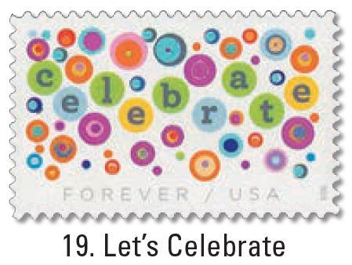
Worst 2020 Definitive Design
Tie: Let’s Celebrate and Thank You

Slide 14
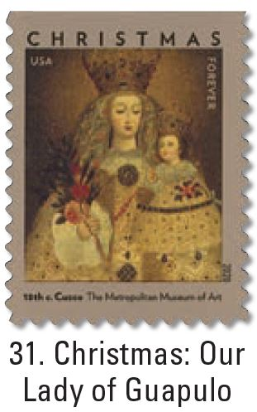
Most Important 2020 Definitive Subject
Christmas-Our Lady of Guapulo

Slide 15
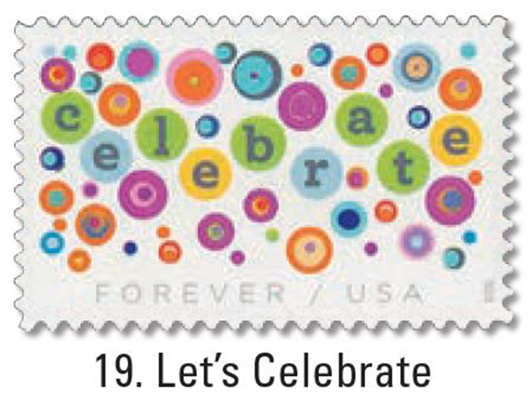
Least Important 2020 Definitive Subject
Let’s Celebrate

Slide 16
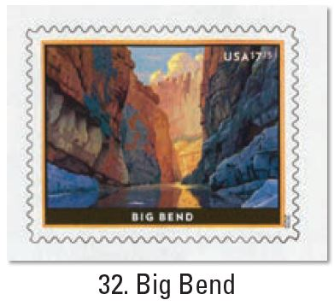
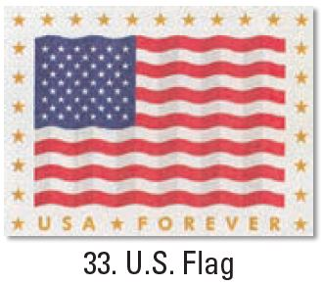
Postal Stationery – Only Two Designs
Best Design
Big Bend
Worst Design
U.S. Flag
Most Important
U.S. Flag
Least Important
Big Bend

