Slide 1
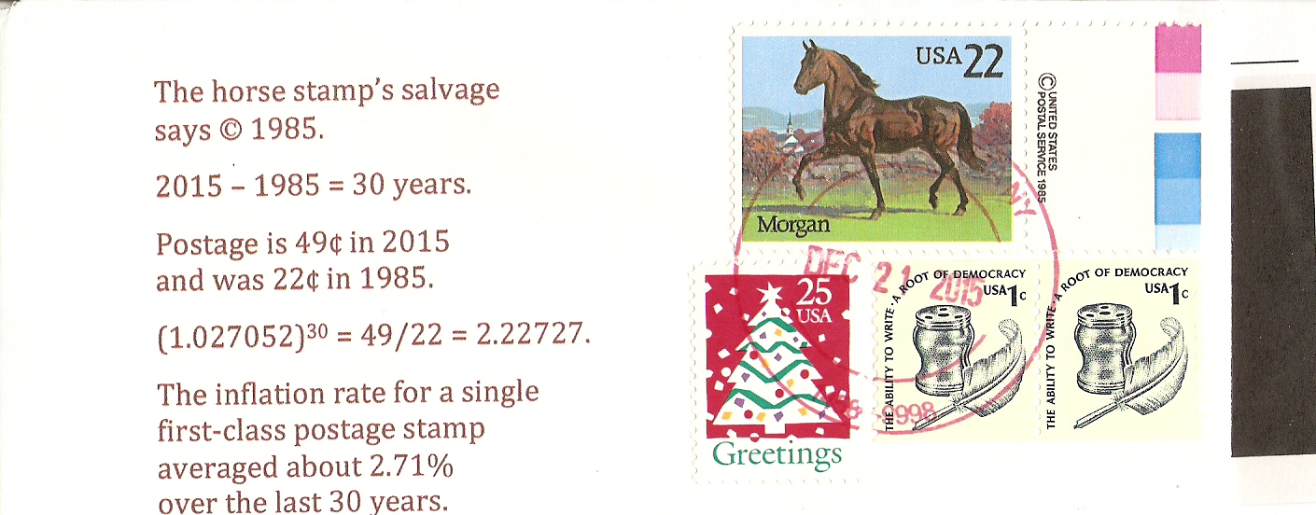
January 2016 RPA Cachet Contest
Entry 1a: Ink Jet printing. Using the Morgan Horse stamp to demonstrate 30 Year Postage Inflation Rate

Slide 2
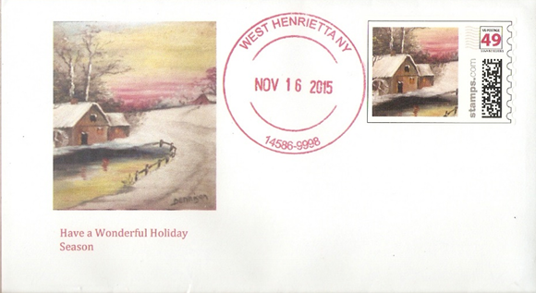
January 2016 RPA Cachet Contest
Entry 1b: Ink Jet Printing. Contemporary American Scene of Personal United States 49 Cent Stamp

Slide 3
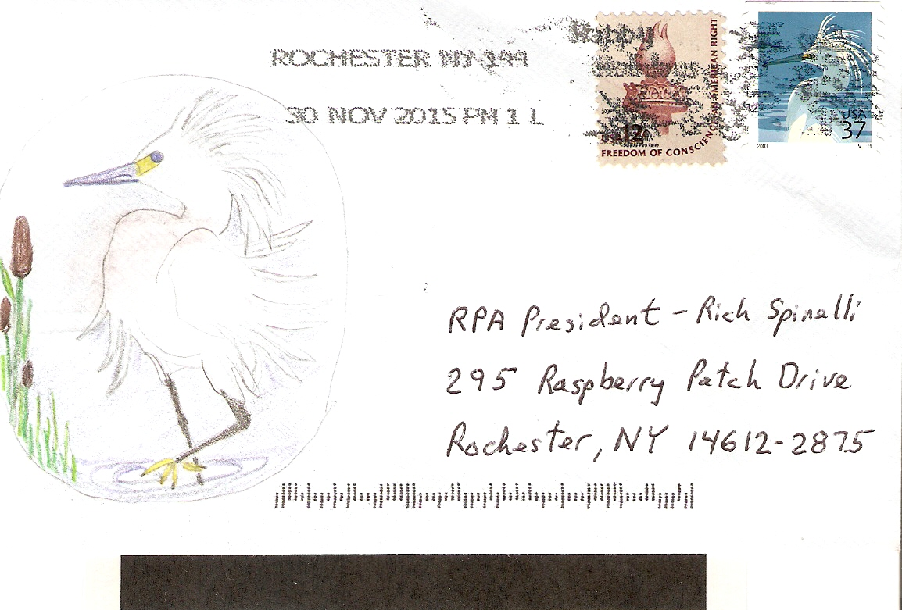
January 2016 RPA Cachet Contest
Entry #2
Flower Stamp and Bird Stamp
Free - hand drawn & pencil colored

Slide 4
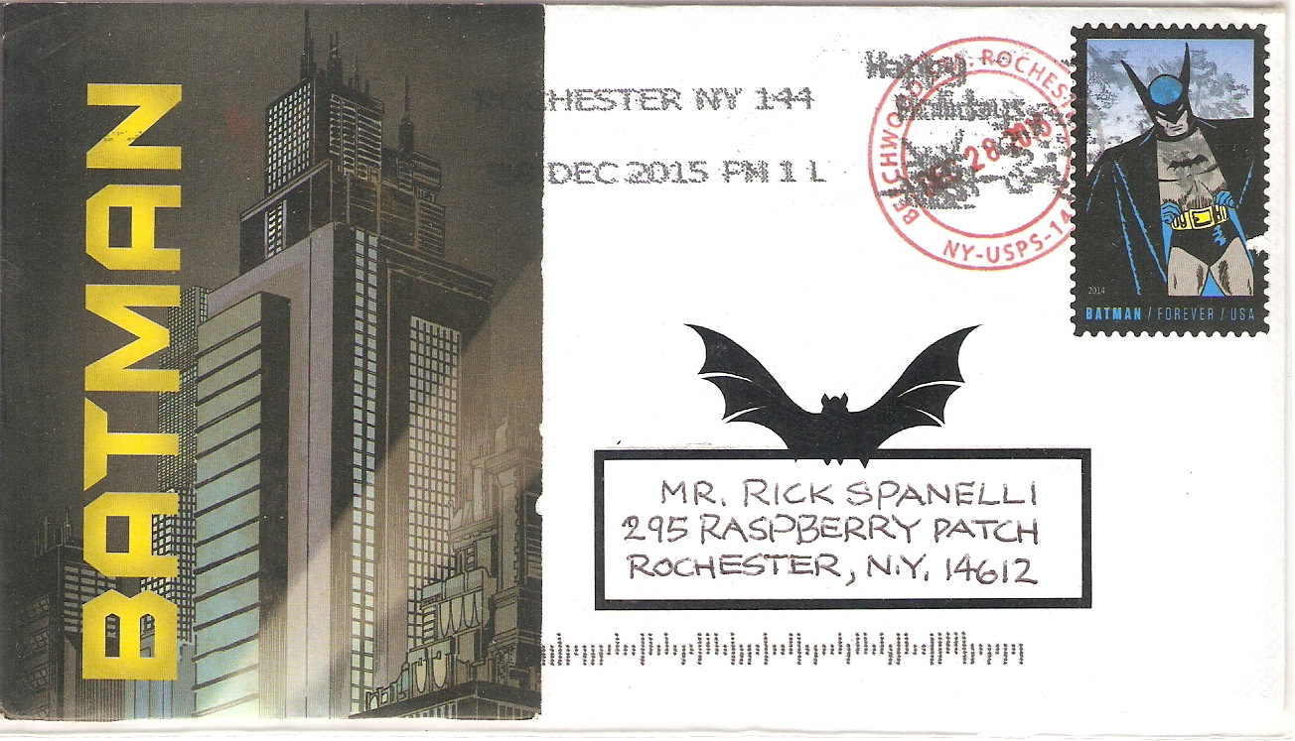
January 2016 Cachet RPA Contest
Entry #3
Ink jet Batman!!!!!!

Slide 5
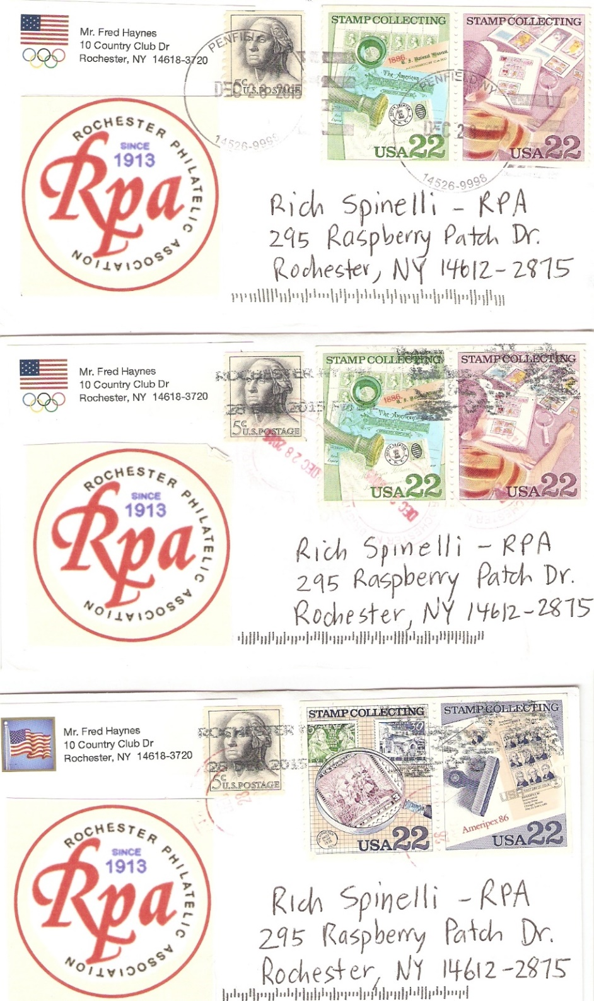
January 2016 Cachet RPA Contest
Entry #4: Recognizing Stamp Collecting and the Rochester Philatelic Association
with eight (8) different Monroe County Post Office cancels
Pg 1/3
Penfield, New York Post Office Cancel 14526
22 Cent Stamp Collecting Stamps Scott #2198 and #2199
Brighton, New York Post Office Cancel 14610
22 Cent Stamp Collecting Stamps Scott #2198 and #2199
(unclear), New York Post Office Cancel 14xxx
22 Cent Stamp Collecting Stamps Scott #2200 and #2201

Slide 6
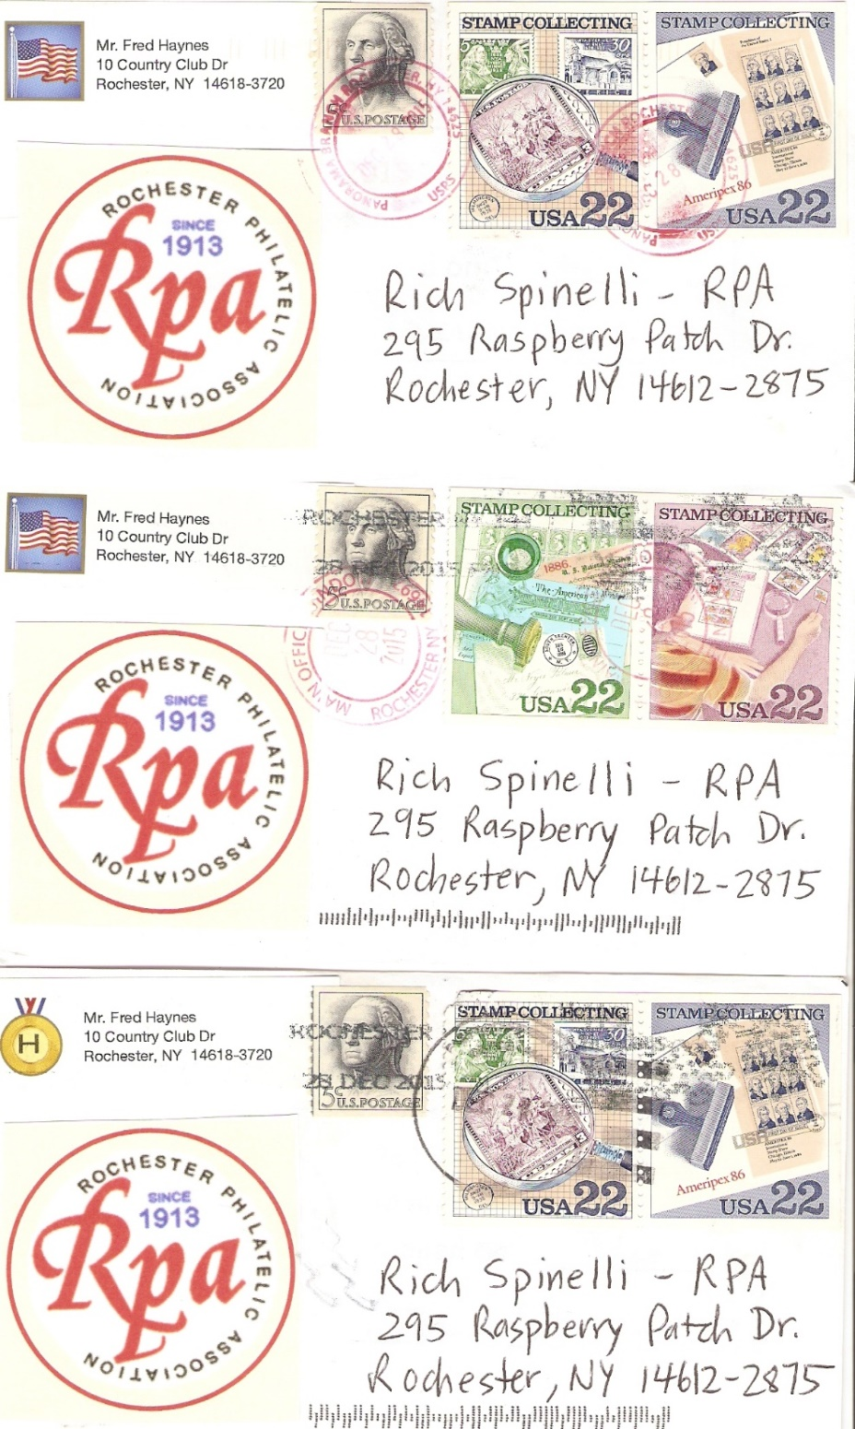
January 2016 RPA Cachet Contest
Entry #4: Recognizing Stamp Collecting and the Rochester Philatelic Association
with eight (8) different Monroe County Post Office cancels
Pg 2/3
Panorama Branch, New York Post Office Cancel 14625
22 Cent Stamp Collecting Stamps Scott #2200 and #2201
Main Office, New York Post Office Cancel 14692
22 Cent Stamp Collecting Stamps Scott #2198 and #2199
Unclear, New York Post Office Cancel 14
22 Cent Stamp Collecting Stamps Scott #2200 and #2201

Slide 7
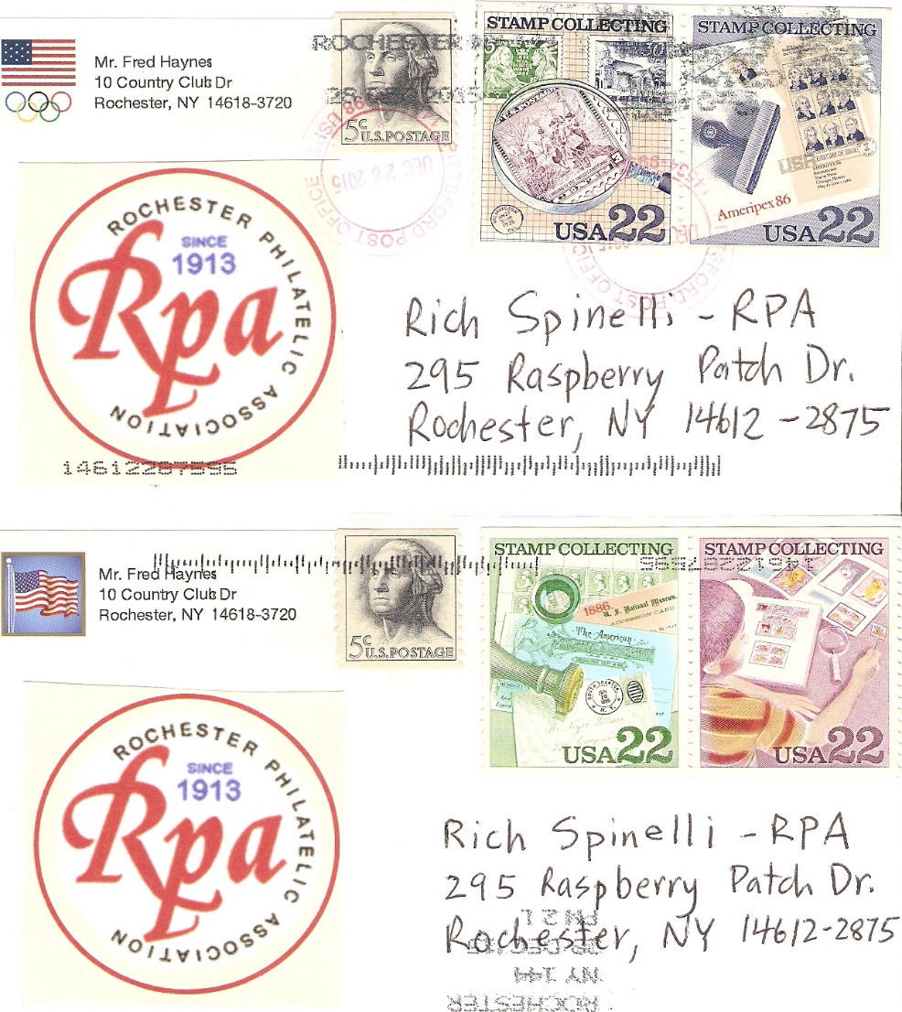
January 2016 RPA Cachet Contest
Entry #4: Recognizing Stamp Collecting and the Rochester Philatelic Association
with eight (8) different Monroe County Post Office cancels
Pg 3/3
Pittsford, New York Post Office Cancel 14534
22 Cent Stamp Collecting Stamps Scott #2200 and #2201
Main Office, New York Post Office Cancel 14692
22 Cent Stamp Collecting Stamps Scott #2198 and #2199

Slide 8
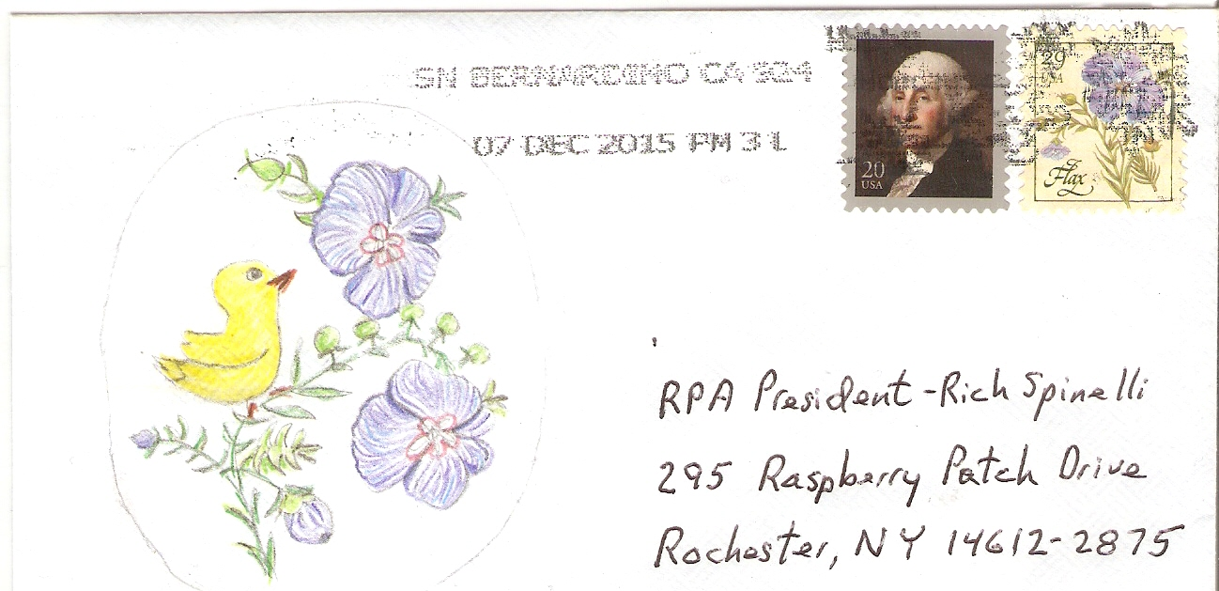
January 2016 RPA Cachet Contest
Entry #5: Hand Drawn and Pencil Colored
Rendition of Flax Stamp with Canary

Slide 9
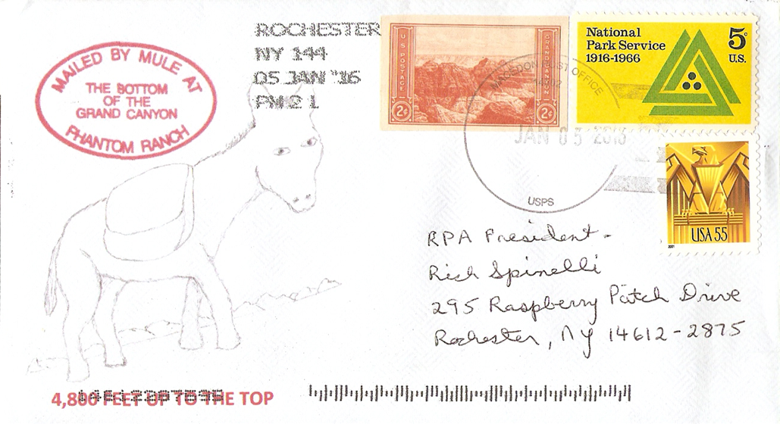
January 2016 RPA Cachet Contest
Entry #6: Hand Drawn and Rubber Stamp Cachet Recognizing Postage in the National Park System

Slide 10
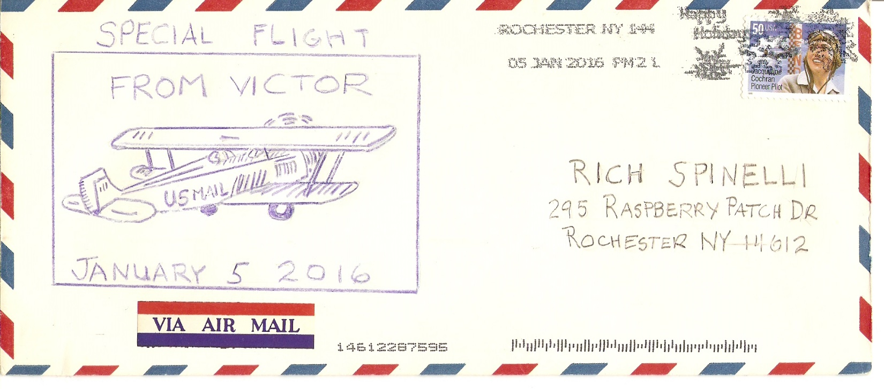
January 2016 RPA Cachet Contest
Entry #7: Free hand Color Pencil Drawing
Recognizing American Air Mail Postage

Slide 11
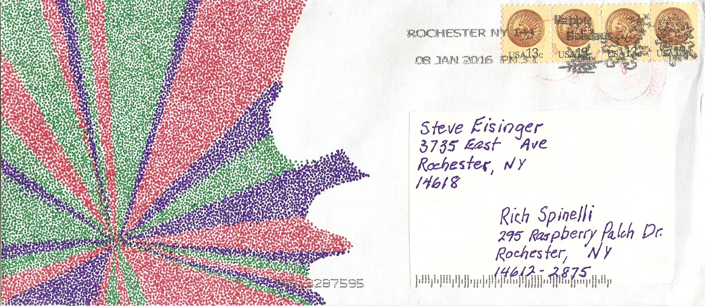
January 2016 RPA Cachet Contest
Entry #8a: Hand-applied Color Ink Dots in Modernistic Design

Slide 12
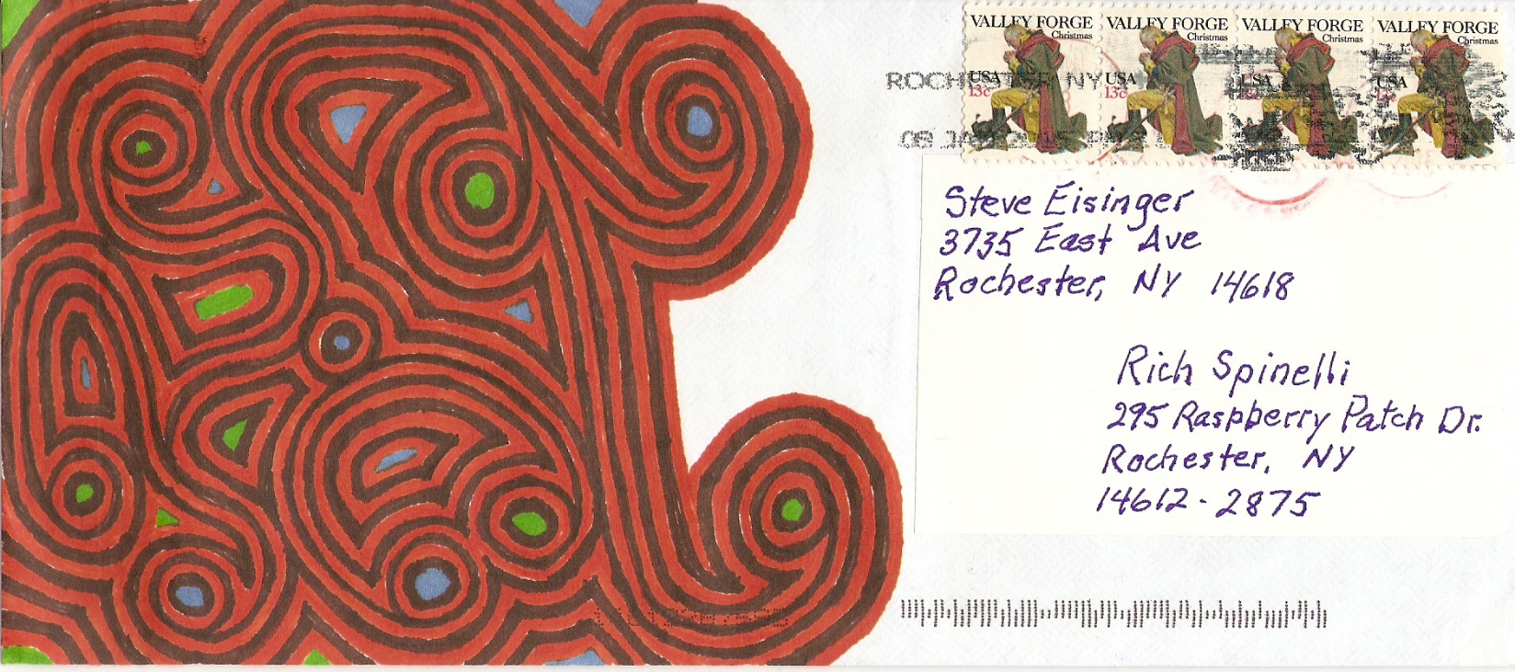
January 2016 Cachet RPA Contest
Entry #8b: Hand-applied Color Ink Lines in Modernistic Design

Slide 13
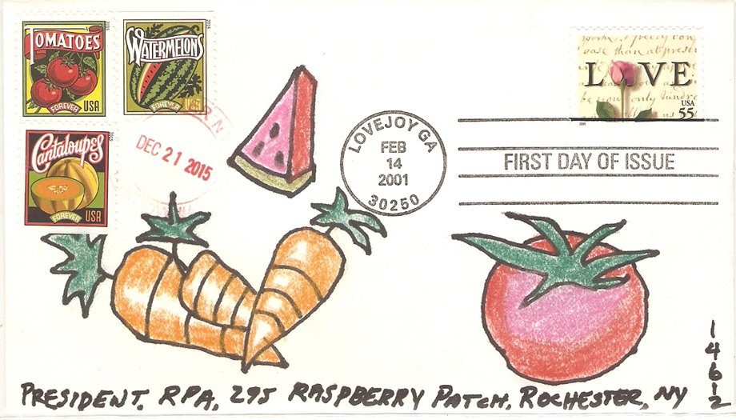
January 2016 RPA Cachet Contest
Entry#9a: Hand Drawn and Chalk Colored Fruits Recognizing the 2015 Seed Catalog Stamps

Slide 14
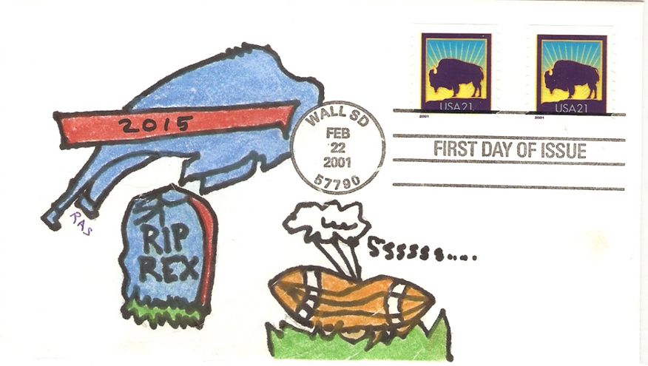
January 2016 RPA Cachet Contest
Entry#9b: Hand Drawn and Chalk Colored Summary of the Buffalo Bills 2015 Season

Slide 15
Blond “Toope”
January 2016 RPA Cachet Contest
Entry# 9b: Hand Traced and Chalk Colored Picture of Donald Trump
”Off to the Races”

Slide 16
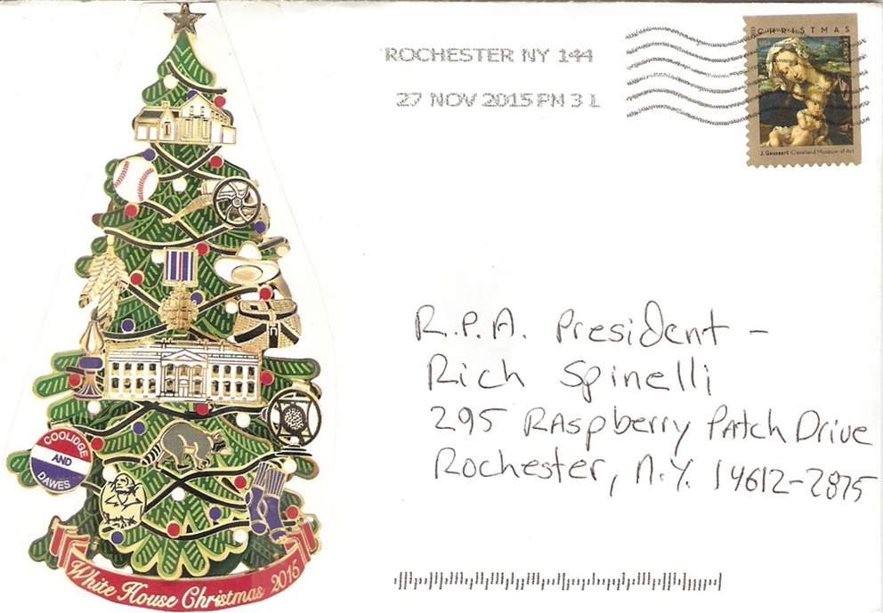
January 2016 RPA Cachet Contest
Entry 10: Printed Holiday Sticker Recognizing the Christmas Season

