Slide 1
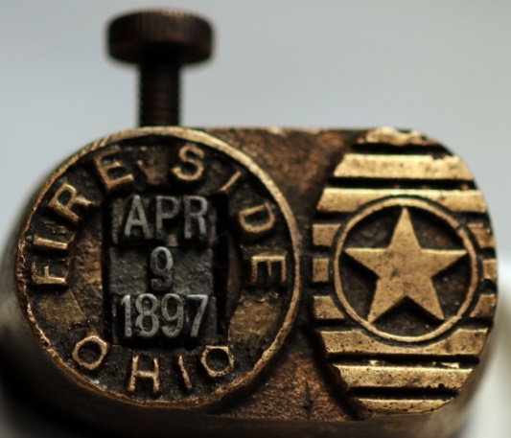
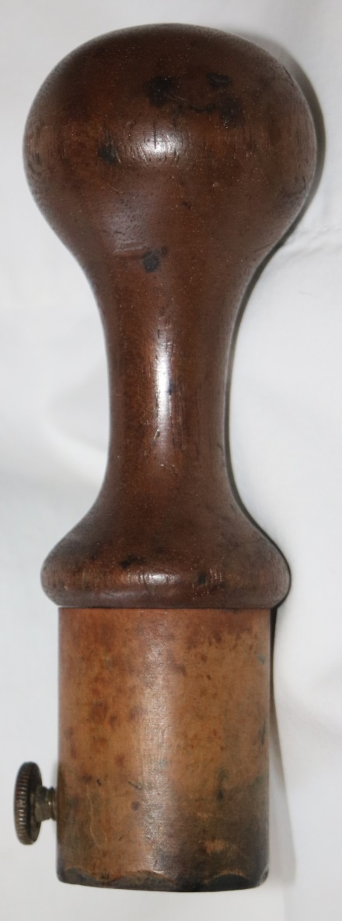
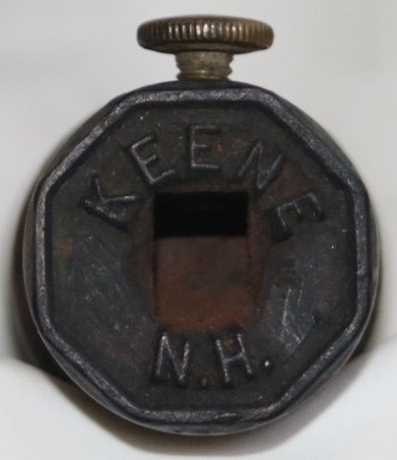
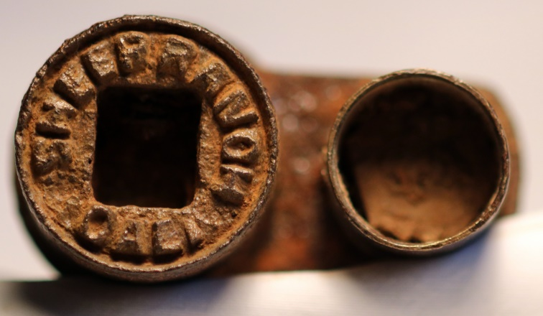
Postal Hand Dies Found
2015
Larry Rausch

Slide 2
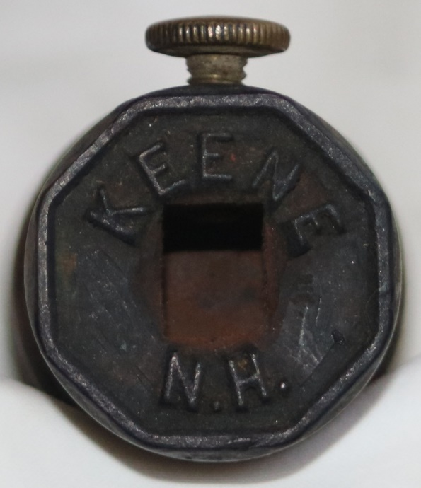
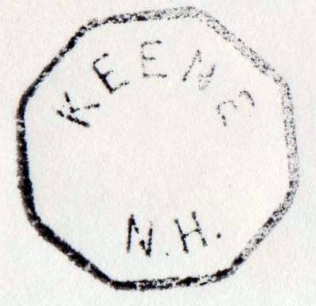
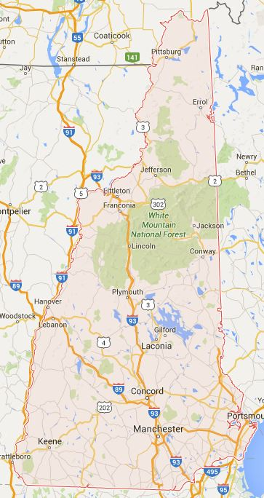
Keene, NH
Usage 1860’s
Keene, NH
est.1874
Pop 6700

Slide 3
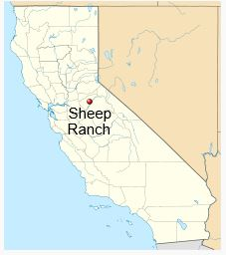
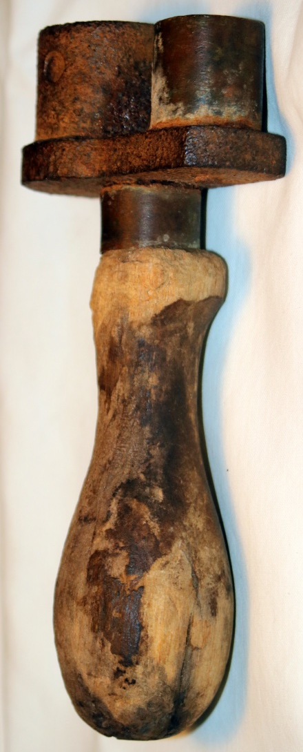
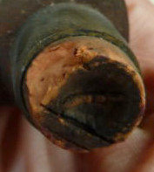
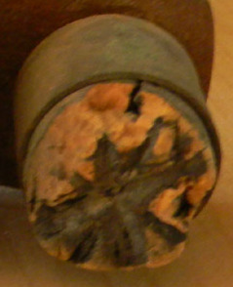
Cork Postal Die
Sheep Ranch, Ca.
Pop. >100
Post office est. 1877
Spelling changed to
Sheepranch 1895
DPO 2008
SF
LA

Slide 4
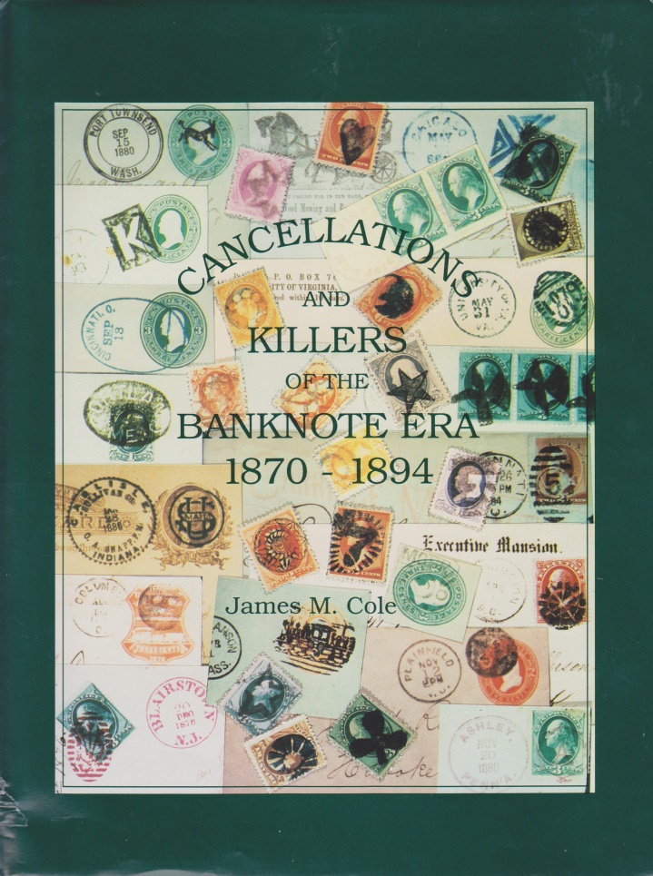
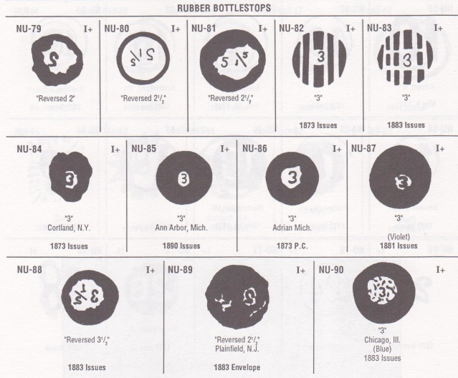
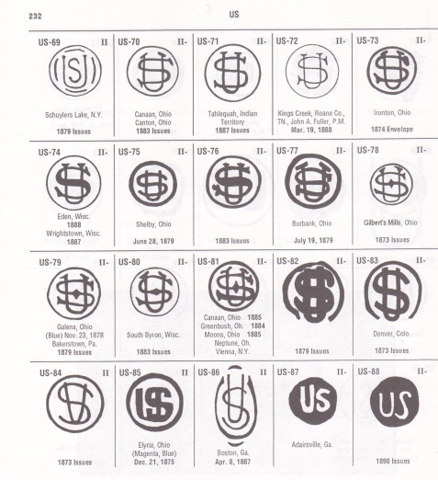
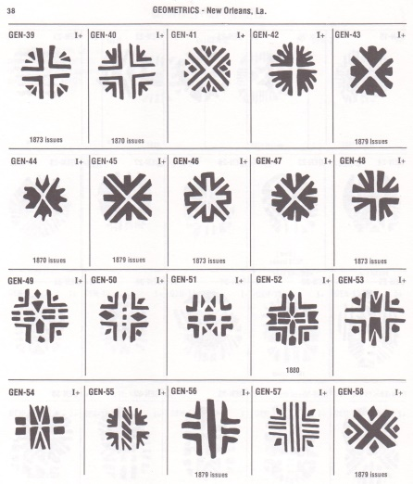
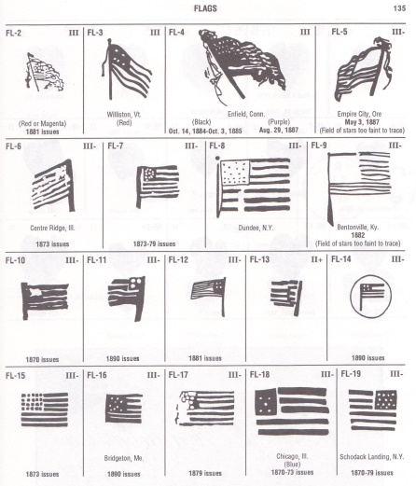
Cancellations
And Killers
of the
Banknote Era
1870-1894
James M Cole
Rubber BottleStops
Cork

Slide 5
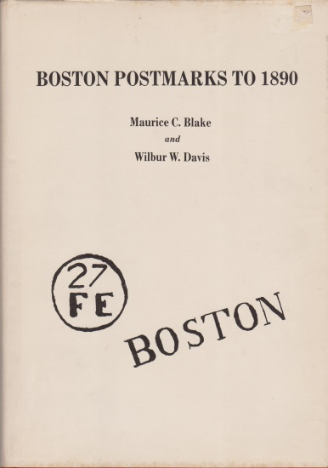
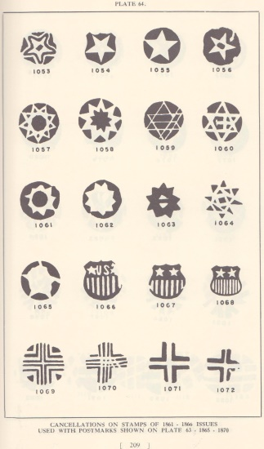
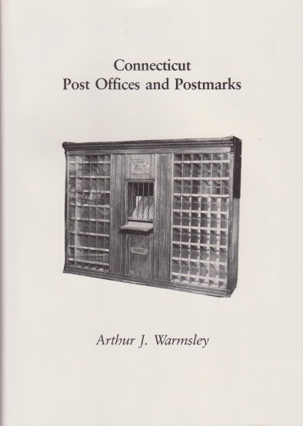
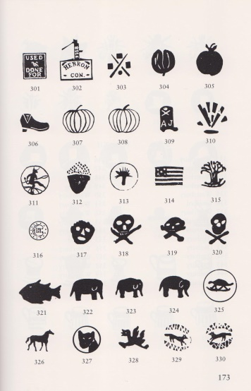
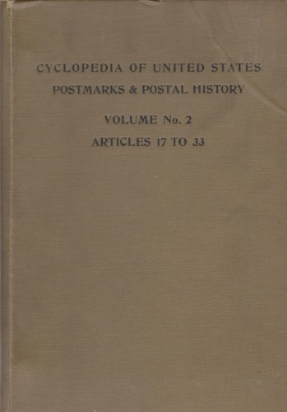
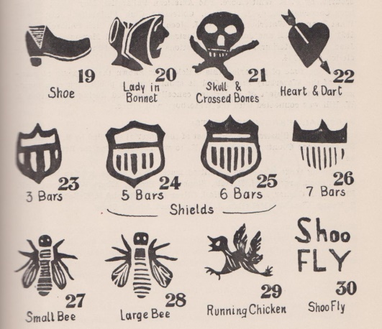
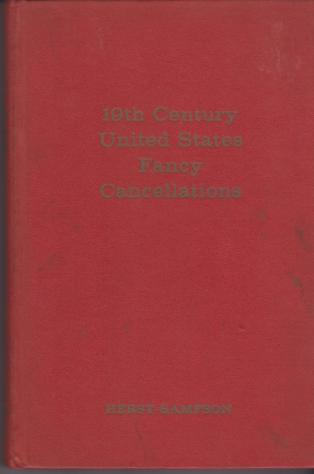
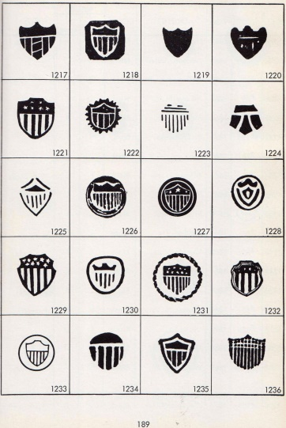
Fancy
Cancellations

Slide 6

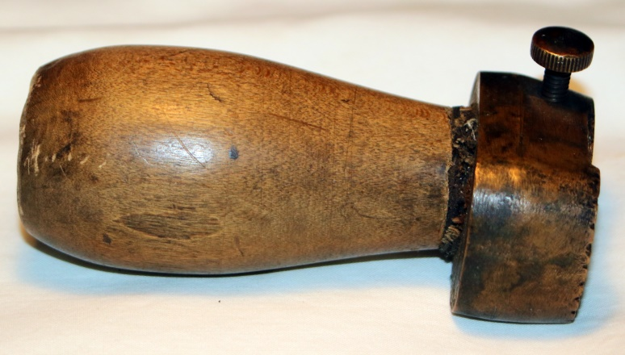
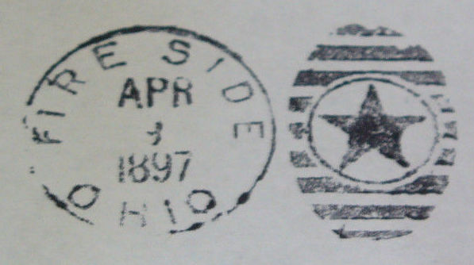
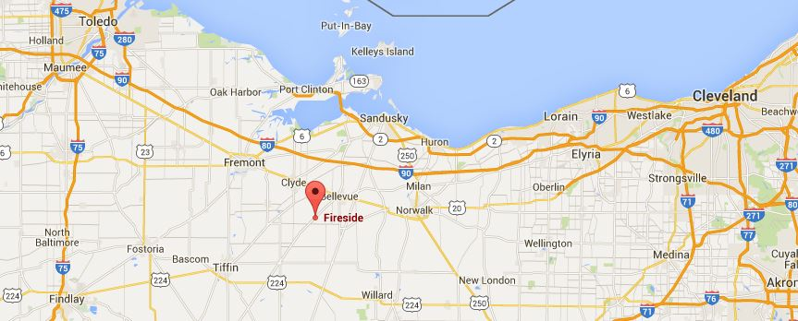
Fire Side (Fireside), Ohio
Fire Side, Ohio
est.1866
DPO 1900

Slide 7
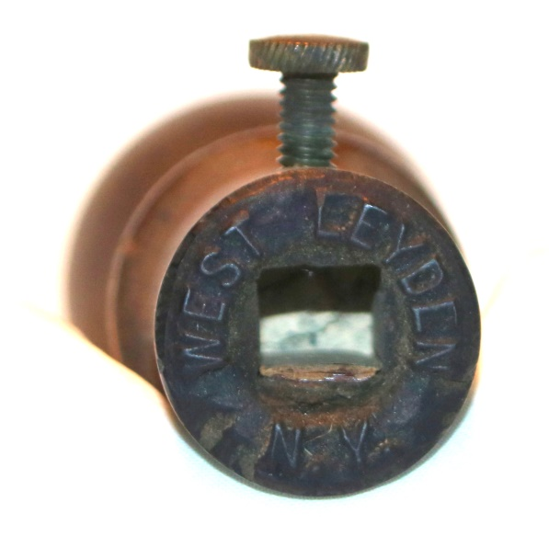
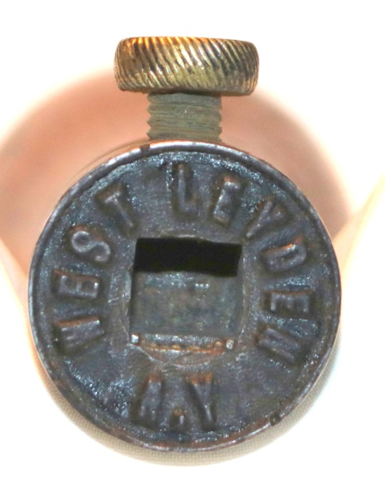
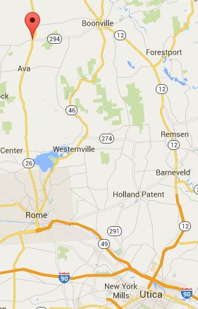
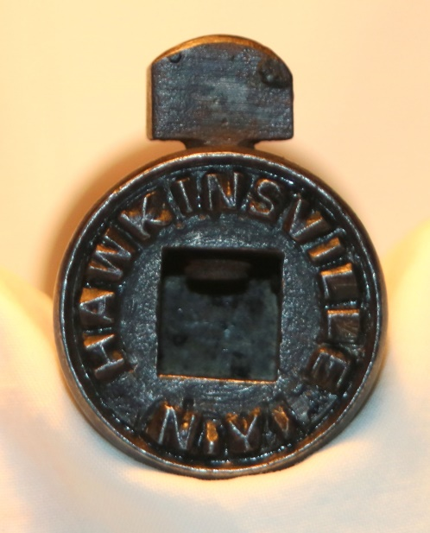
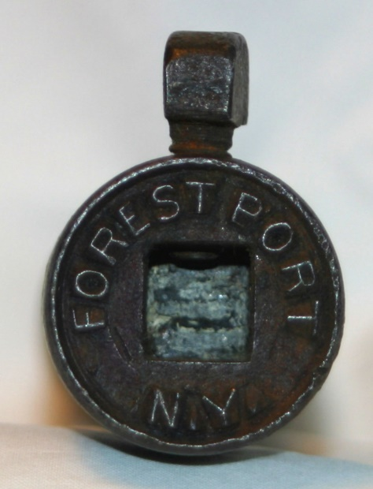
Adirondacks Postal Dies
Forest Port, Hawkinsville & West Leyden, NY
West Leyden
Est. 1794
Pop. 1700
West Leyden
Hawkinsville
1869
Pop. 300
Hawkinsville
Forest Port
Est.1869
Pop. 1500
Forest Port

Slide 8
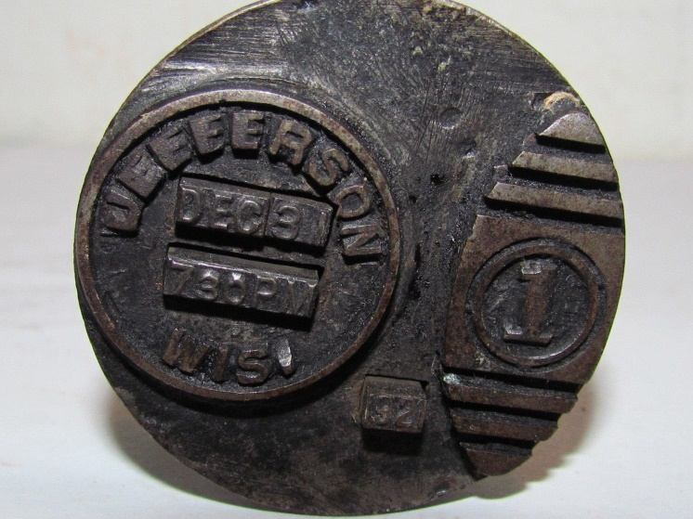
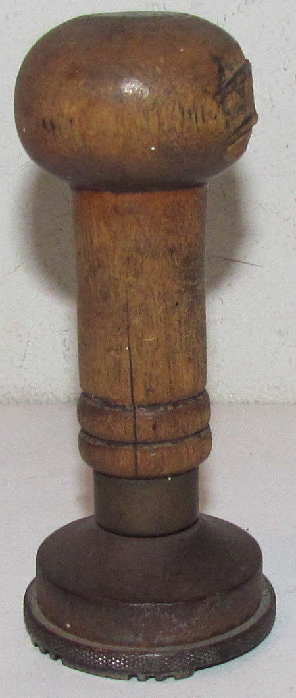
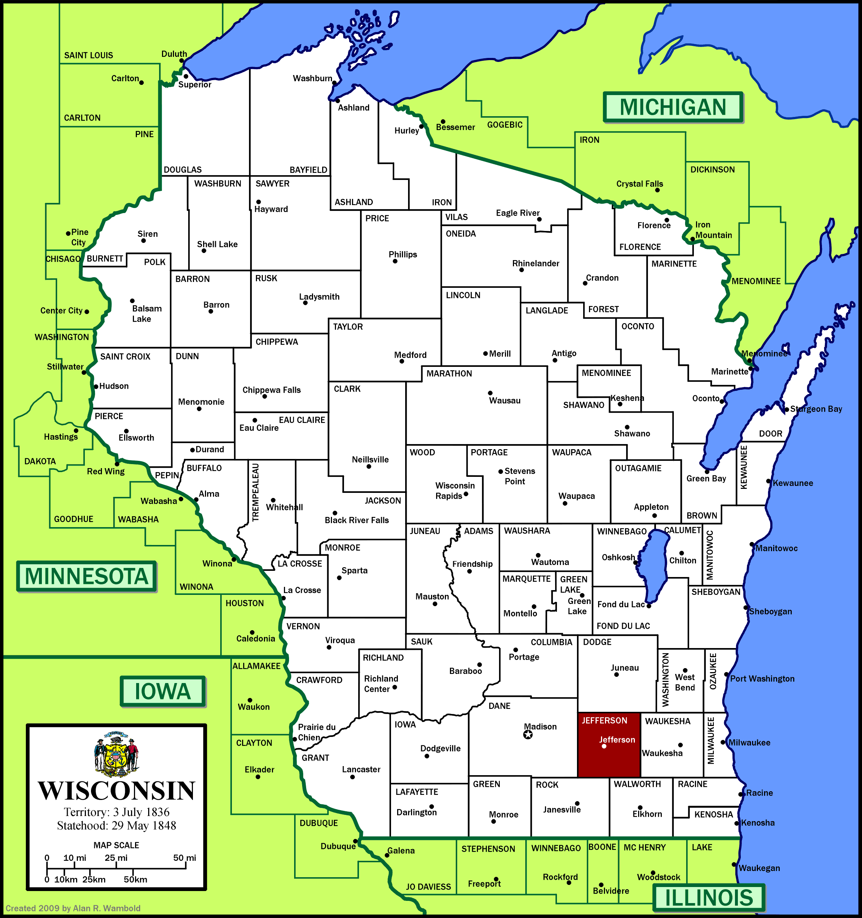
Triplex Die
Jefferson, Wisc.
CDS (Circular Date stamp), Killer, Year
Jefferson City, Wis.
est. 1857
Pop. 8000

Slide 9
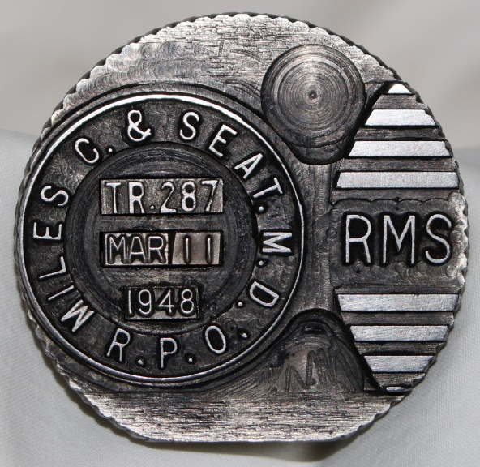
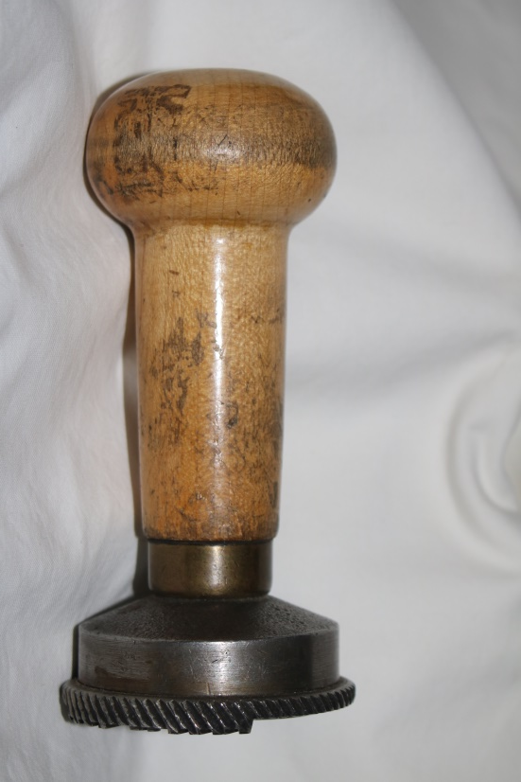
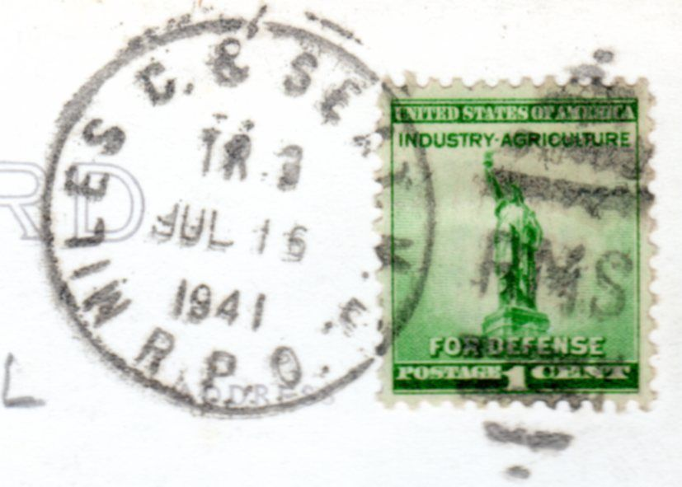
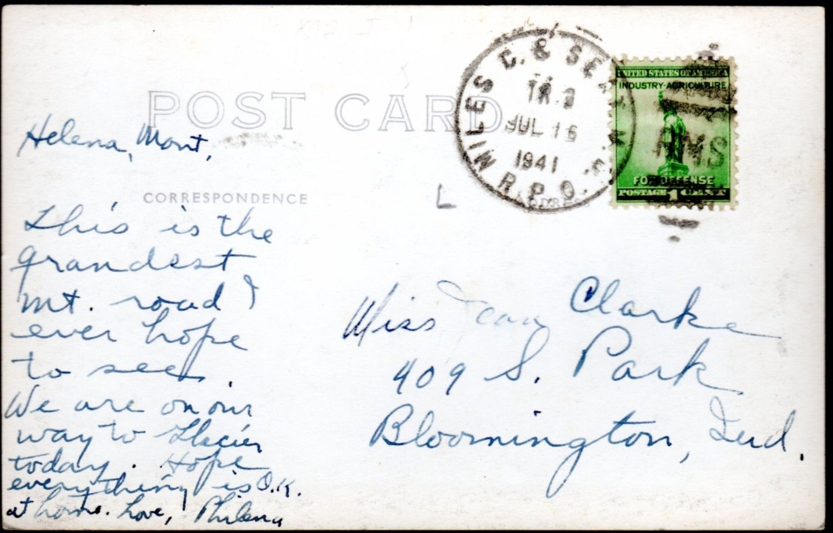
Railroad Mail Service (RMS)
Miles City Mt to Seattle, Wa.

Slide 10
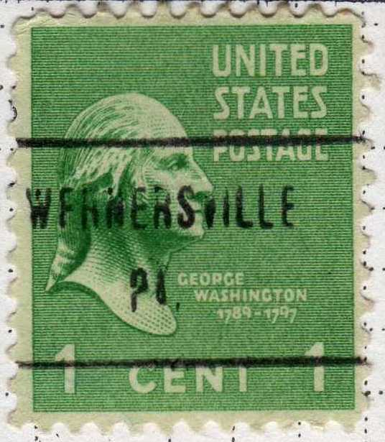
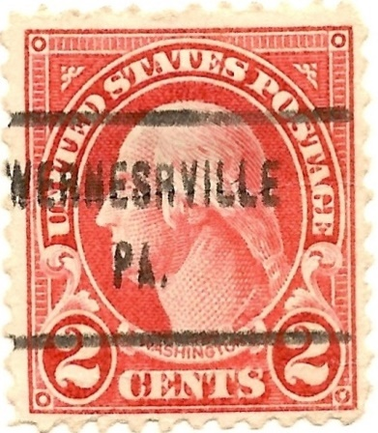
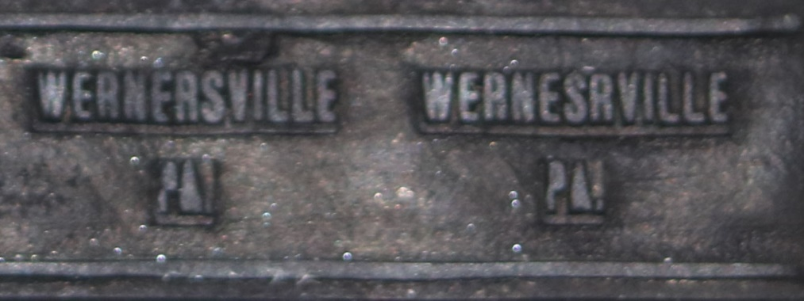
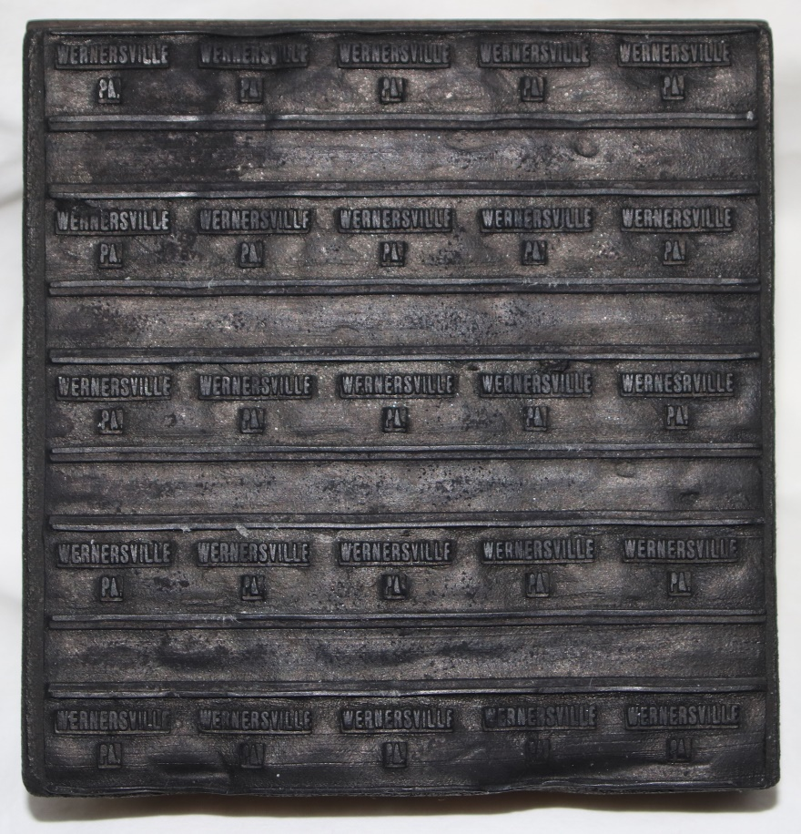
Wernersville, Pa
5x5 Precancel Die with Error
ERS
ESR

Slide 11
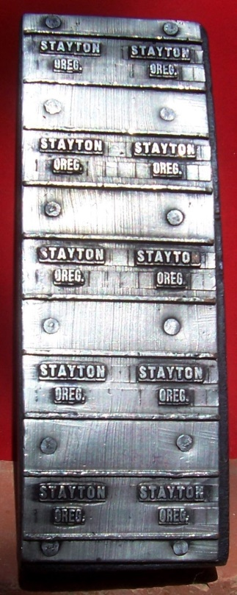
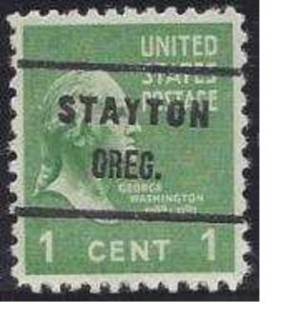
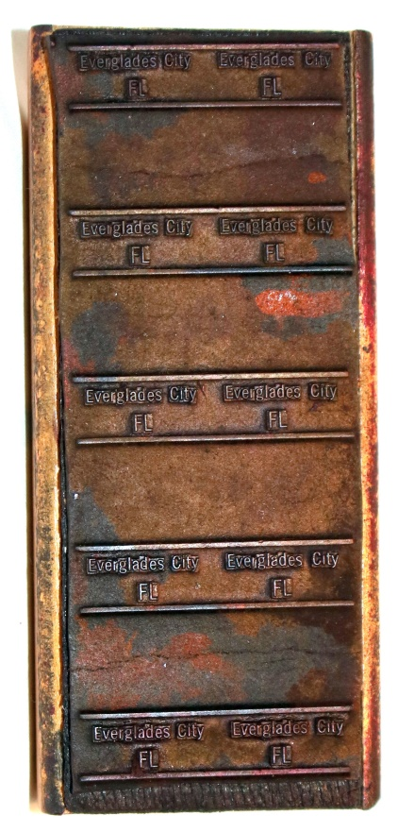
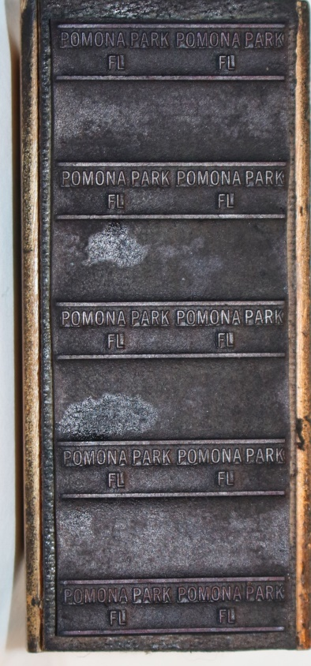
2x5 Precancel Dies
Stayton, Oregon
Everglades City, Florida
Pomona Park, Florida

Slide 12
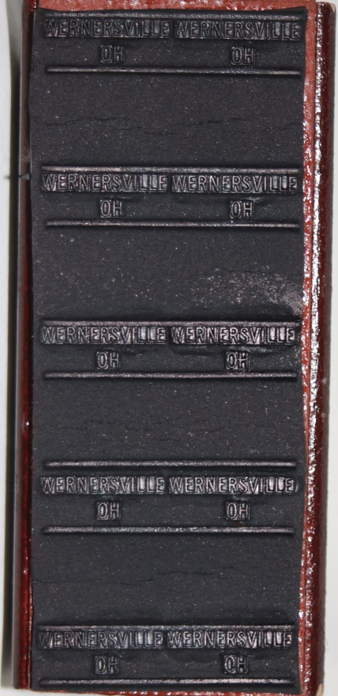
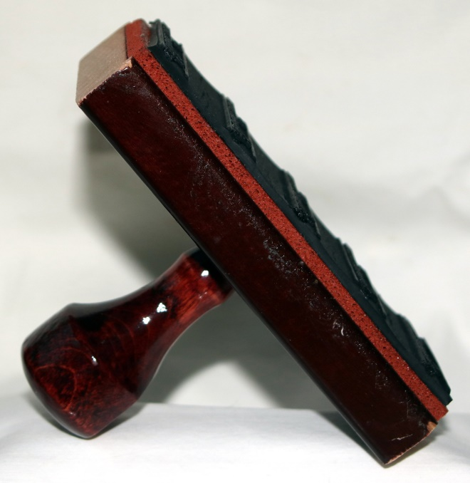
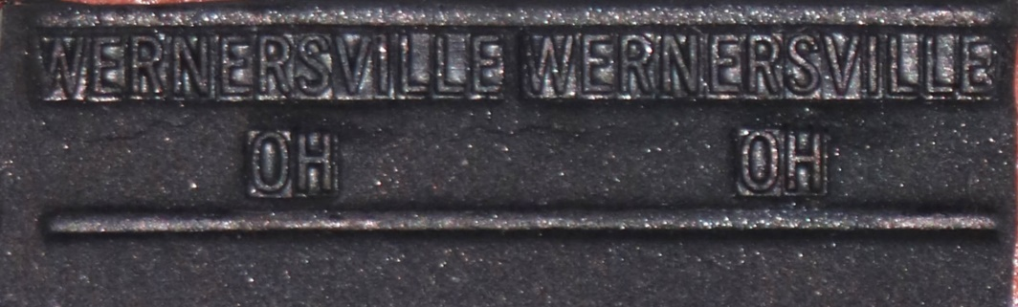
Wernersville, Pa
2x5 Precancel Error Die
Wrong State---Ohio

Slide 13



Port Townsend, Washington
Money Order Branch (MOB)
YEAR DATE FROM
1894-1905

Slide 14

Ad January 1884
U.S. Postal Guide

Slide 15




PAID 3
George W Linn
1955

Slide 16







Number set

Slide 17



POSTAL STAMPS
FREE
ADVERTISED
OFFICIAL BUSINESS

Slide 18






Auxiliary Markings
RETURNED FOR
BETTER DIRECTION
MISSENT TO
RETURNED TO
NOT CALLED FOR
Return to Writer
INSUFFICIENTLY
PREPAID

Slide 19





My Personal Perfin Machine
Larry & Susan Rausch
H.E. Gosh & Co

